Slide 1

Communication TT
Collaborative Compilers Hub for the Statistical Community
UNECE: Meeting of the Group of Experts on National Accounts
May 17, 2021
James Tebrake
Assistant Director
IMF Statistics Department

Slide 2
Outline
      Objective of the Compilers Hub
      Project Development Stages
      Structure of the Compilers Hub
        Designs and features are based on ‘blue sky thinking’. Not all features will make it into the first release of the final product.

Slide 3
Compilers Hub: Project Goal
Design and develop a digital solution for the national accounts, balance of payments and government finance statistical compilers community that would allow them to:
    Centralize and share knowledge
    Engage in global collaboration and discourse
    Convene topical conversations

Slide 4
Compilers Hub: Project Development Stages

Slide 5

Compilers Hub: Project Stage
1
2
3
        Participatory design sessions
        Engaged internal stakeholders and partners from other IOs and NSOs to translate their vision into features and requirements that work together in a unified hub.
        5 virtual whiteboarding sessions held in Mural
        60-90 minutes each
        Information architecture testing
        Conducted with users to gather feedback on content priority and investigate mental models for categorization.
        500 participants engaged
        120+ completed responses
        Series of global interviews
        Held with end users to investigate actual needs and behaviors — both validating and correcting previous assumption-based personas.
        14 Interviews
        45 Minutes Each
        13 Countries
        4 Statistical Domains

Slide 6

Compilers Hub: Project Stage
4
5
(In Progress)
6
        Low-fidelity wireframes
        Mock-ups created considering the user research and stakeholder needs.
        Designs are based on
        ‘blue sky thinking’ – they are conceptual. Not all features will make it to the production
        IT feasibility assessment
        IMF will assess which features are feasible (at least at launch).
        This will determine the design of the high-fidelity wireframes
        Production
        IMF will start implementing the high-fidelity wireframes.

Slide 7
Overview of Compilers Hub: Current Structure

Slide 8
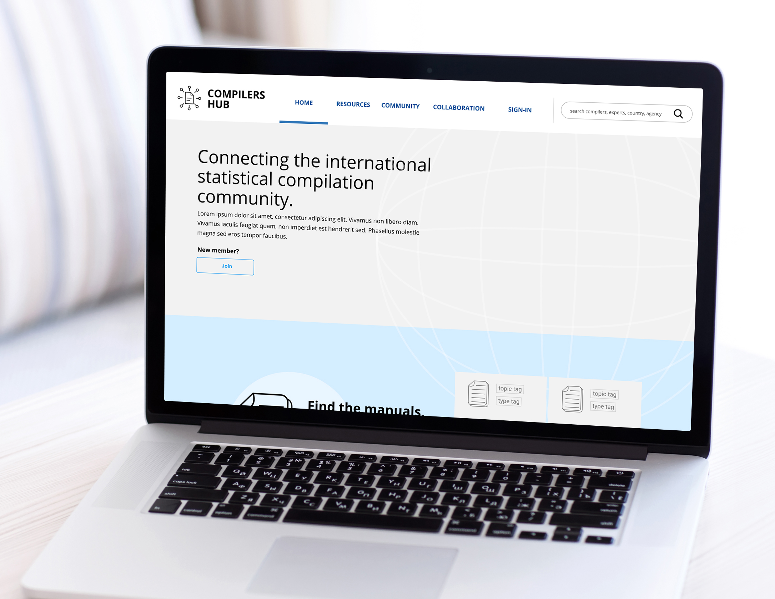
“ Structure” of the Hub
User research revealed that the target audiences’ needs can be classified in three distinct buckets:
    Resources
    Community
    Collaboration
Information architecture was structured around these needs, and it reflects the users’ mental model.

Slide 9
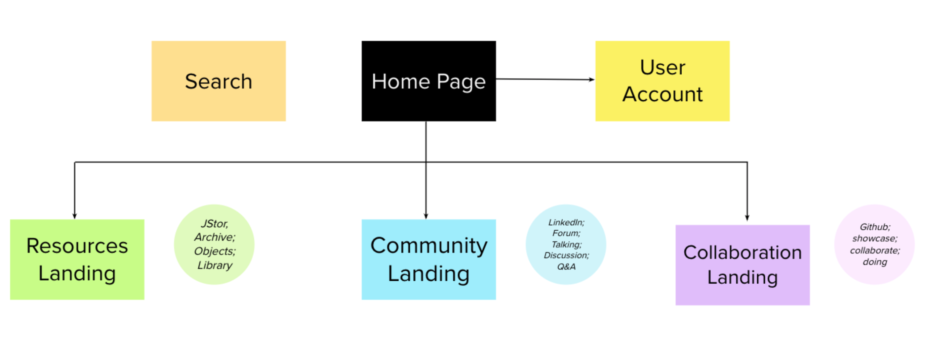
Compilers Hub: Overview of Site Structure
Profile maintenance: Key to participate in core intention of site (community / collaboration)
  Areas/years of experience, demographics, publications, skills, interests, etc.
Subscriptions / following
Favorites / bookmarks
Group affiliations
Previous activity on site
“My Projects”
Log-in not required to view resources
Manuals
Working Papers
Training Resources
Seminar Recordings
Completed Projects
Each resource paired with cross-links to related discussions or collaborations (citing the resource)
Log-in required to participate
Discussion boards
Open and closed channel groups
Institution accounts
Discussion threads can cite projects or resources already on the site
Log-in required to view and participate -
potential for integration with GitHub functionality
Showcase completed projects
CTAs for consultations, co-development, co-authoring, calls for feedback, etc.
“My Projects”

Slide 10
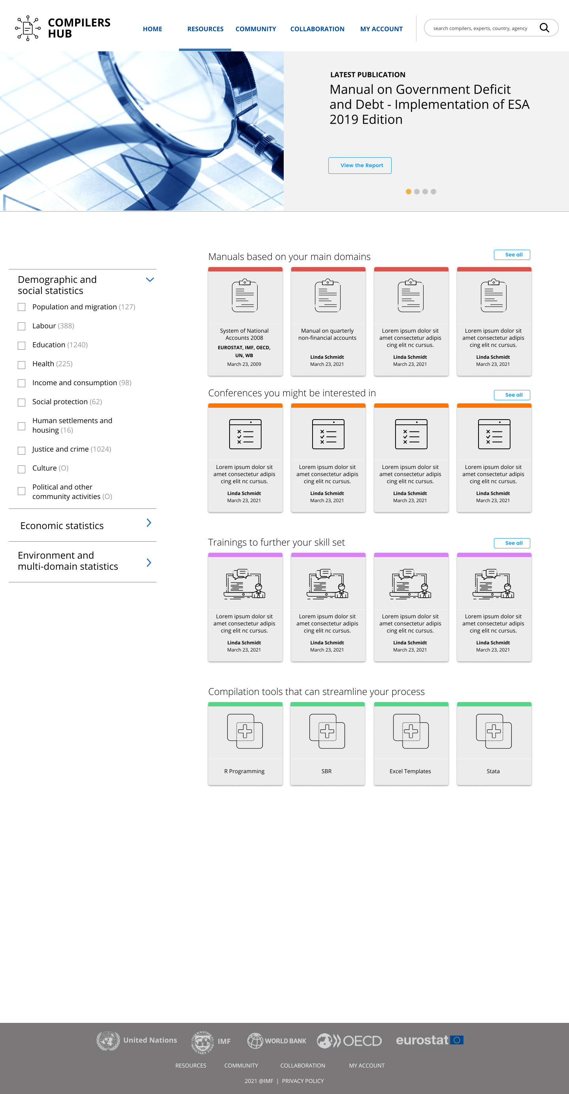
Hub Resources
Rotator that enables selected resources to be featured.
In this section users will be able to find manuals, links to conferences and training materials, and information on ‘tools’ such as ‘R Programming’, ‘SBR’, ‘Stata’ and Excel templates.
All resources will be tagged with the domains and topics to which they relate, making it easy for users to filter and access the information they need quickly.
Resources are classified in four main areas: Manuals, Conferences, Trainings and Compilation Tools.
Users can filter the content by domains and topics.
Based on the user’s domains and topics, relevant content will be positioned at the front.

Slide 11
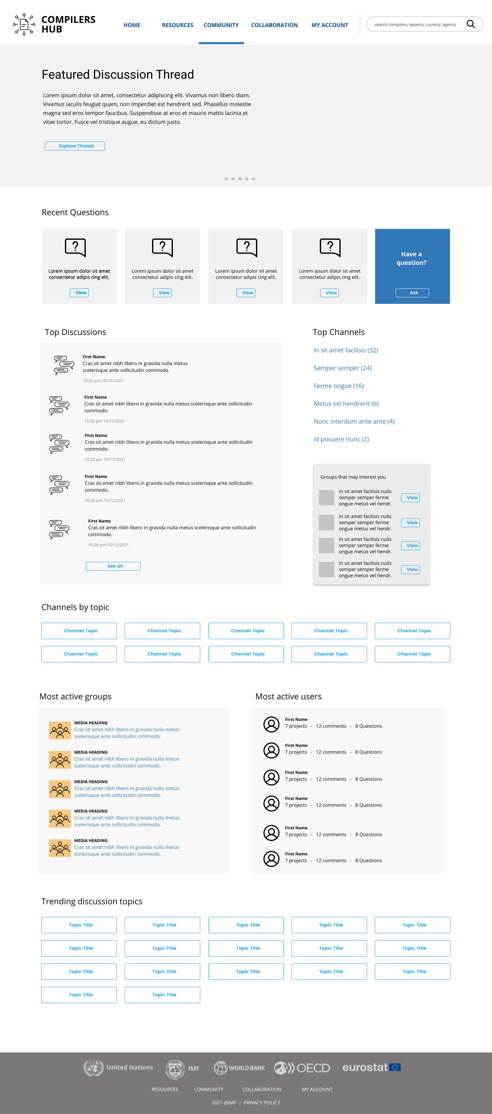
Community
Rotator that enables certain content to be featured.
Users will have the opportunity to interact with other compilers and expand their networks.
They can join existing groups or create new ones; participate in discussions; and post the questions that they might have.
Most recent questions will be highlighted to give experts more visibility of the less experienced users who need help.
Groups that might be of interest based on the domains and topics of the user.
To encourage community/collaboration, users who participate most in conversations and in answering questions will be featured.

Slide 12
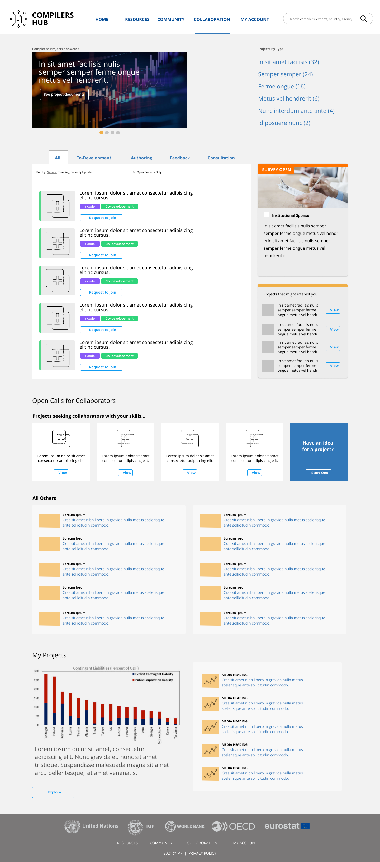
Collaboration
One of the most sophisticated features of the hub is to give the users the ability to collaborate on projects.
In this sense, it is like GitHub where users can co-develop a compilation tool, host the files, manage version control and distribution.
Users can collaborate on co-development such as writing ‘R’ programs, authoring documents, collating feedback on a completed project, and getting consultations on an ongoing project.
Institutions can call for participation in their surveys.
New projects that are looking for contributors are featured here.
Users can also start a new project to collaborate with other compilers.

Slide 13
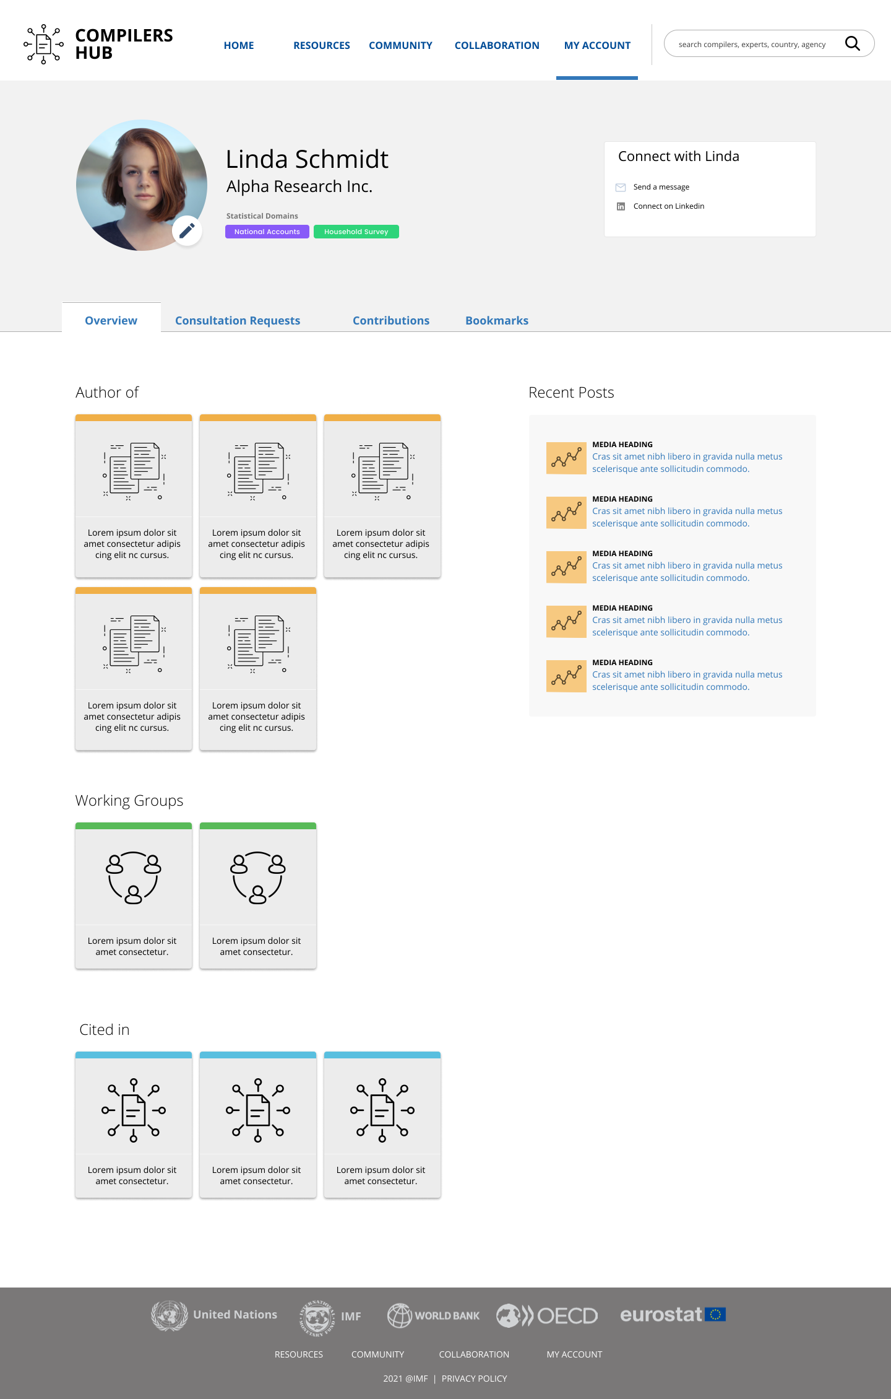
User Profile
In addition to the institution for which the user works, they can also indicate their statistical domain.
Users can message others on the platform directly. They can also provide a link to their LinkedIn profiles.
On the profile pages, users can get detailed information on other users’ backgrounds, expertise and their contributions to projects that are being developed on the hub.
Users can also use this as a landing page for quick access to the documents that they have saved.
Users’ profiles will automatically be populated with any content that they have authored.
Their most recent posts will be listed on the user’s profile page, making it easy to keep track of their contributions.
When their work is cited in other articles, the article will appear here.

Slide 14


