Slide 1

Communication TT
Terminology and Branding of the Macroeconomic Accounting Frameworks
UNECE: Meeting of the Group of Experts on National Accounts
May 17, 2021
Albert Braakmann– Federal Statistics Office, Germany

Slide 2
Outline
Motivation and Objective of the CMTT - Terminology Workstream
Harmonizing the Standards
  Terminology/ Accounts
  Glossary
Branding the Statistical Standards
Questions
To note, these are provisional results reflecting a snapshot of where we are, the work is rapidly evolving

Slide 3

Motivation for CMTT – Terminology and Branding Workstream
Does the general public understand, what are we talking about?
UK ESCoE / ONS Study Undertaken to Better Understand:
  how people think about economics;
  how they understand economic concepts and statistics; and
  how they judge and evaluate economic performance and the main economic indicators.
Methodology
  12 focus groups (around 130 people) in Birmingham, Manchester and London, in October 2019.
  Online YouGov survey with nationally representative sample (around 1,665 people), February 2020.
  20 questions exploring knowledge and perceptions of economic indicators, including inflation, unemployment, interest rates, GDP, budget balance, and trade balance.

Slide 4
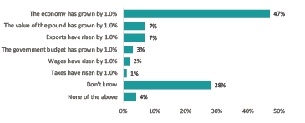


Motivation for CMTT – Terminology and Branding Workstream
Key findings regarding public perceptions from UK ESCoE / ONS Study:
Public understanding of economic concepts can be described as ‘thin’ and ‘superficial.
People struggle to interpret size of economic indicators.
People demonstrate limited knowledge and often misperceptions about how measures are collected and calculated.
People seemed to consider the government / politicians as main source of statistics despite the ONS being identified as the source.
Variations across key demographics.
Which of the following statements, if any, do you think best explains what is meant when GDP has increased by 1.0%?
What is the economy?

Slide 5
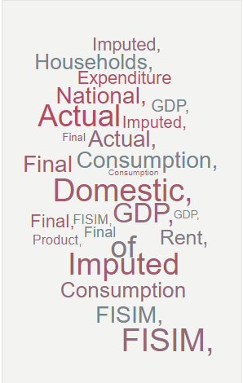


Objective: CMTT – Terminology Workstream
Objective: conduct a review of the current macroeconomic accounting terminology and develop recommendations that seek to improve users’ understanding of macroeconomic statistics.
  The goal is not to change the concepts currently used.
  The goal is to identify complementary alternative terms and descriptions for more consistent and accurate use in the communication with non-experts (and experts) to better convey the meaning and interpretation of the definition and concept to users.

Slide 6
Terminology – Some Important Considerations
Weighing the costs and benefits of a change in terminology
  The cost of any change in terminology and presentation may be significant.
  These costs need to be considered and balanced against the benefits when developing the recommendations.
Costs
Re-training compilers
Additional material to reflect in updated standards, manuals, guides, training
Educating users
Benefits
Increase interpretability
Potential increased use
Potential reduction in misreporting

Slide 7
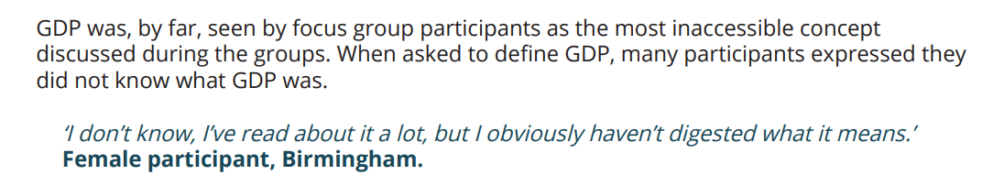

Terminology - What is the G, D and P in GDP?
UK ESCoE / ONS Study: Public Understanding of Economics and Economic Statistics
Current Terminology | Are these alternatives more understandable?
Gross Domestic Product by production | GDP - Gross Domestic Production DP - Domestic Production EP - Economic Production of goods and services
Gross Domestic Product by expenditure | GDE - Gross Domestic Expenditure DE - Domestic Expenditure EE - Economic Expenditure on goods and services
Gross Domestic Product by income | GDI - Gross Domestic Income DI - Domestic Income EI - Economic Income in goods and services

Slide 8
Rebranding the Terminology in the Macroeconomic Accounts

Slide 9
Some Early Thinking - Harmonizing SNA, GFS and BPM
Terminology
SNA | BPM | GFSM | Proposal
Resources | Debits | Revenue | Revenue
Uses | Credits | Expense | Expenditure
Intermediate consumption |  | Use of goods and services | Use of goods and services to make other products
Changes in inventories |  | Net transactions in inventories | Changes in inventories
Acquisitions less disposals of valuables |  | Net transactions in valuables | Net acquisitions of valuables
Acquisitions less disposals of non-produced assets |  | Net transactions in non-produced assets | Net acquisitions of non-produced assets
Acquisitions less disposals of contracts, leases and licenses |  | Net transactions in contracts, leases, and licenses | Net acquisitions of contracts, leases, and licenses
Purchases less sales of goodwill and marketing assets |  | Net transactions in goodwill and marketing assets | Net acquisitions of goodwill and marketing assets
Statistical discrepancy | Net errors and omissions | Statistical discrepancy | Statistical discrepancy

Slide 10
Some Early Thinking – Proposals for More Descriptive Labels
From a communication standpoint, non-specialist users could benefit from more descriptive or self-explanatory account names/labels and concept identifiers.
2008 SNA Accounts | Proposal
The allocation of primary income account | Earned income account
The secondary distribution of income account | Transfer income account
The capital account | Capital formation account
2008 SNA Terminologies | Proposal
Current prices | Actual prices paid or received
Constant prices | Inflation-adjusted prices
Basic prices | Prices received by the producer, excluding some taxes and including some subsidies
Purchasers’ prices | Prices paid by the purchaser, including all taxes and excluding all subsidies
Chained volume | Economic growth after removing inflation
GDP by production approach | Economic contribution by industry
GDP by expenditure approach | Demand-side GDP

Slide 11
Some Early Thinking – Proposals to Expand Definitions
As the CMTT does not recommend changing the technical terms, a glossary with explanations in a user-friendly language could be useful for users.
The glossary may provide either an alternative term or an expanded definition in easy to understand, user-friendly language.
Clarified / Expanded Definitions
Term | Current definition | Can we do better?
Actual Final Consumption of Households | … is measured by the value of all individual consumption goods and services acquired by resident households. | … represents the value of the goods and services acquired by households to satisfy their needs. They may be purchased, own-produced or provided for free, for example, by the government.
Gross National Income | ..... the aggregate value of the gross balances of primary incomes for all sectors. | ... the sum of the balances of primary incomes accrued by institutional sectors as a result of their involvement in processes of production or ownership of assets that may be needed for the purpose of production.

Slide 12
Branding the International Statistical Standards

Slide 13

Some Early Thinking – Branding the System
The way we in which we “brand” the accounting standards can impact users’ expectations and understanding of the standards and data.
What does the name – System of National Accounts (2008) convey to users?
2008 Dated? Does this only apply up to 2008. Is it no longer relevant?
System Complete, Integrated?
Accounts Are these Economic Accounts? Social Accounts? Company Accounts?

Slide 14

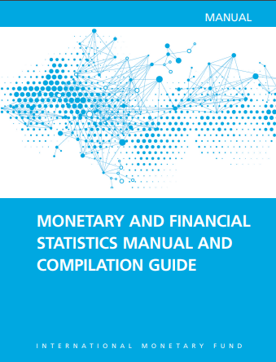

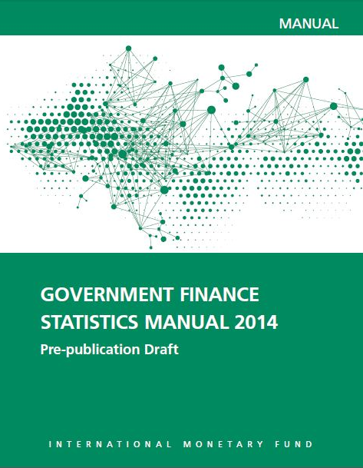
Some Early Thinking – Branding the Statistical Ecosystem
What is the difference between a “Manual”, a “Standard”, a “System”?
How should we refer to the group of “standards, manuals, systems”?
    Macroeconomic Accounting Standards
    International Statistical Standards
    International Macroeconomic and Environmental Accounting Standards
How should the versions be demarcated - “release year”, “edition” or “revision”?

Slide 15
Early Proposals for Branding the Statistical Ecosystem
The CMTT proposes to standardize the naming conventions across all domains.
The proposal is to harmonize the demarcation with the edition/revision of the manual instead of the release year e.g.
  National Accounts Statistics Manual, xxx Edition/Revision
  Balance of Payments and International Investment Position, xx Edition/Revision
  Government Finance Statistics Manual, xxx Edition/Revision
  The CMTT proposes to brand the group of standards as the ‘International Statistical Standards’.

Slide 16
Questions?
    How far should we push this? How much rebranding/clarification should we aim for?
    Are there specific terms you would really want to make easier for users to understand?
    Do you agree with the proposed standardized branding of the manuals and the group of standards?
    Do you have any other ideas to help this initiative?

Slide 17


