Slide 1
Status Report of the Informal Working Group on Safer Transport of Children in Buses and Coaches (IWG-STCBC)
Submitted by Spain
Informal document GRSP-69-05
69th GRSP, 17-21 May 2021
agenda item 19
69th GRSP Session
17 – 21 May 2021
Chair: Marta Anglès , SPAIN
Secretary: FARID BENDJELLAL, CLEPA

Slide 2
Informal Working Group
1st IWG-STCBC meeting
Date: 9th July 2019 Location: Ministerio de Industria, Comercio y Turismo , Madrid, Spain
2nd IWG-STCBC meeting
Date: 30th October 2019 Location: Applus IDIADA, Tarragona, Spain
3rd IWG-STCBC meeting
Date: 16th-17th January 2020 Location: Clepa Offices, Brussels
4th IWG-STCBC meeting
Date: 29th Octubre 2020 Location: Online meeting
5th IWG-STCBC meeting
Date: 28th January 2021 Location: Online meeting
6th IWG-STCBC meeting
Date: 22nd April 2021 Location: Online meeting

Slide 3
Timeline
Plan and Schedule
2019
2020
2021
2022
2023
11 12
1 2 3 4 5 6 7 8 9 10 11 12
1 2 3 4 5 6 7 8 9 10 11 12
1 2 3 4 5 6 7 8 9 10 11 12
1 2 3 4 5 6
WP.29
GRSP
IWG
180
181
182
183
184
185
186
187
188
189
190
66
67
68
69
70
71
72
3
4
5
6
7
8
9
10
11
Formal Doc.
Informal Doc.
IWG creation approved
IWG submission of new regulation

Slide 4
Key elements
Test configurations: Frontal impact and rollover
Retention system: 2-point belt and 3-point belts
Consideration of the CRS (if needed): R-129 approved CRS
Test method
Compatibility of R-16 fixtures

Slide 5
On going tasks
Market overview of seat belt installation
Market overview on children using Bus/Coach
Possibility to install CRS in the Bus/Coach
Analysis of the test pulse to be used for frontal impact
Testing phase

Slide 6
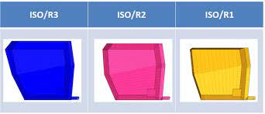
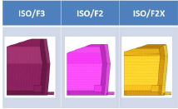
ISO Envelopes compatibility
CAD study was performed by OICA using the UN R-16 envelopes
The study showed some incompatibilities which mean loosing 1 seat row when 1 seat row is dedicated to install CRS.
Physical installation of different size of CRS to be
performed in a Bus/Coach to verify the
compatibility/incompatibility

Slide 7
Test pulse
Technical study to review the appropriateness of crash pulses used in current EU legislation
The group will review the test pulse proposed according to the European Commission study.

Slide 8
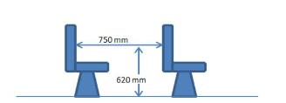
Tests and tests results
CRSs: Infant carrier, toddler, booster cushion
Dummies: Q1.5, Q3, Q6 and Q10
Test configuration:
2pts vs. 2pts + CRS,
2 rows of seats
Distance between seat R80
R80 test pulse
Dummy |  | 2 pts & CRS | 2 pts
Q1,5 | Infant carrier 129 belted | X | X
Q3 | Toddler R44 | X | X
Q6 | Booster cushion R44 | X | X
Q10 | Booster cushion R44 | X | X

Slide 9
Discussion
Large dummy rotation which may lead to a risk of ejection
Bigger children
Q6 - Q10
Contact with front seat
Smaller children
Q1.5 – Q3
Based on these results the usage of a 2-point belt only restraint does not provide an adequate protection
booster with 2-point belt leading to severe head contact

Slide 10
Next IWG Meeting
7th IWG-STCBC meeting
Date: 7th September 2021 Location: Online

Slide 11
Next Steps
ISO envelope compatibility
Physical installation of CRS in Bus/Coach environment
Analysis of the test pulse for frontal impact
Tests using 3-point belts seats

Slide 12
Thank you for your attention!

