Slide 1
New monthly non-market healthcare output indicators in Finland
Ville Lindroos

Slide 2
Agenda
01 | Significance of non-market healthcare
02 | Push for development from COVID-19
03 | New solutions

Slide 3
Significance of non-market healthcare

Slide 4

Non-market output compilation
Current price values, sum of inputs
  ${P1}_{CP}= {P2}_{CP}+{P51C}_{CP}+{D1}_{CP}$
  ${P132}_{CP}= {P1}_{CP}−{P11}_{CP}−{P12}_{CP}−{P131}_{CP}$
Volume, sum of deflated inputs
  ${P1}_{FP}= {P2}_{FP}+{P51C}_{FP}+{D1}_{FP}$
  ${P132}_{FP}= {P1}_{FP}−{P11}_{FP}−{P12}_{FP}−{P131}_{FP}$
  Or by extrapolating volume
  ${P132}_{FP}= {P132}_{CP(t−1)}∗{P132}_{VolInd}$
  ${P1}_{FP}= {P132}_{FP}+{P11}_{FP}+{P12}_{FP}+{P131}_{FP}$

Slide 5
Volume indicators can relate to
Input
    E.g. labor input. Can’t catch productivity change
Activity
    E.g. number of surgeries. Tells how inputs were used. Productivity interpretation challenging.
Outcome
    ESA 2010 has rejected the outcome approach.
Output
    Primary method. Can be hard to define unit of production.

Slide 6
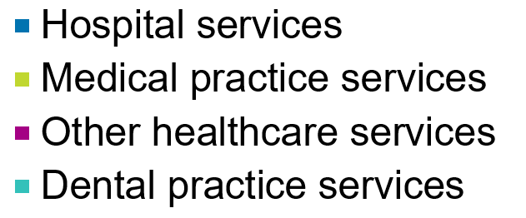
Significance of non-market healthcare in Finland
Non-market output of healthcare services
Proportion of GDP volume
Product shares
10,4B €
4,4%

Slide 7
ANA method in non-market healthcare
Extrapolation of volume with an output indicator
Separate indicator for three products:
    Hospital services
    Medical practice services
    Dental practice services

Slide 8
ANA method
Product | Indicator | Stratification
Hospital services | DRG weighted episode output | DRG, region, hospital type, and more…
Medical practice services | Visits, periods of care | Service, profession, RUG
Dental practice services | Visits | Service, profession

Slide 9
QNA method
Value indicator
  Based on Wage and salaries sum
Deflation with the Index of wage and salary earnings
Both current value indicator and the price information related to inputs
→ Deflation of input(s)

Slide 10
QNA forecast performance

Slide 11
Push for development -COVID-19

Slide 12
Impact of COVID-19
Laws and regulations
Non-critical care cut down
Capacity directed for intensive care

Slide 13
Impact of COVID-19
Phenomenom | Unit cost | Volume
Testing | + | +
Treatment | + | +
Vaccination | + | +
Cut down of other services | + | -
Changes in processes | ?? | ??
Changes in people’s behaviour | ?? | ??
Total effect | ??? | ???

Slide 14
QNA weakness of current method
Doesn’t count for any direct or indirect effect that doesn’t show in employee compensations
Which leads to…
  Unrealistic volume figures while waiting for ANA
  Significant revision when ANA published

Slide 15
QNA ideal non-market volume
Realistic and accurate forecast for future annual change
Gives quickly an updated image of the economy
Shows the seasonal progress within the year
Intertemporal and interspatial comparability

Slide 16
Wishlist for new volume indicator
Quick…but relevant
Simple… rather than complicated
Long lasting solution… over temporary
Requires only one person…rather than a group of experts
Automated process…over manual

Slide 17


Eurostat reminder
No explicit quality adjustments
  Remote work / school should not be adjusted explicitly
  Quality changes can come through stratification
Unused capacity does not contribute to the volume of output
  Facilities, personnel, machinery

Slide 18
New solutions

Slide 19
Medical practice services

Slide 20
New volume indicator for QNA
Medical practice visits (100%)
Medical practice services (100%)
Hospital services (0%)
Healthcare output indicator

Slide 21
Hospital services indicator
2019 average = 89

Slide 22
New volume indicator for QNA v2
Medical practice visits (100%)
In-patient treatment periods (50%)
Outpatient visits (50%)
Medical practice services (100%)
Hospital services (0%)
Healthcare output indicator

Slide 23
Volume index Jan’19=100
New method

Slide 24
Healthcare services, deflator of output

Slide 25
2020 volume forecast

Slide 26
2020 volume forecast

Slide 27
Advantages of the new indicator
Indicators similar to annual method
Frequently updated source data
Open data
  JSON-stat format
  Anybody can retrieve it with their statistical (or any) programming language of choice (eg. R, Python, SAS)
  Automation
Simple
Long-term solution
Low human risk factor

Slide 28
Challenges
Based on new data
  Difficult to test backwards
Main annual data source delayed, Finnish institute for health and welfare
  Can’t test yet the performance of monthly/quarterly indicators compared to the annual indicator

Slide 29
Next steps
Annual data hopefully in May 2021
ANA this summer with the annual indicator
Reviewing the performance of the new indicator
2020 DRG base + 2021 visit- and treatment period data = V3 of the volume indicator?

Slide 30
Thank you!

