Slide 1
“European Network of Multinational Enterprise Coordinators (MNEnet)”
Conference of European Statisticians
Group of Experts on National Accounts
  25 May 2021
Eurostat

Slide 2
Table of contents
Background
MNEnet – tasks and objectives

Slide 3
Background
2019 DGINS Bratislava conclusions and the European Statistical System Committee (ESSC) recognition:
activities on Multinational Enterprises (MNEs) carried out by the ESS, such as the EuroGroups Register (EGR), European profiling, LCU coordination and Early Warning System (EWS) to be organised in a systematic, coordinated and cost-effective approach, in particular to ensure the data consistency in business and macroeconomic statistics.

Slide 4
MNEnet
Eurostat established the expert group called “European Network of MNE Coordinators (MNEnet)”
- a virtual Workshop to prepare the launch of the MNEnet group took place on 12 March 2021
MNEnet members: 27 EU Member States, observers: EEA/EFTA countries
Planned frequency of meetings: 2 meetings per year

Slide 5
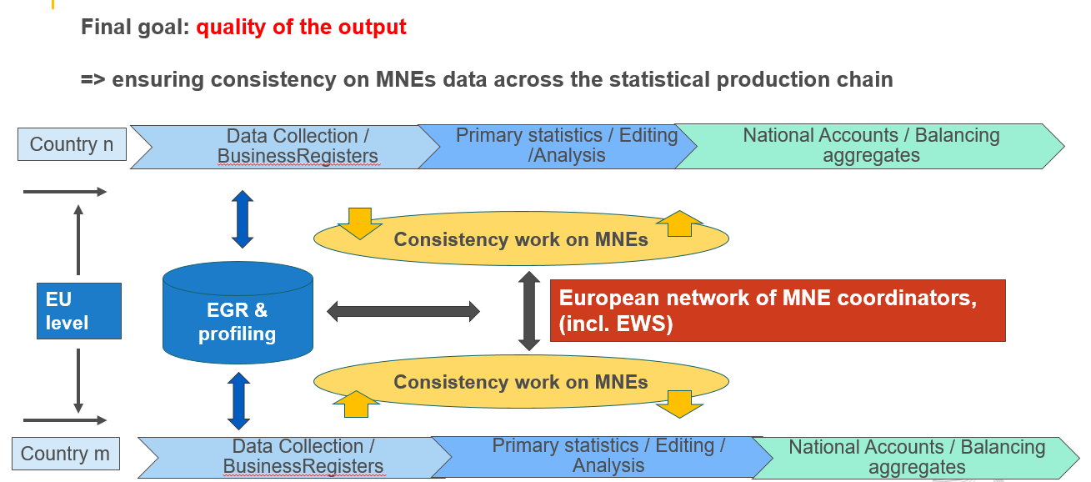
MNEnet

Slide 6
MNEnet – tasks and objectives
MNEnet is contributing to:
the improved quality and consistency of the European business and macroeconomic statistics by following harmonized methodological principles
the enhanced comparability between EU Member States
the improved quality of economics statistics by capturing and recording restructuring processes of MNEs in a consistent way across domains

Slide 7
MNEnet – tasks and objectives
MNEnet:
  strengthens the cooperation of the European MNE experts and Large Cases Units to create a network where knowledge, experiences and information are shared
  ensures knowledge flows to all the statistical domains and countries as well as that the information on top MNEs are coherent and consistent

Slide 8
MNEnet – tasks and objectives
supports consistency work done by LCUs (or similar organisational structures) and the Early Warning System (EWS)
assists Eurostat in optimising the organization of the MNEnet and the EWS process

Slide 9
MNEnet – tasks and objectives
shares knowledge about the various statistical tools and processes used, such as: Large Cases Units (LCUs), EuroGroups Register (EGR), Interactive Profiling Tool (IPT), Early Warning System (EWS)
collaborates with other expert groups and domains, addresses the needs of the users

Slide 10
Thank you for your attention!

