Slide 1
The Distributional Financial Accounts of the United States
Mike Batty
Federal Reserve Board
Group of Experts on National Accounts May, 2021

Slide 2
Acknowledgements and Disclaimer
This project reflects the combined efforts of the Flow of Funds and Microeconomic Survey sections at the Federal Reserve Board.
Contributors include: Michael Batty, Jesse Bricker, Joseph Briggs, Marco Cagetti, Ella Deeken, Sarah Friedman, Elizabeth Holmquist, Susan McIntosh, Kevin Moore, Danielle Nemschoff, Eric Nielsen, Karen Pence, Sarah Reber, Molly Shatto, Paul Smith, Kamila Sommer, Tom Sweeney, Jeff Thompson, Alice Henriques Volz.
The analysis and conclusions set forth here are those of the authors and do not indicate concurrence by other members of the research staff, the Board of Governors, or the Federal Reserve System.

Slide 3
Overview
Motivation: Produce quarterly, timely data on the distribution of wealth that are consistent with macro aggregates in the Financial Accounts of the United States.
Construction of the Distributional Financial Accounts (DFA)
Headline results
Comparisons with other measures of the wealth distribution
Application: demographic trends

Slide 4
DFA Construction Approach
Combine two existing FRB data products:
Financial Accounts (FA): quarterly aggregate household wealth
Survey of Consumer Finances (SCF): triennial survey of household balance sheets
Apply the distributional information contained in the SCF to aggregate wealth in the FA:
Match each component of FA wealth to an analogous SCF measure (Reconciliation)
For each part of the wealth distribution, interpolate and forecast the SCF analog in between SCF waves
In each quarter, apply the distribution of the SCF analog to the FA wealth component

Slide 5
Reconciliation
For 30% of assets and liabilities (by amount), the SCF “Bulletin” measure aligns well with the FA (e.g. real estate, mortgages, DC pensions, checking accounts)
50% require significant adjustments to the SCF measure (e.g. assets in trusts and IRAs, valuation of non-publicly traded businesses)
20% are not directly measured in the SCF and instead are imputed using related SCF information (e.g. DB pensions, annuities, and insurance)
►
The SCF is re-weighted to incorporate the wealth of the Forbes 400

Slide 6
Empirical Reconciliation Results
Table 1: FA and SCF Wealth Levels
 | Average SCF/FA (%) | FA 2019Q3 ($M) | SCF 2019 ($M)
Total Assets | 101 | 124,905 | 123,320
Nonfinancial assets | 104 | 37,416 | 35,323
Real estate | 114 | 33,718 | 29,612
Consumer durable goods | 61 | 3,699 | 5,711
Financial assets | 99 | 87,489 | 87,997
Time deposits and short-term investments | 55 | 4,436 | 9,761
U.S. government and municipal securities | 78 | 3,388 | 4,380
Corporate equities and mutual fund shares | 131 | 29,812 | 27,010
Pension entitlements | 100 | 27,145 | 27,166
Equity in noncorporate business | 105 | 14,799 | 12,259
Other | 90 | 7,909 | 7,422
Total Liabilities | 85 | 14,028 | 15,305
Home mortgages | 91 | 10,743 | 10,415
Consumer credit | 61 | 2,727 | 4,117
Other | 110 | 558 | 772
Net worth | 104 | 110,877 | 108,015

Slide 7
Interpolation and Forecasting
We employ the “temporal disaggregation” method of Fernandez (1981) to construct quarterly DFA data:
Extension of Chow and Lin (1971)
Estimate the relationship between the triennial SCF and quarterly indicator series (currently 11 overlapping observations)
Use these relationships to fill in distributions between SCF waves for each asset and liability, for each wealth and demographic group
Indicator series: relevant FA series level, SP 500, Fed Funds rate, home prices and ownership, etc.

Slide 8
Headline Results
Trillions of nominal dollars ₁₂₀
Percent of aggregate
Top 1%
Next 9%
Next 40%
Bottom 50%
Top 1%
Next 9%
Next 40%
100
100
Bottom 50%
80
80
60
60
40
40
20
20
0
0
1990 1995 2000
2005
2010 2015 2020
1990 1995 2000 2005 2010 2015 2020
Figure 1: Net Worth by Wealth Percentile Group

Slide 9
Shares by Asset Category
Percent of aggregate
Percent of aggregate
Top 1%
Next 9%
Next 40%
Bottom 50%
Top 1%
Next 9%
Next 40%
Bottom 50%
100
100
80
80
60
60
40
40
20
20
0
0
1990 1995
2000 2005
2010 2015 2020
1990 1995
2000 2005
2010 2015 2020
Figure 2: Business Equity (left), Pensions and Real Estate (right)

Slide 10
Comparison with SCF
Table 2: Average Wealth Shares by Decade
SCF Wealth Breakdown
Directly Measured Indirectly Measured
Baseline
SCF Levels
Years | Wealth Group | (1) | (2) | (3) | (4)
1989-1999 | Bottom 50 | 4.0 | 4.4 | 3.5 | 7.6
 | Next 40 | 35.0 | 34.8 | 34.7 | 38.0
 | Next 9 | 34.8 | 34.6 | 34.9 | 33.6
 | Top 1 | 26.3 | 26.1 | 26.9 | 20.8
2000-2009 | Bottom 50 | 2.4 | 3.5 | 1.8 | 7.3
 | Next 40 | 33.2 | 32.8 | 32.0 | 42.6
 | Next 9 | 36.7 | 36.2 | 36.5 | 35.6
 | Top 1 | 27.7 | 27.4 | 30.0 | 14.6
2010-2019 | Bottom 50 | 1.0 | 2.1 | 0.2 | 5.9
 | Next 40 | 29.7 | 29.3 | 28.4 | 39.6
 | Next 9 | 38.4 | 37.6 | 38.8 | 38.7
 | Top 1 | 31.0 | 30.9 | 32.6 | 15.8
Indirectly Measured: DB pensions, annuities, life insurance, misc. assets, other loans and advances, unpaid life insurance premiums

Slide 11
Comparison with World Inequality Database (WID)
DFA Shares
WID Shares
45
DFA Shares
WID Shares
45
40
Next 9%
40
35
30
35
Next 40%
25
20
Top 1%
30
15
10
25
Bottom 50%
5
0
1990 1994 1998 2002 2006 2010 2014 2018
20
1990 1994 1998 2002 2006 2010 2014 2018
Figure 3: Wealth Shares from the DFA and WID

Slide 12
Comparison with Smith et al (2020)
45
DFA Shares
Smith et al. (2019) Shares
Next 9%
40
35
Top 1%
30
Bottom 90%
25
1990 1994 1998 2002
2006 2010
2014 2018
20
Figure 4: Wealth Shares from the DFA and Smith et al.

Slide 13
Wealth by Education
Real wealth per household relative to 1989
College Degree Some College
High School Diploma
Less than High School Diploma
2.0
1.5
1.0
0.5
1990
1995
2000
2005
2010
2015
2020

Slide 14
Wealth by Race
Real wealth per household relative to 1989
White Black Hispanic Other
2.5
2.0
1.5
1.0
1990
1995
2000
2005
2010
2015
2020

Slide 15
Wealth by Age
Real wealth per household relative to 1989 _{3.0}
Under 40
40 − 54
55 − 69
2.5
70+
2.0
1.5
1.0
0.5
1990
1995
2000
2005
2010
2015
2020
0.0

Slide 16
Wealth by Generation
Thousands of real (2020) dollars ₁₅₀₀
Silent
1250
Baby Boomers Gen X Millennials
1000
750
500
250
0
18 23 28 33 38 43 48 53 58 63 68 73 78 83 88
Figure 5: Per Household Real Net Worth by Age

Slide 17
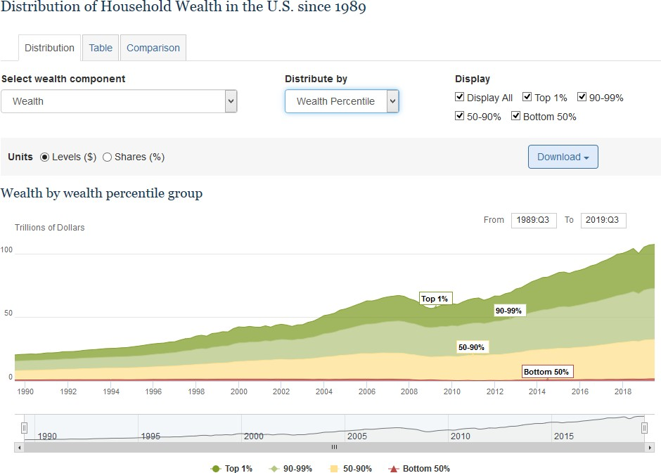
Conclusion
DFA released approximately 11 weeks after the quarter close: https://www.federalreserve.gov/releases/z1/dataviz/dfa/index.html
Distributions of wealth and its components from 1989 to present by: wealth, income, education, race, age, generation

