Slide 1
Informal document GRVA-09-44 9th GRVA, 1-5 February 2021 Agenda item 12(b)
Transmitted by the expert from Israel
Saving Riders’ Lives
Collision Aversion Technology (CAT™) - for every motorbike

Slide 2
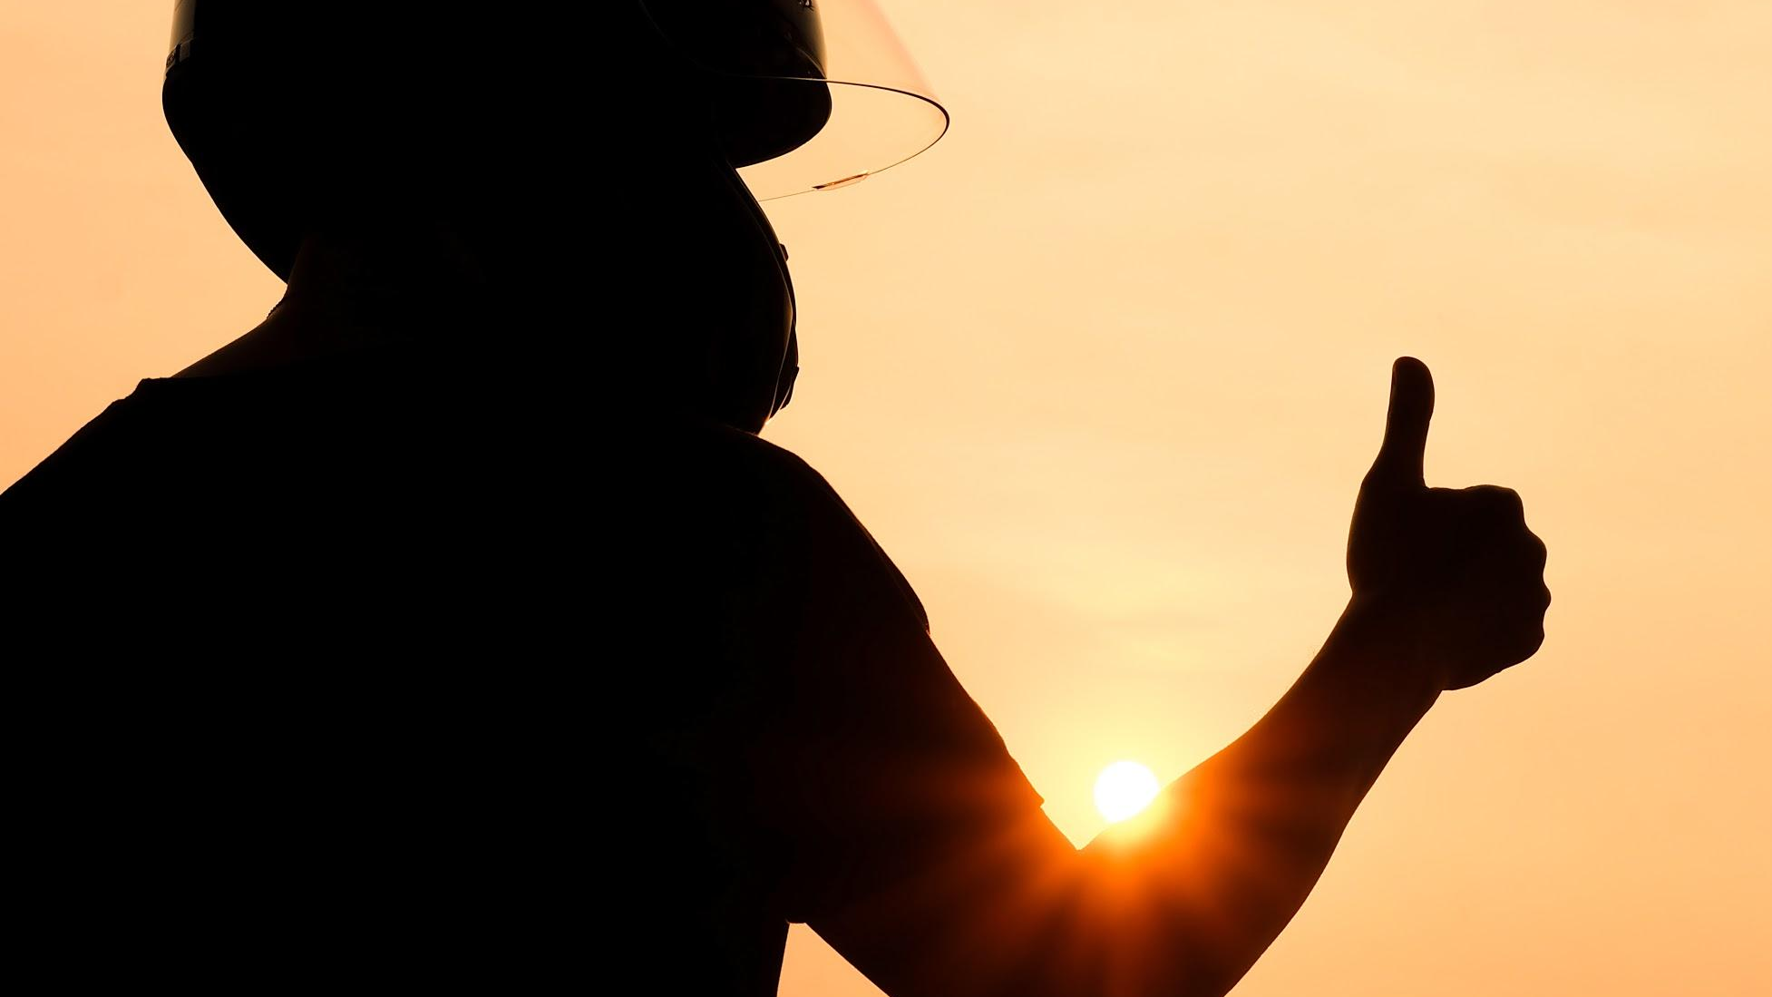
WHO WE ARE?
Ride Vision is an industry-leading
Collision Avoidance Technology
that is designed to fit any kind of two/three-wheeler and
rider behavior.

Slide 3
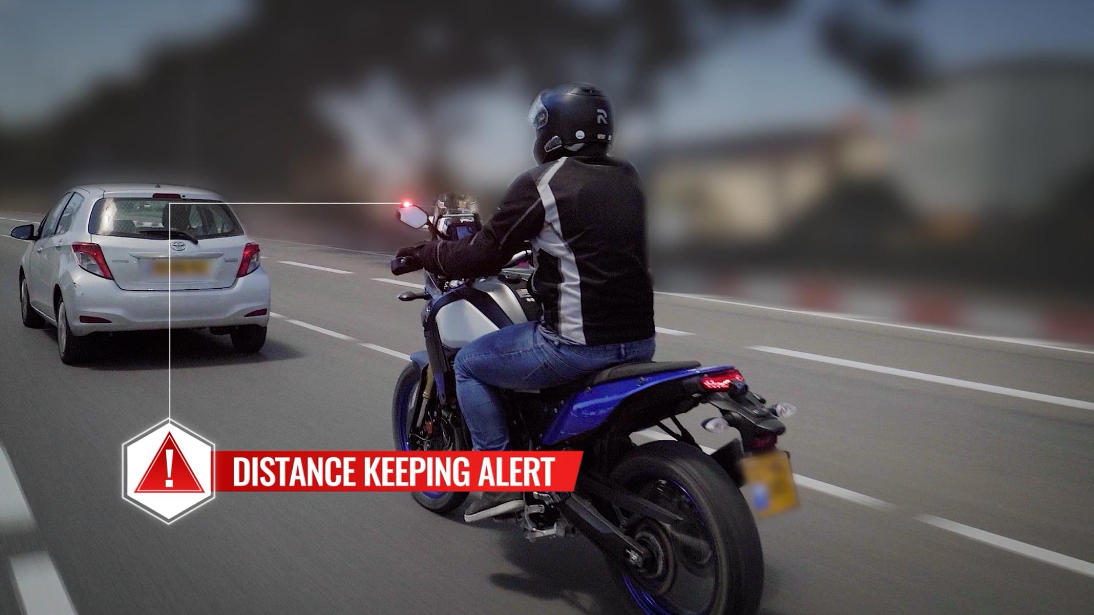
SEE IT IN ACTION

Slide 4
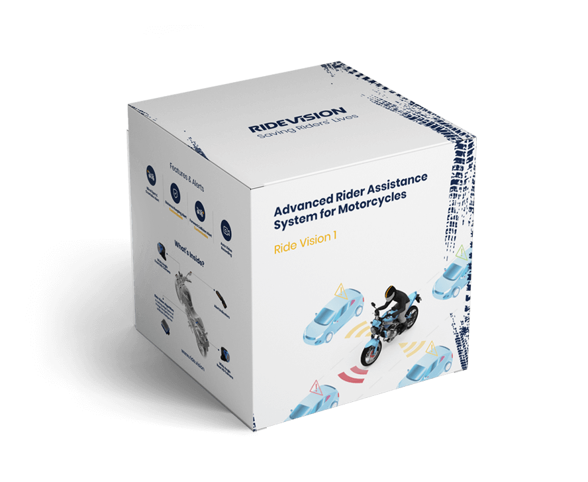
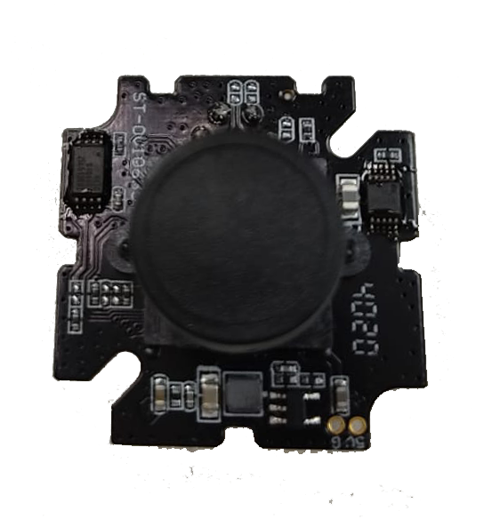
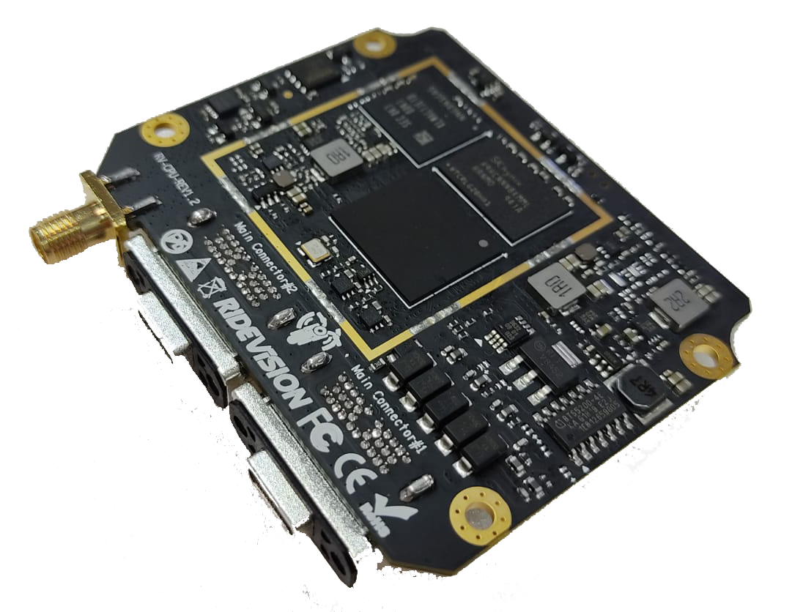
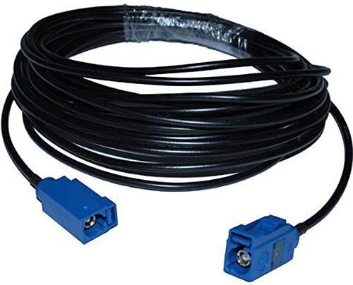
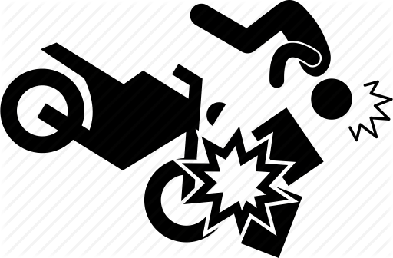
RIDE VISION 1
(aftermarket)
RIDE VISION 1A
(OEM)

Slide 5
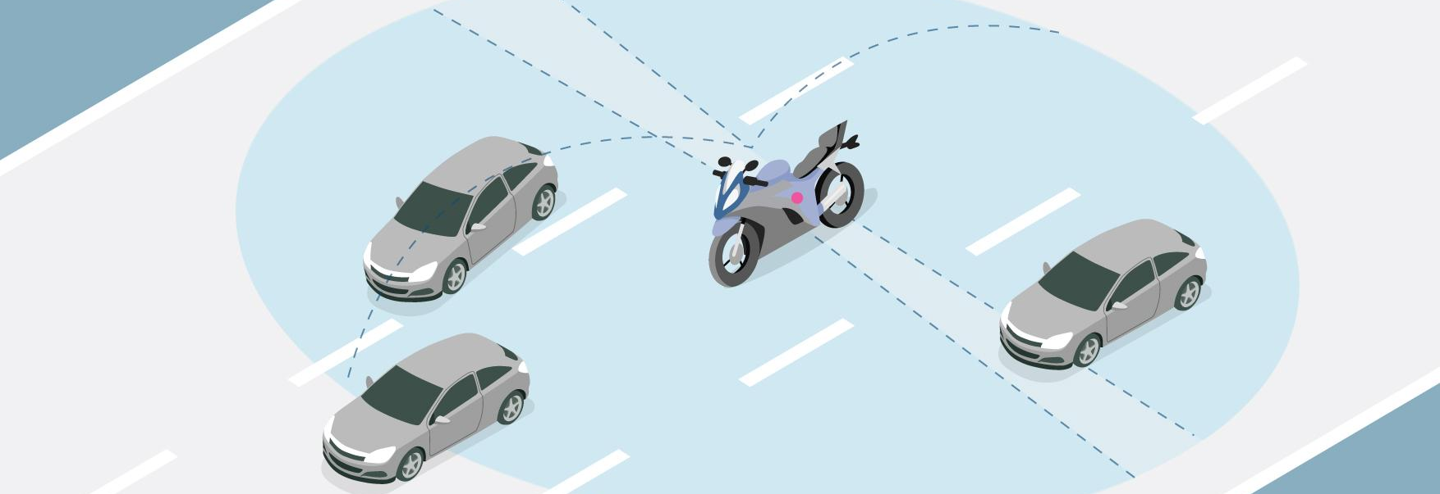
RIDE VISION- PLATFORM
Safety & Experience features delivered Over the Air (OTA)
Rear Collision Alert
Forward Side Collision Alert
Dangerous Overtake Alert
Blind Spot Alert
Forward Collision & Distance Keeping Alert

Slide 6
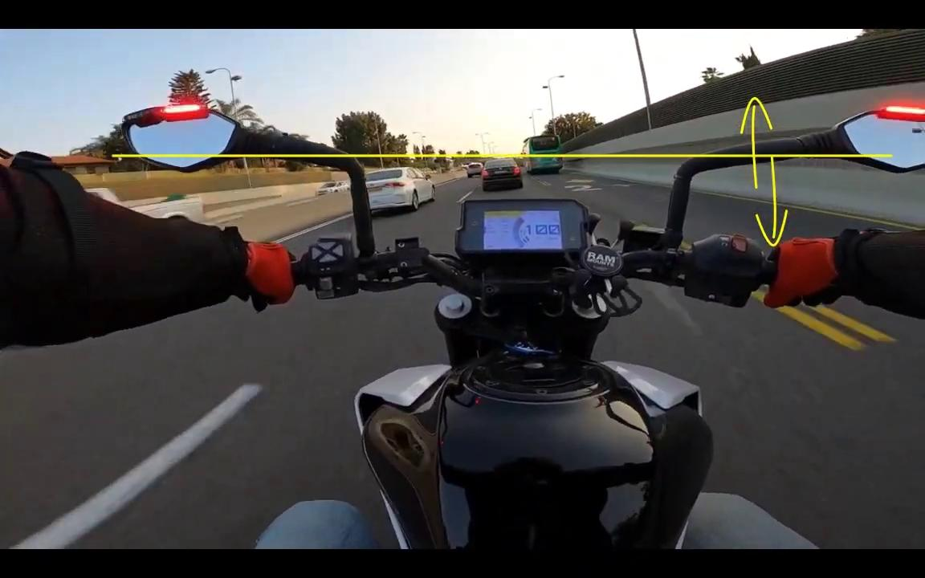
RIDING A MOTORCYCLE VS A CAR (THE REALITY)
VIBRATIONS

Slide 7
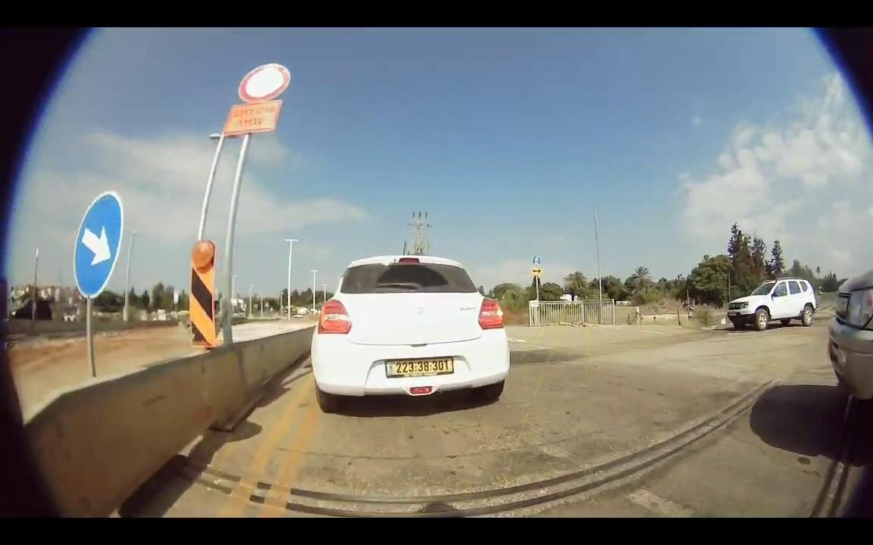
RIDING A MOTORCYCLE VS A CAR (THE REALITY)
TRAFFIC

Slide 8
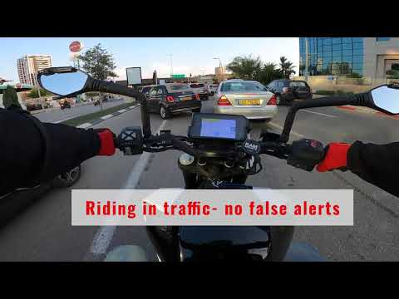
RIDING EXPERIENCE: RIDE VISION 1

Slide 9
Preventing Accidents
40%
Reducing 10 km/h reduces up to 25% of Front Collisions*
Using Front Collision Alert systems reduces chances of
forward collision by 27% **
+
=
Ride Vision’s internal research shows
using Ride Vision Front Alerts
reduces average speed by 15 km/h

Slide 10
Regulating for a better future?
ADAS systems have proven to reduce car accidents.
Now is the time for the motorcycle revolution.

Slide 11
THANK YOU!
https://ride.vision

