Slide 1
ALKS Implementation
Informal document GRVA-09-33
9th GRVA, 1-5 February 2021
Agenda item 4(d)
Douglas Hannah
Head of Automated Vehicle Technologies

Slide 2
Considerations from UK implementation of R 157- ALKS
Background
UK Government’s Centre for Connected and Autonomous Vehicles published a ‘Call for Evidence’ on the Safe Use of ALKS (www.gov.uk/government/consultations/safe-use-of-automated-lane-keeping-system-on-gb-motorways-call-for-evidence)
Included questions regarding the ability of ALKS to comply with certain road traffic rules.
Received a mixture of responses (including those from safety organisations and vehicle manufactures)
UK road traffic rules
Highway Code lists the mandatory legal requirements (‘must / must not’) and advisory rules (‘should / should not’) - www.gov.uk/guidance/the-highway-code

Slide 3
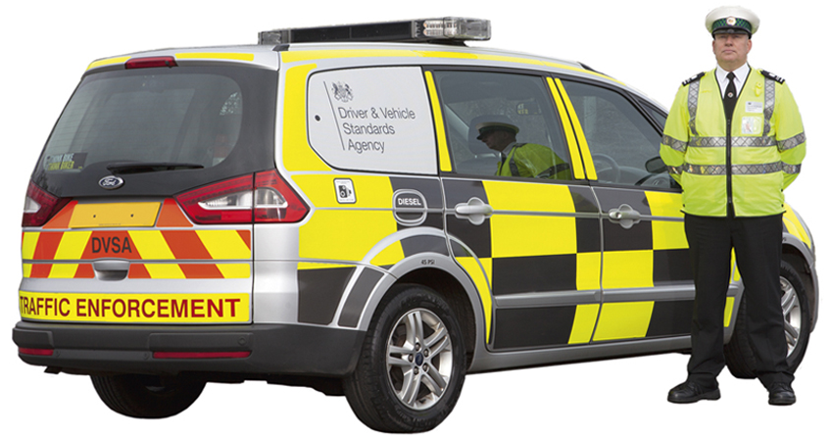
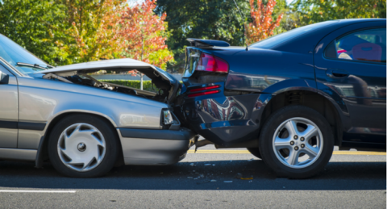
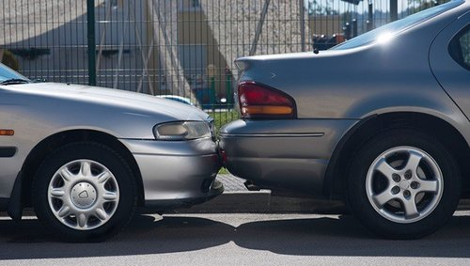
Considerations from UK implementation of R 157- ALKS
Examples of UK traffic rules
A driver must comply with the direction of an enforcement officer
(Rule 106, 107 & 108)
Red X - You must not proceed further in this lane
(Rule 258)
Not all enforcement vehicles have sirens and blue flashing lights so will the vehicle respond to them?
A legal requirements so can they be detected and understood?
If you are involved in a collision which causes damage or injury to any other person, vehicle, animal or property, you must stop
(Rule 268)
Will this collision be a detectable collision?

Slide 4
Considerations from UK implementation of R 157- ALKS
Local traffic rules
Should knowledge should be shared on local traffic rules?
What is the best way to do this?
Detectable collisions
Is there a disparity with what is considered a detectable collision?
Is there a need to specify what is a collision?

