Slide 1
Status Report of the Informal Working Group on Validation Methods for Automated Driving (VMAD)
Informal document GRVA-09-29 9th GRVA, 1-5 February 2021
Provisional agenda item 4(b)
United Nations Economic Commission for Europe (UNECE) Working Party on Automated/Autonomous and Connected Vehicles (GRVA)
1-5 February 2021 Virtual meeting

Slide 2
Purpose
To report on the outcome of the work of the Validation Methods for Automated Driving (VMAD) Informal Working Group (IWG). Specifically the following:
Final Draft NATM Master Document
Next steps including possible future work

Slide 3
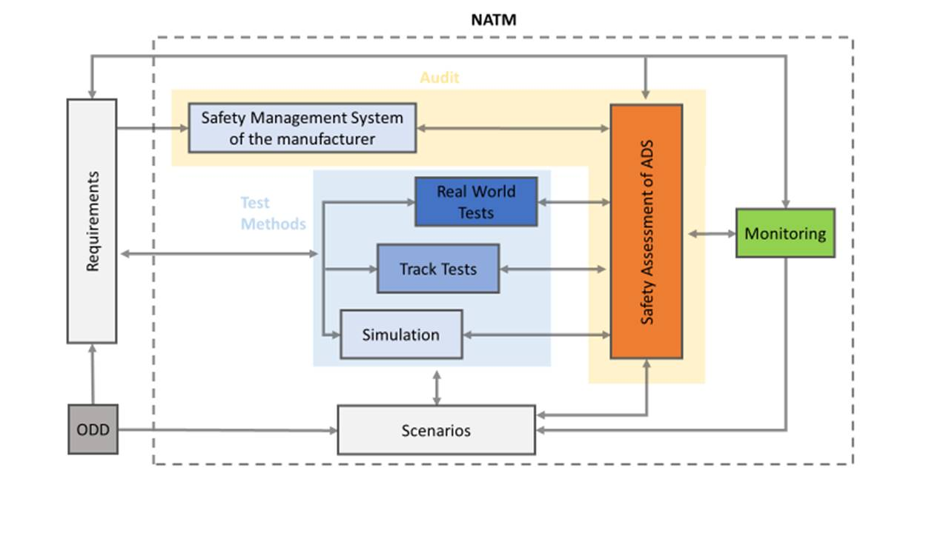
Final Draft NATM Master Document (MD)
Section 9
Section 8
Section 10
Section 7
Section 12
Section 6
Section 5
3

Slide 4
Draft MD Section 1-4, 11
Section 1: Background
Section 2: Purpose and Scope
Section 3: Definitions
Section 4: Applying a Multi-pillar Approach to the NATM
Section 11:NATM Pillars/Element Interaction
4

Slide 5
Draft MD Section 5 (Senarios)
A scenario catalogue, [consisting of descriptions of real-world driving situations that may occur during a given trip, will be a tool used by the NATM-pillars to validate the safety of an ADS.]
5

Slide 6
Draft MD Section 6 (Simulation)
Simulation/virtual Testing which uses different types of simulation toolchains to assess the compliance of an ADS with the safety requirements on a wide range of virtual scenarios including some which would be extremely difficult if not impossible to test in real-world settings.
6

Slide 7
Draft MD Section 7 (Track Test)
Track testing which uses a closed-access testing ground with various scenario elements to test the capabilities and functioning of an ADS.
7

Slide 8
Draft MD Section 8 (Real-world Test)
Real-world testing uses public roads to test and evaluate the performance of ADS related to its capacity to drive in real traffic conditions.
8

Slide 9
Draft MD Section 9 (Audit)
Audit/assessment procedures which establish how manufacturers will be required to demonstrate to safety authorities using documentation, their simulation, test-track, and/or real-world testing of the capabilities of an ADS. The audit will validate that hazards and risks relevant for the system have been identified and that a consistent safety-by-design concept has been put in place. The audit will also verify that robust processes/mechanisms/strategies (i.e., safety management system) that are in place to ensure the ADS meets the relevant safety requirements throughout the vehicle lifecycle. It shall also assess the complementarity between the different pillars of the assessment and the overall scenario coverage.
9

Slide 10
Draft MD Section 10 (Monitoring)
In -service monitoring and reporting addresses the in-service safety of the ADS after its placing on the market. It relies on the collection of fleet data in the field to assess whether the ADS continues to be safe when operated on the road. This data collection can also be used to fuel the common scenario database with new scenarios from the field and to allow the whole ADS community to learn from major ADS accidents/incidents.
10

Slide 11
Draft MD Section 12 (VMAD NATM/FRAV Integration)
This section describes how the NATM links with the safety requirements developed by FRAV.
For example, considering the categories of the requirements currently being considered by FRAV, virtual testing seems particularly relevant for assessing requirements related to a topic of “ADS should drive safely, and ADS should manage safety critical situations”, and so forth.
Although the fact that FRAV started its work long after VMAD, requirements which are currently being developed by FRAV are becoming mature enough to start considering the VMAD NATM/FRAV integration which could be incorporate in the NATM Master Document at a later stage.
11

Slide 12
Next steps
VMAD agreed to start with validation of NATM for Highway systems.
VMAD and its sub-groups have been working together to scope out list of issues to be tackled as next steps (outline of the list will be shown on the next slide and later).
Recognizing the synergies between FRAV and VMAD, the two IWGs will continue to collaborate to advance our respective workplans.

Slide 13
Next steps for SG1 (Scenarios)
Determine how scenarios can be applied with the NATM
Determine how best to demonstrate sufficient coverage of critical scenarios.
Determine which scenarios are required to validate the requirements established by FRAV
Determine methods for dealing with the possible risk of overfitting
Determine how unusual situations (e.g. wrong way driver) are dealt with in the scenario catalogue
Develop a common dictionary of terms
Note: full text of outstanding issues can be obtained from VMAD-15-05-rev.1

Slide 14
Next steps for SG2 (Simulation)
Provide examples of simulation toolchains used for virtual testing
Define requirements and methods for simulation tool-chain validation, including:
differences between ADAS and ADS
appropriate metrics evaluating toolchain accuracy
type of scenarios used for toolchain validation
Define documentation requirements for vehicle manufacturers and ADS developers (including the establishment of a clear link with the audit pillar)
Define standardization requirements to allow authorities performing in-house virtual testing (following activities carried out by ASAM and other associations)

Slide 15
Main next steps for SG3 (Audit and Monitoring)
Audit | In-service monitoring
Review best practices/procedures related to audit | Gap analysis: Identifying relevant on going work and reference documents (phase 2)
Review which functional safety requirements established by FRAV is relevant for the audit? | Identify data elements to be monitored and reported (phase 2)
Establish which documentation shall be made available to demonstrate safety processes, risk analysis, safety by design and validation put in place by the manufacturer? | Investigate reporting mechanisms and reporting criteria as well as data accessibility(phase 2)
Establish pass/ fail criteria for the audit/demonstration (e.g. minor/major non compliance). Conditions for validity/renewal of the assessment/audit. | Identify reporting mechanism for the reporting of new scenarios (phase 3)
Consider safety audit for sub-systems/components of the ADS and the responsibility of the different actors within the supply chain | Develop strategy for safety recommendations based on reported accidents/incidents (phase 3)
Which competences for the auditor?
Which information shall be made available to the public/authorities?
Investigate differences between between type approval and self certification systems

Slide 16
Next steps for SG4 (Track Test and Real-world Test)
Identification of best practices/procedures that currently exist for both TT and RWT. Also: tools to be developed still and identification of supporting components.
Identification of scenario elements of an ODD (in consultation with SG 1)
Determination various levels of abstraction of test scenarios required for TT and RWT
Description of methods for TT and RWT that could be used to assess an ADS's safety requirements
Identification of data/information produced during TT and RWT that can provide a clear, objective assessment of the ADS performance
Identification how TT and RWT can be used to validate specific safety requirements established by FRAV
Identify how TT and RWT could be used to validate the results of specific virtual tests (note: to be covered by sub-group focusing on simulation/virtual testing).

Slide 17
Thank you!

