Slide 1
Progress Report
Informal document GRVA-09-27
9th GRVA, 1-5 February 2021
Provisional agenda item 4(a)
9th GRVA session, 1-5 February 2021

Slide 2
Progress report
White paper describing FRAV work
Summary for GRVA
Explanation of work, current thinking, and intentions
Work ongoing—Contents of paper subject to change
Six sections
Definition of an Automated Driving System
Structure for ADS safety requirements
Elaboration of ADS safety requirements
Status of FRAV activities
FRAV coordination with VMAD
Outlook for 2021

Slide 3
Definition of an ADS
Driving and the Dynamic Driving Task (DDT)
Driving: Strategic, operational, and tactical functions
Strategic refers to decisions related to trip goals (e.g., destination)
Operational refers to basic driving skills and competencies
Tactical refers to maneuvering the vehicle under prevailing conditions
DDT: All the real-time operational and tactical functions required to operate a vehicle in on-road traffic
Automated driving and Operational Design Domains (ODD)
ADS may be designed to operate under defined sets of conditions and constraints
ODD: The conditions under which an ADS is designed to operate
User roles and responsibilities may differ across ADS configurations
Automated Driving Systems
ADS: A driving automation system capable of performing the entire DDT on a sustained basis
ADS functions
Subsets of ADS hardware and software designed to perform aspects of the DDT and support operational safety
ADS features
Applications of ADS capabilities designed to operate within an ODD

Slide 4
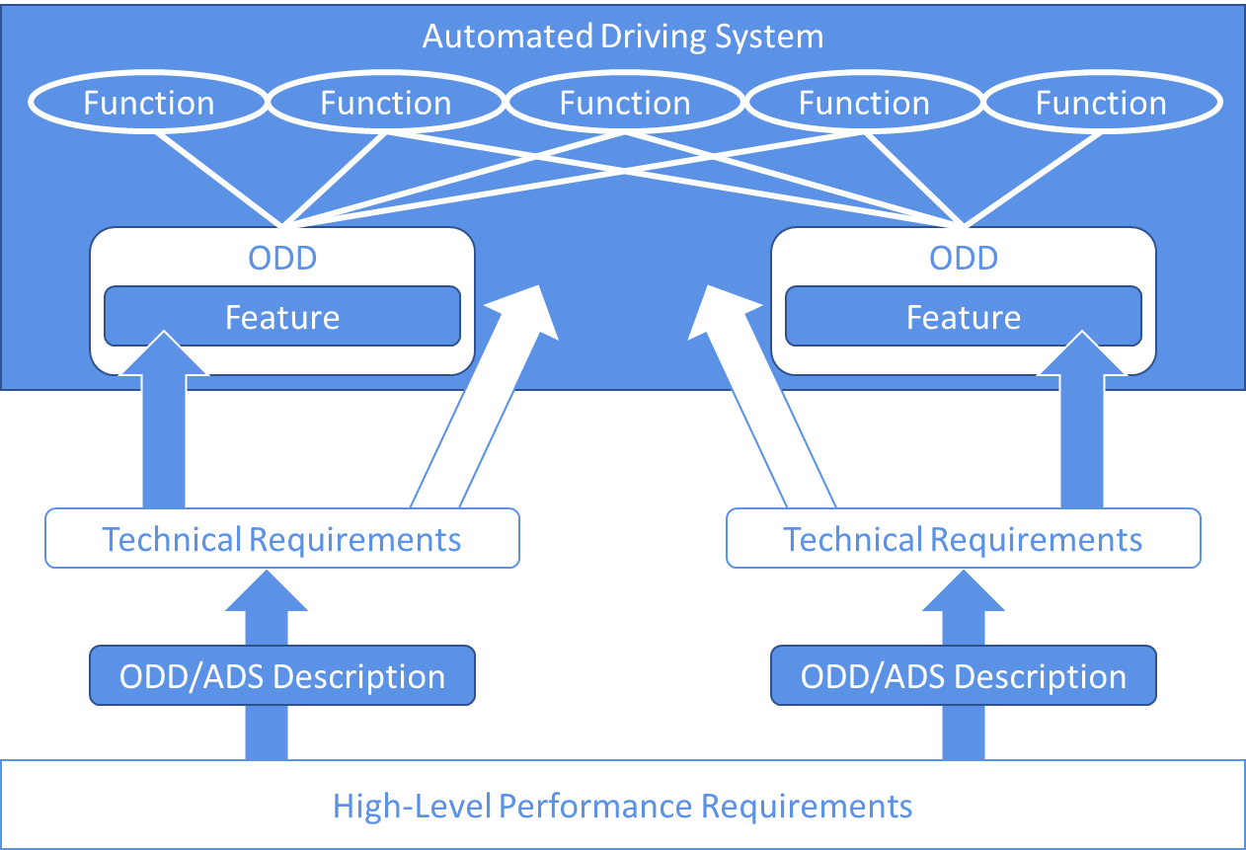
Agenda item 2 Structure for ADS safety requirements
Scope
All ADS (application or usage-specific approach discarded)
3+ wheeled vehicles, excluding motorcycle derivations
Current vehicle category definitions may not address all ADS vehicle configurations
ADS descriptions
Manufacturer definition of each ADS in accordance with requirements to ensure coverage and uniformity
ADS safety requirements
Objectively applied to any ADS based on its uses and limitations as defined in the ADS description
Overall approach
ADS descriptions enable application of requirements at technical level without interfering with innovation.
ADS features assessed on their merits within overall assessment of ADS

Slide 5
Elaboration of ADS safety requirements
Guiding principle
Short term: ADS intended for human use in human-dominated traffic
Traffic flows, predictability, public acceptance, user mental models, crash causation
C&C human driver, state-of-the-art, mathematical models, statistical positive risk balance (all have merits and may be used in combination)
Improve road safety and efficiency, performance-based, technology-neutral, verifiable, feasible, social acceptance
Explanation of guiding statement
Crash causation to understand what can and cannot be addressed by ADS
Crash causation to understand behaviors ADS may encounter
Addresses smooth integration into current traffic, improvement of road safety, use of new technology
Top-down approach
General discussion → 5 categories → 40 topics → further elaboration
ADS performance should be consistent with safe human driving behaviors while avoiding recognition, decision, and performance errors and the introduction of unreasonable ADS-specific risks.

Slide 6
Status of FRAV activities
Data collection
Understand traffic patterns, flows, and human responses to these conditions
Understand causes of crashes and human behaviors ADS may encounter
Nominal conditions and safety-critical conditions
Elaboration of safety requirements
Derive measurable/verifiable assessment criteria from the 40 safety topics
Apply data and methods to determine specifications for ADS assessment
Elaboration of ADS description requirements
Derive elements that may impact use and performance from the 40 safety topics
Define measurable/verifiable terms to describe use constraints and boundaries

Slide 7
Coordination with VMAD
Leadership meetings to coordinate activities and desired outcomes
Explanation of FRAV activities that may inform VMAD work
Scenarios: FRAV deliberations on ODD elements, current traffic patterns, nominal driving, and safety-critical conditions
Audit: FRAV deliberations on prerequisite functions and system safety
Virtual testing: FRAV deliberations on smooth ADS integration with current traffic
Physical testing: FRAV deliberations of performance, ODD exits, HMI, etc.
In-service performance: FRAV deliberations on maintaining the safe operational state of the ADS
Integration under the NATM
Procedure to review and verification of ADS descriptions
Procedure to determine application of safety requirements to individual ADS
Procedure to determine relevance of scenarios to individual ADS

Slide 8
Outlook for 2021
FRAV aims to address all ADS configurations (not application-specific)
Recognize interest in motorway applications
Aim to address but not be limited to motorway applications
Recognize VMAD needs
Sufficient detail on goals and criteria to support decisions on assessment methods
Anticipate increasing collaboration and reference to VMAD outcomes
Top-down approach moving through phases
General discussions → Five categories → 40 topics → Criteria → Specifications
General outlook and aims
May 2021: ADS description elements and safety assessment criteria
September 2021: Verifiable specifications (covering motorway subset)
February 2022: Package covering descriptions and requirements (covering motorway subset)

