Slide 1
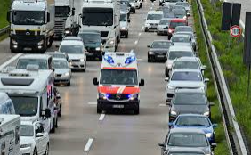
ALKS Response to Emergency Vehicles approaching from the rear
Informal document GRVA-08-25 8th GRVA, 14-16 December 2020
Agenda item 3(d)
Submitted by the expert from OICA
Relevant scenario:
Questions to align understanding:
Isn‘t an active siren of an approaching emergency vehicle equal to or even more distinct than an acoustic warning of a Transition Demand by the ALKS?
Wouldn‘t the driver (that is trained to operate a vehicle) naturally respond once he hears an emergency vehicle approaching?
What would then be the expected benefit of additionally giving a Transition Demand?

