Slide 1
UN R26 (external projections) Comments to document GRSG/2019/11 Current production radius analysis
Informal document GRSG-117-26
117th GRSG, 8–11 October 2019
Agenda item 3

Slide 2
The following slides show existing wiper designs (not exhaustive) of different OEM’s that are not able to meet the proposed amendment (see next slide) by France
The table below shows the affected number of vehicles on an annual basis if the proposed amendment would be introduced as an amendment to UN R26
Company | example | vehicles affected annually (million)
A | Design A | 0.71
B | Design B | 2.76
C | Design C | 0.70
D | Design D | 0.70
E | Design E | 1.80
F | Design F | 2.50
G | Design G1,2,3 | 2.30
H | Design H1, H2 | 4.00
I | Similar to Design E | 0.60
Total |  | 16.07

Slide 3
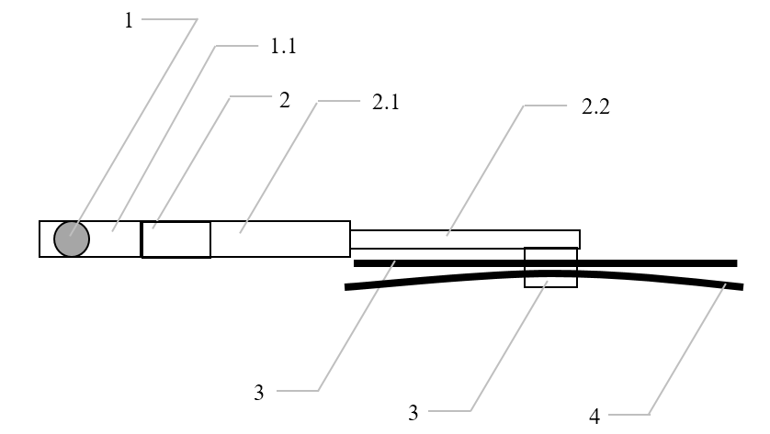
ECE/TRANS/WP.29/GRSG/2019/11
I. Proposal (France)
Paragraphs 6.4. to 6.4.2., amend to read:
"6.4. Windscreen wipers
6.4.1. The windscreen wiper fittings shall be such that the wiper shaft (number 1 in Figure 0) is furnished with a protective casing (number 1.1 in Figure 0) which has a radius of curvature meeting the requirements of paragraph 5.4. above and an end surface area of not less than 150 mm². The holder (head, main and/or other parts, i.e. numbers 2, 2.1 and 2.2 in Figure 0) are designed with a radius of curvature meeting the requirements of paragraph 5.4. above. In the case of rounded covers, these shall have a minimum projected area of 150 mm² when measured not more than 6.5 mm from the point projecting furthest. These requirements shall also be met by rear window wipers and headlamp wipers.
6.4.2. Paragraph 5.4. shall not apply to the wiper blades (number 4 in Figure 0), or to any to supporting members (number 3, 2.2, 2.1 in Figure 0) or to the functional hinge between the holder head and the holder (number 5 in figure 0). However, these units shall be so made as to have no sharp angles or pointed or cutting parts.
Figure 0
Example of parts distribution
Red text is added to the French proposal by OICA as to overcome the problems with current wiper designs
The examples in the next slides show that part 2.1, part 2.2 and the functional hinge of current wiper designs do not meet the requirement of par. 5.4
Red text is added to the drawing by OICA to clarify the hinge location.
1 – Wiper shaft
1.1 – Protective casing
2 – Holder head
2.1 – Main holder
2.2 – Second holder
3 – Supporting members
4 – Wiper blades
5 – functional hinge"
5

Slide 4
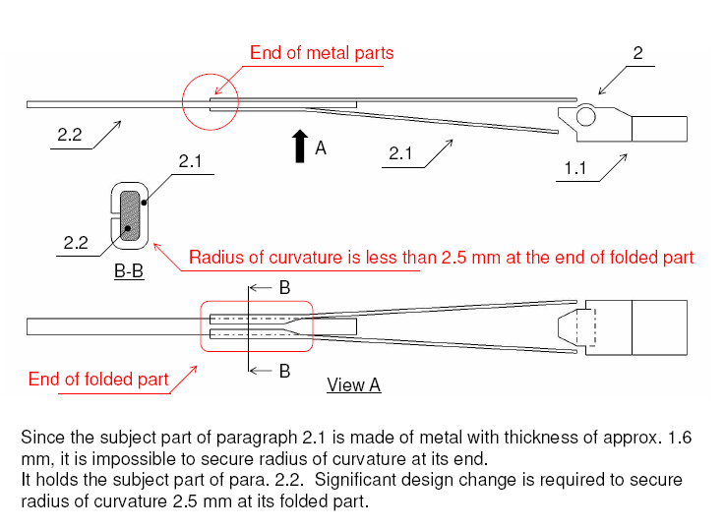
Design A

Slide 5
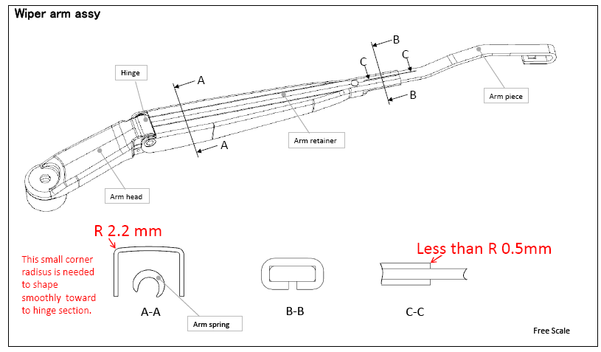
design B

Slide 6
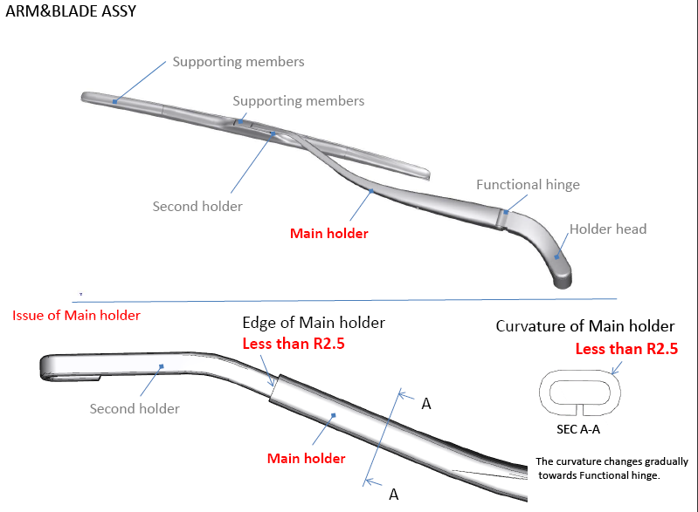
design C

Slide 7
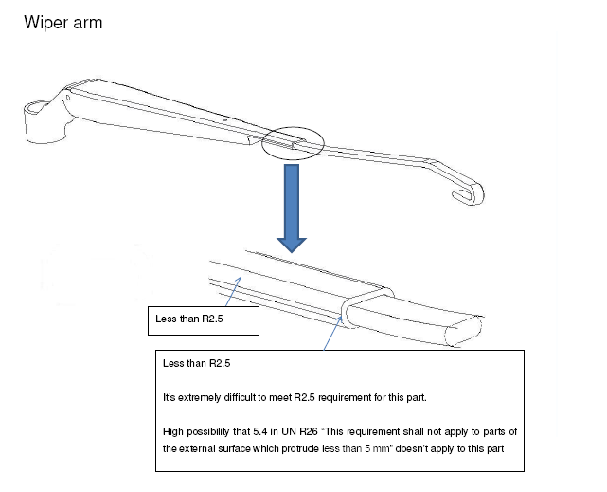
design D

Slide 8
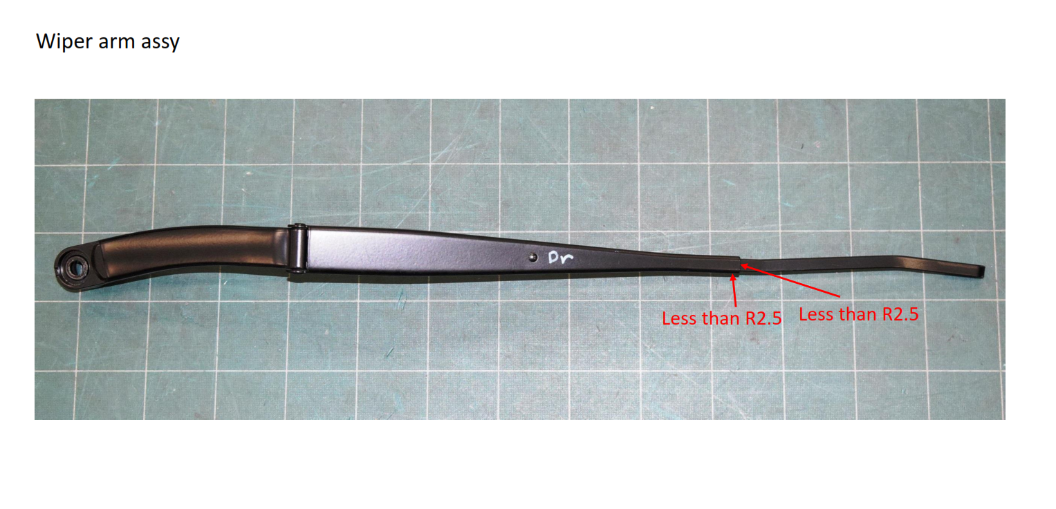
design E

Slide 9
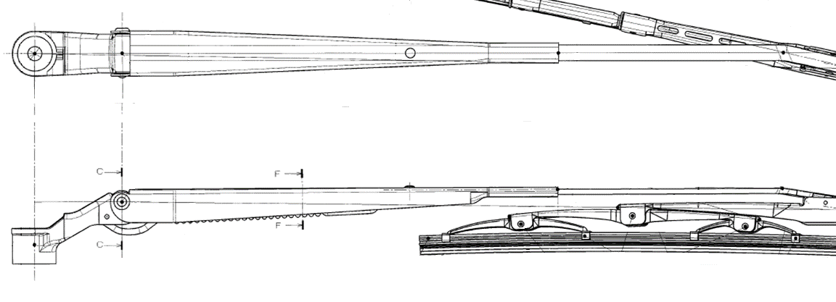
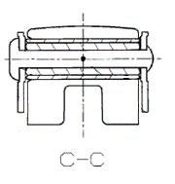
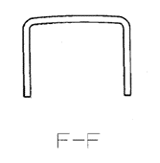
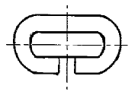
design F
Part 2.1
D
Functional hinge
D
R2.1～R4
R1.7～R2.1
DｰD

Slide 10
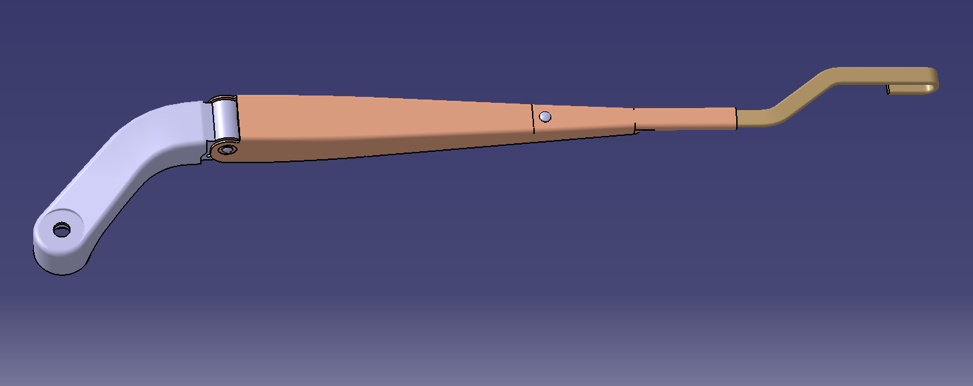
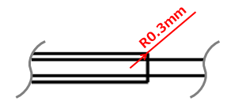
Front wiper arm assy
Second holder
design G1
A
B
A
B
Functional hinge
Main holder
Holder head
Curvature of second holder
less than R2.5mm
Edge of main holder
less than R2.5mm
SEC A-A
SEC B-B

Slide 11
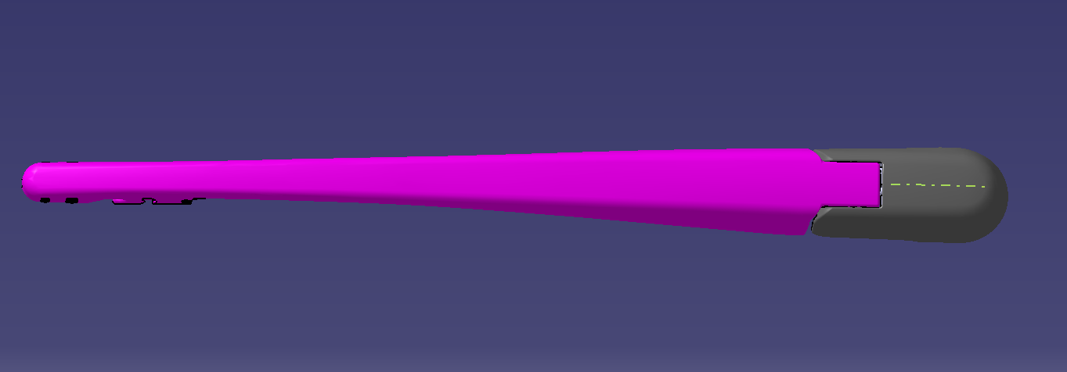
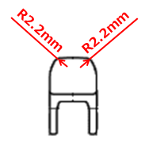
Rear wiper arm assy #1
design G2
Protective casing
A
A
Main holder
Curvature of main holder
less than R2.5mm
SEC A-A

Slide 12
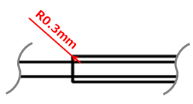
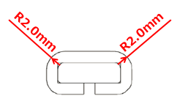
Rear wiper arm assy #2
Protective casing
design G3
Second holder
Main holder
A
C
A
B
B
C
Functional hinge
Curvature of second holder
less than R2.5mm
Edge of main holder
less than R2.5mm
Curvature of main holder
less than R2.5mm
SEC A-A
SEC B-B
SEC C-C

Slide 13
design H1
Cutting areas
Less than R2,5

Slide 14
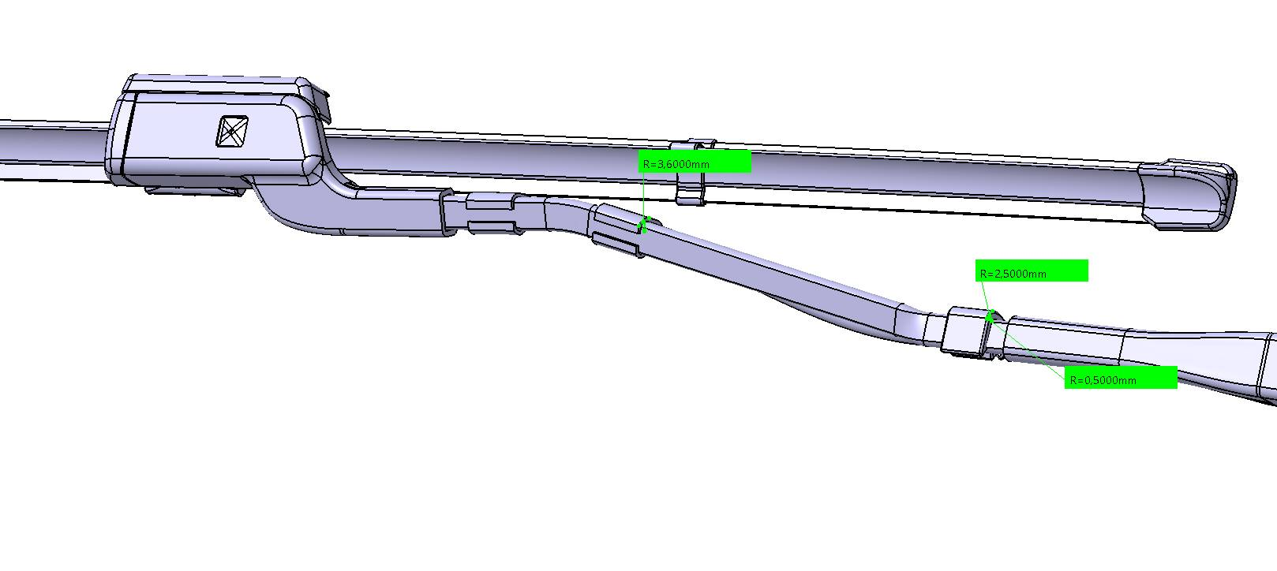
design H2
Wiper arm with embedded washing
Nozzle
Less than R2,5 on sides
Hose clips
Less than R2,5 on sides (cutting parts)

