Slide 1
Transport Indicators – Quick information about the transport sector in corona times
Maria Melkersson Transport Analysis

Slide 2
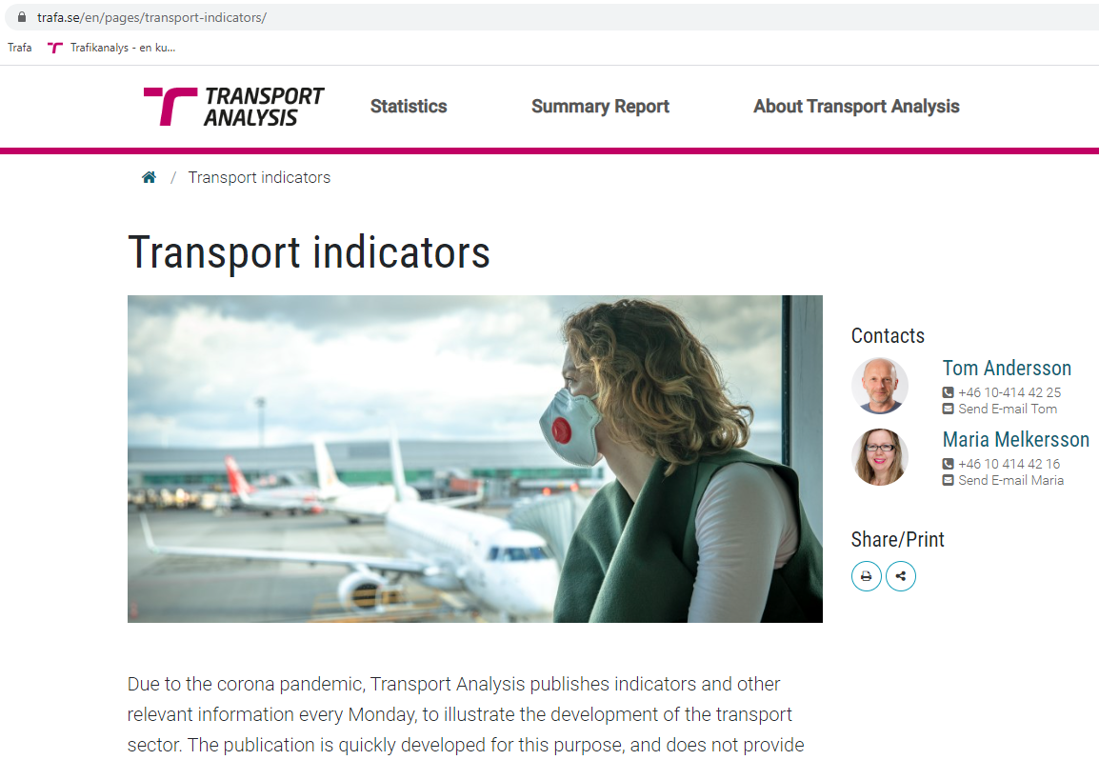

Slide 3
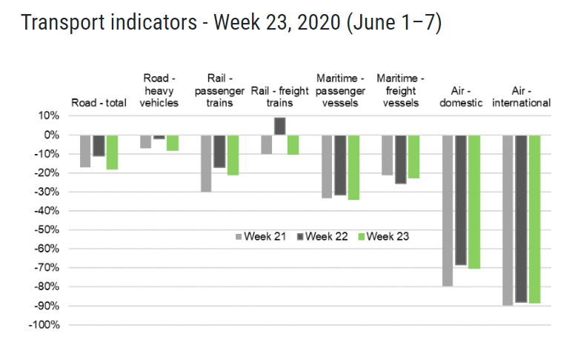

Slide 4
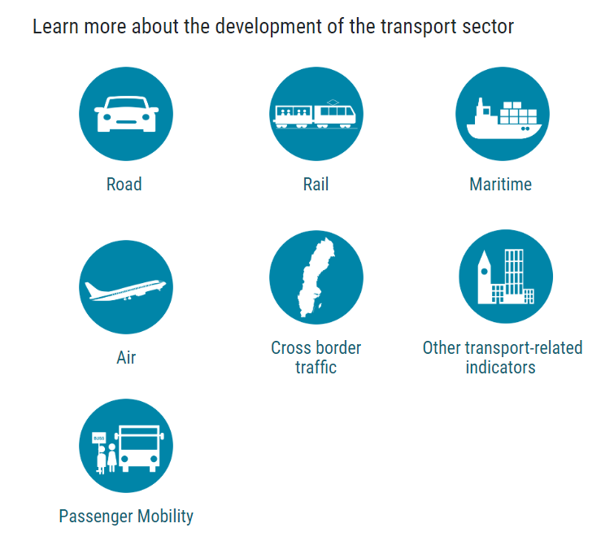
Indicators for a number of themes

Slide 5
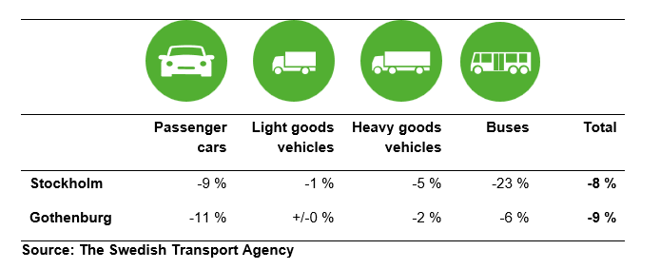
An example: ROAD
Vehicle kilometres in the national road network (weekly)
Road traffic in central Stockholm and Gothenburg: passages at congestion tax stations (monthly)

Slide 6
Another example: Passenger mobility
Preliminary results from the Swedish National Travel Survey
April 2020 vs. April 2019
Journeys by public transport: -76%
All journeys: -25%
Trips by car: -28%
Trips to/from school: -64%

Slide 7
Some other examples of indicators
Cross-border traffic
Trains SE – DK (Öresund Bridge) (weekly)
Road traffic SE – DK (Öresund Bridge) (weekly)
Road traffic SE – NO (daily, not used as such)
Other transport-related indicators
Turnover in the transport business (monthly)
# of bankruptcies and notices (monthly)
# killed in road traffic accidents (monthly)
# new passenger cars and LGVs (monthly)

