Slide 1
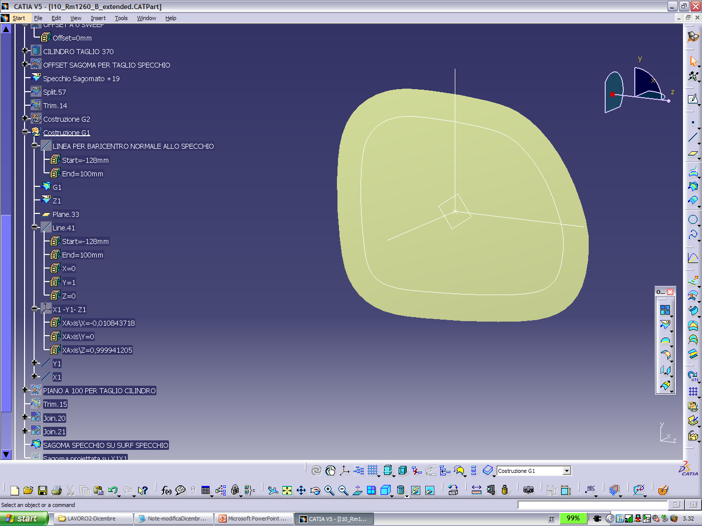
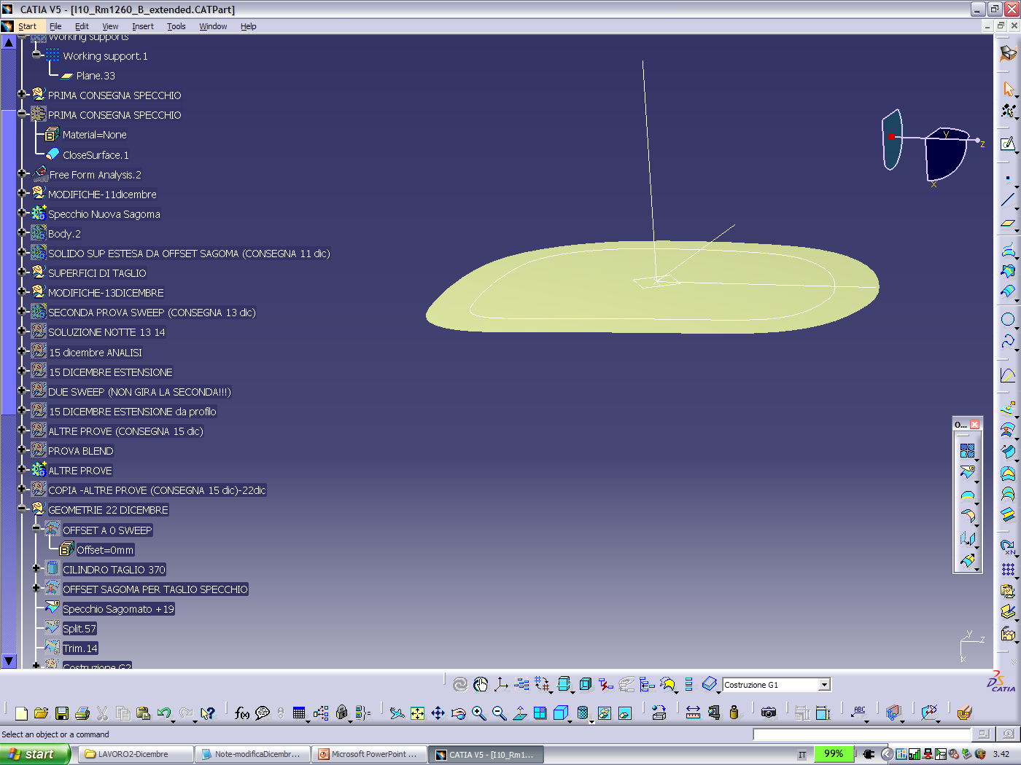
Reg. ECE 46/06
IT proposal for amendments (doc. GRSG/2020/6)
Informal document GRSG-119-26
(119th GRSG, 6-9 October 2020 Agenda item 4a)
This document describes a proposal of revision of Reg. ECE 46/06.
The proposal is based on studies, started twenty years ago, on non-spherical optical surfaces applied on exterior rear view mirrors. Optical surfaces are designed with the support of a dedicated software suitable to simulate the optical performances of free form mirrors.
The intention of the proposed amendment is not to replace the current spherical product (which will continue to be offered on the market), but to allow the new generation of optical reflecting mirrors being proposed to OEMs in order to improve the quality of the reflected images and optimize the mirror size for a given field of vision.

Slide 2

Spherical mirrors : do they represent the optimal field of view?
Reg. ECE 46/06 requires that the reflecting surface of the mirrors be spherically convex, with allowance of mean radius deviations due to the production tolerances (+/- 15% radius)
The Regulation establishes an experimental procedure to measure the deviation of the real surface of a mirror with respect the ideal one, and sets the limits.
Therefore, cars should be equipped with perfectly spherical mirrors. In reality, because of production, all of the mirrors have surfaces where each point randomly deviates with respect to the position on the ideal sphere.
External mirrors, especially those on passenger’s side, are commonly far from drivers eyes and their inclination is not orthogonal. Therefore surface design shall take into consideration mirror’s position and inclination effects on potential image distortion.
Main dvantages of Free Form mirrors
Better field of view / or smaller glass for the same field of view
Reducing glass housing
Reduced costs
Lower c_{d}
Less fuel consumption

Slide 3


Reg. ECE 46/06: Compliance requirements
ECE R46 Standard
The legal minimum radius is measured according to the ECE R46 Standard
That’s to say :
3 measuring points (r_{p}1, r_{p}2, r_{p}3) with the Mean Radius r defined as follow :
2 principal radii of curvature for each point
Mean Radius r > 1,200 mm
For r < 3,000 mm
The difference between r_{i} or r’_{i}, and r_{p} at each reference point must not exceed 0.15 r
The difference between any of the radii of curvature (r_{p}1, r_{p}2, and r_{p}3) and r must not exceed 0.15 r
➔ The Free form mirror uses the room allowed by this coefficient 0.15 r in order to increase the field of view.

Slide 4
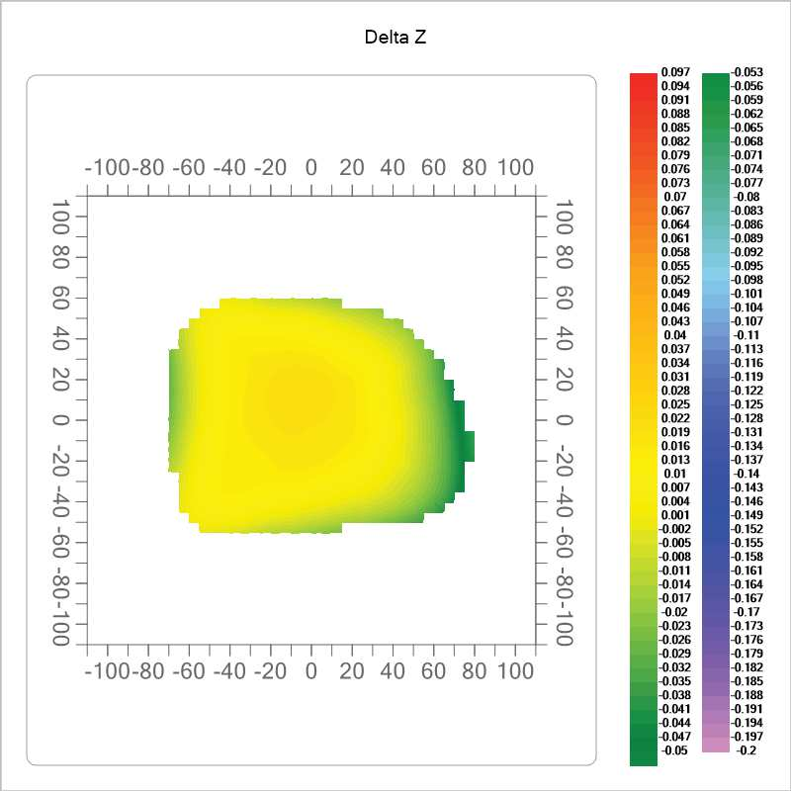
The current process of manufacturing of optical surfaces can be adopted for Free Form Mirrors.
Design software and manufacturing processes of molds - CNC multi axes and optical polishing - have created the concrete conditions to reproduce complex surfaces with very affordable quality and reproducibility.
Measured samples - Actual Z axis vs Theoretical Z axis

Slide 5
IMAGE DISTORTION: MAP OF POINTS
31 deg
mirror
detector
31 deg
projector
mirror oriented as used on the car (3D configuration)
1.18 1.16 1.14 1.13 1.12 1.11 1.11 1.11 1.11 1.11 1.12 1.14 1.16 1.18 1.21 1.24 0.00 0.00 0.00
1.19 1.17 1.15 1.14 1.13 1.13 1.12 1.12 1.13 1.13 1.14 1.15 1.17 1.20 1.22 1.26 1.29 0.00 0.00
1.20 1.18 1.17 1.16 1.15 1.14 1.14 1.14 1.14 1.15 1.16 1.17 1.19 1.21 1.24 1.27 1.31 0.00 0.00
1.21 1.19 1.18 1.17 1.16 1.15 1.15 1.15 1.15 1.16 1.17 1.18 1.20 1.22 1.25 1.28 1.32 1.36 0.00
1.22 1.20 1.19 1.18 1.17 1.16 1.16 1.16 1.16 1.17 1.17 1.19 1.21 1.23 1.26 1.29 1.33 1.37 1.41
1.22 1.20 1.19 1.18 1.17 1.17 1.16 1.16 1.16 1.17 1.18 1.19 1.21 1.23 1.26 1.29 1.33 1.37 1.41
1.22 1.20 1.19 1.18 1.17 1.16 1.16 1.16 1.16 1.17 1.18 1.19 1.21 1.23 1.26 1.29 1.33 1.37 1.41
1.22 1.20 1.18 1.17 1.17 1.16 1.15 1.15 1.16 1.16 1.17 1.18 1.20 1.22 1.25 1.28 1.32 1.36 1.40
1.21 1.19 1.18 1.16 1.16 1.15 1.14 1.14 1.15 1.15 1.16 1.17 1.19 1.21 1.24 1.27 1.30 1.34 1.39
1.20 1.18 1.17 1.15 1.14 1.14 1.13 1.13 1.13 1.14 1.14 1.16 1.17 1.20 1.22 1.25 1.29 1.32 1.37
1.19 1.17 1.15 1.14 1.13 1.12 1.12 1.11 1.11 1.12 1.13 1.14 1.16 1.18 1.20 1.23 1.27 1.30 1.34
1.18 1.16 1.14 1.12 1.11 1.10 1.10 1.10 1.10 1.10 1.11 1.12 1.14 1.16 1.18 1.21 1.24 1.28 1.32
1.17 1.15 1.13 1.11 1.10 1.09 1.08 1.08 1.08 1.08 1.09 1.10 1.12 1.14 1.16 1.19 1.22 1.25 1.29
1.17 1.14 1.12 1.10 1.08 1.07 1.07 1.06 1.06 1.07 1.07 1.08 1.10 1.12 1.14 1.17 1.20 1.23 1.27
1.17 1.14 1.11 1.09 1.07 1.06 1.06 1.05 1.05 1.05 1.06 1.07 1.08 1.10 1.12 1.15 1.18 1.21 0.00
D_{max}/d_{min} ratios
Free Form Mirror (passenger side)
Mean value = 1.18, standard deviation = 0.0735, min. val. = 1.05, max. val. = 1.41
1.25 1.26 1.27 1.29 1.30 1.31 1.33 1.34 1.36 1.37 1.39 1.41 1.42 1.44 1.46 1.48 1.51 1.53 0.00 0.00 0.00
1.25 1.26 1.27 1.28 1.30 1.31 1.32 1.34 1.35 1.37 1.39 1.40 1.42 1.44 1.46 1.48 1.50 1.53 1.55 0.00 0.00
1.25 1.26 1.27 1.28 1.30 1.31 1.32 1.34 1.35 1.37 1.39 1.40 1.42 1.44 1.46 1.48 1.50 1.52 1.55 1.57 0.00
1.25 1.26 1.27 1.28 1.29 1.31 1.32 1.34 1.35 1.37 1.38 1.40 1.42 1.44 1.46 1.48 1.50 1.52 1.55 1.57 1.59
1.24 1.26 1.27 1.28 1.29 1.30 1.32 1.33 1.35 1.36 1.38 1.40 1.42 1.44 1.46 1.48 1.50 1.52 1.54 1.57 1.59
1.24 1.25 1.26 1.28 1.29 1.30 1.32 1.33 1.35 1.36 1.38 1.40 1.41 1.43 1.45 1.47 1.49 1.52 1.54 1.56 1.59
1.24 1.25 1.26 1.27 1.29 1.30 1.31 1.33 1.34 1.36 1.38 1.39 1.41 1.43 1.45 1.47 1.49 1.51 1.54 1.56 1.58
1.24 1.25 1.26 1.27 1.28 1.30 1.31 1.32 1.34 1.36 1.37 1.39 1.41 1.43 1.45 1.47 1.49 1.51 1.53 1.55 1.58
1.23 1.24 1.26 1.27 1.28 1.29 1.31 1.32 1.34 1.35 1.37 1.39 1.40 1.42 1.44 1.46 1.48 1.50 1.53 1.55 1.57
1.23 1.24 1.25 1.26 1.28 1.29 1.30 1.32 1.33 1.35 1.36 1.38 1.40 1.42 1.44 1.46 1.48 1.50 1.52 1.55 1.57
1.23 1.24 1.25 1.26 1.27 1.29 1.30 1.31 1.33 1.34 1.36 1.38 1.40 1.41 1.43 1.45 1.47 1.49 1.52 1.54 1.56
1.22 1.23 1.25 1.26 1.27 1.28 1.30 1.31 1.32 1.34 1.36 1.37 1.39 1.41 1.43 1.45 1.47 1.49 1.51 1.53 1.56
1.22 1.23 1.24 1.25 1.26 1.28 1.29 1.31 1.32 1.34 1.35 1.37 1.39 1.40 1.42 1.44 1.46 1.48 1.51 1.53 1.55
1.22 1.23 1.24 1.25 1.26 1.27 1.29 1.30 1.31 1.33 1.35 1.36 1.38 1.40 1.42 1.44 1.46 1.48 1.50 1.52 1.54
1.21 1.22 1.23 1.24 1.26 1.27 1.28 1.30 1.31 1.33 1.34 1.36 1.37 1.39 1.41 1.43 1.45 1.47 1.49 1.52 0.00
D_{max}/d_{min} ratios
Spherical Mirror (passenger side)
Mean value = 1.38, standard deviation = 0.1015, min. val. = 1.21, max. val. = 1.59

Slide 6
From spherical mirror surface to free form mirrors compliant with ECE 46 Rev. 6 Regulation
RADII OF CURVATURE MEASUREMENT ACCORDING TO ECE46-rev6 REGULATION
Distances between the tracing pin of the dial gauge and the fixed legs = 31.62 [mm]
tolerance = 190.34 [mm] (0.15r >>1268.91 mm.)
orientation: 0° deg. and 90° deg
Horizontal Radii Vertical Radii Average Radii rp
a) r1 = 1348.62[mm] r'1 = 1114.37[mm] rp1 = 1231.49[mm]
r1-rp1 = 117.12[mm] r'1-rp1 = -117.12[mm]
b) r2 = 1441.58[mm] r'2 = 1133.67[mm] rp2 = 1287.63[mm] r2-rp2 = 153.96[mm] r'2-rp2 = -153.96[mm]
c) r3 = 1441.58[mm] r'3 = 1133.67[mm] rp3 = 1287.63[mm]
r3-rp3 = 153.96[mm] r'3-rp3 = -153.96[mm]
r = 1268.91 [mm] rp1-r = -37.42 [mm] rp2-r = 18.71 [mm] rp3-r = 18.71 [mm]
orientation: + 45 deg and 135°
45° Radii 135° Radii Average Radii rp
a) r1 = 1231.66[mm] r'1 = 1217.71[mm] rp1 = 1224.68[mm]
r1-rp1 = 6.98[mm] r'1-rp1 = -6.98[mm]
b) r2 = 1274.97[mm] r'2 = 1268.23[mm] rp2 = 1271.60[mm]
r2-rp2 = 3.37[mm] r'2-rp2 = -3.37[mm]
c) r3 = 1268.23[mm] r'3 = 1274.97[mm] rp3 = 1271.60[mm]
r3-rp3 = -3.37[mm] r'3-rp3 = 3.37[mm]
r = 1255.96 [mm] rp1-r = -31.28 [mm] rp2-r = 15.64 [mm] rp3-r = 15.64 [mm]
On a free form surface each point has been defined through an algorithm to achieve optical design targets.

Slide 7

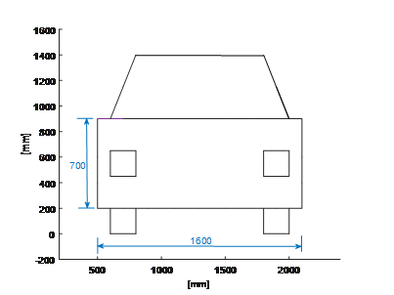


QUALITY OF OBJECTS REFLECTED - MIRRORS ON VEHICLE
car at 10 m –
Free Form mirror on passenger side
reflected size of vehicle 238 sq.mm
car at 30 m –
Free Form mirror on passenger side RATIO 1,85
Spherical mirror on passenger side
reflected size of vehicle 239 sq.mm
Spherical mirror on passenger side
RATIO 1,71

Slide 8
Experience of process design and manufacturing on mirrors for vehicles
DRIVING FIELD TEST
TARGET OF THE PROJECT WAS MIRROR SURFACE AREA -20%
  Application was dedicated to a passenger rear view mirror
  the free form mirror complied with ECE R46 and contributed to reduce volume of the mirror body, noise at wind gallery test and CX of the vehicle. Results have been validated by an car maker.
  The field of view is absolutely identical to the original mirror; the exceeding area of the overlaid spherical mirror shows the same images as the peripheral area of the free form mirror
  Comfort of view is absolutely evident; absence of distortion and perception of object sizes
  Reduction of size combined with correlated volume of the assembly makes a big difference in impact

Slide 9
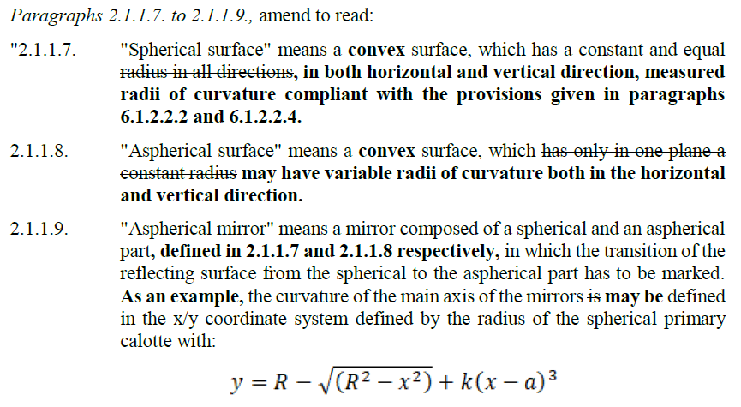
Proposed amendments (1)
ECE-TRANS-WP.29-GRSG-2020-06e

Slide 10
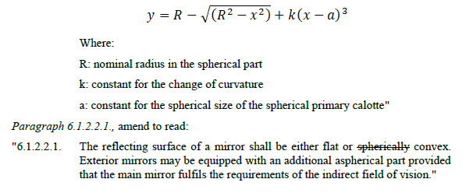
Proposed Amendments (2)
ECE-TRANS-WP.29-GRSG-2020-06e

