Slide 1
Proposal to amend UN Regulation No. 110
Informal document GRSG-119-21
(119th GRSG, 6 to 9 October 2020 Agenda item 7)
Shut off Valve
GRSG-119 / October 2020

Slide 2
Background
ISO 15500-14 Road vehicles — Compressed natural gas (CNG) fuel system components — Part 14: Excess flow valve defines “shut-off type excess flow valve”
ISO 15501-1 Road vehicles — Compressed natural gas (CNG) fuel systems — Part 1: Safety requirements does not restrict the used of such an excess flow valve
UN R110 currently only recognizes “pressure-equalization type excess flow valve” as excess flow limiting devices
In Japan current systems use configurations with “shut-off type excess flow valves”
UN R110 coming into effect in Japan in March 2022

Slide 3
Proposal: Add alternative configuration with a «shut-off type excess flow valve» to UN R110
Concept
Accessories fitted to the container
Automatic
valve
（Secondary,
option)
Pressure sensor
Automatic
Valve
（Primary）
Container
(cylinder)
Automatic
cylinder
valve
Manual
valve
Pressure
relief Valve
(PRV）
Excess flow
Valve
(EFV)
Pressure-equalization type
Current UN R110 Configuration
Integrated with container
To Engine
M
P
M
EFV
Proposed New Alternative
Integrated with container
To Engine
M
P
M
EFV
Shut-off type
The proposal amends the definition of the excess flow valve (EFV) in the sub group of pressure-equalization type and shut-off type excess flow valves to enable a configuration which uses an automatic valve separated with piping from the cylinder but close by the container, instead of an automatic cylinder valve fitted to the container.

Slide 4
Proposal
Amend definition of “Excess flow valve” to differentiate between pressure-equalization type and shut-off type excess flow valves:
4.21. "Excess flow valve" (excess flow limiting device) means a device that automatically shuts off, or limits, the gas or liquid flow when the flow exceeds a set design value.
4.21.1 “Pressure-equalization type excess flow valve” means an excess flow valve which automatically resets when the excess flow condition is no longer present.
4.21.2 “Shut-off type excess flow valve” means an excess flow valve that stops flow when in the closed position, which has to be reset by manual operation.

Slide 5
Proposal (2)
Amend the CNG system requirements in paragraphs 18.3.1.4. and 18.5.1.1. such that the automatic cylinder valve can be substituted in case a Shut-Off Type Excess flow valve is used:
18.3.1.4. Automatic cylinder valve or automatic valve;
18.5.1.1. An automatic cylinder valve shall be installed directly on each CNG container and to each CNG accumulator.
The automatic cylinder valve can be substituted by an automatic valve attached close to the CNG container, if the excess flow valve attached to the container is a shut-off type excess flow valve.

Slide 6
Proposal (3)
Correct paragraph 18.5.3.1. to reflect that the Excess flow limitting device must be fitted in the CNG fuel container the automatic cylinder valve might have been substituted by an automatic valve:
18.5.3.1. The excess flow limiting device shall be fitted in the CNG fuel container(s) and on each CNG accumulator on the automatic cylinder valve.
Update Annex 1A, Pargraph 1.2.4.5.8.3 accordingly:
1.2.4.5.8.3. Automatic cylinder valve / Automatic valve

Slide 7
Proposal (4)
Identify in Annex 4, paragraphs 5.4. and 5.6. the applicable requirements based on the excess flow valve type:
5.4.The pressure-equalization type excess flow valve shall be designed with a bypass to allow for equalization pressures.
The shut-off type excess flow valve shall have a function to reset actuation.”
5.6. When the pressure-equalization type excess flow valve is at cut-off position, the by-pass flow through the valve shall not exceed 0.05 normal m³/minute at a differential pressure of 10,000 kPa.
When the shut-off type excess flow valve is at cut-off position, the amount of leakage from the valve shall not exceed 2.5x10⁻⁷ normal m³/minute during operation.

Slide 8
Justification
In the UN Regulation No.110 an excess flow valve (EFV) is admitted only for the pressure-equalization type.
At the time of operation, the pressure-equalization type EFV does not completely shut off the fuel gas.
In the UN Regulation No.110, the pressure-equalization type EFV plays a role of limiting the gas flow rate at the time of actuation. In the event of accident such as fuel outflow, the automatic cylinder valve attached to the container shuts completely off the fuel.
In this document, OICA proposes an alternative type of EFV which can shut off the fuel, different from the pressure-equalization type. This shut-off type EFV makes it possible for the EFV to play the role of fuel shut-off instead of the automatic cylinder valve attached to the container. Therefore, the same effect can be obtained without providing the automatic valve integrally with the container.
The actuation of such shut-off type EFV can be cancelled by operating the manual valve (Manual Reset).

Slide 9
Please consider positively these proposed amendments, which we believe contribute to the improved safety of the entire CNG fuel system.

Slide 10
Backup Material
The following slides document considerations which have been taken into account, when creating the proposal:
Excess flow valve（EFV):
Structure and Operation (Comparison of both types)
Operational Performance (shut-off type)
Current configuration under UN R110
Assessment of proposed alternative configuration compared to current UN R110 configuration
Example of accident in Japan with shut-off type valve configuration

Slide 11
Excess flow valve（EFV）- Structure and Operation
【 Pressure-equalization type 】
pressure equalizing nozzle
（Normal）
（Operation）
Valve body
Gas
flow
Gas flow restricted when excessive flow rate occurs
Small amount of gas is allowed to flow, and when it is equalized, automatic return
Pressure plate
Spring
【 Shut-off type 】
Valve body
（Normal）
（Operation）
（Reset）
Gas
flow
×
Shut
off
Push rod
Shut off gas flow when excessive flow occurs
Manual pushing push rod reset
Pressure plate
Spring

Slide 12
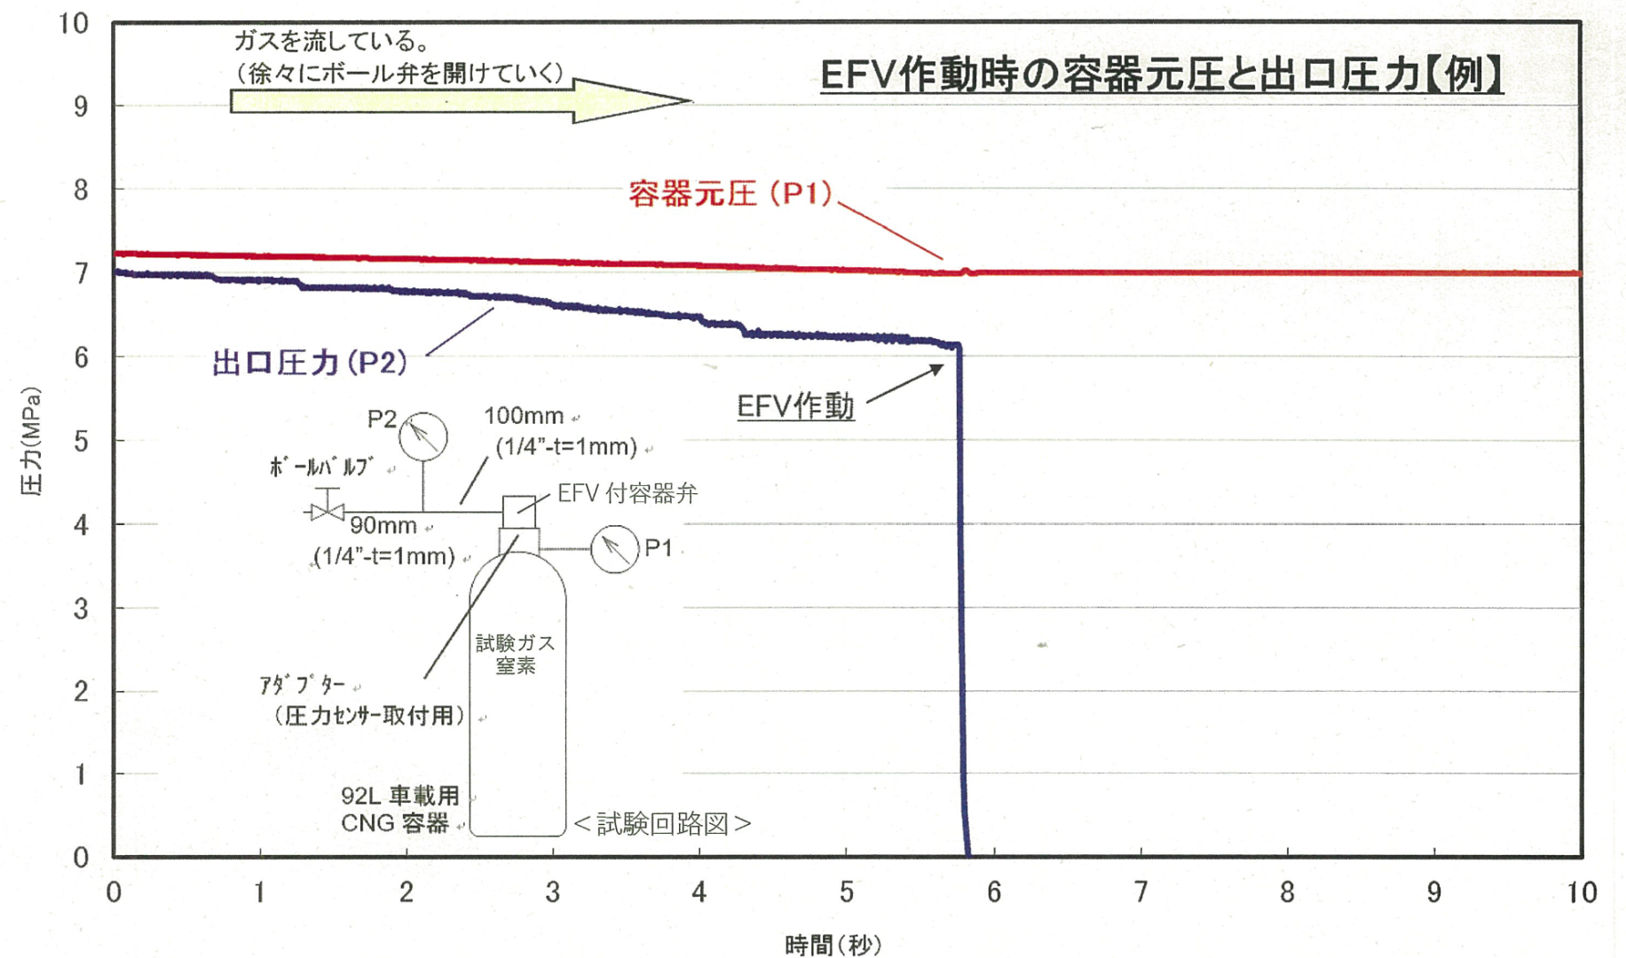
Operation performance of fuel shutoff type EFV
Gas flow
(gradually release ball valve)
The pressure inside the container
and the outlet pressure
inside pressure (P1)
outlet pressure
(P2)
Pressure (MPa)
EFV Shutoff
Ball valve
EFV integrally cylinder valve
Test
Gas
N2
Pressure sensor
mounting attachment
NGV container
(92L)
＜Circuit diagram＞
Time (s)

Slide 13
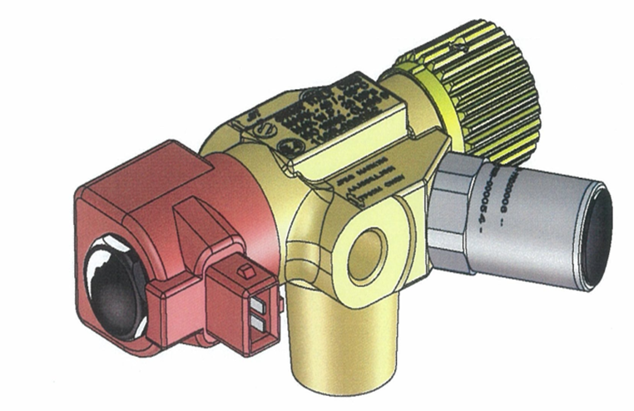
Example of a cylinder valve according to the current UN regulation No. 110 (made by EMER)
① Valve body
②Manual valve handle
③ Automatic valve coil
❍ Pressure relief valve
■ Excess flow valve
Since the Excess flow valve is inserted in the threaded portion for attachment to the cylinder, it is difficult to break. On the other hand, the automatic valve is exposed to the outside.
Excess flow valves are more suitable than automatic valves, for preventing fuel outflow during accidents.
External view
Circuit diagram
①
②
③
To Engine
（Port A）
Valve
body
To Engine or Receptacle
（Port B）
Automatic
valve
M
Pressure relief valve
(Temperature type)
Manual valve
④
Excess flow
valve
EFV
Pressure relief valve
(Pressure type , option)
Attachment to
the cylinder
（⑤EFV inside）
From cylinder

Slide 14
Assessment of Proposal
During discussion with experts following concerns have been raised on
(1) Setup of automatic valve (AV)
- adds potential leaking points upstream of the AV
- slow leaks cannot be avoided because they are not detected by EFVs
(2) Malfunction of EFV
- access to reset EFV
- how to detect if there is gas inside the cylinder
(3) Harmonization with ISO
Concerns seem to come from reflecting partial points of view.
Risk assessment was made considering both configuration (with/without shut off type EFB) and various cases of possible accidents, events/operations and the risks in each case.
Risk Assessment (next slides):
Case 1 Malfunction of EFV
Case 2 Slow leak in enclosed parking places
Case 3 Pipe break (just after AV)
Case 4 Pipe break (just after AV) with malfunction of AV or pressure switch (AV open)
Case 5 Cylinder dropout (cylinder valve survive)
Case 6 Cylinder dropout (only PRD and EFV survive)

Slide 15
Risk Assessment: Concerns about potential leak points upstream of the Automatic Valve
Connection points upstream of AV exist and are allowed in UNR and ISO.
PRDs for cylinders of long length are assembled by extending from the opposite end of the cylinder with piping connection.
UNR110 provides methods of bonfire test.
UNR110 Annex 3A – Appendix A
A.15.7. Cylinders greater than 1.65 m length
If the cylinder is fitted with a pressure relief device at one end, the fire source
shall commence at the opposite end of the cylinder. If the cylinder is fitted
with pressure relief devices at both ends, or at more than one location along
the length of the cylinder, the centre of the fire source shall be centred
midway between the pressure relief devices that are separated by the greatest
horizontal distance.
If the cylinder is additionally protected using thermal insulation, then two fire
tests at service pressure shall be performed, one with the fire centred midway
along the cylinder length, and the other with the fire commencing at one of
the cylinder ends.

Slide 16
Risk Assessment Case 1 Malfunction of EFV
Event / Operation
- Engine stop - Leak check by driver - Operation of MV and EFV reset - Engine restart | - Engine stop - Automatic pressure equalization and EFV reset - Engine restart
Risk
- Collision from other approaching vehicles - Contact with driver operating outside the vehicle by other approaching vehicles | - Collision from other approaching vehicles
Safety
M
M
P
P
M
AV
M
AV
MV
MV
PRD
PRD
EF
V
EFV
EF
V
EFV
≤
Pressure-equalization type
Shut-off type

Slide 17
Risk Assessment Case 2 Slow leak in enclosed parking places
Event / Operation
- Leak unpreventable | - Automatic cylinder valve shuts off gas leaks downstream - For PRDs installed at the opposite end of the cylinder, leaks due to over-pressurization are unpreventable
Risk
- Accumulation of gas in enclosed parking places |  | - Accumulation of gas in enclosed parking places
Safety
M
M
P
P
M
AV
M
AV
MV
MV
PRD
PRD
EF
V
EFV
EF
V
EFV
PRD
PRD
≤
Pressure-equalization type
Shut-off type

Slide 18
Risk Assessment Case 3 Pipe break (just after AV)
Event / Operation
- Engine stop - Shut-off by EFV or manual reset - Confirmation by driver and proceed to accident handling | - Engine stop - Automatic pressure equalization and EFV reset - Confirmation by driver and proceed to accident handling
Risk
- Less possibility of misjudging EFV malfunction, by visual observation - Engine restart only occurs when misjudges malfunction | - Driver misjudges malfunction of EFV and repeat trying engine restart
Safety
M
M
P
P
M
AV
M
AV
MV
MV
PRD
PRD
EF
V
EFV
EF
V
EFV
=
Pressure-equalization type
Shut-off type

Slide 19
Risk Assessment Case 4 Pipe break (just after AV)
with malfunction of AV or pressure switch (AV open)
Event / Operation
- Engine stops - Continuous shut-off by EFV - Driver proceeds to accident handling | - Engine stops, continuous leak - Driver evacuates or operates MV - When MV is shut, driver proceeds to accident handling
Risk
- Small gas leak by fast response of EFV | - Ignition of leaking gas (Driver injury when operating MV)
Safety
M
M
P
P
M
AV
M
AV
MV
MV
PRD
PRD
EF
V
EFV
EF
V
EFV
≥
Pressure-equalization type
Shut-off type

Slide 20
Risk Assessment Case 5 Cylinder dropout (cylinder valve survive)
Event / Operation
- EFV activated - Continuous shut-off by EFV - Gas residual found by close MV -> open MV | - EFV activated - Pressure equalization to AV and reset EFV (AV shut off gas leakage) - Gas residual found by close MV -> open AV -> open MV
Risk
Safety
M
AV
MV
MV
PRD
PRD
EF
V
EFV
EF
V
EFV
=
Pressure-equalization type
Shut-off type

Slide 21
Risk Assessment Case 6 Cylinder dropout (only PRD and EFV survive)
Event / Operation
- No gas leakage - Professional skill necessary to treat | - Continuous gas leak until the cylinder becomes empty, and no way to shut off - Prevent fire spread, and evacuate
Risk
- Gas eruption or cylinder rupture when disposing cylinder (but just at specialized sites) | - Ignition of leaking gas
Safety
M
AV
MV
MV
PRD
PRD
EF
V
EFV
EF
V
EFV
≥
Pressure-equalization type
Shut-off type

Slide 22
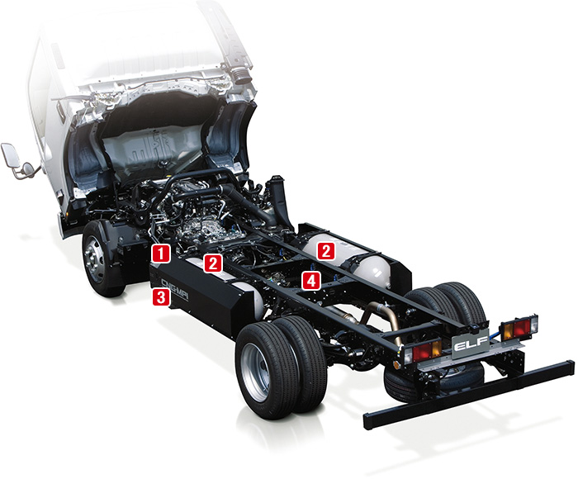
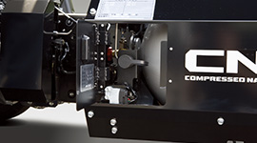
Assessment: Accessibility to reset shut-off type EFVs
For some vehicles it is actually easy to access and operate manual valves.
Shut-off type EFVs should be allowed based on the ease of access by the configuration of assembly.
MV
MV
MV

Slide 23
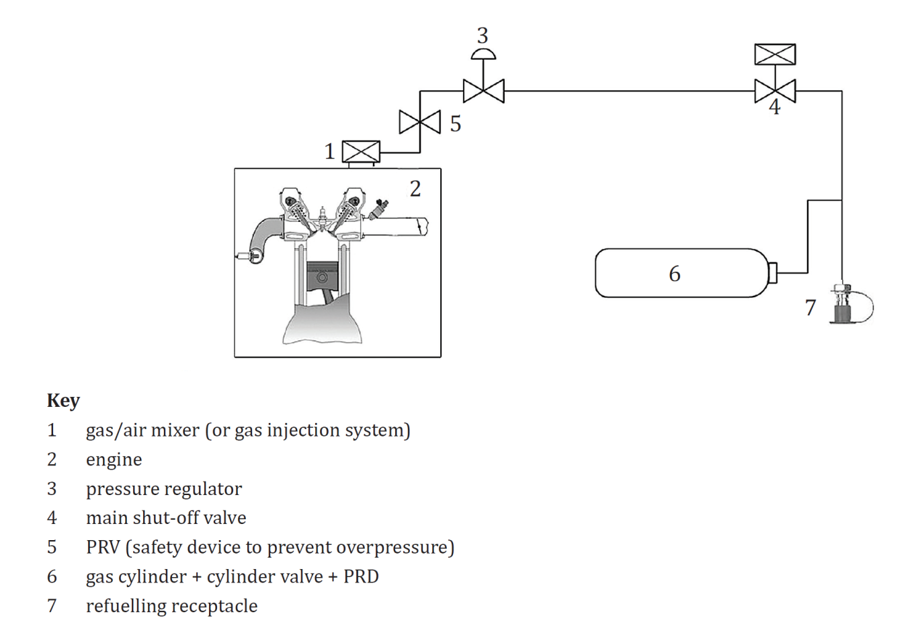
Assessment on Harmonization with ISO
ISO15501-1 requires Automatic Valves installed “directly” on cylinder, not “rigidly”.
“Directly” should be interpreted “without other components in between (just piping allowed)”.
4 Requirements
4.1 Design
4.1.1 General
The CNG on-board fuel system shall include the following:
— an automatic valve to be installed directly on every CNG cylinder with a manual valve rigidly fixed to the CNG cylinder, which may be integrated into the automatic valve.
Annex B

Slide 24
Risk Assessment Conclusion
Safety depends on accident case.
“Separated AV and Shut-off type EFV” are judged generally safe.
The proposal harmonizes with the ISO provisions.
The potential risks can be limited by:
- Length of connection piping
- Number of connection points

Slide 25
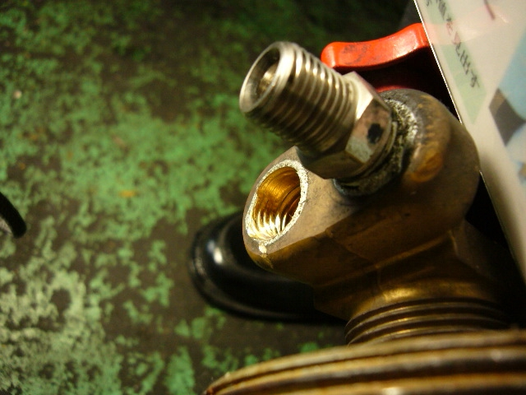
Example of an accident in Japan proves safety of the valve configuration with shutoff type EFV.
- A truck caused the metal cover of a roadside gutter to come loose and strike a cylinder valve, causing it to break.
- One of the two fuel pipe fittings dropped, and another deformed.
- Nevertheless, an outflow of fuel was blocked thanks to the shutoff type EFV.

