Slide 1
Transposition of GTR15 (WLTP) and GTR19 (Evap) into UN Regulations Update for GRPE from WLTP Transposition Task Force June 2020
Informal document GRPE-80-37
80th GRPE, 14-17 January 2020
Agenda item 3(a)

Slide 2
Background
TASK = Transpose GTR15 WLTP and GTR19 EVAP into a new ‘UNR WLTP’ regulation
Level 2 to contain most stringent requirements from across all regions
Subject to full mutual recognition: TA shall be accepted by all CPs
Regional levels (Level 1A, 1B etc. ) to contain regional requirements
Optional acceptance by other CPs
EU and Japan are the two CPs to be represented
UNR WLTP to be ‘accompanied by’ a UNR83 08 series that covers all the requirements of UNR83 07 series not covered by new UNR WLTP (e.g. Low temperature test etc.)
Original scheme was to introduce at same time as UNR WLTP. It will now be introduced at the same time as UNR RDE, i.e. one GRPE later
As and when GTR15 and UNR WLTP add new tests (e.g. Type 6 test) ‘UNR 83 08 series’ will ‘shrink’ in content.
EU would be a CP to UNR No. 83 and UNR WLTP. Japan would be a CP to just UNR WLTP

Slide 3
Schematic of proposed transposition route
UNR 83 08 series
UNR WLTP
Type I test
Level 2 most stringent – including Type 1, Type 4 and Type 5 tests
Type II test – modified for ‘WLTP world’*
Type III test – modified for ‘WLTP world’ *
Level 1a (Europe) – including Type 1, 4 and 5 tests
Level 1b (Japan) – including Type 1, 4 and 5 tests
Type IV test
Type V test – modified for ‘WLTP world’ *
Type VI test – modified for ‘WLTP world’ *
* Where other tests refer to the Type I test (NEDC) it will be necessary to say (where appropriate) that this should be seen to be the WLTP Type 1 test (over a certain transition period in some cases)
OBD, ISC
+
Shall demonstrate compliance with Level 1A of UNR WLTP

Slide 4
Post-79th GRPE Update
Intensive activity of the various WLTP IWG Task Forces contributing to the content and drafting of the UNR, in particular those for Conformity of Production, Durability, Sub-Group EV, OBD and the Transposition Task Force
Working Documents submitted for the 80th GRPE
00 series: GRPE-20-03
01 series: GRPE-20-04
Further work on various elements of the UNR has required the development of Informal Documents to amend these two Working Documents
These have been submitted to the 80th GRPE
Decision taken to postpone UNR83 08 by one GRPE session
The ISC requirements will need to align with UNR RDE

Slide 6
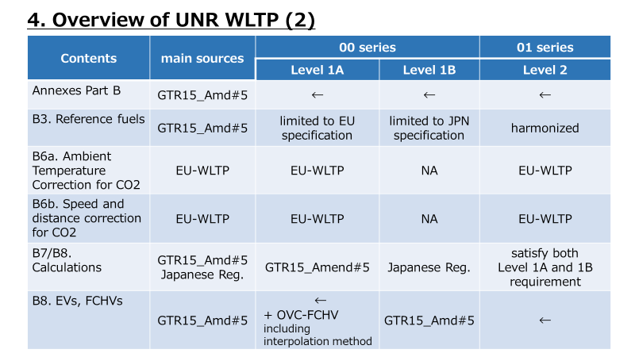

Slide 7
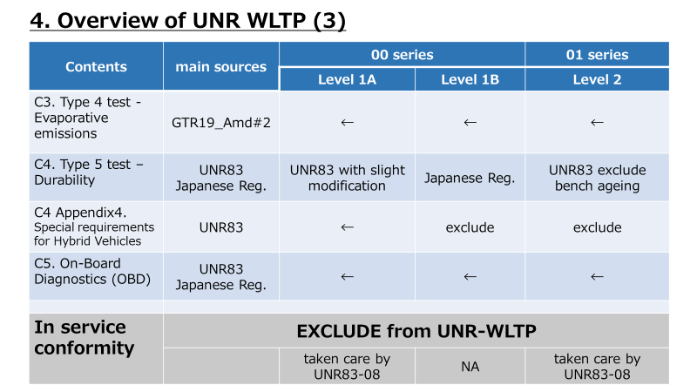

Slide 8
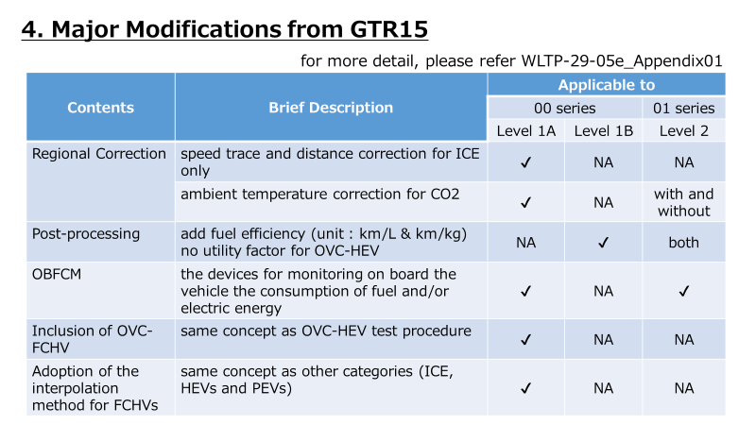

Slide 10
Modifications in Informal Documents
The Working Documents included several sections/paragraphs in square brackets – these needed to be considered for their inclusion in UNR (or not)
Key changes in the Informal Documents relate to the following topics (inter-alia):
Updates for Conformity of Production for Type 1 and Type 4 tests
Updates for Type 5 Durability test
Introduction of changes from the Gear Shift Task Force
Addition of requirements for fuel efficiency
Amendments to the Type 1 test post-processing tables
Addition of requirements for OVC-FCHVs (into Level 1A only)
Inclusion of revised OBD requirements to align with ‘WLTP world’

Slide 11
Next Steps
UNR WLTP development group to have a well deserved break from UNR!
Development of the 08 Series for UNR 83 – alongside the UNR RDE
Working Document for 81st GRPE
Align GTR15 with UNR WLTP (where appropriate) via a new GTR No. 15 Amendment 6
Working Document for 81st GRPE

Slide 12
Thank you for your attention
Questions?
Contact information
Rob Gardner, TRL Ltd on behalf of the European Commission (Task Force Leader)
rgardner@trl.co.uk

