Slide 1
Update from RDE IWG GRPE January 2020 From the sponsors: European Union Japan Korea
Informal document GRPE-80-29
80th GRPE, 14-17 January 2020
Agenda item 3(c)

Slide 2
Background
During GRPE meeting in June 2018, EU, Japan and Korea requested the creation of an RDE IWG and the proposal was accepted.
Creation of RDE IWG accepted by AC.3 in its June 2018 meeting

Slide 3
Meetings
The group met on:
11-12 September 2018 in Brussels
27-28 November 2018 in Brussels
9 January 2019 in Geneva
1-2 April 2019 in Tokyo
22 May 2019 in Geneva
9-10 July 2019 in Vienna
30-31 October 2019 in Seoul
14-15 January 2020 in Geneva

Slide 4
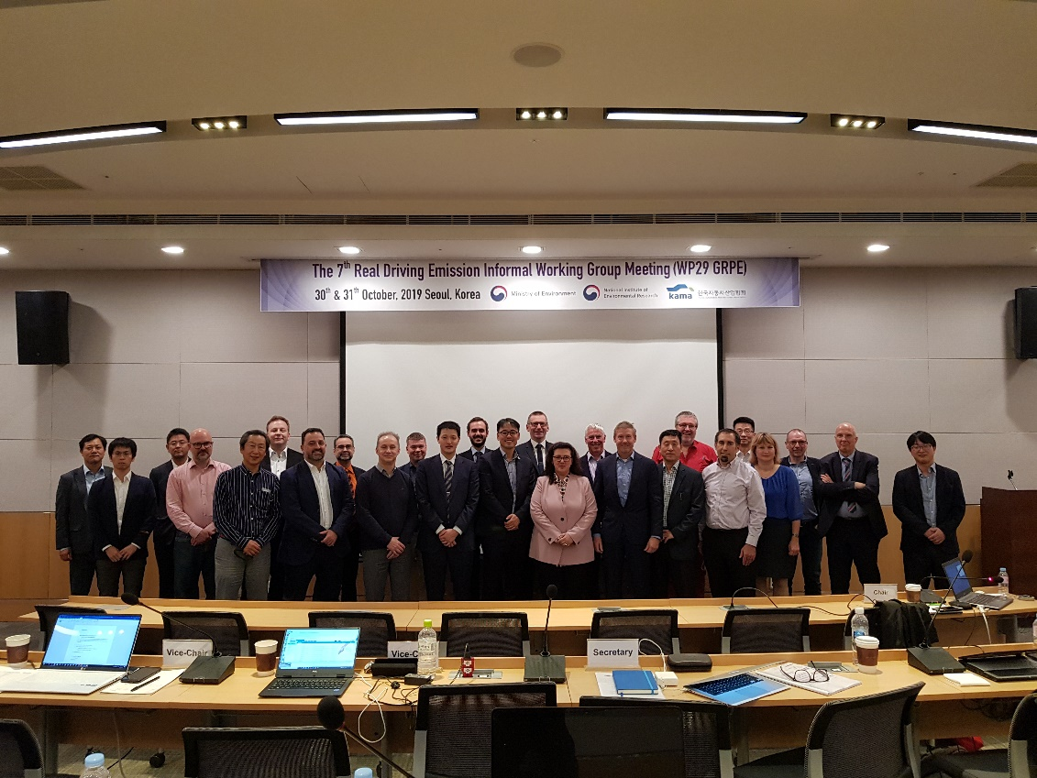
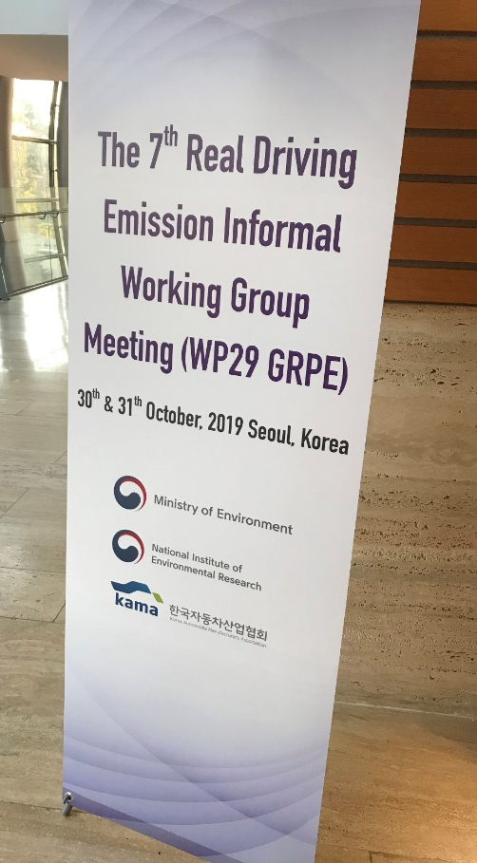
Seoul meeting

Slide 5
Status report
GTR developed keeping provisions generic and appropriate for many CPs
Decisions on boundary conditions, trip composition etc. left mostly for decision by CPs
Example:
“The composition of the RDE test shall broadly reflect the composition and characteristics of the relevant regulatory cycles against which compliance will be checked.”

Slide 6
Status report
Applications of the rules for countries applying WLTP (EU, Japan, Korea) are provided as examples
Application of the rules for India and MIDC also included as examples

Slide 7
Status report
When emission limits are respected, allow the testing to count even if the vehicle is stuck in traffic (Korean suggestion)
Other improvements will include:
Better methods for checking consistency of signals
Addition of PEMS-PM methodology
List for checking whether selected vehicle is appropriate

Slide 8
Upcoming Meetings
9th meeting in 25-27 February 2020 in Ispra, Italy to prepare working document
Ad-hoc meetings if needed
Working documents in June 2020 GRPE meeting (half day requested for IWG meeting)
And then….Phase 2
Contents still to be decided, but wish to make the methodology more wide
Request for extension in June meeting
Meetings already foreseen in USA and China

Slide 9
UN Regulation
A proposal for UN Regulation was prepared in parallel by EU and Japan
Proposal was discussed in Seoul and in Geneva meetings with all participants of the group
The proposal for the UN Regulation will be formally submitted by EU and Japan (not part of the mandate of the IWG)

Slide 10
UN Regulation details
Draft text reflects the current status quo of the existing Regulations, with some improvements made
Able to achieve a fully harmonised text
One RDE test will be checked with two methods, one complying with EU and one complying with Japanese regulations
Boundaries, methods, etc. all harmonised

Slide 11
Summary:
Work progresses well and plan to deliver as promised in June 2020
Need to ensure that text is harmonised between UNR and GTR
Some elements still missing in GTR (PM method)
We create a database on RDE measurements and tool to analyse results that is available to all
Second phase likely to modify the GTR to include other methodologies

Slide 12
Thank you for your attention! From the sponsors: European Union Japan Korea

