Slide 1
Proposal for amendments / corrigendum to UN GTR No. 4 - Summary of correction -
Submitted by the expert of OICA Informal document GRPE-80-17 80th GRPE, 14-17 January 2020
agenda item 4.(b)

Slide 2
Background and Contents of Proposal
There are many discrepancy among the amendment version of UN GTR No. 4 and UN Regulation No. 49 which seems to be mistakes in drafting.
Amendment is only for the correction of the mistake in technical descriptions.
It is expected to be confirmed by the expert in each area and determined in next GRPE.
If there are any question or suggestion, please contact following address.
Yoshihide TAKENAKA : yoshihide.takenaka@hino.co.jp
Yoshihiro TAKAHASHI : Yoshihiro_Takahashi@notes.isuzu.co.jp

Slide 3
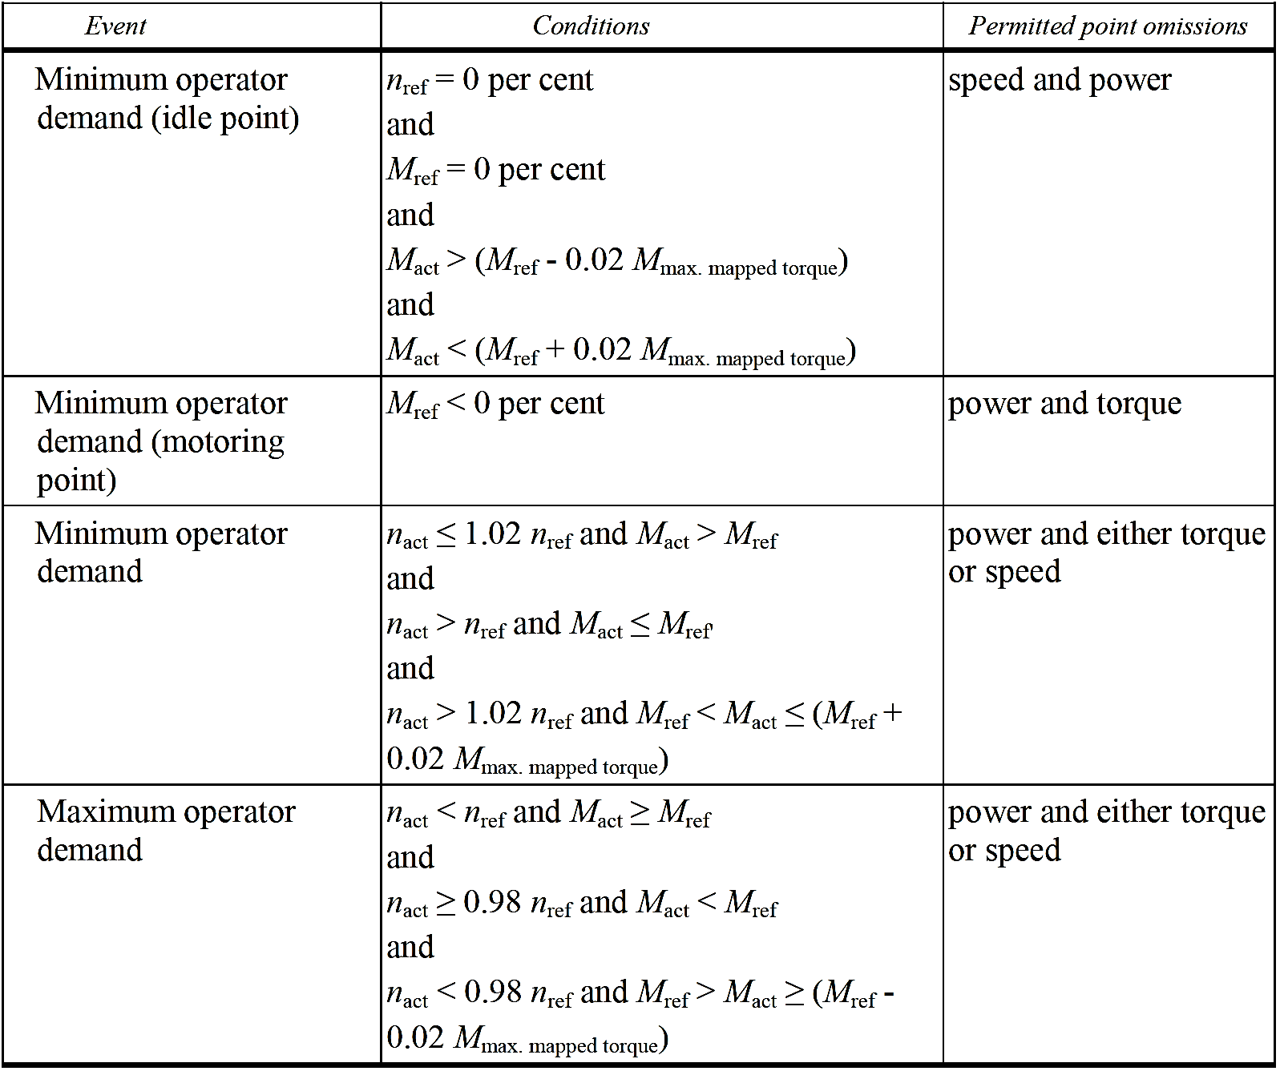
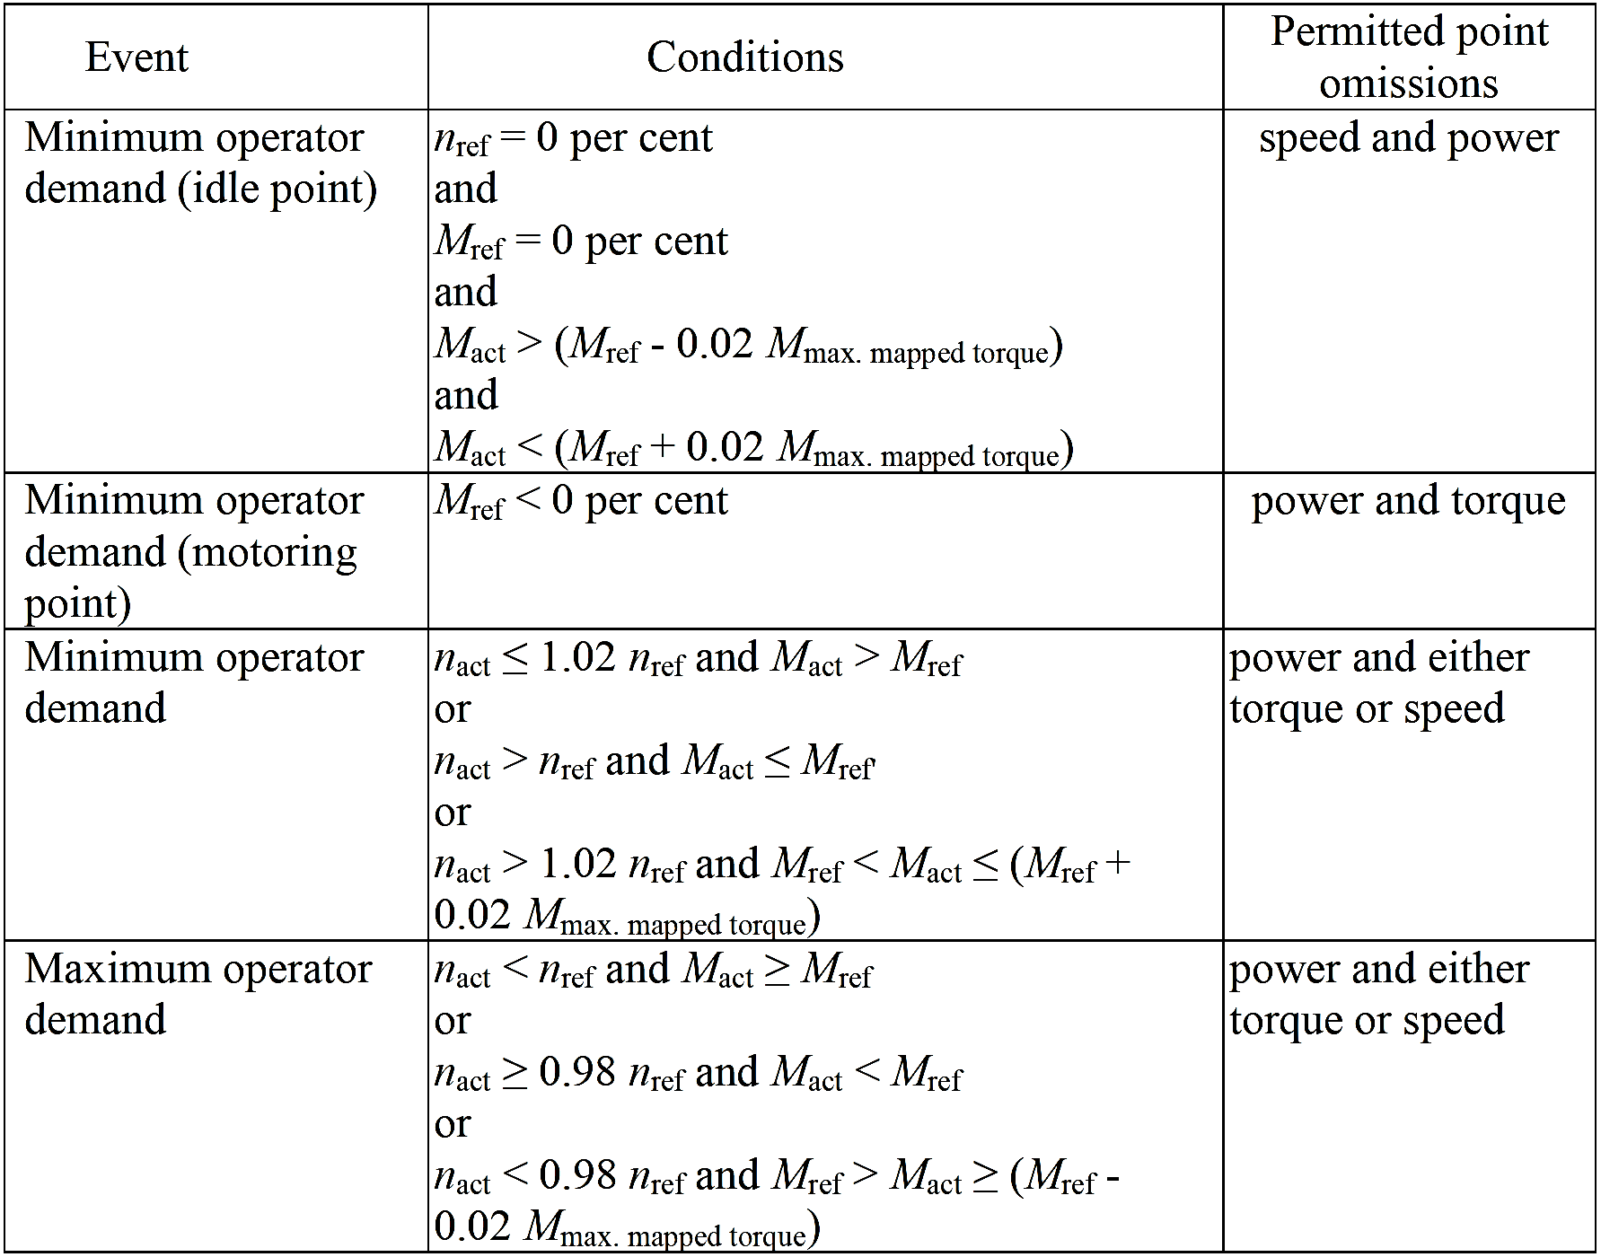
◇Paragraph 7.8.8. Validation statistics of the test cycle -Table4-
Error | Correct
◇Paragraph 8.1.1. Raw exhaust gas –Equation(15)-
Error | Correct

Slide 4
◇Paragraph 8.1.1. Raw exhaust gas –Equation(16)-
Error | Correct
◇Paragraph 8.4.2.3. Calculation of mass emission based on tabulated
values –Equation(35)-
Error | Correct
◇Paragraph 8.4.2.4. Calculation of mass emission based on exact emissions
–Equation(36)-
Error | Correct

Slide 5
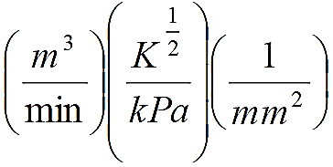
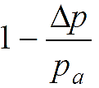
◇Paragraph 8.5.1.4. SSV-CVS system
Error | Correct
The calculation of the mass flow over the cycle shall be as follows, if the temperature of the diluted exhaust is kept within ±11 K over the cycle by using a heat exchanger: m_{ed} = 1.293 x Q_{SSV} (55) With Where: A₀ is 0.006111 in SI units of d_{V} is the diameter of the SSV throat, m C_{d} is the discharge coefficient of the SSV p_{p} is the absolute pressure at venturi inlet, kPa T is the temperature at the venturi inlet, K r_{p} is the ratio of the SSV throat to inlet absolute static pressure, r_{D} is the ratio of the SSV throat diameter, d, to the inlet pipe inner diameter D | The calculation of the mass flow over the cycle shall be as follows, if the temperature of the diluted exhaust is kept within ±11 K over the cycle by using a heat exchanger: m_{ed} = 1.293 x Q_{SSV} (55) With Where: A₀ is 0.005692 in SI units of d_{V} is the diameter of the SSV throat, mm C_{d} is the discharge coefficient of the SSV p_{p} is the absolute pressure at venturi inlet, kPa T is the temperature at the venturi inlet, K r_{p} is the ratio of the SSV throat to inlet absolute static pressure, r_{D} is the ratio of the SSV throat diameter, d, to the inlet pipe inner diameter D
60

Slide 6
◇Paragraph 8.5.2.3.1. Systems with constant mass flow –Equation(59)-
Error | Correct
◇Paragraph 8.6.1. Drift correction
Error | Correct
Depending on the measurement system and calculation method used, the uncorrected emissions results shall be calculated with equations 38, 39, 58, 59 or 64, respectively. For calculation of the corrected emissions, c_{gas} in equations 38, 39, 58, 59 or 64, respectively, shall be replaced with c_{cor} of equation 68. | Depending on the measurement system and calculation method used, the uncorrected emissions results shall be calculated with equations 38, 39, 58, 60 or 64, respectively. For calculation of the corrected emissions, c_{gas} in equations 38, 39, 58, 60 or 64, respectively, shall be replaced with c_{cor} of equation 68.
◇Paragraph 8.6.1. Drift correction
Error | Correct
If instantaneous concentration values c_{gas,i} are used in the respective equation, the corrected value shall also be applied as instantaneous value c_{cor,i}. In equation 64, the correction shall be applied to both the measured and the background concentration. | If instantaneous concentration values c_{gas,i} are used in the respective equation, the corrected value shall also be applied as instantaneous value c_{cor,i}. In equations 60,64, the correction shall be applied to both the measured and the background concentration.

Slide 7
◇Paragraph 9.5.4.1. Data analysis
Error | Correct
The gas flow rate (Q_{SSV}) at each restriction setting (minimum 16 settings) shall be calculated in standard m³/s from the flowmeter data using the manufacturer's prescribed method. The discharge coefficient shall be calculated from the calibration data for each setting as follows: Where: Q_{SSV} is the airflow rate at standard conditions (101.3 kPa, 273 K), m³/s T is the temperature at the venturi inlet, K d_{V} is the diameter of the SSV throat, m r_{p} is the ratio of the SSV throat to inlet absolute static pressure = r_{D} is the ratio of the SSV throat diameter, d_{V}, to the inlet pipe inner diameter D To determine the range of subsonic flow, C_{d} shall be plotted as a function of Reynolds number Re, at the SSV throat. The Re at the SSV throat shall be calculated with the following equation: | The gas flow rate (Q_{SSV}) at each restriction setting (minimum 16 settings) shall be calculated in standard m³/s from the flowmeter data using the manufacturer's prescribed method. The discharge coefficient shall be calculated from the calibration data for each setting as follows: Where: Q_{SSV} is the airflow rate at standard conditions (101.3 kPa, 273 K), m³/s T is the temperature at the venturi inlet, K d_{V} is the diameter of the SSV throat, mm r_{p} is the ratio of the SSV throat to inlet absolute static pressure = r_{D} is the ratio of the SSV throat diameter, d_{V}, to the inlet pipe inner diameter D To determine the range of subsonic flow, C_{d} shall be plotted as a function of Reynolds number Re, at the SSV throat. The Re at the SSV throat shall be calculated with the following equation:

Slide 8
◇Paragraph 9.5.4.1. Data analysis
Error | Correct
With Where: A₁ is 25.55152 in SI units of Q_{SSV} is the airflow rate at standard conditions (101.3 kPa, 273 K), m³/s d_{V} is the diameter of the SSV throat, m μ is the absolute or dynamic viscosity of the gas, kg/ms b is 1.458 x 10⁶ (empirical constant), kg/ms K^{0.5} S is 110.4 (empirical constant), K Because Q_{SSV} is an input to the Re equation, the calculations shall be started with an initial guess for Q_{SSV} or C_{d} of the calibration venturi, and repeated until Q_{SSV} converges. The convergence method shall be accurate to 0.1 per cent of point or better. For a minimum of sixteen points in the region of subsonic flow, the calculated values of C_{d} from the resulting calibration curve fit equation shall be within ±0.5 per cent of the measured C_{d} for each calibration point. | With Where: A₁ is 27.43831 in SI units of Q_{SSV} is the airflow rate at standard conditions (101.3 kPa, 273 K), m³/s d_{V} is the diameter of the SSV throat, mm μ is the absolute or dynamic viscosity of the gas, kg/ms b is 1.458 x 10⁶ (empirical constant), kg/ms K^{0.5} S is 110.4 (empirical constant), K Because Q_{SSV} is an input to the Re equation, the calculations shall be started with an initial guess for Q_{SSV} or C_{d} of the calibration venturi, and repeated until Q_{SS}V converges. The convergence method shall be accurate to 0.1 per cent of point or better. For a minimum of sixteen points in the region of subsonic flow, the calculated values of C_{d} from the resulting calibration curve fit equation shall be within ±0.5 per cent of the measured C_{d} for each calibration point.

Slide 9
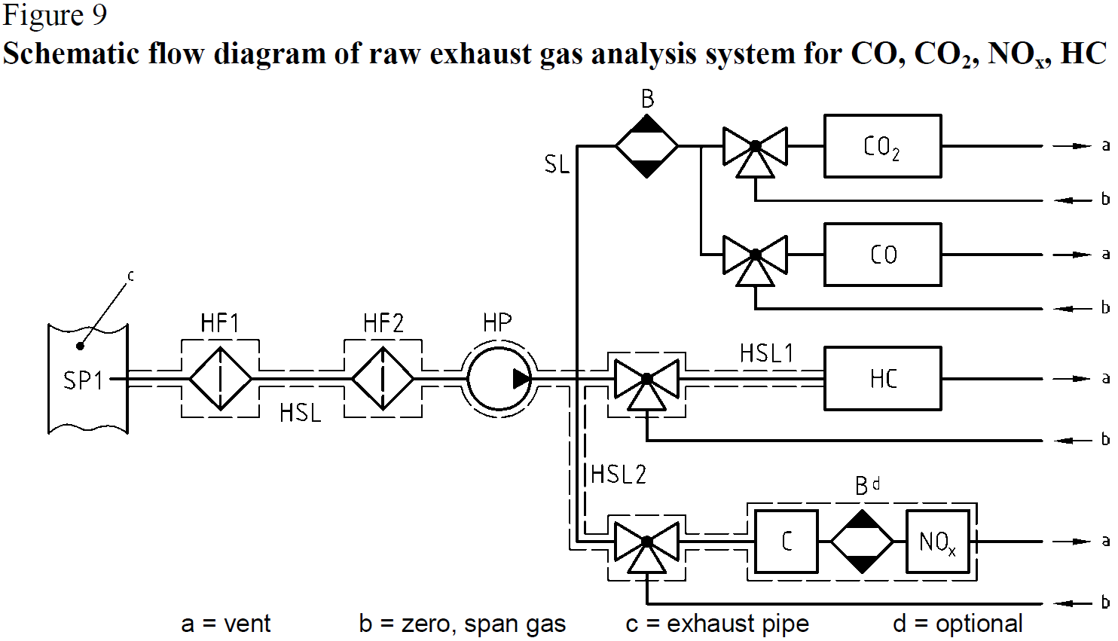
◇Annex 3 Measurement equipment
A.3.1.3. Components of Figures 9 and 10
Error | Correct
A.3.1.3. Components of Figures 9 and 10 EP Exhaust pipe SP Raw exhaust gas sampling probe (Figure 9 only) | A.3.1.3. Components of Figures 9 and 10 EP Exhaust pipe SP1 Raw exhaust gas sampling probe (Figure 9 only)

Slide 10
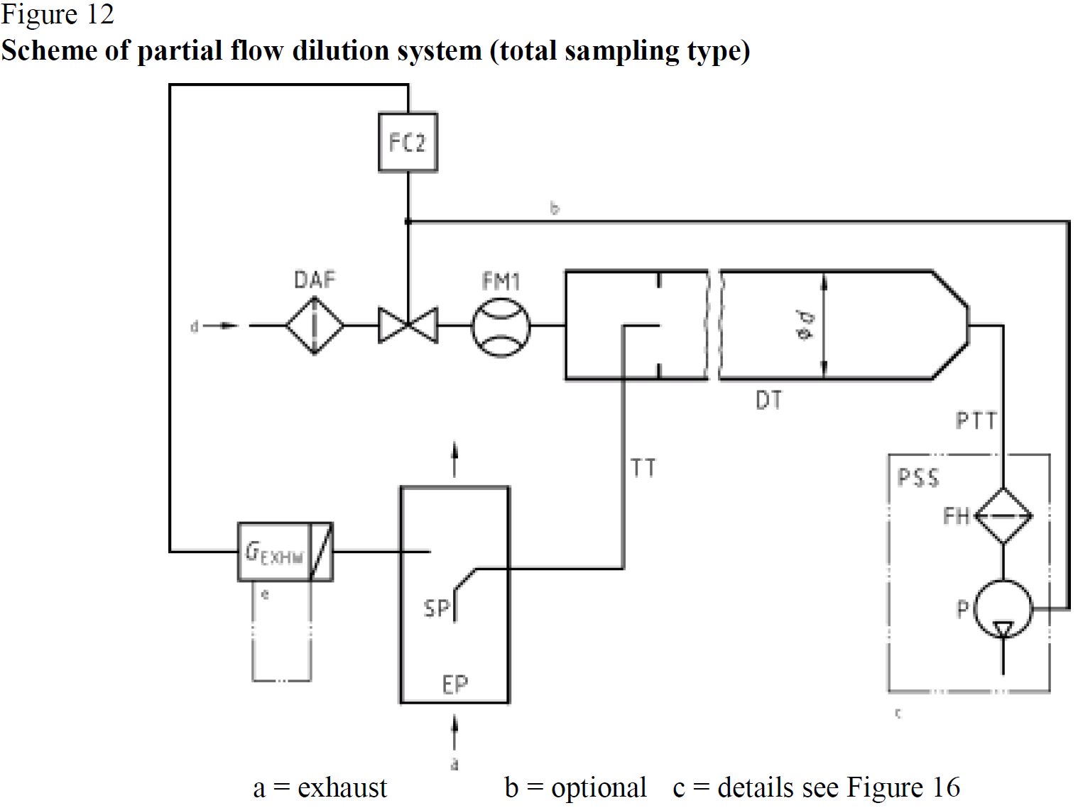
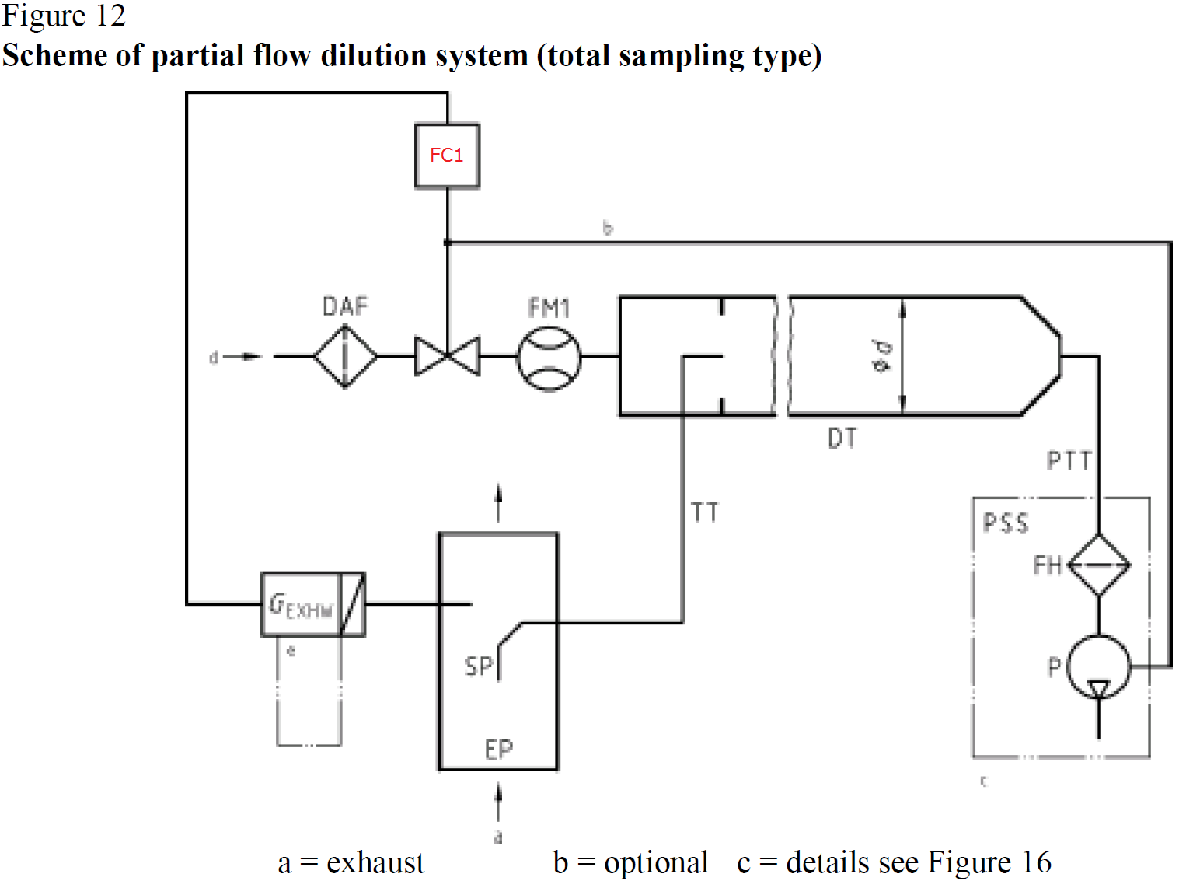
◇Annex 3 Measurement equipment
A.3.2.1. Description of partial flow system -Figure 12-
Error | Correct

Slide 11
◇Annex 3 Measurement equipment
A.3.2.5. Description of particulate sampling system
Error | Correct
The sample is passed through the filter holder(s) FH that contain the particulate sampling filters. The sample flow rate is controlled by the flow controller FC3. For of full flow dilution system, a double dilution particulate sampling system shall be used, as shown in figure 17. A sample of the diluted exhaust gas is transferred from the dilution tunnel DT through the particulate sampling probe PSP and the particulate transfer tube PTT to the secondary dilution tunnel SDT, where it is diluted once more. The sample is then passed through the filter holder(s) FH that contain the particulate sampling filters. The dilution airflow rate is usually constant whereas the sample flow rate is controlled by the flow controller FC3. If electronic flow compensation EFC (see figure 15) is used, the total diluted exhaust gas flow is used as command signal for FC3. | The sample is passed through the filter holder(s) FH that contain the particulate sampling filters. The sample flow rate is controlled by the flow controller FC2. For of full flow dilution system, a double dilution particulate sampling system shall be used, as shown in figure 17. A sample of the diluted exhaust gas is transferred from the dilution tunnel DT through the particulate sampling probe PSP and the particulate transfer tube PTT to the secondary dilution tunnel SDT, where it is diluted once more. The sample is then passed through the filter holder(s) FH that contain the particulate sampling filters. The dilution airflow rate is usually constant whereas the sample flow rate is controlled by the flow controller FC2. If electronic flow compensation EFC (see figure 15) is used, the total diluted exhaust gas flow is used as command signal for FC2.

Slide 12
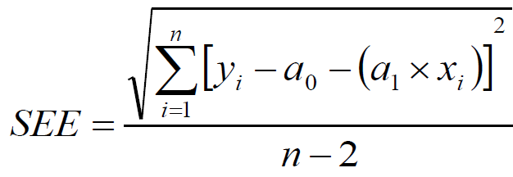
◇Annex 4 Statistics
A.4.2. Regression analysis -Equation (100)-
Error | Correct

