Slide 1
Alternative Approach to UN R13 Type-IIA for Battery Electric Vehicles
Submitted by the experts from OICA
Informal document GRVA-04-30
4th GRVA, 24-27 September 2019
Agenda item 8 (c)
OICA
GRVA-04 - September 2019
v1

Slide 2
Background
At the 2nd session of GRVA in January 2019, OICA and CLEPA presented document GRVA-01-27, and collected some first comments from GRVA experts.
The technical issue is that a Battery Electric Vehicle (BEV) is not able to pass the type IIA test with a fully loaded battery (the worst case for the test), unless the vehicle would be equipped with specific technical solutions like e.g. resistors with high-temp cooling system, extra batteries.
Such solutions would highly impact the vehicle weight and autonomy, packaging (vehicle architecture) and cost, reducing the environmental and economic interest of BEVs.

Slide 3
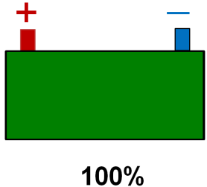
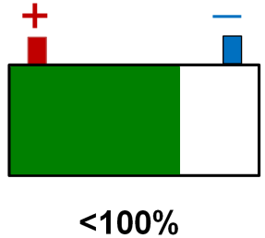
Reminder from GRVA-01-27
No change for vehicles not equipped with an ERB system
BEV & Hybrid vehicles *
* M3 class II, III & B + N3 ADR and/or authorized to tow cat. O4, equipped with an ERB system of cat A or B
Current way
Alternative approach
Type-IIA
Type-II
+
Type-IIA
+
Brake estimator
Warn the driver if performance is below Type-II hot-stop requirements:
N3 = 3.3 m/s²
M3 = 3.75m/s²
30 +/-5km/h
hot-stop requirements:
N3 = 3.3 m/s²
M3 = 3.75m/s²
30 +/-5km/h

Slide 4
Rationales
The main challenge is to ensure the availability of sufficient free capacity in the batteries, to be able to pass the type IIA without using the brakes.
This can of course be done by always keeping a free capacity equivalent to the energy of a type-IIA, which would only be used manually by the driver (e.g. using a dedicated control). The major issue with that simplistic approach is that this permanently free capacity cannot be used for traction.
The interest of the proposed alternative approach is to permit some smart strategies (e.g. based on route planning) to optimize the use of the installed battery capacity for the purpose of traction, while ensuring the driver is well informed of the available endurance braking capacity and/or being warned if the service brake performance falls below a given threshold.

Slide 5
Next steps
Collect comments from CPs → Oct 31, 2019
Address them with relevant proposals and justifications.
Present a draft text proposal at GRVA-05 of February 2020.

Slide 6
Backup slides

Slide 7
Technical background UN R13 - Type-II and IIA tests
Type-II
Downhill Behaviour Test
Type-IIA
Endurance Braking Performance Test
30km/h
30km/h
6%
6 km
7%
6 km
Scope
M3 and N3
Except vehicles submitted to Type-IIA
Service brake: no restriction
Pass criteria: Hot-stop performance after Type-II
N3: 3.3 m/s²
M3: 3.75m/s²
Scope
M3 class II, III & B
N3 ADR and/or authorized to tow cat. O4
Service brake: prohibited
Pass criteria: Average speed of 30km/h (+/- 5 km/h)

Slide 8
Technical background UN R13 – Definition of SoC *
* State of charge
2.21.4. “Electrical state of charge” means the instantaneous ratio of electric quantity of energy stored in the traction battery relative to the maximum quantity of electric energy which could be stored in this battery;
_
_
_
+
+
+
SoC
0%
50%
100%

Slide 9
Technical background Description of the issue
BEV
30km/h
General:
UN R13 Type-IIA test is not adapted to Battery Electric vehicles (BEV) technology.
Technical issue:
Technical Services requires Type-IIA to be conducted with a fully charged traction battery (i.e. the worst case).
In these conditions:
The kinetic energy of the vehicle cannot be converted and stored in the traction battery,
No endurance braking is available.
Type-IIA cannot be passed without complex technical solutions highly impacting weight, packaging and cost, e.g. resistors and high-temp cooling system, extra batteries. ➔ Such solutions kill the economical interest of BEV technology.
6 km
7%
Type-IIA not feasible
An alternative approach is needed for BEVs

