Slide 1
The Safety of the Intended Functionality
Report on ISO/TC22/SC32/WG8 activities
Geneva, 31/01/2019
Nicolas Becker, ISO21448 project leader
Transmitted by the expert from ISO
Informal document GRVA-02-32
2nd GRVA, 28 January – 1 Februar 2019
Agenda item 5(a)

Slide 2
Content
Safety aspects of automated driving
Motivation – What is the Safety of the Intended Functionality (SOTIF)?
ISO/PAS 21448 status and activities
Connection with Automated Driving (AD) regulatory activities
Summary

Slide 3
Safety aspects for an automated driving system
The automated driving system is safe
Other safety requirements (incl Cybersecurity, passive safety, etc)
scScope of ISO/TC22/SC32/WG8
Its failures are adequately avoided or mitigated
Its behaviour is adequate for the intended operation domain
ISO26262 : Functional Safety
Hazard Analysis and Risk Assessment
Design, Verification and Validation (V&V) requirements
Safety management
ISO/PAS 21448 : Safety of the Intended Functionality
Scenario identification incl. Reasonably foreseeable misuses
Functional improvements
V&V strategy
Notes:
The ISO/TC22/SC32/WG8 deals with functional safety, ISO/PAS21448 complements the ISO26262 by addressing non-fault conditions. Other safety requirements are important but addressed in other working groups.

Slide 4
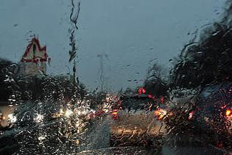

SOTIF Example
Automatic emergency braking feature :
camera
unintended braking could be caused by limitations in perception
system
weather (rain/sun/fog)
misinterpretation of image
…
triggering events
Notes:
This is an example of a SOTIF-relevant functionality : a camera-based automatic emergency braking system, whose intention is to brake the vehicle in the case of an imminent crash. An unwanted braking can be a safety-relevant condition, as it can lead to a crash from a close tailing vehicle. This unwanted braking can be caused by an incorrect detection of the scene by the camera, called ‘triggering event’ in ISO PAS 21448.

Slide 5
Key Aspects of 21448 - SOTIF
ISO/PAS 21448 publication 01/2019
  Focuses on driver assistance features with SAE automation levels 1 and 2
  Covers potentially hazardous behavior under non-fault conditions
    Caused by technological or system limitations
    Includes evaluation of reasonably foreseeable misuse
  Provides guidance for design, verification and validation measures
  Issued as publicly available specification (PAS) (and not as an ISO standard) to enable fast publication
  Includes high-level requirements on the objectives to achieve in the SOTIF analyses, and informative guidance on how to achieve them
The work on ISO 21448 started in 11/2018
  Extension to higher levels of automation (up to Level 5)
  Significant interest in this work
    18 countries
    80 experts in Plenary featuring worldwide OEMs, Tier 1 and Tier 2 suppliers, and governmental institutes
  Publication targeted for 2022

Slide 6
Categorization of real-life driving scenarios
 | Known | Unknown
Safe | Area 1 Nominal behavior | Area 4 System robustness
Potentially hazardous | Area 2 Identified system limitations | Area 3 “Black swans”
Notes:
ISO/PAS 21448 is based on a possible classification of every real-life driving scenario under two aspects : has it been identified by the development organization (known/unknown), and has it the ability to lead to harm (safe/potentially hazardous). This lead to four potential categories, with dedicated SOTIF activities. The following slides provide examples for these categories.

Slide 7
Categorization of real-life driving scenarios
 | Known | Unknown
Safe | Area 1 Nominal behavior | Area 4 System robustness
Potentially hazardous | Area 2 Identified system limitations | Area 3 “Black swans”

Slide 8

Categorization of real-life driving scenarios
 | Known | Unknown
Safe | Area 1 Nominal behavior | Area 4 System robustness
Potentially hazardous | Area 2 | Area 3

Slide 9
Categorization of real-life driving scenarios
 | Known | Unknown
Safe | Area 1 Nominal behavior | Area 4 System robustness
Potentially hazardous | Area 2 Identified system limitations | Area 3 “Black swans”

Slide 10

Categorization of real-life driving scenarios
 | Known | Unknown
Safe | Area 1 Nominal behavior | Area 4 System robustness
Potentially hazardous | Area 2 | Area 3
Notes:
This illustrates a scenario that might not have been identified during development. Depending on the vehicle reaction, this could lead to an unsafe outcome and therefore be an Area 3 scenario.

Slide 11
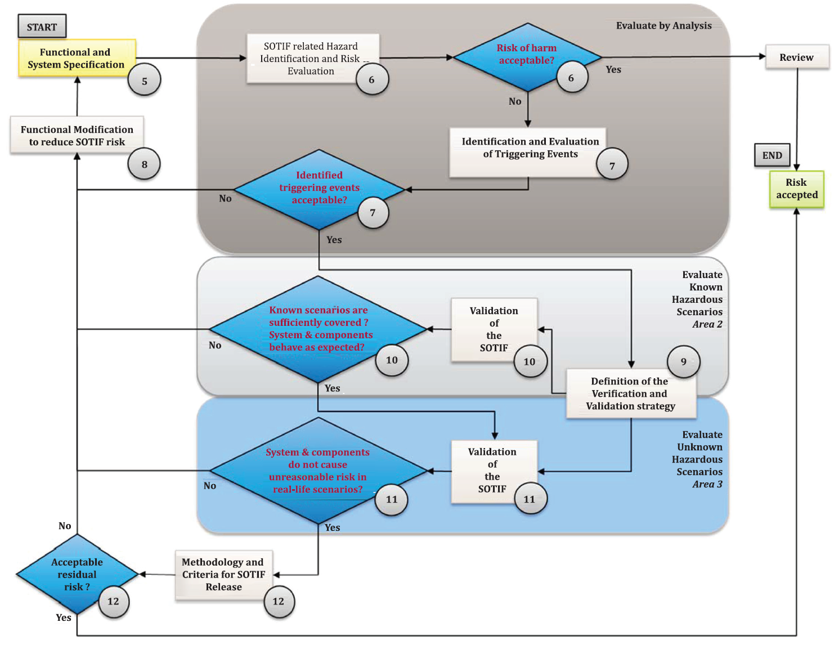
Flowchart of SOTIF Activities (ISO/PAS 21448, Fig. 9)
Notes:
The numbers in circle denote the ISO/PAS 21448 section related to this activity.

Slide 12
Verification and Validation activities
 | Known | Unknown
Safe | Area 1 Normal validation | Area 4 Not applicable
Potentially hazardous | Area 2 V&V of the adequate behaviour of the system, incl. of the functional improvements | Area 3 Qualitative and Quantitative evaluation of the residual scenarios

Slide 13
Residual scenarios evaluation – Quantitative approach for AREA 3
The ISO/PAS 21448 indicates that :
  A quantitative target is defined for the demonstration that the unknown/unsafe scenarios are sufficiently implausible, e.g. a maximum probability of incorrect behavior per hour.
    The PAS however does not specify normative quantitative target values
  This quantitative target considers applicable regulations, standards and relevant traffic statistics.
  The validation strategy shall provide demonstration that this target is met
This quantitative approach is NOT a criteria that would allow to ignore a plausible potentially hazardous scenario : those must be addressed anyhow
It is ONLY a criteria to claim sufficient validation coverage at the time of the beginning of customer activation of the functionality
For a SAE level 1 or 2 functionality in the scope of the PAS, this leads to a validation strategy that is in the order of what a captured fleet can achieve
For a SAE level 3+ functionality in the scope of the future ISO21448, the target derived through this approach are much more stringent., The validation will therefore require techniques in addition to the road tests, for instance a higher contribution of simulations. This is a primary topic for the future ISO21448.
The procedure for the demonstration on how these targets are met is still a topic of discussion.

Slide 14
How can ISO21448 support AV regulation?
ISO 21448 will provide a consensus from the ISO experts on the framework to design and demonstrate the Safety of the Intended Functionality
A first draft will be available for voting and commenting in 2020
It will describe an integrated, scenario-based approach, for the demonstration of the safety of the intended functionality, contributing to the safety evaluation of automated driving systems
The approach to ensure the safety of the intended functionality combines several activities :
  Design–level analyses of the system, its performances and its operating environment
  Qualitative and quantitative evaluations
  V&V techniques based on simulation, tests in specified scenarios, and captured fleet in real driving to maximize coverage
  Quantitative justification of sufficient validation, derived from comparable human-driven behaviour
  It augments the ISO26262 guidance with non-fault conditions considerations.

Slide 15
Open discussion points
Requirements that should be confirmed in an AD regulation
  Overall framework for SOTIF demonstration
  Acceptance condition for the identified residual risks :Under which conditions of implausibility is a potentially potentially hazardous behavior acceptable? => Societal issue
  Acceptance condition for the end-of-validation milestone : is the proposed argument for sufficient validation acceptable?
Demonstration of compliance to future AD regulation
  The intention of 21448 is to provide a demonstration framework to support the safety evaluation of an automated driving functionality
What future connections between ISO and UN/ECE on the SOTIF?
  How to ensure a continued exchange of knowledge and information between the GRVA and the ISO committee?

