Slide 1
Direct driving field of vision: Toward a Field of View Assistant (FOVA) UN Regulation No.125
Informal document GRSG-117-27
117th GRSG, 8–11 October 2019
Agenda item 22
GRSG-117
8-11 October 2019

Slide 2
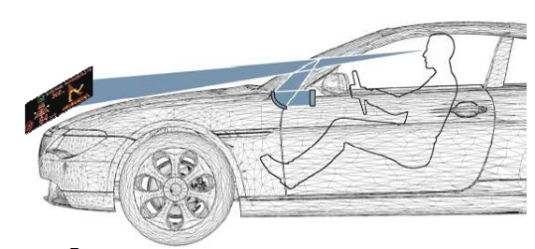
Direct driving field of vision, Regulation n°125
Aim of the presentation:
Sharing information on Field of View Assistance (FoVA),
Clarifying regulatory compliance of ‘augmented reality’ augmenting driver’s direct view.
Background:
Around the 2000’s, introduction of Head Up Displays (HUD) led to clarify ‘obstruction’ This clarification enabled innovative HMI solutions for safety benefit:
2002: in Europe, TAAM refers to EU Statement of Principle.
2010: EiF of UN R125.00 Suppl. 03 introducing 20% allowed obstruction of S zone (between -1° and -4°)
10 years later, thanks to consumer interest, OEMs propose additional information assistance.
➔ 2020’: FOVA for augmented information to the driver seeks agreement on regulatory compliance.
See annexes
Notes:
See annexes for details on accommodation time, accidentology analysis, and statistics.

Slide 3
Field of View Assistant (FoVA)
Question: Can a field-of-view assistant further improve road safety?
Answer: BASt study on FoVA (Report No. 127, published in April 2019*) gives a clear answer
“Coherent with expectations, the results show that both age groups (remark: young and elderly driver) responded faster to cars in the periphery in trials with a centrally located warning….
Thereby, a field-of-view assistance renders to be a promising approach from the perspective of perception psychology, and has proven feasible in the simulator while producing good results: In both experiments, positive effects of the centrally positioned warning presented when cars appeared peripherally, were found for both participant groups.”
Limitation from OEM’s experience: FoVA (including augmented reality) is considered as ‘obstruction’ by some Contracting Parties, i.e. not complying to UN R125.
* Bericht zum Forschungsprojekt FE 82.0615/2014:
Erhöhung der Verkehrssicherheit älterer Kraftfahrer durch Verbesserung
ihrer visuellen Aufmerksamkeit mittels „Sehfeldassistent“

Slide 4
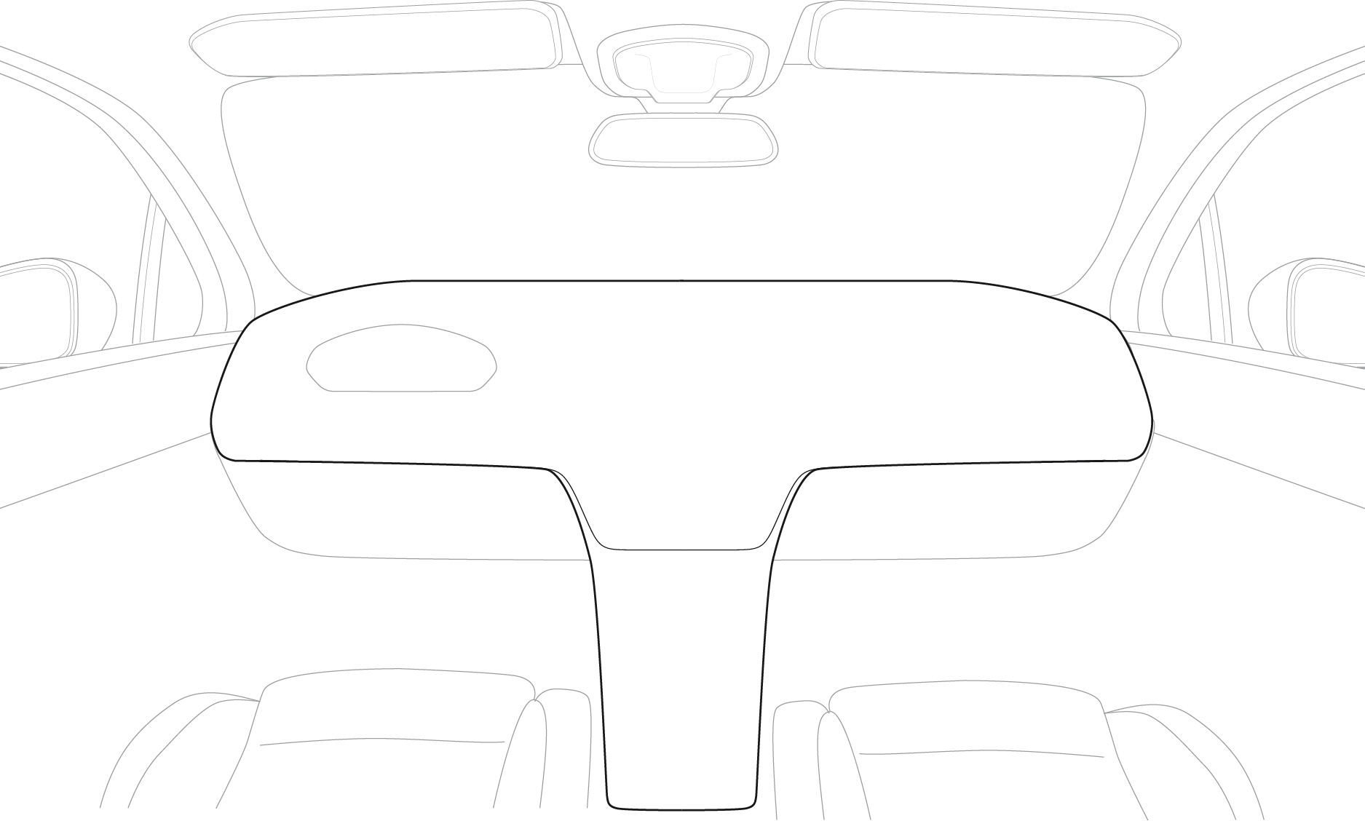
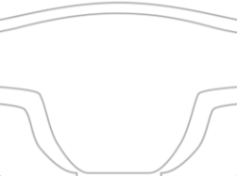
Field of View Assistant (FoVA)
Real view + Augmented reality
Real view
Advanced Driver Assist Systems
providing multiple information to the driver, either:
Haptic
Audible
Visual
Rear view devices
Center Console
Head
Up Display
Cluster
Visual Information
Notes:
While driving, first is the far sighted FoV, behind [dashboard-steering wheel and low/high engine commands],
Completed with rear view devices and basic driving informations,
FVA brings forward with Augmented real Vision.

Slide 5
Field of View Assistant (FoVA)
OICA position on Augmented Field of Vision
FOVA is beneficial to safety and regulatory compliant if:
Light Transmission complies to harmonized regulation UN R43: LT > 70%
Direct view obstructions comply to Regulation UN R125, with additional overlay relevance in case it appears above -1° (plane set from eyes positions):
See examples 1 and 2
a. FOVA must highlight real view and never mask it,
b. FOVA must not be permanent,
c. Light intensity/contrast must be tunable to driver’s convenience,
d. Display reliability/relevance must satisfy best standards (no excessive information, no missing information).
See examples 3 and 4

Slide 6
Direct driving field of vision, Regulation No.125
Elements of discussion:
Field of View Assistant, including augmented reality, is a means for safety benefit
Augmented Field of Vision (AFV) is not defined in UN R125 but is expected to provide the same beneficiary step as Head Up Displays did.
Augmented Field of Vision (AFV) must comply with relevant design requirements:
Should support the addition of relevant driving information (increase driver’s awareness ; avoid driver distraction)
May merge relevant information in the mandatory Field of Vision.
Uncertainty as to whether Type Approval Authorities can support agreement on regulatory compliance.
Expected GRSG guidance:
Is Field of View Assistant (FoVA) of safety benefit?
Can GRSG reach a consensus position on Augmented Field of Vision (AFV) ?

Slide 7
Examples,

Slide 8
Field of View Assistant (FOVA)
Example 1
Source: PSA - 2015
Notes:
Videos on Augmented Field of Vision:
PSA https://www.youtube.com/watch?v=0OdZXf1E7Z8
Continental https://www.youtube.com/watch?v=3uuQSSnO7IE

Slide 9
Field of View Assistant (FOVA)
Example 2
Source: PSA - 2015

Slide 10
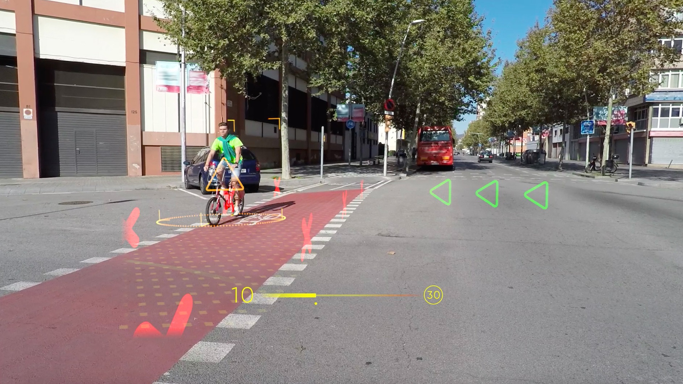
Field of View Assistant (FOVA)
Example 3
Overlaying
driver relevant information in the field of vision
Avoid driver distraction: no room for non ‘driving relevant information’ e.g. entertainment, advertisement
1st aim is safety: increase driver awareness
Overlaying lines and characters
Speed on HUD
Driver navigation and warning:
Highlighting vulnerable road users (here cyclist)
Blocking the road (here with red X)
Source: WayRay - 2019

Slide 11
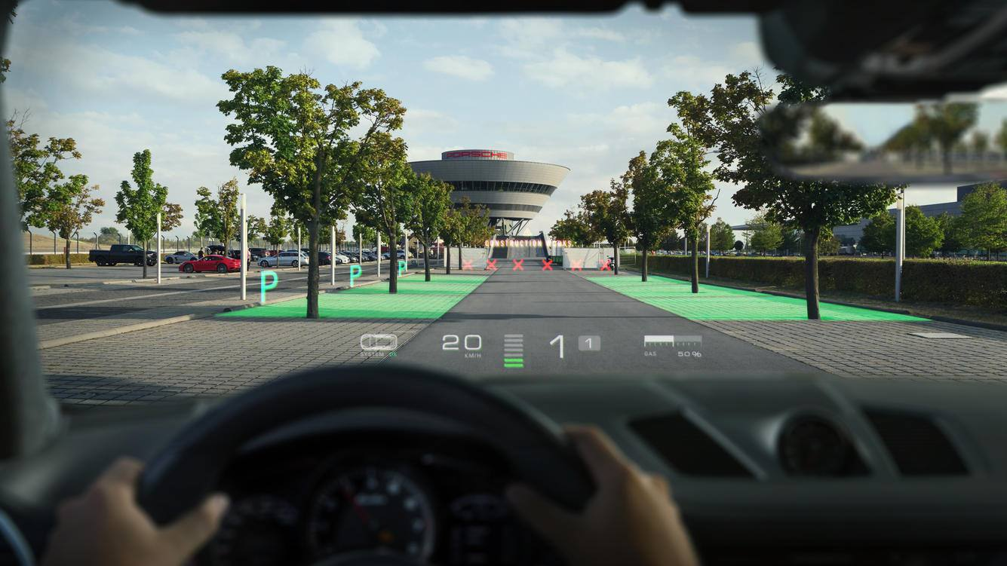
Field of View Assistant (FOVA)
Example 4
Overlaying
driver relevant information in the field of vision
Hotel location and itinerary, Free park places..: must remain driving relevant information
Next’s:
Information,
Entertainement (AD)
Overlaying road surface coloured-3D
Navigation: coloring the road surface without covering objects (here trees)
Source: WayRay - 2019

Slide 12
Thank you for your attention

Slide 13
Annexes,

Slide 14
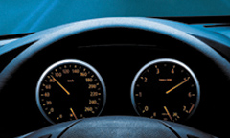
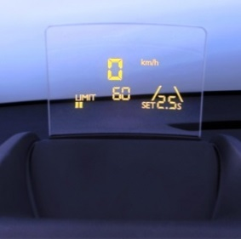
Situation 2010:
Head Up Displays (HUD) to shorten accommodation’s time
After discussions in the early 2000’ on direct field of vision obstruction risk, in case of information presented above cluster, European Type Approval Authorities (TAA) agreed on the safety benefit of best practices to present information in front of the driver, limiting head move and accommodation time, and refered to recommendations (Statement of Principle, SoP) for conformity criteria.
December 2010, UN WP29 adopted supplement 3 to the original series of regulation n°125, introducing 20% allowed obstruction in the S zone defined in the field of vision between -1° and -4°, hence allowing cluster to raise above steering wheel.
Sources: TAAM - 2002 ; UN ECE WP29 - 2010
Sources: TAAM - 2002 ; UN ECE WP29 - 2010 ; PSA - 2015
Notes:
HUD improving time to information while limiting head move and accommodation time ; evaluation on test panel, middle aged drivers.

Slide 15
Situation today:
Accidentology: UN Global status report on road safety 2018
WHO’s report highlights .. the disproportionately burden borne by pedestrians, cyclists and motorcyclists.. (price is too high.. proven measures exist). Drastic action is needed.. with main findings:
Car occupants continue to benefit most from road safety improvements,
Safer vehicles to the fleets, equipped with technologies that prevent crashes (such as Electronic Stability Control) or mitigate their consequences (e.g. airbags) contribute to this improvement.
The number of vulnerable road users killed increased in many countries,
Pedestrians, riders of powered two-wheelers and cyclists represent now more than half of the total number of road deaths. Each respective share of all traffic fatalities rose since 2000.
The rise of distracted driving, while using smartdevices.
Empirical evidence is patchy in the absence of standardised data to monitor the impact of distraction on driving. .. available information supports the view.. that distracted driving is developing into a major road safety risk ..
Recommendations foster seatbelt and helmet use, but highlight main issues on Alcohol (aim for a systematic alcohol testing ; improve harmonized statistics) and Speed: set limits based on the Safe System principles (the forces a human body can tolerate and still survive)…
Notes:
Road safety strategies, for all countries, benefit from analysis & recommendations on best driving practices: https://www.who.int/violence_injury_prevention/road_safety_status/2018/en
Traffic fatalities in 2016 were down 3.6% compared to 2010, but raised in the last years, long-term trend is « positive but very far from sufficient ».

Slide 16
Situation today:
The most common mistakes made by drivers leading to an accident with injuries
 | Number of accidents | Percentage
Mistakes during turning, returning, ingressing roads.. | 56.642 | 15,7 %
Disregarding priority | 52.332 | 14,5 %
Non sufficiant distance | 50.267 | 13,9 %
Too high vehicle speed | 45.058 | 12,5 %
Wrong road usage | 24.203 | 6,7 %
Other reasons | 132.234 | 36,7 %
Total | 360.736 | 100 %
Increased Driver Awareness could further reduce the number of accidents
Source: German Federal Office for Statistic - 2017

