Slide 1
Transmitted by IWG SLR
Informal document GRE-82-39
(82nd GRE, 22-25 October 2019,
agenda item 4)
Simplification of the UN Lighting and Light-signalling Regulations
Progress report on the
Stage 2 / Step 1

Slide 2
Workload and meeting pace
33 meetings held until now:
11 September 2014 in Brussels (BE)
23 October 2014 in Geneva (CH)
14 January 2015 in Brussels (BE)
13 April 2015 in Geneva (CH)
13 October 2015 in Brussels (BE)
5-6 November 2015 in Brussels (BE)
15-16 December 2015 in Brussels (BE)
13-14 January 2016 in Brussels (BE)
29 February & 1 March 2016 in Brussels (BE)
14-15 April 2016 in Brussels (BE)
9-10 June 2016 in Brussels (BE)
5-7 September 2016 in Brussels (BE)
5-7 October 2016 in Brussels (BE)
5-7 December 2016 in Brussels (BE)
21-23 February 2017 in Brussels (BE)
22-24 March 2017 in Brussels (BE)
16-18 May 2017 in Tokyo (JP)
13-15 June 2017 in Brussels (BE)
12-14 July 2017 in Brussels (BE)
4-6 October 2017 in Brussels (BE)
18-21 December 2017 in Brussels (BE)
29 Jan / 1 Feb 2018 in Shenzhen (CN)
4-6 April 2018 in Brussels (BE)
30 May / 1 June 2018 in Brussels (BE)
3-5 July 2018 in Brussels (BE)
24-26 September 2018 in Brussels (BE)
10-12 December 2018 in Brussels (BE)
25-27 February 2019 in Brussels (BE)
27-29 March 2019 in Brussels (BE)
22-24 May 2019 in Brussels (BE)
3-5 July 2019 in Brussels (BE)
3-5 September 2019 in Tokyo (JP)
9-11 October 2019 in Brussels (BE)
Next meetings:
SLR-34 on 4-6 November 2019 in Brussels (BE)
SLR-35 on 11-13 December 2019 in Brussels (BE)
SLR-36 on 8-10 January 2020 in Brussels (BE)
SLR-37 on 2-4 March 2020 in Brussels (BE)

Slide 3
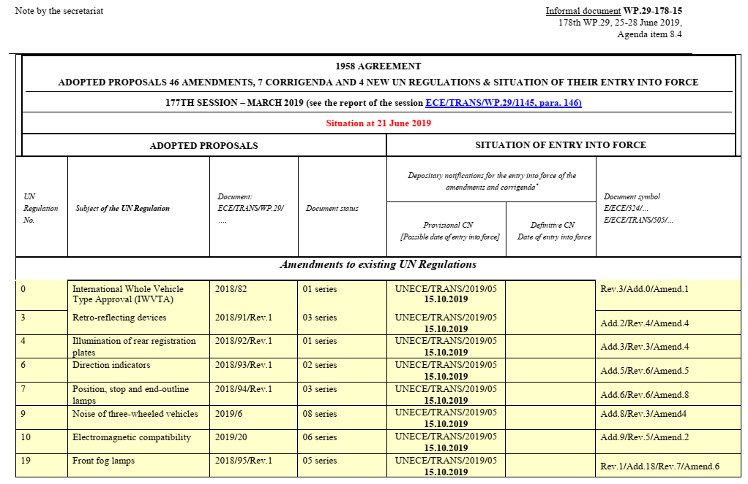
Entry into Force of Stage 1
Amendments to existing UN Regulations:
15 October 2019
New UN Regulations:
15 November 2019

Slide 4
Work plan and time schedule for “Stage 2”
STAGE 2 = SIMPLIFIED REGULATIONS with technology neutral and performance based requirements
ECE/TRANS/WP.29/GRE/80 Annex II

Slide 5
UN Regulation No. 148
LIGHT SIGNALLING
DEVICES (LSD)

Slide 6
Stage II – Regulation No. 148
WP.29/2018/157
Stage I “Editorial” simplification
Stage II “Real” simplification
Reg. 4
License plate illuminating devices
Reg. 6
Direction indicator
Reg. 7
Position, Stop, End-outline marker
Reg. 23
Reversing
Merge to one single Regulation
R-148
technology
independent
performance based
objective test-methods
Reg. 38
Rear fog
Reg. 50
Position, stop, direction indicator
(Vehicles Class L)
Reg. 77
Parking
Reg. 87
Daytime running
Reg. 91
Side marker

Slide 7
Stage II – Regulation No. 148
Main progress made
TOPIC
MAIN IMPROVEMENTS
PARAGRAPHS MAINLY AFFECTED
Rearrangement of requirements
Harmonised requirements’ structure for different functions
Empty requirements are marked as empty
Par. 5.
Error correction
Avoid errors
Light source module marking
Table 1, Table A2-1
Par. 3.3.5.4.
Alignment
Max intensities direction indicator
Table 8
CoP
Restructuring and streamlining of the requirements
Par. 3.5., New Par. 6.
Light Sources
Technology neutral
Reduced need for amendments
Suitable for future technology
Par. 3 + Annex (new)
This topic will be addressed by SLR depending on the GRE-82 decision concerning the approach proposed for R-149

Slide 8
Stage II – Regulation No. 148
Main progress made
TOPIC
Proposals within SLR
GRE-82-30
LATEST DRAFT CONSOLIDATION
Rearrangement of requirements
SLR-32-02/Rev.1
Error corrections
SLR-32-01/Rev.1
Max. intensities of DI
SLR-33-02
CoP
SLR-32-21/Rev.1
TOPIC
Proposals originated by SLR and now on GRE or WP.29 agenda
Error corrections
Substitute light sources
Low intensity DRL
WP29/2019/81 + GRE-82-05
SLR-33-04/Rev.1
Error corrections
GRE/2019/25
Sequential activation of DI for motorcycles and agricultural vehicles
GRE-82-27
Light source module marking
GRE-82-28

Slide 9
UN Regulation No. 149
ROAD ILLUMINATION
DEVICES (RID)

Slide 10
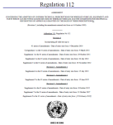
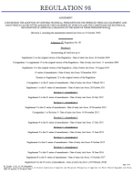
Stage II – Regulation No. 149
WP.29/2018/158/Rev.1
YESTERDAY
TODAY (RID “Stage 1”)
TOMORROW (RID “Stage 2”)
R112 Class A
Class B
Class AR
Class BR
R98 Class DC
Class DR
R123 Class C
Class E
Class V
Class W
Class XR
ADB
R113 Class AS
Class BS
Class CS
Class DS
Class ES
Class R-BS
Class R-CS
Class R- DS
Class R- ES
R19 Class B- F3
R119 Class K
Class A
Class B
Class AR
Class BR
Class DC
Class DR
Class C
Class E
Class V
Class W
Class XR
ADB
Class AS
Class BS
Class CS
Class DS
Class ES
Class R-BS
Class R-CS
Class R- DS
Class R- ES
Class F3
Class K
Basic /”C” Passing beam
Low speed /”V” Passing beam
Motorway/”E” Passing beam
Adverse weather/”W” passing beam
Basic Driving beam
Low speed Driving beam
ADB
AS, BS for mopeds
CS, DS for motorbikes
Secondary driving beams (2 wheelers)
Auxiliary driving beam
Fog beam
Cornering beam
…
6 Regulations
24 Beam patterns
1 Regulation
16 Beam patterns
TC4-45 SAE J2829
Expertise of Optical engineers
1 Regulation
23 Beam patterns

Slide 11
Stage II – Regulation No. 149
Main progress made
TOPIC
MAIN IMPROVEMENTS
PARAGRAPHS MAINLY AFFECTED
Front Fog Lamp &
Cornering Lamps
Alignment of type approval and CoP requirements (FFL)
Increase of the minimum performance (CL)
Par. 5.5 and 5.6.
Passing beams
Symm. passing beam
Driving beams
Reduction of the number of beams
Improvement of performance requirements
Technology neutral
System approach
Par. 5.2. and 5.3.
Par. 5.4.
Par. 5.1.
CoP
Restructuring and streamlining of the requirements
Par. 3.5., 6., 7. + A4, A5
Annexes 5 and 6
Visual adjustment requirements harmonised in Annex 5
Instrumental aiming procedure in specific Annex 6
Par. 5. + A5, A6
Light Sources
Technology neutral
Reduced need for amendments
Suitable for future technology
Par. 4.5., 4.6. + A15 (new)

Slide 12
Stage II – Regulation No. 149
Main progress made
Passing beams
Symmetrical passing beam
Driving beams
Reduction of the number of beams
Improvement of performance requirements
Technology neutral
System approach
Par. 5.2. and 5.3.
Par. 5.4.
Par. 5.1.
SLR-33-11
Focus on performance and Technology neutral
Same requirements for any light source category
Performances are independent from the light source technology
Same requirements for passing beam / AFS class C .
Similar glare values as currently in R123
Significant improvement for basic/ “C” passing beam
Width of the light on the road +70% → 20 m instead of 11.6 m
Illumination projected on the road +20% → 2,1 lux instead of 1,8 at 75m
Significant improvement for motorway/ “E” passing beam
Width of the light on the road +70% → 20 m instead of 11.6 m
Same illumination at 75m + Minimum requirement of 0,75 lux at 125m
Better coverage of the road surface in front of the vehicle

Slide 13
Stage II – Regulation No. 149
Main progress made
Light Sources
Technology neutral
Reduced need for amendments
Suitable for future technology
Par. 4.5., 4.6. + A15 (new)
4.5. Light sources
4.5.1. Restrictions on light sources
The lamps shall only be equipped with UN approved replaceable light source(s), provided that no restriction on the use is made at the time of application for type approval, and/or light source module(s), and/or non-replaceable light source(s).
[Where more than one light source is used to provide a beam, the correlated colour temperatures …]
Additional light sources may be used inside the “passing beam headlamp” to contribute to bend lighting …
Where more than one light source is used to provide the driving beam, these light sources shall be …
4.5.2. General requirements for light sources (e.g. fixation, 2000lm limit, …)
4.5.3. Specific requirements for light sources (e.g. minimum source flux, …)
4.6. Testing of the lamp with respect to light sources
Depending on the light source used, the following conditions shall apply.
Tests shall be carried out according to Annex 15.
4.7. Testing of light transmitting components …
4.8. Testing of cut-off …
4.9. Tests for stability of photometric performance …
Text of 4.5.1. reduces significantly
All testing details under 4.6. moved to Annex 15.
See SLR-32-06/Rev.1

Slide 14
Stage II – Regulation No. 149
Main progress made
Light Sources
Technology neutral
Reduced need for amendments
Suitable for future technology
Par. 4.5., 4.6. + A15 (new)
NEW Annex 15 - Testing procedures [with respect to light sources]
In case of filament [incandescence] technology
A lamp (function) is deemed to comply with the corresponding minimum and maximum intensity requirements at all points in time, if the values measured after photometric stability are compliant.
In case of gas-discharge technology
A lamp (function) is deemed to comply with the corresponding minimum and maximum intensity requirements at all points in time, if the values according to Table x of this Annex and the values measured after photometric stability are compliant.
In case of LED technology
A lamp (function) is deemed to comply with the corresponding minimum and maximum intensity requirements at all points in time, if the values measured at [1] minute after activation and after photometric stability are compliant.
In case of any other technology or in case of doubts
The corresponding minimum and maximum intensity requirements of a lamp (function) are tested and checked for compliance at all points in time starting at the corresponding point in time listed in Table x of this Annex and ending when photometric stability is reached.

Slide 15
Stage II – Regulation No. 149
Main progress made
TOPIC
Proposals within SLR
TOPIC
Proposal from TF-SR
Front Fog Lamp &
Cornering Lamps
SLR-32-13/Rev.1
LED substitute
GRE/2019/19
Passing beams
Symmetrical passing beam
Driving beams
SLR-32-14
SLR-32-15
SLR-32-16
SLR-33-11 (Justification)
SLR-33-05/Rev.2
LATEST DRAFT CONSOLIDATION
CoP
SLR-31-05/Rev.1
SLR-32-21/Rev.1 (CoP)
SLR-30-15/Rev.1 (A5 & A6)
Annexes 5 and 6
Light Sources
SLR-32-07/Rev.2
TOPIC
Proposals originated by SLR and now on GRE or WP.29 agenda
Improve and clarify (Par. 2.1. and Annex 2)
Error corrections (Table 8 and 13)
Error corrections (Reintroduce the run-up provisions for HID)
WP29/2019/82
WP29/2019/125 (=GRE-82-02)
GRE/2019/24

Slide 16
UN Regulation No. 150
RETRO REFLECTIVE
DEVICES (RRD)

Slide 17
Stage II – Regulation No. 150
WP.29/2018/159/Rev.1
IA
IB
IIIA
IIIB
IVA
Stage I “Editorial” simplification
Stage II “Real” simplification
Reg 3
Retroreflectors
Reg 27
Type 1
Type 2
Advance Warning Triangle
Merge to one single Regulation
R-150
System of classes
technology
independent
performance based
objective test-methods
Reg 69
Slow Moving Vehicle Plate
Class 1
Class 2
Class 1
Class 2
Class 3
Class 4
Class 5
Reg 70
Rear marking Plate
for long and heavy vehicles
Class C
Class D
Class E
Class F
Reg 104
Conspicuity Marking
for long and heavy vehicles

Slide 18
Stage II – Regulation No. 150
Main progress made
TOPIC
MAIN IMPROVEMENTS
PARAGRAPHS MAINLY AFFECTED
Merging of requirements and tables
Restructuring and streamlining of the requirements
Significant reduction of pages by avoid repetition of text
Par. 5.1. to 5.3. merged into (new) 5.1., which derives from R3
Par. 5.4. to 5.8. merged into (new) 5.2., which derives from R69, R70, R104
Par. 5.9. is now 5.3. (new), which is a stand-alone from R27
TOPIC
Proposals originated by SLR and now on GRE or WP.29 agenda
Error corrections
WP29/2019/83
GRE-82-26
LATEST DRAFT CONSOLIDATION
Error corrections
GRE/2019/26
TOPIC
Proposals within SLR
Merging of requirements and tables
SLR-33-14

Slide 19
UN Regulation No. 48
HEADLAMP LEVELLING
Revised proposal

Slide 20
Headlamp Levelling
Excerpt of the official GRE Report on the 81st session - ECE/TRANS/WP.29/GRE/81

