Slide 1
Transmitted by IWG SLR
Informal document GRE-81-19
(81st GRE, 15-18 April 2019,
agenda item 4)
Simplification of the UN Lighting and Light-signalling Regulations
Progress report on the
Stage 2 and request for advice to GRE

Slide 2
Workload and meeting pace
29 meetings held until now:
11 September 2014 in Brussels (BE)
23 October 2014 in Geneva (CH)
14 January 2015 in Brussels (BE)
13 April 2015 in Geneva (CH)
13 October 2015 in Brussels (BE)
5-6 November 2015 in Brussels (BE)
15-16 December 2015 in Brussels (BE)
13-14 January 2016 in Brussels (BE)
29 February & 1 March 2016 in Brussels (BE)
14-15 April 2016 in Brussels (BE)
9-10 June 2016 in Brussels (BE)
5-7 September 2016 in Brussels (BE)
5-7 October 2016 in Brussels (BE)
5-7 December 2016 in Brussels (BE)
21-23 February 2017 in Brussels (BE)
22-24 March 2017 in Brussels (BE)
16-18 May 2017 in Tokyo (JP)
13-15 June 2017 in Brussels (BE)
12-14 July 2017 in Brussels (BE)
4-6 October 2017 in Brussels (BE)
18-21 December 2017 in Brussels (BE)
29 Jan / 1 Feb 2018 in Shenzhen (CN)
4-6 April 2018 in Brussels (BE)
30 May / 1 June 2018 in Brussels (BE)
3-5 July 2018 in Brussels (BE)
24-26 September 2018 in Brussels (BE)
10-12 December 2018 in Brussels (BE)
25-27 February 2019 in Brussels (BE)
27-29 March 2019 in Brussels (BE)
Next meetings:
SLR-30 on 22-24 May 2019 in Brussels (BE)
SLR-31 on 3-5 July 2019 in Brussels (BE)
SLR-32 on 3-5 September 2019 in Tokyo (JP)
SLR-33 on 9-11 October 2019 in Brussels (BE)
SLR-34 on 4-6 November 2019 in Brussels (BE)
SLR-35 on 11-13 December 2019 in Brussels (BE)

Slide 3
SLR “Stage 1”
The complete package adopted by WP.29 in March 2019
NEW SIMPLIFIED UN REGULATIONS
Light Signalling Devices (LSD) → WP.29/2018/157 (GRE/2018/36 to Nov 2019)
Road Illumination Devices (RID) → WP.29/2018/158/Rev.1 (part of GRE/2018/37 to Nov 2019)
Retro-Reflective Devices (RRD) → WP.29/2018/159/Rev.1 (part of GRE/2018/38 to Nov 2019)
Transitional Provisions
Collective Amendments for Regs Nos. 3, 4, 6, 7, 19, 23, 27, 38, 50, 69, 70, 77, 87, 91, 98, 104, 112, 113, 119 and 123
WP.29/2018/091/Rev.1 to …/098/Rev.1, …/103/Rev.1, …/106/Rev.1, …/107/Rev.1, …/109/Rev.1, …/112/Rev.1 to …/119/Rev.1
Updated References to device Regs. + Reorganized and grouped definitions + Use of ”Change Index” and its definition
R48, series 03, 04, 05 and 06 of amendments (WP.29/2018/102, …/101, …/100/Rev.1, …/099/Rev.2)
R53, series 01 and 02 of amendments (WP.29/2018/105 + WP29-177-07, …/104/Rev.1 + GRE-80-05 to Nov 2019)
R74, series 01 of amendments (WP.29/2018/108/Rev.2)
R86, series 00 and 01 of amendments (WP.29/2018/111, …/110/Rev.1)

Slide 4
Work plan and time schedule for “Stage 2”
STAGE 2 = SIMPLIFIED REGULATIONS with technology neutral and performance based requirements

Slide 5
LIGHT SIGNALLING
DEVICES (LSD)

Slide 6
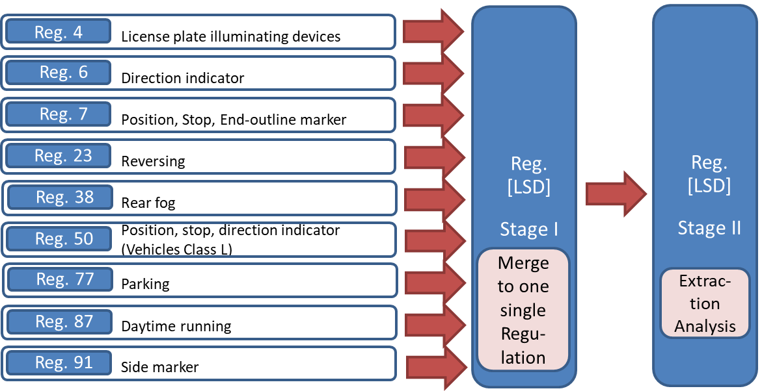
Stage II – Regulation No. [LSD]
WP.29/2018/157
SIMPLIFICATION
Technology independent
Objective test-methods
Performance based

Slide 7
Stage II – Regulation No. [LSD] Main topics of work
Rearrangement of the requirements -> §5.x.x
Align „D“ and „Y“ lamp provisions -> §4.4
Light source module definition -> §4.3.2.ff
Harmonise failure provisions -> §4.6. (see also §5.4.4.ff)
Rear registration plate lamp – harmonisation -> §5.11.
Reversing lamp – improvement -> §5.8.
Rear fog lamp – improvement -> §5.9.
Additional functions -> New §x.y.
Move requirements to main text -> Annex 2,3

Slide 8
Stage II – Regulation No. [LSD]
Re-arrangement of the specific technical provisions in Par. 5
Existing provisions for each function in Regulation No. [LSD]
Proposal: New structure for Paragraph 5.x. including a fixed framework and empty requirements if no provision exists.
5.x. Name(s) and Symbol(s)
5.x.1. Luminous intensity:
5.x.2. Standard light distribution:
5.x.3. Colour:
5.x.4. Apparent surface:
5.x.5. Measurement:
5.x.6. Other requirements:
If necessary, add subparagraphs
See SLR-29-04-Rev.1 for further details

Slide 9
ROAD ILLUMINATION
DEVICES (RID)

Slide 10
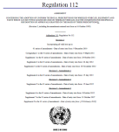
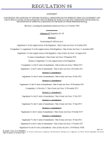
WP.29/2018/158/Rev.1
YESTERDAY
TODAY (RID “Stage 1”)
TOMORROW (RID “Stage 2”)
R112 Class A
Class B
Class AR
Class BR
R98 Class DC
Class DR
R123 Class C
Class E
Class V
Class W
Class XR
ADB
R113 Class AS
Class BS
Class CS
Class DS
Class ES
Class R-BS
Class R-CS
Class R- DS
Class R- ES
R19 Class B- F3
R119 Class K
Class A
Class B
Class AR
Class BR
Class DC
Class DR
Class C
Class E
Class V
Class W
Class XR
ADB
Class AS
Class BS
Class CS
Class DS
Class ES
Class R-BS
Class R-CS
Class R- DS
Class R- ES
Class F3
Class K
Basic /”C” Passing beam
Low speed /”V” Passing beam
Motorway/”E” Passing beam
Adverse weather passing beam
Basic Driving beam
Low speed Driving beam
ADB
AS, BS for mopeds
CS DS for motorbikes (>< 11 kW /125 cm³)
Secondary driving beams (>< 11 kW /125 cm³)
Auxiliary driving beam
Fog beam
Cornering beam
…
6 Regulations
24 Beam patterns
1 Regulation
16 Beam patterns
TC4-45 SAE J2829
Expertise of Optical engineers
1 Regulation
23 Beam patterns

Slide 11
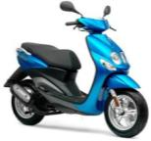
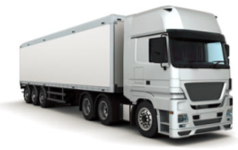
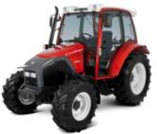
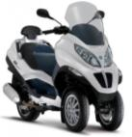
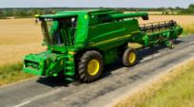
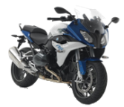
Installation requirements after SLR step 1 Regulation RID
AS
BS, R-BS
CS, R-CS
DS, R-DS
ES, R-ES
A, AR
B, BR
CS, R-CS
DS, R-DS
ES, R-ES
Class B, BR
Class DC, DR
F3
R74
Class B, BR
Class DC, DR
Class C
Class E
Class V
Class W
Class XR
ADB
Class F3
Class K
Class A, AR
Class B, BR
Class DC, DR
Class AS
Class BS, R-BS
Class CS, R-CS
Class DS, R-DS
Class ES, R-ES
Class F3
Class K
< 50 Km / h
R53
R48
R86
<125 cm³
2 x CS, 2 x R-CS
DS, R-DS
ES, R-ES
A, AR
B, BR
DC, DR
F3
GREEN colour means «optional»
BLACK colour means «mandatory»
Should the beam requirements be based on the category of the vehicle?
>125 cm³

Slide 12
RETRO REFLECTIVE
DEVICES (RRD)

Slide 13
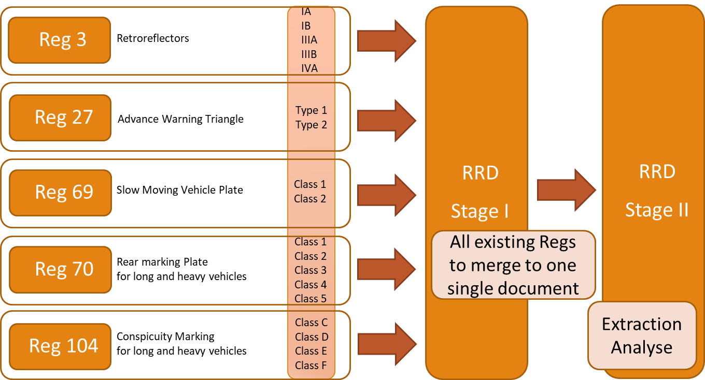
Stage II – Regulation No. [RRD]
WP.29/2018/159/Rev.1

Slide 14
Stage II – Regulation No. [RRD] Main topics to be worked on in future
Requirements for CIL for retroreflective devices – classes
Requirements for R´ (R_{A}) for retroreflective devices/markings – classes
Colorimetric requirements – daytime and nighttime visibility enhanced visibility
Photometric measurement conditions – to define independent from device
Water-penetration test and corrosion test independend from the device
Weathering test (colour fasness) to adapt to state of the art testing
Mechanical requirements to define testing independend from device
Chemical and environmental requirements - testing independend from device
Specific requirements and testing, which is depending from the device

Slide 15
GRE advice needed (1/3)
Is it OK to continue having the headlamp provisions expressed on the basis of luminous intensities equivalent to illuminance measured on screen at a distance of 25m?

Slide 16
GRE advice needed (2/3)
Items about Light Sources:
SLR is considering to allow all (including the not yet known) technologies for all functions
Should the combination of different Light Source technologies be possible for all functions?
SLR is considering to separate the test procedures from the requirements and to move them to a new Annex called “Testing procedures”

Slide 17
GRE advice needed (3/3)
Impact/usage of the Unique Identifier in LSD/RID/RRD:
Accessibility via DETA
What markings and symbols will actually be replaced by the UI?
Should some of the existing additional markings and symbols be maintained also with the UI?

