Slide 1
Informal document GRBP-70-20
(70th GRB, September 11-13, 2019,
agenda items 6 (d) and (e))
Submitted by the expert of ETRTO
WET GRIP TEST METHOD IMPROVEMENT for Passenger Car Tyres (C1)
Overview of Tyre Industry and ISO activities
GRBP - 70th session
Geneva September, 2019

Slide 2
BACKGROUND / RECAP
TRAILER method revision – RECAP and UPDATE
VEHICLE method revision
TIMELINE

Slide 3
BACKGROUND / RECAP
TRAILER method revision – RECAP and UPDATE
VEHICLE method revision
TIMELINE

Slide 4
CURRENT REGULATORY FRAMEWORK
ISO test method for PSR wet grip is thr reference for several regulations (EU, UN and worldwide)
TYPE approval - UN R117.02 – Test method in Annex 5(A)
(minimum requirement on WET grip for homologation)
ISO 23671:2015 Passenger car tyres — Method for measuring relative wet grip performance -- Loaded new tyres
UNDER REVISION
TYRE LABELLING
Europe EC 1222/2009* - Test method in Annex V (Reg. 228/2011) … but also Brazil, Korea, Japan, … *Note: revision of EU label will directly refer to UN R117 for wet grip test
GTR16 Global Technical regulation
This standard is under revision: the experience accumulated so far by the Industry and by the EU Member States Authorities indicated an opportunity for developing further improvements on the accuracy of the test method

Slide 5
REPRODUCIBILITY OF THE CURRENT WET GRIP TEST
The current wet grip test method allows the NECESSARY FLEXIBILITY in terms of testing conditions worldwide: possibility to test using different tools (vehicle/trailer), on different tracks (wide friction range for tracks), and in different periods of the year (wide temperature range).
When the test was firstly developed, it appeared to grant both a good repeatability (same test conditions = same test results) and a good reproducibility (different test conditions = same grade).
Anyhow the reproducibility of the test is not in line with the initial evaluations.
In other words, when different set of testing conditions (within the allowed ranges) are adopted to test the same tyre, the same wet grid index might not be always granted.
Note
This problem was identified in the Final Report on the Review study on the Regulation (EC) No 1222/2009 on the labelling of tyres (March 2016)
Following the experience accumulated after the implementation of EU label Reg. 1222, Tyre Industry progressively recognized the problem and indicated opportunities for improvements in the same Review Study

Slide 6
TYRE INDUSTRY / ISO COLLABORATION
Following preliminary collaboration among EUROPE, USA and JAPAN Tyre Industry, the revision of the existing ISO 23671:2015 for PSR was launched last Sept 14th, 2017;
An ISO (global) “technical table” is currently in place: The WET GRIP Working Group (TC31/WG12) was established with the aim to
By priority
1. Improve the reproducibility of the current ISO,
2. Try to keep on average similar wet grip indexes values and ratings as current test procedure
3. Drive the global standardization & promote harmonization worldwide
Status update (2018, August)
Draft International Standard registered

Slide 7
TYRE INDUSTRY and ISO TECHNICAL ACTIVITIES
Step 1 – Identification of the parameters affecting the dispersion of the test
✓ completed
Step 2 - 3 Round Robin Tests using TRAILER methodology
✓ Completed
Total of 37 tires - 1163 results! 16 different test sites/trailer in EU (ETRTO), Japan (JATMA) and USA (USTMA)
Step 3 – 1 Round Robin Tests Using VEHICLE methodology
✓ Completed tests In EU (ETRTO)

Slide 8
Step 1 – Identification of the parameters affecting the dispersion
The parameters having an influence on the variability of test method were listed exhaustively
The most impacting the reproducibility of the test were identified:
1. Methodologies (TRAILER / VEHICLE)
2. Conditioning (stabilization) of tyre prior testing
3. Wet Track - Friction & Temperature
4. Tyre typologies & corresponding correction equations

Slide 9
BACKGROUND / RECAP
TRAILER method revision – RECAP and UPDATE
VEHICLE method revision
TIMELINE

Slide 10
TYRE BREAK-IN (CONDITIONING)
Tyre Break-In (conditioning) was identified as an important source of variability
Current standard
For tyre break-in, two braking runs shall be performed under the load, pressure and speed as specified
Not enough!
New proposed approach:
The tyres should be stabilized in performance prior to testing, which means that no evolution of the μ_{peak} /BFC values in test runs should be detectable; in any case there will be an ex-post verification according to clauses specified in [the test procedure]* In all cases, tyre designed tread depth and designed tread block or rib integrity shall not change significantly with break-in, which means the pace and “severity” of the break-in needs to be carefully controlled to avoid such changes.
[*paragraph “Validation of tests results” – improved requirements on the Coefficient of Variation (CoV) of the µ_{peak} /BFC values of both reference and candidate tyres and on the evolution of the reference tyre (SRTT) during the test cycles]
Note: “how” operationally stabilizing the tyre (on road driving, drum,…)is left to each company, being also dependent on internal practices and tyre constructions.

Slide 11
TRACK GRIP
In the current method, the grip of the track can be controlled with one of two criteria BPN _{[42-60]} or μ _{SRTT14”} _{[0,6-0,8]} Anyhow there is no correlation between the 2 criteria → this point is an important source of variability between different test centers. Also the reference tyre SRTT14’’ will be discontinued
SRTT 16’’ will be used NOT ONLY AS REFERENCE TYRE, BUT ALSO FOR TRACK VALIDATION IN PLACE OF [SRTT 14 or BPN]
Replacement of SRTT14 and discontinuation of BPN measurement
A source of variability eliminated
agreement for friction range μ _{SRTT16”} [0.65 ; 0.90 ]

Slide 12
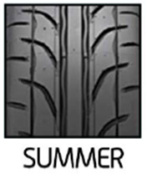
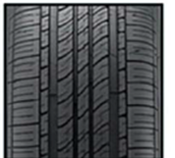
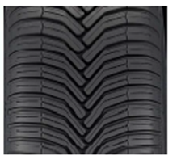
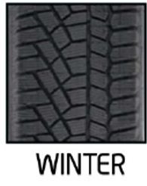
TYRE TYPOLOGIES / Track Temperature
3 different typologies of tyres should be treated differently within the wet grip test procedure
R117 category of use / markings
Normal
-
Snow
M+S - not 3PMSF
Snow for use in severe snow conditions
M+S and 3PMSF
Commercial name
USA ALL SEASON
EU ALL SEASON
Normal tires are designed to perform best in warm weather and are not typically used at low temperature
intended to perform across most temperature ranges. They are designed also for use in lower temperatures but not at the level of a Severe Snow (Winter) tire. They can operate at higher temperatures, without the typical limitations of Severe Snow (Winter) tires
guarantee the min snow traction of a Severe Snow (Winter) tire. They are also designed to operate at higher temperatures, without the typical traction limitations of Severe Snow (Winter) tires
Severe Snow tires are designed to perform best in severe cold weather conditions and are not typically used during extended warm weather conditions
WET GRIP test
CONDITIONS
T ref = 20
T ref = 15
T ref = 10
12-35 ˚C
5-35˚C
5-20 ˚C
each tyre typology has its own behavior vs friction & temperature
→specific /different correction formulas and coefficients shall be applied

Slide 13
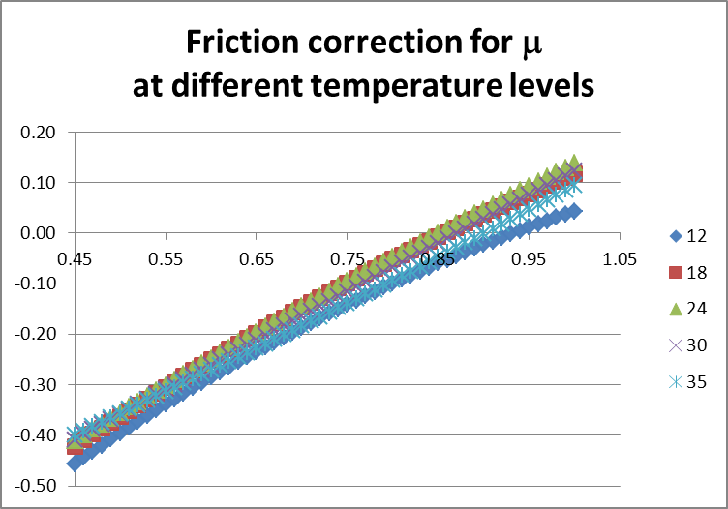
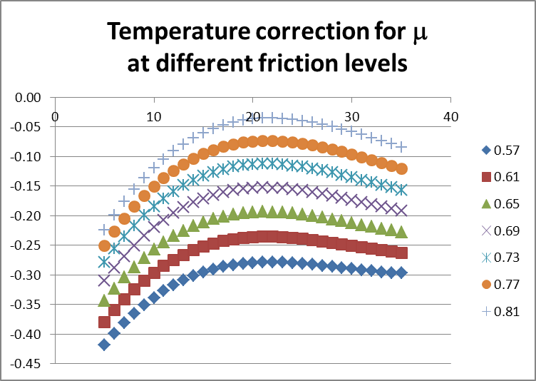
CORRECTION FORMULAS
Example for Normal
Example for Normal
µ(tyre) vs track grip µ(SRTT16)
~ linear → $a Δ\text{μ}$
µ(tyre) vs Track temperature T
~ quadratic → $\text{b} \text{Δ}\text{T} \text{+}\text{c}{ \text{Δ}\text{T}}^{2}$
The grip of the track has a strong influence The MTD (Mean Texture Depth) has also a minor influence
$$\text{d}Δ\text{MTD}$$
The temperature (especially the low temperature for normal tyres) has also an influence (even if lower than the grip)
$$NEW G\left(T\right)=K_{trailer}∗\left[μ_{test} −\left(a Δ\text{μ} \text{+} \text{b} \text{Δ}\text{T} \text{+}\text{c}{ \text{Δ}\text{T}}^{2} \text{+} \text{d}Δ\text{MTD}\right)\right]$$
ΔT = T_{test} – T ref where: Δμ = μ_{SRTT16} – 0.85 ΔMTD = MTD – 0,8
a, b, c, d : different depending on tyres typologies
K-trailer: minimizes the difference in average current vs future procedure for TRAILER

Slide 14
CORRECTION FORMULAS
Dataset 2014-2017 = RRT ETRTO-JATMA-USTMA TRAILER 1163 results of 37 different tires (18 “Normal”, 9 “M+S”, 10 “3PMSF”)
Correction coefficients [a, b, c, d] minimize the dispersion of the tests results for each tyre typology
Tyre sidewall marking | t₀ | a | b | c | d
Neither M+S marking nor 3PMSF marking | 20 | 0.99757 | 0.00251 | -0.00028 | 0.07759
M+S marking without 3PMSF marking | 15 | 0.87084 | -0.00025 | 0.00004 | -0.01635
3PMSF marking | 10 | 0.67929 | 0.00115 | -0.00005 | 0.03963
K-trailer: minimize the difference in average current vs future procedure for TRAILER
Method: Least Squares
Calculation
S = Σ (WGI proposed – WGI current) ² → S minimization: K trailer = 1.502
K trailer = 1.50

Slide 15
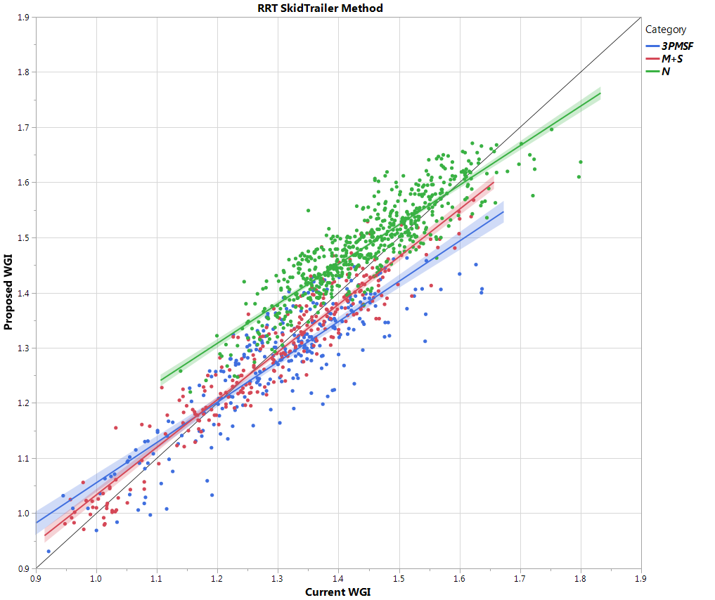
ADDITIONAL CONSIDERATIONS
Bisector line
Current WGI = New WGI
K=1.50
New WGI
Normal
M+S (not 3PMSF)
3PMSF
Current WGI
On average:
All points (Current WGI / new WGI) well distributed across the bisector line (= overall gap is minimized)
On average, for each tyre typology (Normal, M+S only, 3PMSF)
similar WGI values as current procedure
On the single tests results
The proposed procedure grants more stability (vs tests conditions) than current procedure: consequently possible differences in WGI (new vs current) on single tests results depend on the specific test conditions

Slide 16
BACKGROUND / RECAP
TRAILER method revision – RECAP and UPDATE
VEHICLE method revision
TIMELINE

Slide 17
Step 3 – Round Robin Tests Using VEHICLE methodology
Some of - but not all - the technical findings on trailer can be automatically transposed to vehicle methodology.
ETRTO (EU only) performed dedicated test campaign on vehicle:
to compare the variability of both TRAILER and VEHICLE methodologies
to check the correlation between the two modified methods (both methods should give same Index)
Technical findings on trailer directly applicable also to vehicle method
Tyres typologies and permitted temperature range - Stabilization of tyre performance prior testing
Dedicated technical analysis for vehicle method
Usage of two vehicles with a “control” tyre (Bridge test)
Track friction description
corrections formulas (tailored for vehicle)
…other… e.g. Vehicle, Tyres Inflation Pressure adjusted depending on actual axle load

Slide 18
VEHICLE – “BRIDGE TEST”
Currently used when size of the candidate tyre differs significantly from SRTT
VEHICLE 1
Control
Vs
SRTT
VEHICLE 2
Candidate
Vs Control
+
Candidate
Vs SRTT
bridge
Bridge test increases significantly the dispersion
Possibility of bridge test is ELIMINATED Even if it is recognized that it will be not possible to test on vehicle the full range of existing sizes (Load indexes).
For the “extreme” sizes trailer method shall be used.

Slide 19
VEHICLE – “FRICTION RANGE”
IN CASE OF TRAILER → Elimination of BPN and µ_{SRTT14’’}
Friction Range µ_{SRTT16”} [0.65 ; 0.90 ]
IN CASE OF VEHICLE - Not possible to measure the µ_{SRTT16”} [on trailer] → agreed to use the corresponding parameter on vehicle: BFC (SRTT16’’) correlation µ_{SRTT16”} [on trailer] <-> BFC(SRTT16’’) [on vehicle] depends on both vehicle and trailer used
On average
µSRTT16” [on trailer] = (0.65-0.90) corresponds to BFC(SRTT16’’) [on vehicle] = (0.57-0.79)

Slide 20
VEHICLE – “CORRECTION FORMULAS”
Same formulas as trailer: 4 “optimized terms but tailored for vehicle
$$G\left(T\right)=Kvehicle∗\left[{BFC}_{test} −\left(a′ Δ\text{BFC} \text{+} \text{b}\text{′ }\text{Δ}\text{T} \text{+} \text{c}\text{′}{\text{Δ}\text{T}}^{2} \text{+} \text{d}\text{′}Δ\text{MTD}\right)\right]$$
Correction coefficients [a, b, c, d] minimize the dispersion of the tests results for each tyre typology
Tyre sidewall marking | t₀ | a' | b' | c' | d'
Neither M+S marking nor 3PMSF marking | 20 | 0.99382 | 0.00269 | -0.00028 | -0.02472
M+S marking without 3PMSF marking | 15 | 0.92654 | -0.00121 | -0.00007 | -0.04279
3PMSF marking | 10 | 0.72029 | -0.00539 | 0.00022 | -0.03037
K-vehicle: minimize the difference new procedure for TRAILER vs new procedure for VEHICLE.
Using ETRTO dataset of the tyres tested on both vehicle and trailer
→ K-vehicle = 1,87

Slide 21
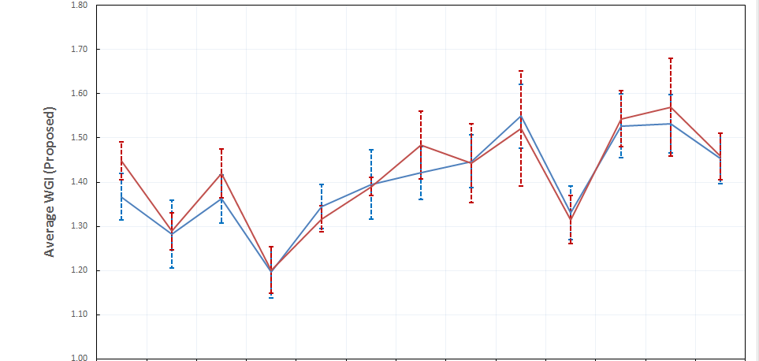
VEHICLE – ADDITIONAL CONSIDERATIONS
The possible gap between trailer and method is minimized.
No method (trailer or vehicle) provides systematically higher or lower WGI results
TRAILER
VEHICLE
3PMSF
M+S
Normal
Proposed amendment of paragraph 4 of ISO 23671:2015
For the evaluation of the wet grip index (G) of a candidate tyre, the wet grip braking performance of the candidate tyre is compared to the wet grip braking performance of the reference tyre on a straight, wet, paved surface. It is measured with one of the following methods:
- vehicle method consisting of testing a set of tyres mounted on a commercialized vehicle;
- test method using a trailer or a tyre test vehicle equipped with the test tyres.
In case of verification of the wet grip index (G) the same test method [i.e. Trailer / Vehicle] used for its declaration shall be used.

Slide 22
TRAILER & VEHICLE – IMPROVEMENT BY THE NEW FORMULAS
 |  | TRAILER RRT | VEHICLE RRT BRIDGE excluded
Total number of data |  | 1163 | 319
Number of candidate tyres | Normal | 18 | 9 (7 same as trailer)
 | M+S | 9 | 2 (2 same as trailer)
 | 3PMSF | 10 | 7 (4 same as trailer)
Number of testing companies |  | 17 EU + USA + JPN | 6 EU
Weighted Standard deviation CURRENT formula | Normal | 0.083 | 0.103
 | M+S | 0.077 | 0.047
 | 3PMSF | 0.088 | 0.059
Weighted Standard deviation NEW formula | Normal | 0.065 (- 22%) | 0.089 (-14%)
 | M+S | 0.060 (- 22%) | 0.025 (-46%*)
 | 3PMSF | 0.060 (-32%) | 0.051 (-13%)
* Improvement to be considered jointly with the number of candidate tyres

Slide 23
BACKGROUND / RECAP
TRAILER method revision – RECAP and UPDATE
VEHICLE method revision
TIMELINE

Slide 24
TIMELINE
FROM PREVIOUS INDUSTRY MEETING / GRBP INFORMAL DOC
ACTIVITIES ENLARGED AT ISO level - Robust technical approach - Worldwide Harmonization
2015 |  | 2016 |  |  |  | 2017 |  |  |  | 2018 |  |  |  | 2019 |  |  |  | 2020
3Q | 4Q | 1Q | 2Q | 3Q | 4Q | 1Q | 2Q | 3Q | 4Q | 1Q | 2Q | 3Q | 4Q | 1Q | 2Q | 3Q | 4Q | 1Q | 2Q
EC 1222 Review study Reproducibility to be improved!
TRAILER activities
ETRTO (EU) & JATMA (Jap)
Informal doc. GRBP
Informal doc. GRBP
Working doc. GRBP
(tbc)
TRAILER activities
RMA (USA) test + ETRTO (EU) analysis
VEHICLE testing activities
ETRTO (EU)
Completion of data analysis
ISO
NWIP
CD approved
DIS registration
DIS validation

Slide 25
APPENDIX

Slide 26
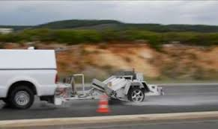
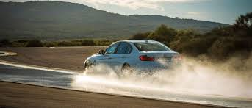
CURRENT WET GRIP TEST - TECHNICAL PRINCIPLES
For the calculation of the wet grip index of a candidate tyre, the wet grip performance of the candidate tyre is compared to the reference tyre ASTM SRTT 16’’ (Standard Reference Tyre Test).
→ Thus it is a COMPARISON TEST.
The wet grip index can be measured with one of the 2 following methodologies (today considered as equivalent):
TRAILER using a trailer towed by a vehicle
VEHICLE
using an instrumented passenger car
1 tyre mounted on a specific tool
OUTPUT peak braking force coefficient (μ peak)
highest value of the ratio braking force / vertical load
1 set of 4 tyres mounted on a commercialized vehicle
OUTPUT Average Deceleration (AD)
measured during braking

Slide 27
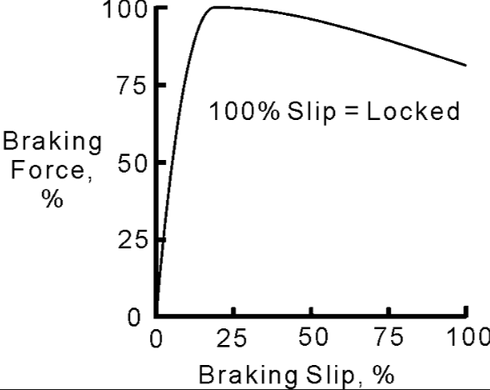
WET GRIP TEST METHOD - CURRENT REGULATORY FRAMEWORK
TRAILER METHODOLOGY
The tyre to be tested is fitted on a specific position for measurements (test position)
The brake in the test position is applied maintaining the specified speed (65 km/h) and the specified Load (depending on the Load Index of the tyre) until test-tyre lock-up
The ratio braking force / vertical load is acquired in real time: the highest value of this ratio provide the wet grip performance of the tyre. It is called tyre peak braking force coefficient (μ peak )
μ peak

Slide 28
WET GRIP TEST METHOD - CURRENT REGULATORY FRAMEWORK
VEHICLE METHODOLOGY
An instrumented passenger car, equipped with an Antilock Braking System (ABS). Starting with a defined initial speed, the brakes are applied on four wheels at the same time to activate the ABS
The average deceleration AD is calculated between two pre-defined speeds (80→20km/h).
Braking Force Coefficient → BFC = AD / g
VEHICLE METHODOLOGY USING CONTROL TYRE SET (BRIDGE TEST)
Where the candidate tyre size is significantly different from that of the reference tyre (SRTT), a direct comparison on the same instrumented passenger car may not be possible.
In that case the comparison between a candidate tyre and a reference tyre is obtained through the use of a control tyre set (so called “bridge”) and two different instrumented passenger cars.
CAR 1
Control
Vs
SRTT
CAR 2
Candidate Tyre
Vs Control
Candidate Tyre
Vs SRTT
+

Slide 29
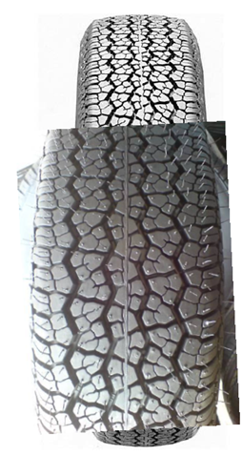
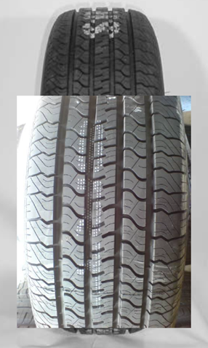
CURRENT WET GRIP TEST - APPLICABLE REFERENCE TYRES (ASTM)
SRTT 16’’
ASTM F2493 P225/60R16
SRTT 14’’
ASTM E1136 P195/75R14
Will be discontinued
Must be used as reference tyre to determine the relative wet grip performance of the candidate tyre
It can be used to verify / certify
track friction properties
(one of the 2 possible methods)

Slide 30
CURRENT WET GRIP TEST - TECHNICAL PRINCIPLES
Mathematical corrections are applied to align the results when the tests are performed in different conditions: i.e. different test locations (tracks) or different weather conditions (temperatures).
$$G\left(T\right)= \frac{μ_{candidate tyre}}{μ_{SRTT16}}1,25 +A·\left(Temp−T_{0}\right)+B·\left(µ_{SRTT16}−µ_{0}\right)$$
This ratio is a raw index of the measured friction of the candidate tyre vs the SRTT16’’ at the tests conditions (Temp, µ_{SRTT16})
Linear correction in friction to estimate the value of the index at the reference friction (track) µ₀
Linear correction in temperature to estimate the value of the index at the reference temperature T₀
The mathematical corrections (coefficient A and B) depend on category of use of the candidate tyre:
- Normal Tyres
- Snow Tyres (all tyres marked M+S, including the tyres marked also 3PMSF)

Slide 31
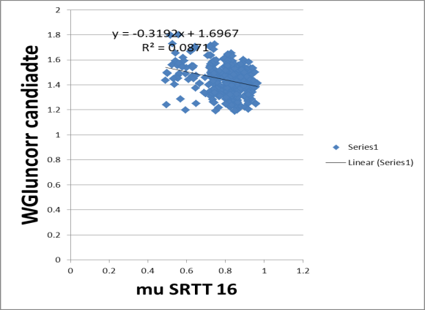
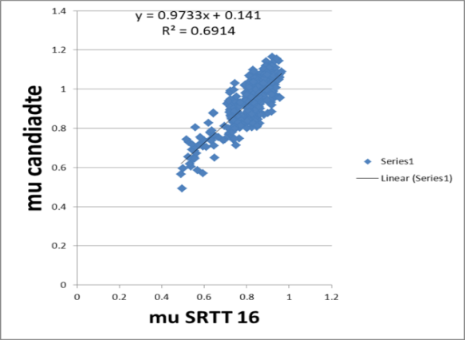
CORRECTION FORMULAS – BASIC IDEA
WGI raw = $\frac{μ_{candidate tyre}}{μ_{SRTT16}}$ $_{candidate tyre}$
WGI raw
No relation between
Ratio WGI raw and µ-SRTT16
Correction should NOT be applied
to WGI raw (as done today)
Evident linear relation between
µ-cand and µ-SRTT16 (track friction)
Correction should be applied directly to µ-cand tyre

Slide 32
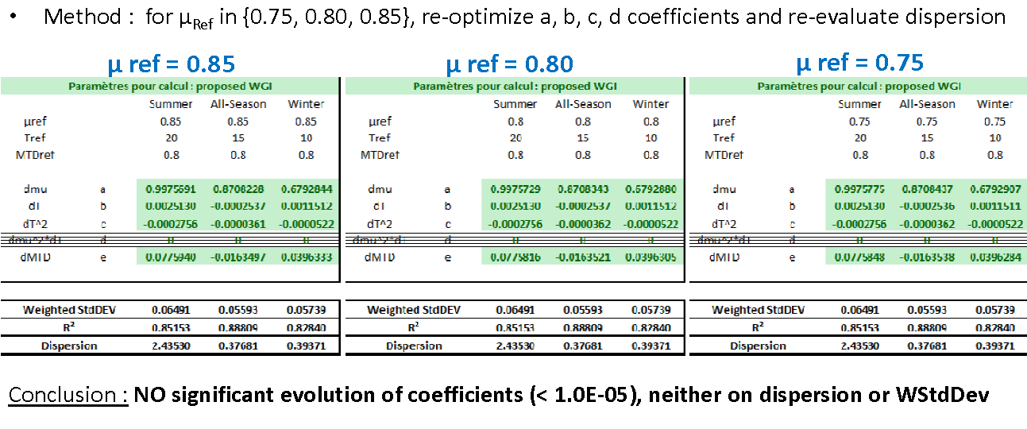
TRAILER METHOD – mu Ref
Reference mu = 0.85 (ref. conditions) unchanged vs current ISO / R117 test method
➔ keep consistency between this revised edition and previous edition of this standard

Slide 33
VEHICLE METHOD – OTHER POINTS
Vehicle
- Age of the car < 5 years
- mechanical conditions according to car manufacturer recommendations - no alert from ABS (e.g. lights warnings).
- No substantial modification of the vehicle & specifically no modification of the braking system
Tyres Inflation Pressure (front axle tyres) - differentiation standard load and XL (same as trailer) - adjusted by a formula: based on actual load of the vehicle + load transfer during braking (+ 30%~)

Slide 34
ISO 23671:201x - TIMELINE
New Project approved (TC31 plenary meeting) 2017, May
WG12 - Kick-off meeting, Working Draft 2017, Sept
ISO WG12 WebEx’s 2017, Oct → March
ISO WG12 meeting (Washington), CD agreed 2018, April
CD submittal for ballot 2018, June
CD approved with technical comments 2018, August
DIS registered (submittal for ballot) 2019, June
DIS validation - Text publicly available
IS publication 2020, May [Deadline]
We are here
DIS registration should be prior working document at UN to grant alignment ISO – R117

Slide 35
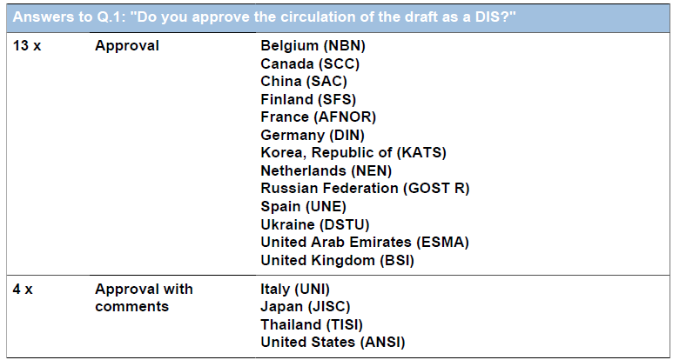
ISO CD 23671:201x – BALLOTS RESULTS
No disapprovals,
12 approval votes
5 approval votes with comments.
3 abstention

