Slide 1
European Agreement on Important International Combined Transport Lines and Related Installations (AGTC)
Session II: Infrastructure connectivity for integrated intermodal transport and logistics
Forum on Sustainable Transport Connectivity between Europe and Asia

Slide 2
AGTC
Objectives
Establishment of a coordinated plan for the development and operation of a network of important international combined transport lines and related installations (international combined transport network) - Network elements: railway lines (link with AGC), combined transport terminals, border crossing points, gauge interchange stations and ferry links/ports (annexes I and II)
Definition of technical characteristics for the network to conform with (annex III)
Definition of operational targets: performance parameters and minimum standards for combined transport trains and related installations (annex IV) (on-line tool)

Slide 3
AGTC
Contracting Parties
32 Contracting Parties*
*AGTC = regional agreement (open to States members of UNECE or admitted to it (para 8 and 11 of ToR of the Commission)

Slide 4
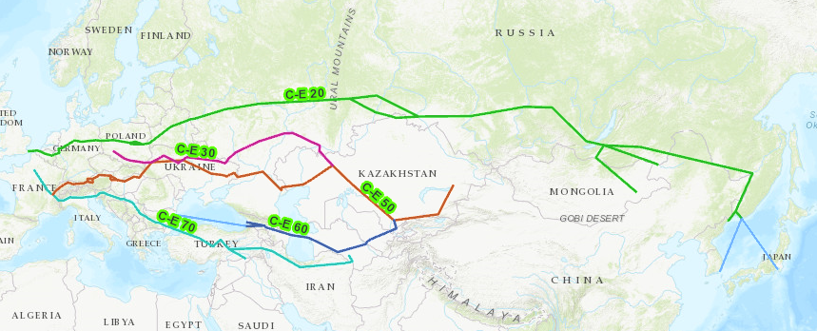
AGTC
AGTC lines west to east

Slide 5
AGTC
Expected outcome
International combined transport network meeting the technical characteristics and operational targets is put in place and maintained
Responsibility for the outcome with the Contracting Parties
UNECE member States not yet Contracting Parties shall accede to the AGTC Agreement and implement it

Slide 6
Thank you!
Forum on Sustainable Transport Connectivity between Europe and Asia
Lukasz Wyrowski
Secretary, WP.24

