Slide 1
Polish rail transport A.D. 2019
and its perspectives
Jerzy Kleniewski
73rd UN ECE Working Party on Rail Transport
Geneva, 25-27.11.2019

Slide 2
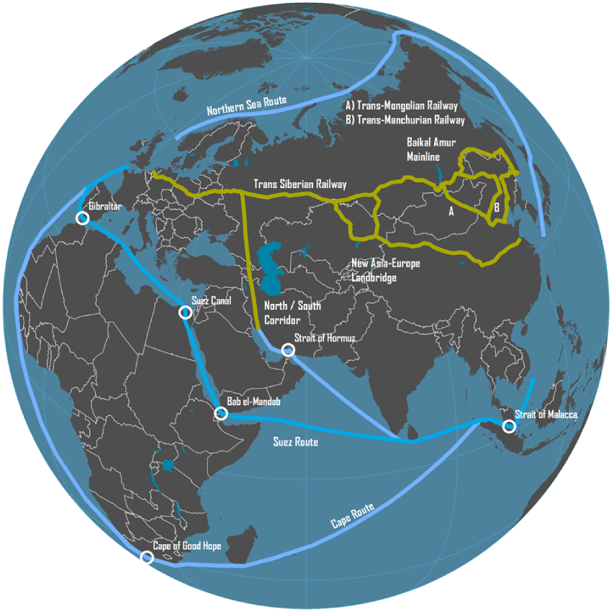
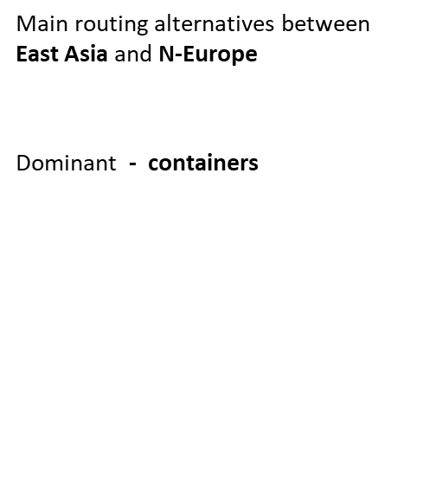
Global transport routes

Slide 3
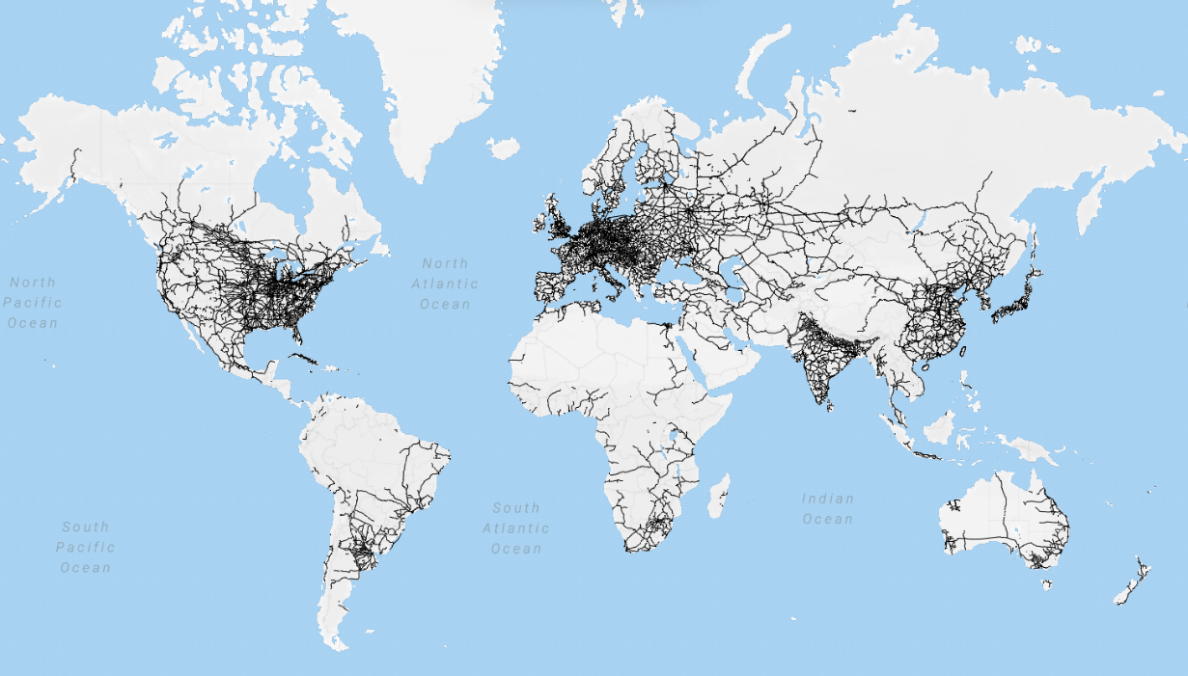
Global
Railways
network

Slide 4
Containers transported by rail - 2018
Main Polish trade partners in 2017 and 2018: Russia, Germany, Ukraine and Czech Rep. – and rail transport with them reached 55,4%. Statistics shows constant increase of trade between Poland and China.
Container transport between China and Europe reached around 324,000 TEU in 2018. Main activity connects 40 cities in China with 40 European ones. Prevailing majority (77%) uses the corridor: China – Kazakhstan – Russia – Belorussia – EU (Poland – Germany and others). Polish / Byelorussian border was passed by around 6.300 trains.

Slide 5
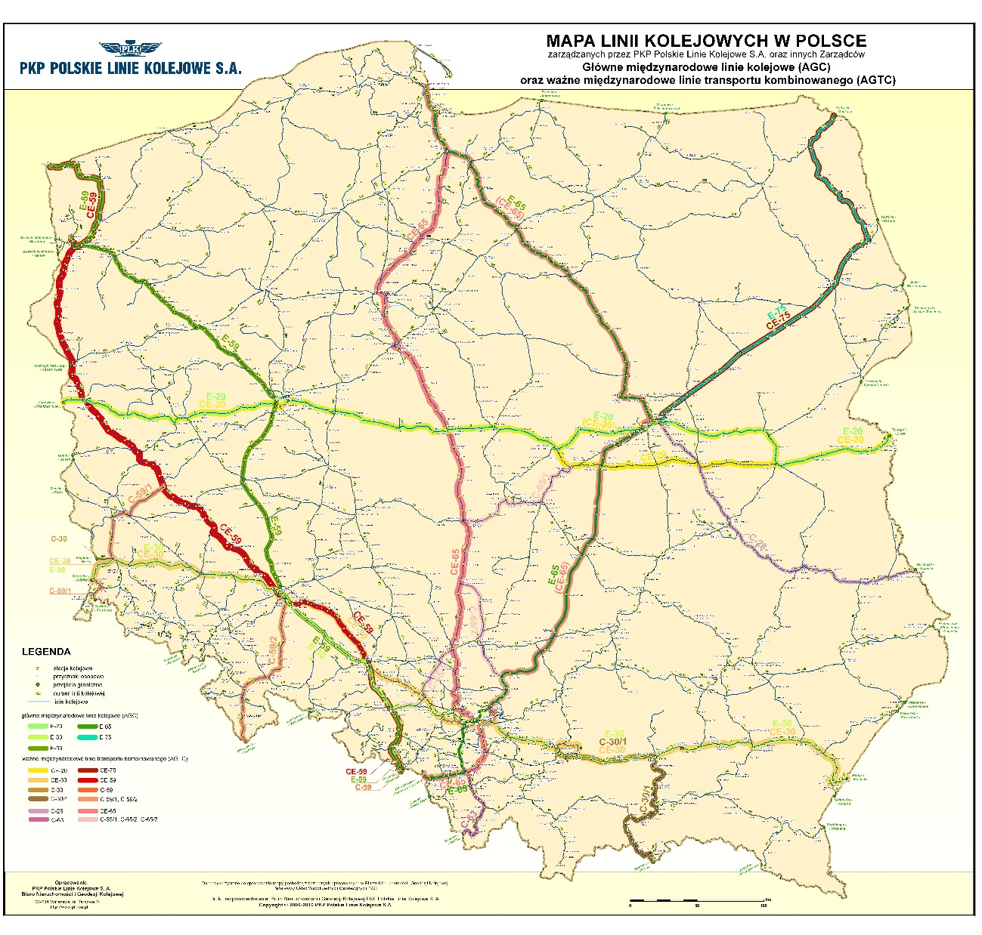
Map of Polish railway lines managed by
PKP Polskie Linie Kolejowe S.A.
and other infrastructure managers
AGC and AGTC lines
marked with colours

Slide 6
Polish national rail lines manager PKP Polskie Linie Kolejowe S.A. - in numbers
18 427 km rail lines
36 079 km tracks
around 39 000 of staff
14 681 rail – road crossings
around 6 000 trains daily
25 382 engineering facilities, including 6 377 bridges and overpasses

Slide 7
National Railway Programme
over 220 projects
almost EUR 18 billion
approximately 9000 tracks to be upgraded
Expected results:
cargo on tracks
safety and environmental protection
easy access to railway transport
faster rail travel

Slide 8
PKP Polskie Linie Kolejowe S.A.
Value of funds spent under the WPIK
Implementation of investment projects based on Government Programmes - currently the National Railway Program (KPK).
The KPK is a document establishing the financial framework and conditions for the implementation of the state's intentions in the field of railway investments planned for implementation by 2023
The KPK program is a continuation of the multiannual program called the Multiannual Railway Investment Program until 2015, with a perspective until 2020 (WPIK).
22.7 bln PLN
Basic list of KPK
220 investment projects
Planned value of funds to be spent under the KPK
66.4 bln PLN

Slide 9
PPKP Polskie Linie Kolejowe S.A.
Main goals of the KPK to 2023 (update)
Length of reconstructed tracks
Construction of ERTMS / ETCS
(Railway lines)
9 000 km
2 000 km
Connections od voivodship centres with lines with an average speed of 100 km/h
18 centres
As a result of the implementation of investments included in the KPK in the years 2016-2023, the speed will be increased on railway lines of length:
9 000 km
of track

Slide 10
data of November 2019

Slide 11
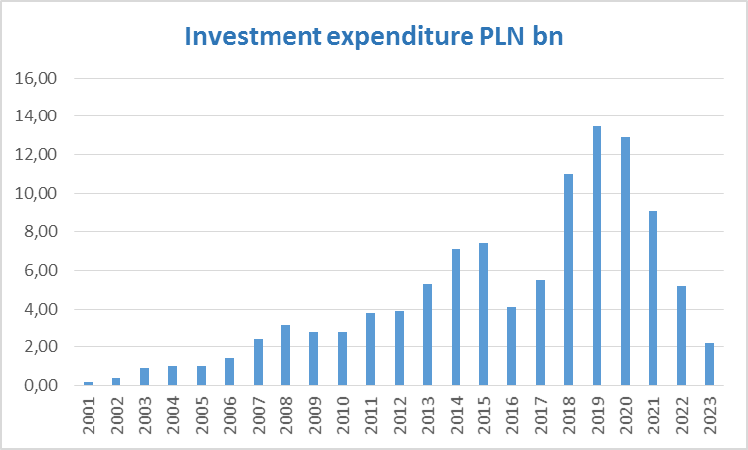
PKP Polskie Linie Kolejowe S.A.
Long term investments
Realized capital expenditure of PKP PLK in the years 2001-2018 and planned to be invested for 2019-2023

Slide 12
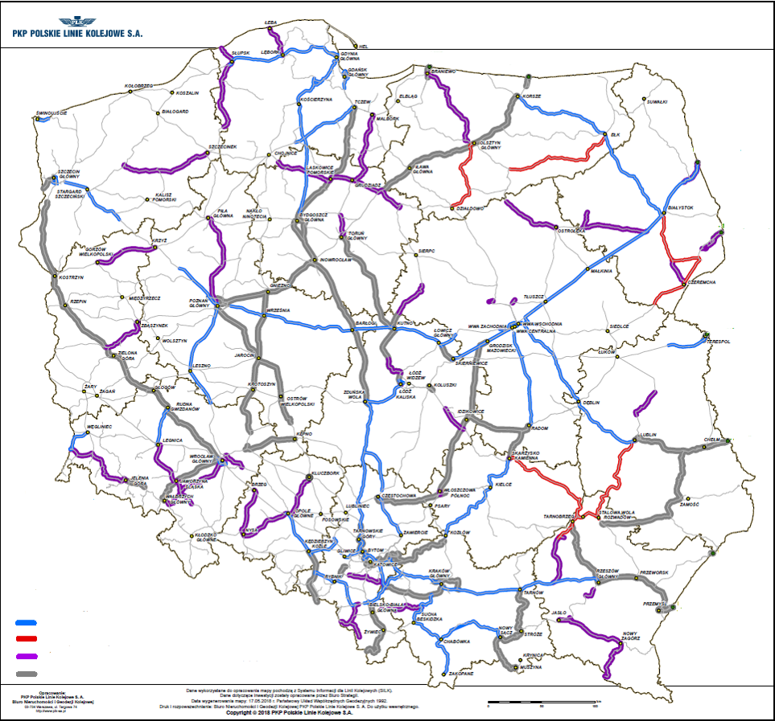
Location of investments of PKP Polskie Linie Kolejowe S.A.
Basic list – investment projects under KPK to implement up to 2023
Both – National and the EU
(OPI&E, CEF, OPEP, ROP)
CF OPI&E & CEF
OPEP
ROP 2014-2020
National Funds

Slide 13
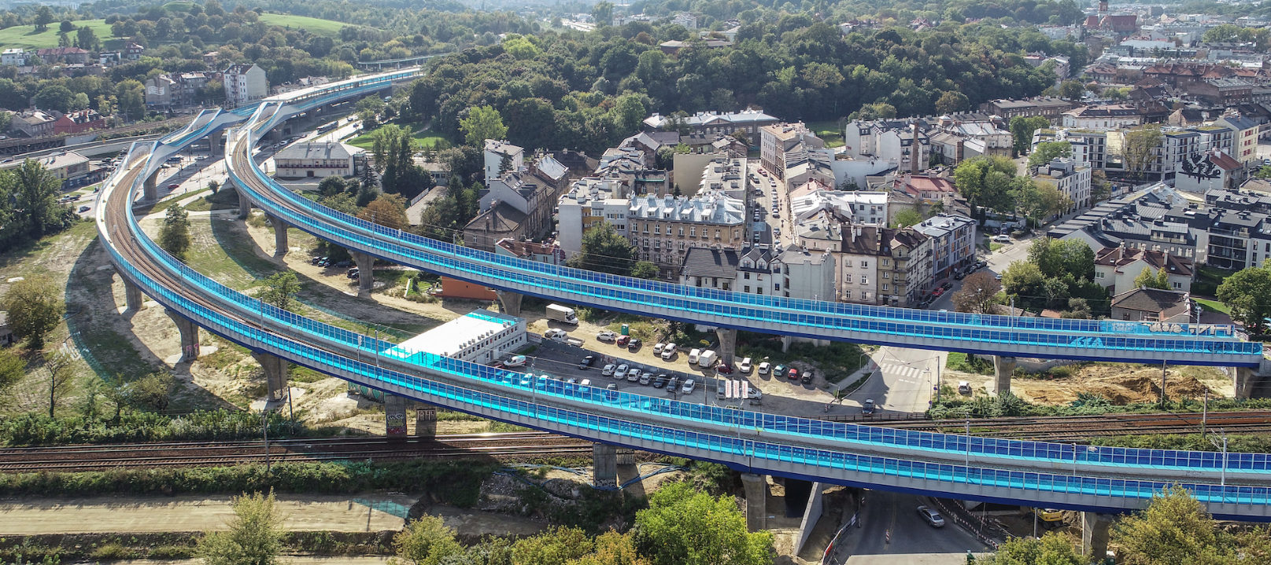
Winner:
Project:
„Construction of a railway junction Kraków Zabłocie – Kraków Krzemionki”

Slide 14
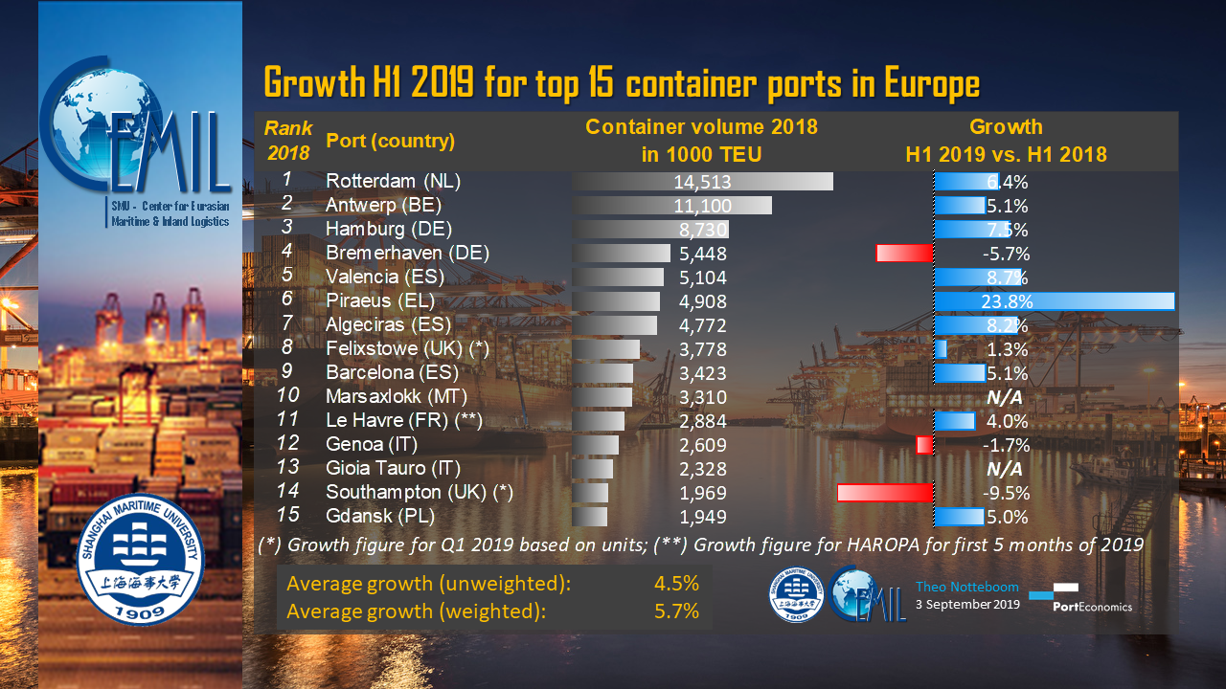
.
European container sea ports
Extension of land cargo transport corridors –
trends in TEUs turnover

Slide 15
TEUs handling in ports of Gdańsk, Szczecin and Gdynia
 | Gdańsk | Szczecin | Gdynia
2014 | 1 212 054 | 78 439 | 849 123
2015 | 1 091 202 | 87 784 | 684 796
2016 | 1 299 373 | 90 869 | 642 195
2017 | 1 580 508 | 93 579 | 710 698
2018 | 1 948 974 | 81 451 | 803 871

Slide 16
Thank you for your attention

