Slide 1
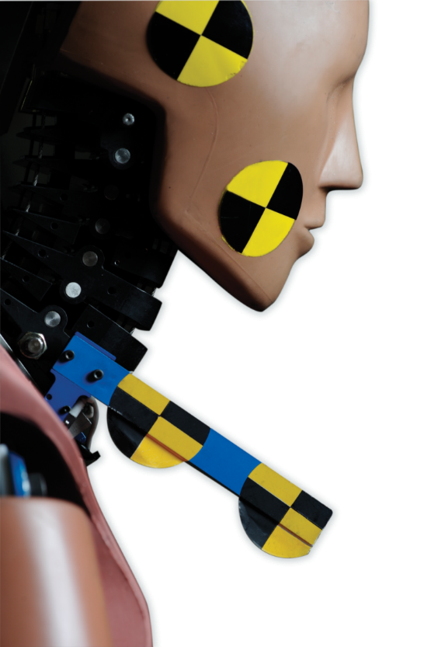
Informal document: GRSP-65-32
(65th GRSP, 13 - 17 May 2019,
agenda item 2)
Introduction to Revision of GTR 7
Formal Document
ECE/TRANS/WP.29/GRSP/2019/5
and GRSP-65-24
(superseding GRSP/2018/27
and GRSP-64-39rev. 1)

Slide 2
Background
At 64th GRSP in December 2018 the updated draft proposal for GTR 7 phase 2 doc GRSP/2018/27 (ammended by by 64-37 rev. 1) was introduced and discussed.
In the following month comments have been received from interested parties and included in GRSP/2019/5.
GRSP/2019/5 still contains square brackets and some issues (especially injury criteria limits) where no agreement has been reached.

Slide 3
The 18th IWG GTR 7 Meeting was hold on 24th / 25th April 2019 in Bergisch Gladbach (Germany)
During the meeting agreements were reached on:
Text of the preamble
Text of regulation especially
Injury criteria
Some minor modifications/corrections were needed after the meeting but are now included in informal document GRSP-65-24 which is superseding GRSP/2019/5.

Slide 4
Latest proposal for injury criteria
as agreed during 18th IWG meeting
Summary of recommendations for GTR 7
NIC 25
Upper and Lower Neck My I30I Nm
Upper Neck Fx I360I N
Lower Neck Fx as care point / monitoring, language in preamble! (§147 in GRSP-65-24)
My and Fx for flexion and extension!

Slide 5
Work items for BioRID TEG
As a result of the 18th IWG meeting the BioRID TEG was reconstituted and had its 17th WebEx meeting on 6th of May with the main task to reach an agreement on certification procedures including corridors
Concerns raised from some strakeholders with regard to Pot A
collect data from different labs until mid of June 2019.
data analysis until mid July 2019.
WebEx to discuss results an proposal …..
Addendum to Mutual Resolution M.R.1.

Slide 6
Draft GTR 7 Phase 2
Outlook / Recommendation
The IWG would welcome final comments on the content of document ECE/TRANS/WP.29/GRSP/2019/5 and 65-24 so that it may consider them while preparing the final proposal for the December 2019 session.
The final proposal shall be accompanied by a proposal for an entry in Mutual Resolution 1 that will detail the BioRID UN test tool.

Slide 7
Thank you for your attention!
Bernd Lorenz
Bundesanstalt für Straßenwesen (BASt)
Brüderstraße 53
D-51427 Bergisch Gladbach
lorenz@bast.de

