Slide 1
Securing of children in buses and coaches
Submitted by the expert From Sweden | Informal document GRSP-65-26 (65th GRSP, 13-17 May 2019, agenda item 26)
Some information and statistics from Sweden

Slide 2
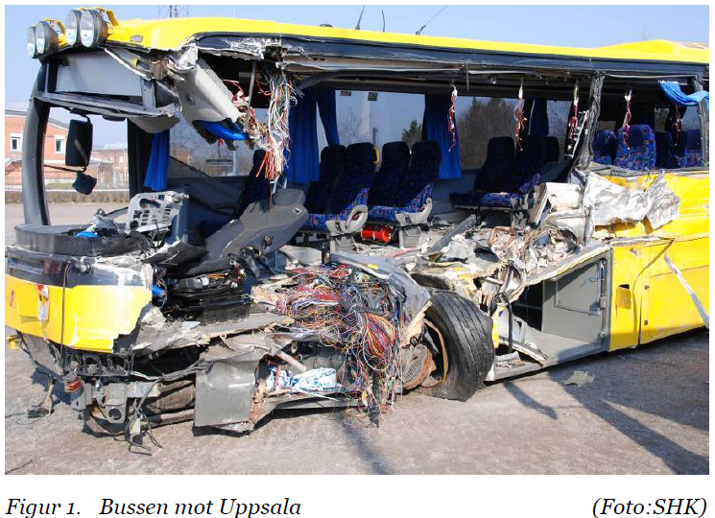
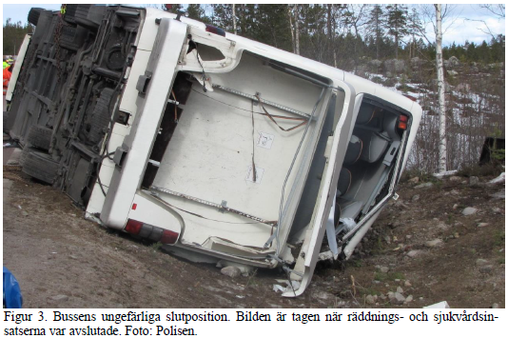
Bus accidents fatal for passengers
Date | Type | Death | Serious/ Moderate | Minor | Involved passengers
2003-01-24 | Tip & slide (single) | 6 | 15 | 14 | 35
2003-08-13 | Collision | 2 | 1 | - | 4
2005-10-12 | Travel (standing passenger) | 1 | 0 | - | 2
2006-01-27 | Tip over (single) | 9 | 24 | 18 | 51
2007-02-27 | Collision 2xBus | 6 | 6 | 47 | 61
2011-12-14 | Collision | 2 | 2 | - | 4
2012-03-02 | Tip & slide (single) | 1 | 2 | - | 3
2014-12-04 | Tip & slide (single) | 2 | 9 | 16 | 27
2017-04-02 | Tip & slide (single) | 3 | 25 | 21 | 50
Collision
Tip & slide
Examples of accidents fatal for passengers of all ages

Slide 3
Comments on fatal accidents
Tip & slide:
Not that high frontal impact force, more lateral impact. Injuries due to falling out through window or tumbling around in the bus.
Unbelted persons on “upper side” falling down on other passengers.
Focus to keep the person in seat place to avoid being tossed around, falling on other passengers or falling out through window.
Use seat belt!

Slide 4
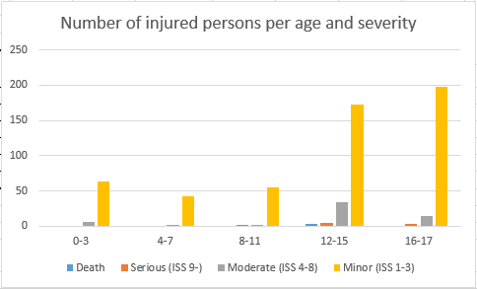
Statistics from STRADA
Based on reporting to national information system STRADA collecting data of injuries and accidents in the entire road transport system. Information from the police and hospitals.
Persons up to age 17 injured travelling by bus, year 2010-2017
Most serious accidents is at higher speed outside city.
Volume of accidents is at lower speed in/close to city.
one accident!

Slide 5
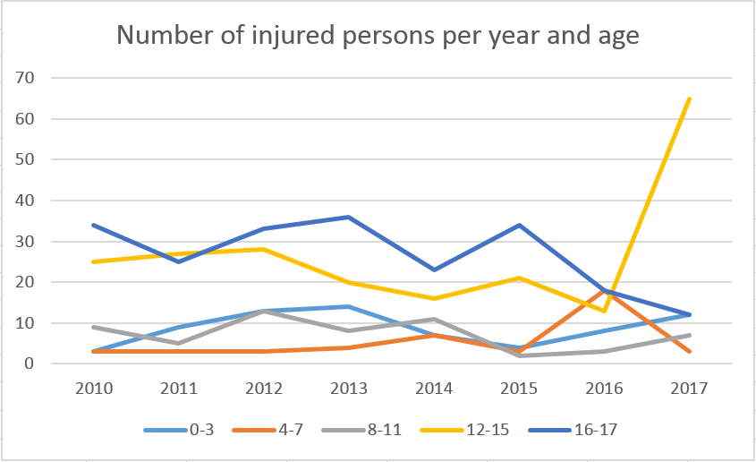
Statistics from STRADA
Based on reporting to national information system STRADA collecting data of injuries and accidents in the entire road transport system. Information from the police and hospitals.
Persons up to age 17 injured travelling by bus, year 2010-2017
one accident!

Slide 6
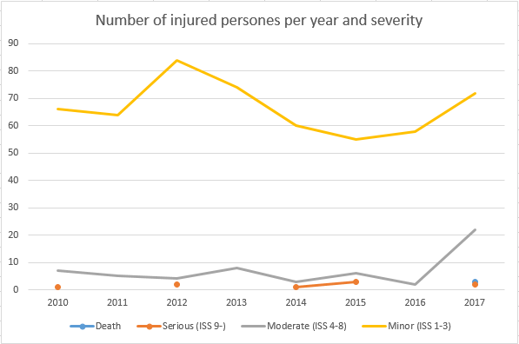
Statistics from STRADA
Based on reporting to national information system STRADA collecting data of injuries and accidents in the entire road transport system. Information from the police and hospitals.
Persons up to age 17 injured travelling by bus, year 2010-2017
one accident!

Slide 7
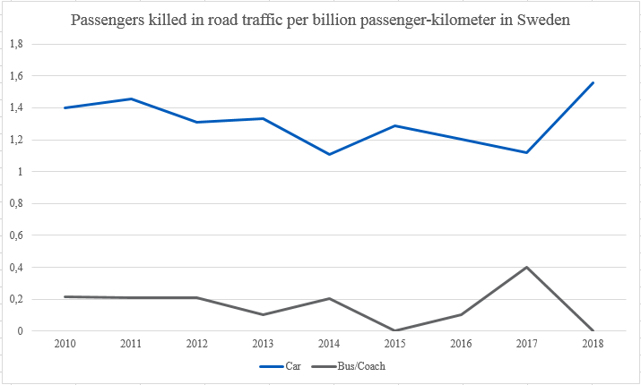
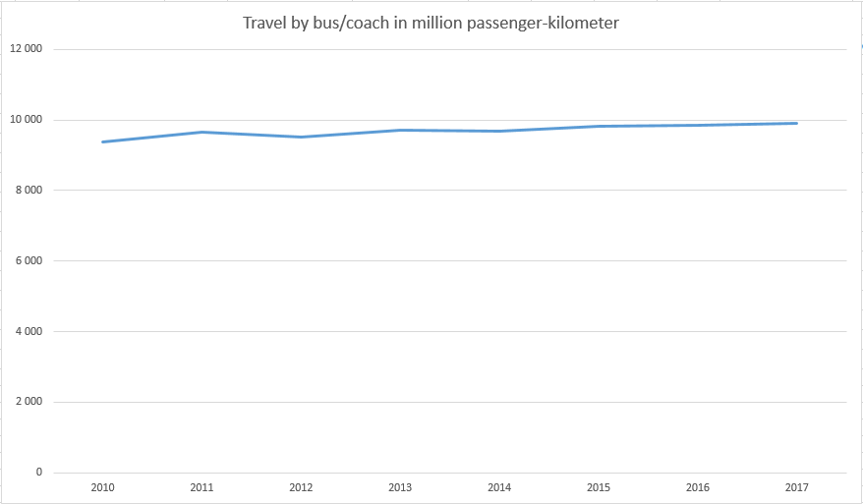
Fatal accident per passenger-kilometres
Passengers of all ages

Slide 8
Regulation regarding children in buses
In general there is no buses in Sweden specially designed for transportation of children. Children use the same bus service as the rest of the population.
In smaller villages there might be some specific routes to carry children to and from school, and there is regulations for the use of buses in these cases. (Sign for carrying children, locking of doors)
In general for bus ride in Sweden any person above 3 years shall use a seat with belt, if available, and is obligated to use the belt. Exception for local transport in cities etc. Passengers shall be informed about the obligation to use seat belt.
It is the responsibility of the driver* to help and make sure that persons under 15 year use seat belt or other suitable protection.

Slide 9
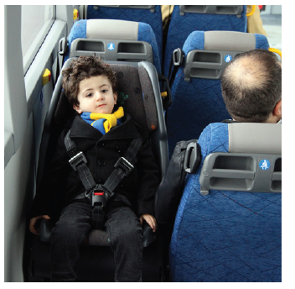
Regarding children <3 years of age
For children below 3 years of age travelling in buses, there is no regulation.
From time to time discussions in media and different parties why there is no regulation for children below 3 years of age.
Technical solutions exist and some bus service providers require at least two seats installed abled to carry children below 3 years of age.

Slide 10
Regarding use of seat belt
Studies on the use of seat belt in buses in Sweden has been studied recently (Class II & III vehicles):
Arranged specific travels using coaches 92%, tourist, charter
Commercial distance bus service 50%, between cities, airport etc
Contractual regional & local bus service 27%, between & partly in cities
Information & reminder to use seat belt are to be given at A after each stop, and also B & C for distance > 50 km and where there is fewer stops.

Slide 11
Proposal on strategy and steps forward
Clarify current situation:
Gather and share statistics on number, frequency, type and severity of children injured in bus accidents.
Gather and share statistics on type of bus accidents related to severe injuries.
Gather and share the situation in different countries regarding special school buses or not, special regulations or solutions for children.
Share studies done on safety in buses - not only a technical matter, it is a lot about behaviour.
Formulate and describe problem:
Based on analysis of the current situation, formulate and describe problem regarding securing of children in buses.

Slide 12
Thank you for your attention!

