Slide 1


The European consumer voice in standardisation
 | Informal Document GRSP-64-32 (64th GRSP, 11-14 December 2018, agenda item 12)
Phasing out belted integral R44 CRS
Ronald Vroman
ANEC / Consumers International

Slide 2
Proposal
No R44 approvals from 1 September 2020 for child restraint systems other than Group III.
No R44 extensions from 1 September 2020 for child restraint systems other than Group III.

Slide 3
Jusitification
Entry into force of R129 Phase 3: 29 December 2018.
(all groups and categories except Group III forward facing non integral CRS covered)
From December 29: CRS approvals can be either according to R44 or R129 (manufacturer’s choice) for an undefined period.
Undesirable that CRS can be developed according to R44:
    Two categories of products offering two levels of protection on the market
    Confusing for consumers (and manufacturers!)
    No encouragement for manufacturers to develop products to the latest (highest) standard.
R44 is signed by 45 CP’s, R129 signed by 53 CP’s. No risk that newly developed ECRS would be withheld from certain markets

Slide 4
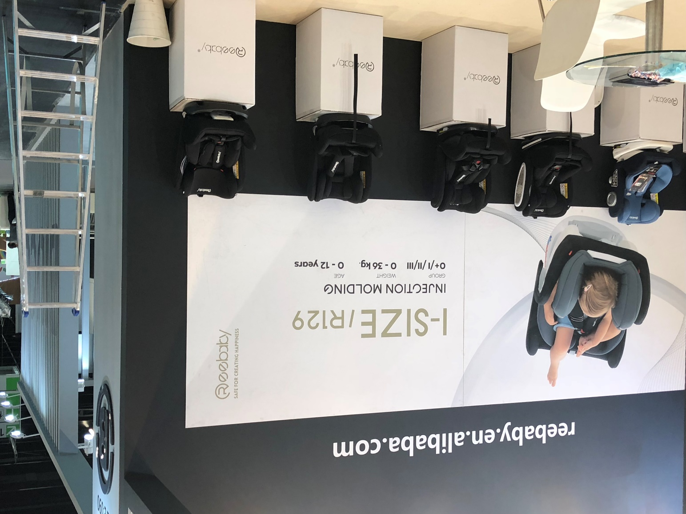
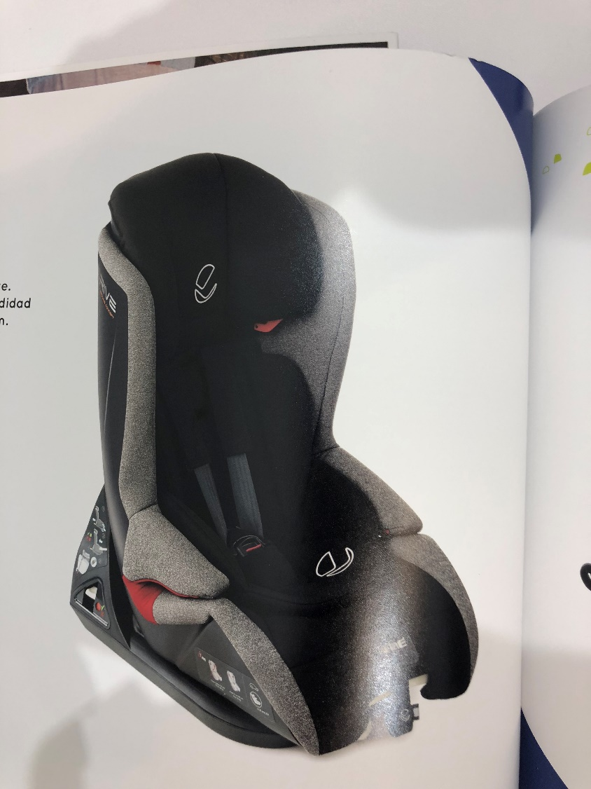
i-Size Group 0+/I/II/III?

Slide 5
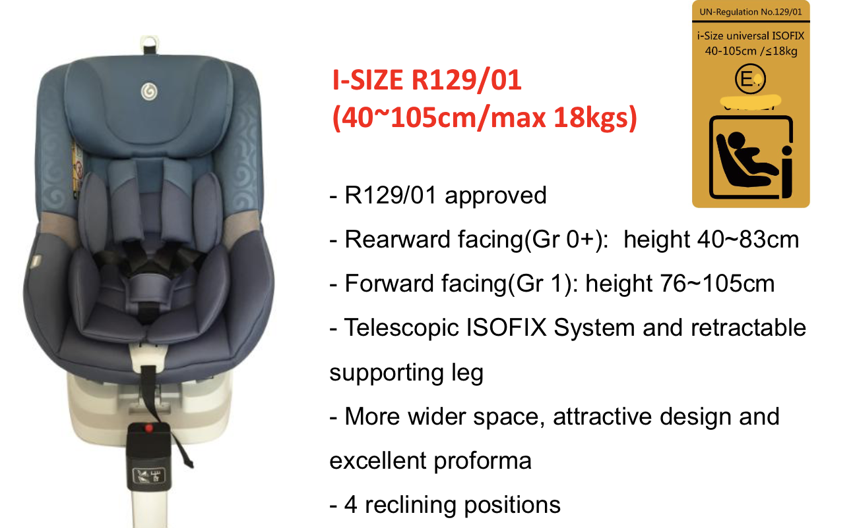
R44 or R129?

Slide 6
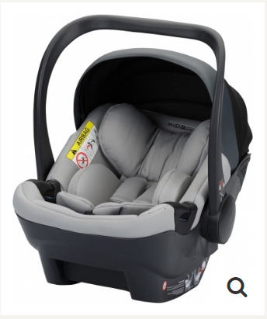
R44 or R129?
Size range upper limit
  Declared: 80cm
  Measured: 65cm
Does not fit R2 fixture

Slide 7

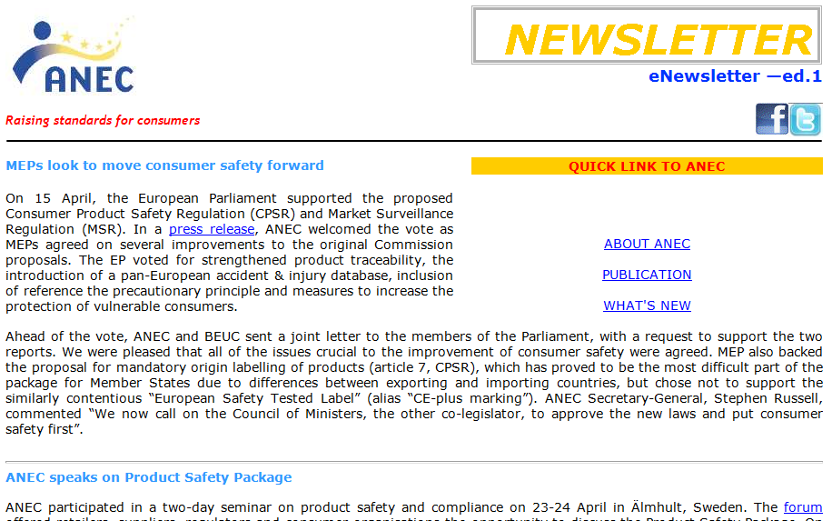



Thank you www.anec.eu
www.facebook.com/ANEC.Standards
@anectweet
ANEC is supported financially by the European Union & EFTA

