Slide 1
Submitted by the expert from CLEPA | Informal document GRSP-63-13 (63rd GRSP, 14-18 May 2018 agenda item 13)
CLEPA analysis of belt contact width measurement
(ref. GRSP/2018/6)
63rd GRSP session, 14-18 May 2018
Palais des Nations, Geneva

Slide 2
Review of actions since GRSP 62nd Session
The formal document GRSP/2017/39 proposed by NL defined a procedure to check the contact width between safety belt and the child.
During this session the proposal was amended to further clarify the procedure which resulted in GRSP-62-33-Rev.1 (issued with slight modifications as formal document GRSP/2018/6 for the 63rd GRSP session)
CLEPA and TSG were asked to check the procedure and provide their feedback in the 63rd GRSP session
CLEPA investigated the proposed procedure and the findings are summarized in this presentation

Slide 3
Current proposal for belt contact width measurement (GRSP/2018/6)
6.2.12. In the case of non-integral child restraint systems, the ease with which the straps and tongue of an adult belt pass through the fixture points shall be examined.
The simulated buckle, when installed on the bench, prior to all dynamic tests, shall not:
(a) pass through the fixture points or belt guides of non-integral child restraint systems, or
(b) permit a lie of the belt that leads to any contact narrower than 38 mm between the adult belt or simulated buckle and the child.
Measurement method:
The width of the contact between the belt and the dummy shall be assessed by measuring the minimum length between the effective sides of the belt.
If the belt, as seen in a cross section, takes the shape of a curve, the outside contour of the curve is measured.
If the belt in cross section has folds, the contact length is defined from side to side of the belt (see figure xx below).
Examples how to measure certain cases:
(Cross section of the belt)
Flat belt
Curved belt
Folded belt

Slide 4
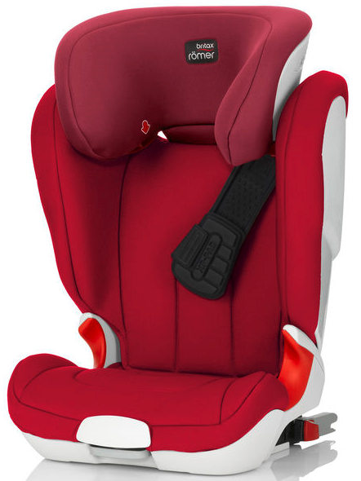
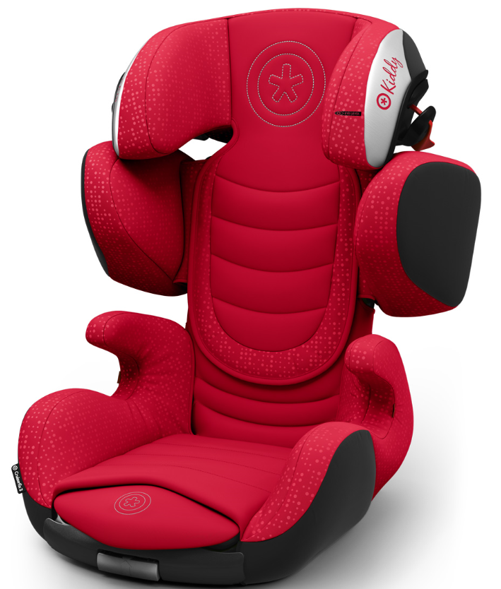
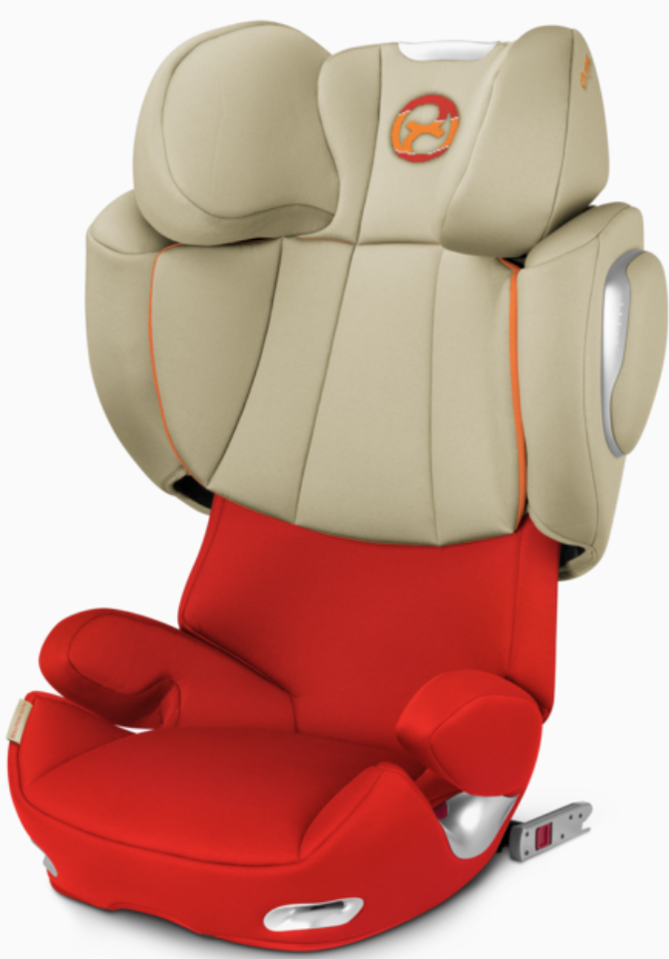
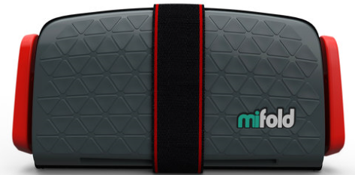
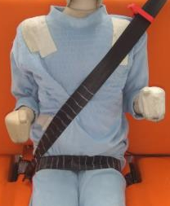
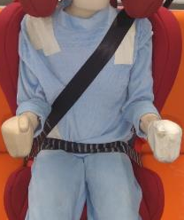
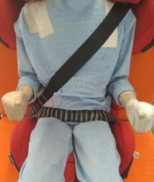
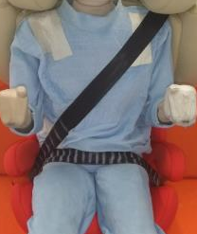
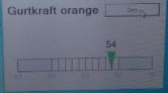
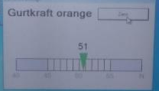
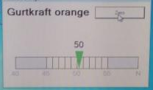
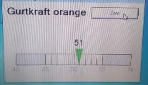
CLEPA feasibility study – Checked configurations
(Installation according to R44,
R44 test bench, P10 dummy)
CRS #1
CRS #2
CRS #3
CRS #4
Overview
Belt tension [N]

Slide 5
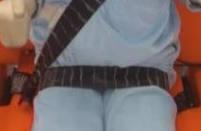
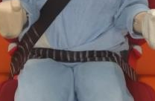
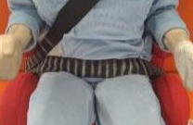
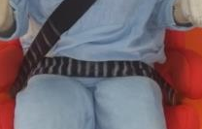
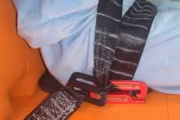
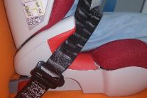
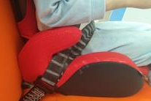
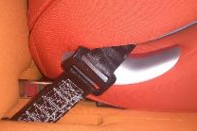
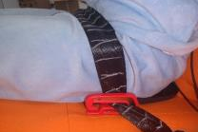
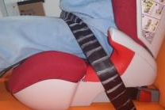
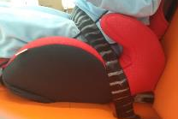
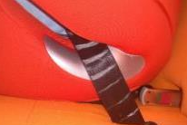
CLEPA feasibility study – Belt positioning
CRS #2
CRS #3
CRS #4
CRS #1
Front view
Buckle side
Non buckle
side

Slide 6
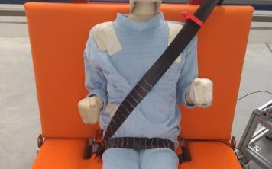
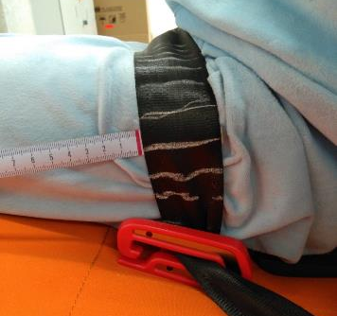
CLEPA feasibility study – Current proposal for belt contact width measurement
CRS #1
Interpretation how to perform this measurement:
The dummy is installed on the test bench acc. to the procedure described in R44 for a dynamic impact test
The belt width at the first and last point of contact with the dummy needs to be measured (two measurement points)
The measurement shall be carried out by inserting the measure tape under the belt and slide it towards the dummy until the belt begins to contact the dummy.
Measured values at the example child seats:
A
B

Slide 7
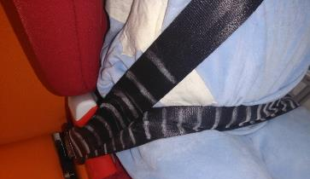
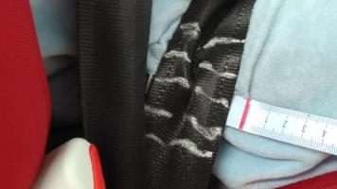
CLEPA feasibility study – Current proposal for belt contact width measurement
CRS #2
Examples for measurement cases:
General:
  First contact of the belt with dummy is a spot whose definition is subjective, but regardless of the selected spot all tested CRSs pass the requirement
Lap belt:
  Contact area on buckle side might be covered from shoulder belt
Summary:
Definition of measurement spots is subjective
Procedure needs to be improved with regards to feasibility and consistency
Measurement seem to add no value in assessing child seats as all tested CRS achieve similar values

Slide 8


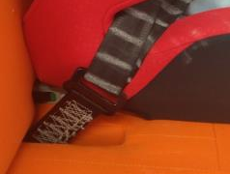
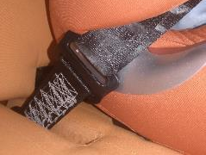
Suggestions for amendments – Measurement on lap belt
CRS #1
CRS #2
CRS #3
CRS #4
Belt width @ simulated buckle
16 mm
(Heavily crumpled)
48 mm
48 mm
48 mm
Suggested measurement
Observation:
Lap belt contact width shows clear difference between two types of booster seat designs.
The slot plate provides a suitable reference for measurement and allows good accessibility.
Safety belt
Proposal:
To assess the contact width of the lap belt it is proposed to measure the belt width at the slot plate of the simulated buckle.
Slot plate
Belt width

Slide 9
Proposal to amend GRSP/2018/6
Proposal to amend 6.2.12.:
In the case of non-integral child restraint systems booster seats and booster cushions, the ease with which the straps and tongue of an adult belt pass through the fixture points shall be examined.
The simulated buckle, when installed on the bench, prior to all dynamic tests, shall not:
(a) pass through the fixture points or belt guides of non-integral child restraint systems, or
(b) permit a lie of the belt that leads to any contact narrower than 38 mm between the adult belt or simulated buckle and the child,
(b) permit a lie of the lap belt within the slot plate that has a width narrower than 38 mm as described in Figure 1
Figure 1 - Suggested measurement
Safety belt
Slot plate
Belt width
Measurement method:
The width of the contact between the belt and the dummy shall be assessed by measuring the minimum width between the effective sides of the belt.
If the belt, as seen in a cross section, the outside contour of the curve is measured. If the belt in cross section has folds, the contact length is defined from side to side of the belt. (see figure xx below)
Flat belt
Curved belt
Folded belt

