Slide 1
Regulation on Blind Spot Information System for the Detection of Bicycles
Introduction and Summary of Changes from IWG VRU-Proxi
Informal document GRSG-115-33
(115th GRSG, 09-12 October 2018,
agenda item 6(b))

Slide 2
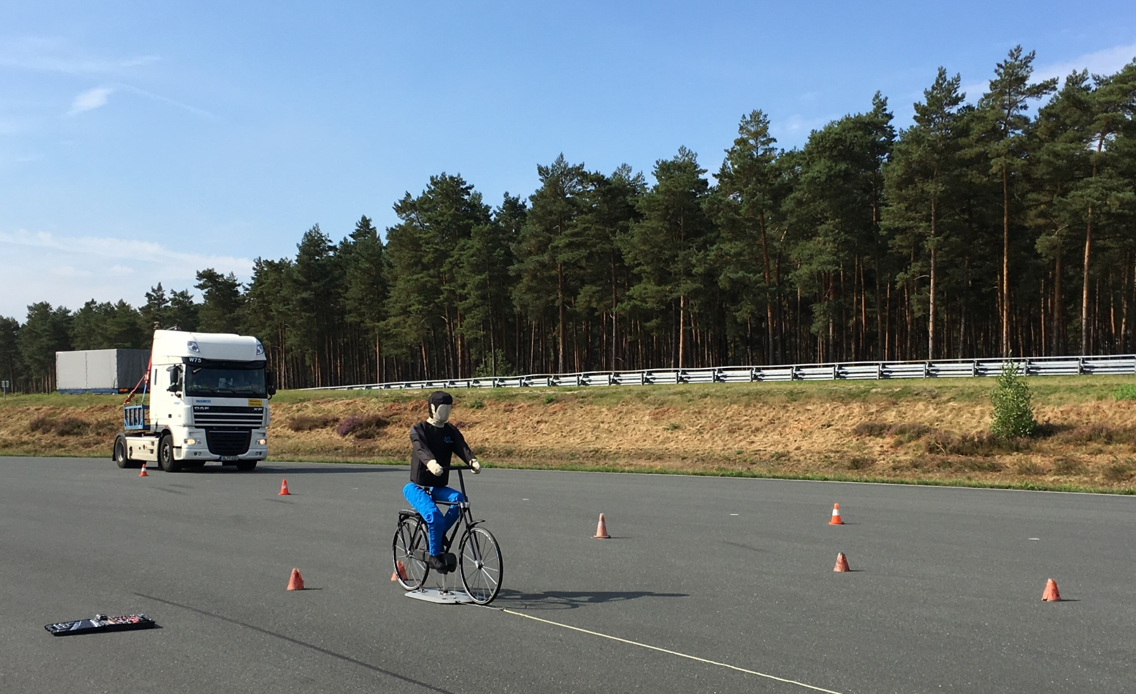
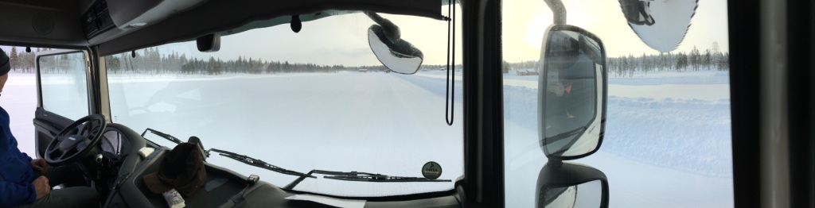
Introduction - Concept

Slide 3
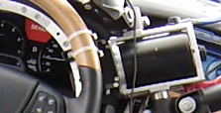
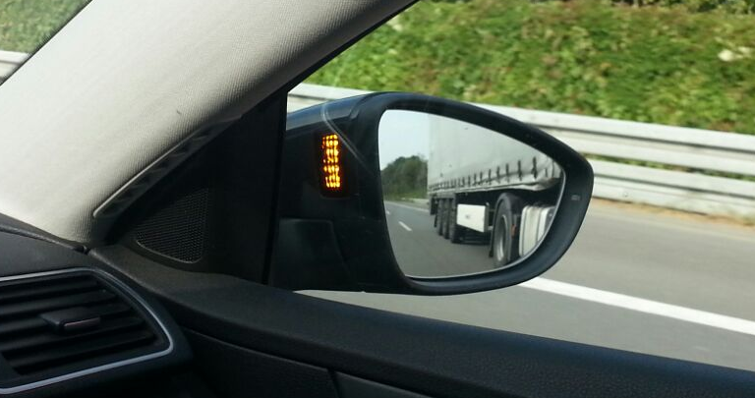
BSIS Concept: Warning and Information
Warning
  High intensity
  If issued right, good effects in
  steering driver‘s attention
  High annoyance if issued too often
  Required, but activation strategy not limited
Information
  Low intensity
  Low annoyance if issued too often
  Lesser effect in steering driver‘s
  attention
  Required with Performance Requirements

Slide 4
Modifications – Function
Optical information signal
> 30° to the right of the driver
Only automatic deactivation (ice, snow on sensors, …)
Additional warning signal
  Different to information signal
  Activation strategy decided by Vehicle Manufacturer
  not before collision becomes imminent
Operation
Vehicle speeds 0 (original proposal: 1) – 30 km/h
Lateral separation of 0.9 (1.25) to 4.25 m
Additional: Information signal for bicycles from 25 cm next to the most forward right wheel
Should detect children as well (36% smaller than 50% male)

Slide 5
Motivation for Warning Signal:
Multiple Cyclists
Cologne Accident (June 2018)
Truck driver stops, gives way to adult bicyclist
Does not see child on sidewalk
Blind Spot Information System
Information signal would have been activated for both cycles
No differentiation for second bicycle possible
Blind Spot Warning
Additional Warning would have been triggered when collision becomes imminent
→ When truck starts to move!
Garbage Collector Truck

Slide 6
Modifications – Tests
Dynamic test cases
  Tests conducted without actual turn manoeuvre
  → Test conduction simplified: Reduction from 12 to 7
  Information signal required 15 m before collision point
  (data shows turning manoeuvre starts not before 15 m)
  → Requirements NOT simplified!
  Information signal not too early
  Tests outside of test case table possible
New: Additional static test cases
  Vehicle stopped before roundabout
  Vehicle stopped at intersection
Cyclist Dummy: Reference to ISO [WD] 19206-4
BSIS System should work with 36% smaller
dummy-bicycle-combinations as well

Slide 7
Sensor Coverage Area
System Operation Requirements
  Coverage starts at 0.9 m separation
Tests without turning: Early information
  Longitudinal coverage area increased to 30 m (rear)
  Lateral coverage area reduced to 4.25 m (side)
Additional sensor coverage 0.25 to 0.9 m right of front wheel
New
…~30 m
~7 m
Approx. to scale, 16x2.55m

Slide 8
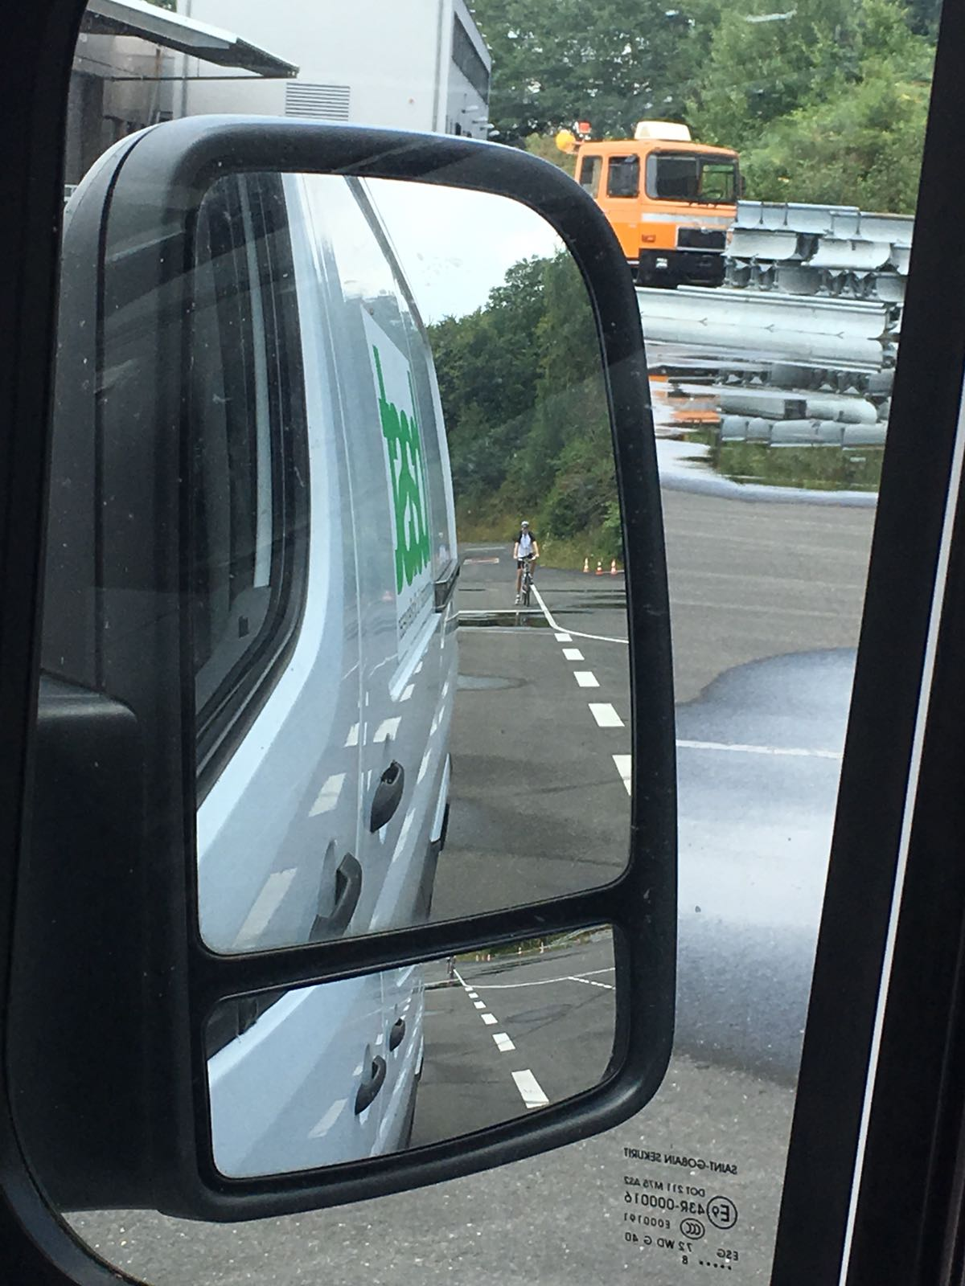
Impressions: Bicycle 30 m @ TTC=5 seconds
Test Case | vx,vut [km/h] | vx,bcy [km/h] | Lateral Offset | Max. Distance [m]
1 | 10 | 20 | 1,5 | 27,8
2 | 10 | 20 | 1,5 | 15,4
3 | 20 | 20 | 1,5 | 6,1
4 | 20 | 10 | 4,5 | -7,05
5 | 10 | 10 | 4,5 | 2,4
6 | 10 | 20 | 4,5 | 30
7 | 10 | 20 | 4,5 | 24
30 m → 5 s TTC!
30 m longitudinal,
1.5 m lateral

Slide 9
Summary
BSIS proposed regulation ECE/TRANS/WP.29/GRSG/2018/11 has been discussed in IWG VRU PROXI
Changes:
  Additional warning required
  Test cases modified
  Slight adjustments wrt coverage area, bicyclist size, vehicle speed
New document ECE/TRANS/WP-29/GRSG/2018/24 and small corrections GRSG-115-10 available, both agreed in IWG VRU PROXI

Slide 10
Open Issues
Scope:
This Regulation applies to the blind spot information system of vehicles of categories [M₂,] N₂ [(> 8 t permissible maximum mass)] and [M₃ and] N₃. Other vehicles may be approved at the request of the manufacturer.
Dummy reference:
ISO [WD] 19206-4 → “Working draft” changed to “Committee Draft” [CD]
Illumination:
The BSIS shall at least operate for all forward vehicle speeds from standstill to 30 km/h, for ambient light conditions above [1,000] Lux.

Slide 11
Thank you for your attention!
Federal Ministry of Transport
and Digital Infrastructure
Robert-Schuman-Platz 1
D-53175 Bonn

