Slide 1
Transmitted by the Chair and Secretary of VIAQ
Informal document GRPE-77-24
77th GRPE, 6-8 June 2018
Agenda item 12
Status Report of the
VIAQ (Vehicle Interior Air Quality)
Informal Working Group
GENEVA, June 8th 2018
Chair: Andrey KOZLOV, Russian Federation
Co-Chair: Jongsoon LIM, The Republic of Korea
Secretary: Mark POLSTER, Ford

Slide 2
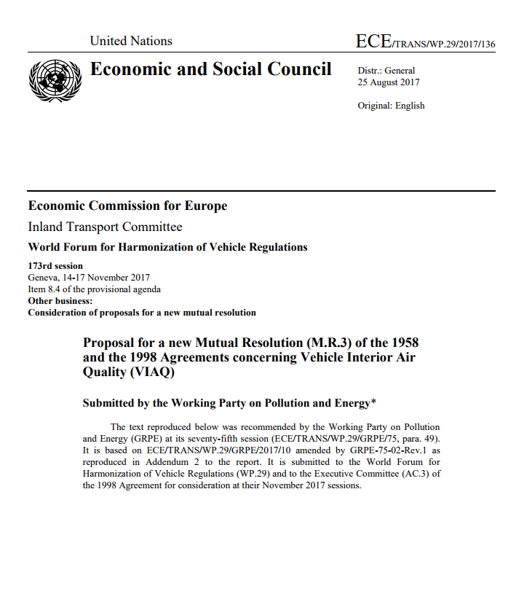
Background
During 173rd WP.29 session in Geneva (14-17 November 2017) Proposal for a new Mutual Resolution (M.R.3) for of the 1958 and the 1998 Agreements concerning Vehicle Interior Air Quality (VIAQ) was adopted (ECE/TRANS/WP.29/2017/136)
Notes:
2

Slide 3
Second Stage
VIAQ ToR and Mandate for the Second Stage
The Chair of the IWG on Vehicles Interior Air Quality (VIAQ) presented a status report on the ongoing activities of the group (GRPE-76-35). He recalled that the original mandate of the group ended in November 2017. He highlighted the conclusion of the work by the tabled proposal for a new Mutual Resolution on recommendations to harmonize test procedures of interior air emissions generated from interior materials (ECE/TRANS/WP.29/2017/136) which was adopted by WP.29 and AC.3 during 173rd WP.29 session in Geneva (14-17 November 2017). He recalled that WP.29 endorsed the extension of the mandate of the IWG on VIAQ until November 2020 to extend the work and consider not only emissions generated by interior materials, but also gases from other sources that enter into the vehicle cabin.
As Chair for the new stage of the IWG on VIAQ, the expert from the Russian Federation highlighted the existing standards on VIAQ in his country. He presented the revised Terms of Reference for the IWG on VIAQ (GRPE-76-27) which were adopted by GRPE
Notes:
3

Slide 4
ToR for the Second Stage
Terms of reference
Identify and collect the information and research data on interior air quality and its relevance for vehicles, taking into account the activities being carried out by various governments, and non-governmental organizations.
Identify and understand the current regulatory requirements with respect to vehicle interior air quality in different markets.
Identify, review and assess existing test procedures suitable for the measurement of harmful substance into the vehicle cabin (including test modes, sample collection methods and analysis methods, etc.)
Develop provisions and test procedures in a recommendation by including Part 3 in the Mutual Resolution No. 3.
Notes:
4

Slide 5
ToR for the Second Stage
Timeline
2018 2019 2020
1 2 3 4 5 6 7 8 9 10 11 12 1 2 3 4 5 6 7 8 9 10 11 12 1 2 3 4 5 6 7 8 9 10 11 12
WP.29
GRPE
VIAQ
180
181
182
76
77
78
79
80
81
VIAQ Madate
Informal
document
formal
document
11
12
13
14
15
16
17
18
19
20
21
Half of working items almost closed
Make a drafting grup
Develop provisions and harmonized test procedures.
VIAQ recommendation (a new part of M.R.3)
January 2020: Submit the draft document to GRPE
June 2020: Adoption of the draft document by GRPE
November 2020: Adoption of the draft document by WP.29
Notes:
5

Slide 6
VIAQ IWG Meetings since the last GRPE sessions
12th VIAQ IWG Meeting
• Paris, France, March 28-29th 2018
Two days
13th VIAQ IWG Meeting
• Geneva, Switzerland, June 6th 2018
Half a day
Notes:
6

Slide 7
Working Items
Vehicle Category
Test Vehicle age/millage
Substances to be Measured
Meteorological Conditions
Test Conditions
Test Modes
HVAC Modes
Test Procedure
Measurement Methods
Sampling Points
Sampling Method
Test Protocol
Notes:
7

Slide 8
Working Items
1. Vehicle Category
Category 1-1
Agreed Item
Notes:
8

Slide 9
Working Items
2. Test Vehicle age/millage
New cars from series production
Millage
3 000 -15 000 km
Agreed Item
Notes:
9

Slide 10
Working Items
3. Substances to be Measured
Formaldehyde СН₂О Nitrogen dioxide NO₂ Nitrogen oxide NO Carbon monoxide СО Saturated hydrocarbons (С₂Н₆…С₇Н₁₆) Methane CH₄
Carbon monoxide СО Nitrogen oxide NO
Nitrogen dioxide NO₂ Formaldehyde СН₂О
Methane CH₄ (only for natural gas vehicles)
Russian Standard
Agreed substances
Carbon monoxide СО
Nitrogen oxide NO Nitrogen dioxide NO₂
Particulate matter (PM)
Korea
For discussion
(see VIAQ-13-04)
Notes:
10

Slide 11
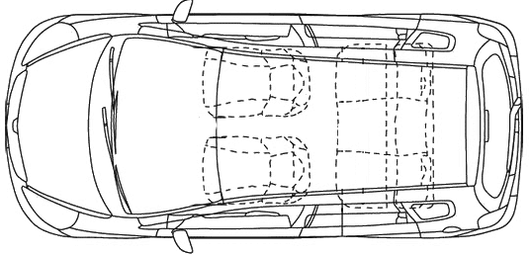
Working Items
10. Sampling Points
The point between headrests of front seats
Agreed Item
Notes:
11

Slide 12
Working Items
4.Meteorological Conditions / 5.Test Conditions
Tests of influence of wind speed and direction to concentration of substances inside a vehicle cabin at idling
Wind speed:
0 m/s
1 m/s
2 m/s
3 m/s
4 m/s
5 m/s
Wind direction:
0 deg.
45 deg.
90 deg.
wind direction
exhaust direction
Test facility is the wind tube in NAMI test center
12
Notes:
12

Slide 13
Working Items
6.Test Modes / 7.HVAC Modes
Different combinations of vehicle movement and HVAC modes was carried out
Movement at constant speed
50 km/h
90 km/h
110 km/h
130 km/h
2. Idling
3. Acceleration from speed of 60 km/h at WOT to speed of 130 km/h and free coasting down to speed of 60 km/h
On each of the driving and idling modes, the measurements of the pollutants were made during the performances of the following operating modes of the ventilation and recirculation systems
Recirculation mode | Ventilation speed
 | Off | Minimal | Medium | Maximum
Off
On
Notes:
13

Slide 14
Next VIAQ IWG Meeting
14th VIAQ IWG Meeting (TBD)
Moscow, Russia, 7-8th November 2018
Two days
15th VIAQ IWG Meeting (TBD)
Geneva, Switzerland, January 2018 during 78th GRPE session
Half a day
Notes:
14

