Slide 1
Submitted by the expert from Poland
Informal document GRE-79-23
(79th GRE, 24-27 April 2018, agenda item 6 (b))
SUMMARY OF INITIAL AIMING AND LEVELLING TOLERANCE ISSUE
Poland April 2018

Slide 2
A) PRESENT STATE OF AIMING AND LEVELLING IN REG. 48 SIGNIFICANTLY INFLUENCE FOR NIGHTTIME TRAFFIC SAFETY
1) GLARE IS TREATED AS THE MOST IMPORTANT ISSUE
2) TYPE APPROVAL LIMITS ONLY GUARANTEE 20m ROAD ILLUMINATION DISTANCE - WORST CASE (SEE GRE-72-27, GRE-70-41-Rev.1)
B) IMPROPER PRESENT „BOX” REQUIREMENTS
1) AT THE BEGINNING OF UN ECE REGULATION (1950s) MANY YEARS WITHOUT PROVISIONS FOR INITIAL AIM AND LEVELLING TOLERANCE
2) VERY SIMPLIFIED LEVELLING REQUIREMENTS IN 1980s NOT TAKING INTO ACCOUNT MOUNTING HEIGHT, ONLY SLIGHTLY MODIFIED IN 1990s
C) ARTIFICIAL FLUX BASED AUTOMATIC LEVELLING OBLIGATION
1) TYPICAL AUTOMATIC LEVELLING PERFECTLY CONTROL INCLINATION
2) 2000 lm FLUX SEPARATION BETWEEN MANUAL AND AUTOMATIC LEVELLING WAS INTRODUCED WHEN HID LIGHT SOURCES WERE BEING INTRODUCED BUT THIS CRITERION IS QUESTIONABLE.
3) LACK IN Reg. 48 SPECIFICATION OF AUTOMATIC LEVELLING SYSTEM - E.G. PRECISION AND CHARACTERISTICS (STATIC, DYNAMIC, ETC.)

Slide 3
D) MISTAKES OF CURRENTLY PRESENTED POSITIONS
1) LOOKING AT GLARE AND IGNORING ROAD ILLUMINATION DISTANCE
BOTH ROAD ILLUMINATION AND GLARE PROTECTION ARE IMPORTANT FOR SAFETY
ROAD USERS COMPLAINTS ARE NOT SUFFICIENT AS JUSTIFICATION
OBJECTIVE SAFETY SHOULD BE BASE FOR DECISION
2) REQUEST FOR AUTOMATIC LEVELLING ONLY
- QUALITY AND PRECISION OF AUTOMATIC SYSTEM IS CRUCIAL
- NOT TECHNOLOGY NEUTRAL
3) REQUEST TO FIND ALTERNATIVE TO ARBITRAL 2000 lm CRITERION
- NOT POSSIBLE AND NO NEED TO FIND SUCH CRITERION
4) CARMAKERS REQUEST TO REQUIRE 1.6% CUT-OFF INCLINATION RANGE FOR MANUFACTURING PURPOSES
- SAFETY AND WORST CASE ARE PRIORITIES FOR TYPE APPROVAL
AUTOMATIC LEVELLING PERFECTLY COMPENSATE MANUFACTURING NON REPEATABILITY AND THERE IS NO JUSTIFICATION TO REQUEST SUCH RANGE AT THE EXPENSE OF SAFETY
- MANUAL LEVELLING MIGHT BE CONDITIONALLY ALLOWED PROVIDING NO NEGATIVE IMPACT FOR ROAD ILLUMINATION AND GLARE

Slide 4
E) GTB/OICA PROPOSAL BASED ON INADEQUATE ASSUMPTIONS
1) BASED ON CIE 188:2010 STANDARD WHICH IS RELATIVE ONE AND NOT SUITABLE FOR NEW DESIGN. IT WAS INTEND TO COMPARE HEADLAMPS WHICH WERE EARLIER TYPE APPROVED
2) IT IS BASED ON RESULTS OF SIX ARBITRAL CHOSEN TYPE APPROVED AND GOOD PERFORMING HEADLAMPS BEAM PATTERN (Reg. 112, Reg. 98,) ON REAL CARS MOUNTING HEIGHT Reg. 48
3) THERE ARE NOT THE MINIMUM WORST CASE REQUIREMENTS
ROAD ILLUMINATION
4) PROPOSAL BASED ON 50 m RANGE COMBINATION OF SIX ABOVE DIFFERENT HEADLAMPS EACH AT DIFFERENT HEIGHT
GLARE
5) FIXED GLARE WINDOW AT 50 m (CIE 188:2010) AND AVERAGE FLUX IN WINDOW :
- INADEQUATE TO REAL GLARE
- NOT RELEVANT FOR DISTANCE DIFFERENT THAN 50m AND RELATION HEIGHT TO INCLINATION
6) VEHICLE TYPE APPROVED ACCORDING GTB/ OICA MIGHT CAUSE GLARE OR POOR ILLUMINATE THE ROAD

Slide 5
F) MANUAL OR AUTOMATIC LEVELLING SYSTEM
1) THE MAIN ISSUE IS TO GUARANTEE PROPER CUT-OFF INCLINATION FOR ANY LOAD CONDITION
2) TYPICAL CONTEMPORARY AUTOMATIC LEVELLING SYSTEM CONTROLS CUT-OFF INCLINATION BETTER THAN POSSIBLE TO MEASURE
3) SOME AUTOMATIC LEVELLING MAY PERFORM REALLY VERY POOR AND SHOULD NOT BE USED
4) AUTOMATIC LEVELLING IS NOT EXPENSIVE
5) MANUAL LEVELLING CAN PERFORM ALSO PROPERLY BUT ONLY UNDER SPECIFIC CONDITION (PRECISION, DRIVER AWARENESS AND COOPERATION)
G) POLISH PROPOSAL - STARTING 2011 - TILL NOW
1) TRUE PERFORMANCE BASED AND TECHNOLOGY NEUTRAL
2) MINIMUM ROAD ILLUMINATION DISTANCE 75m (50m) BASED ON SIMPLE AND OBVIOUS GEOMETRIC CALCULATION
3) SIMILAR GEOMETRIC GLARE CALCULATION AND JUSTIFICATION
4) COVER ALL MOUNTING HEIGHTS AND VEHICLES (M, N)

Slide 6
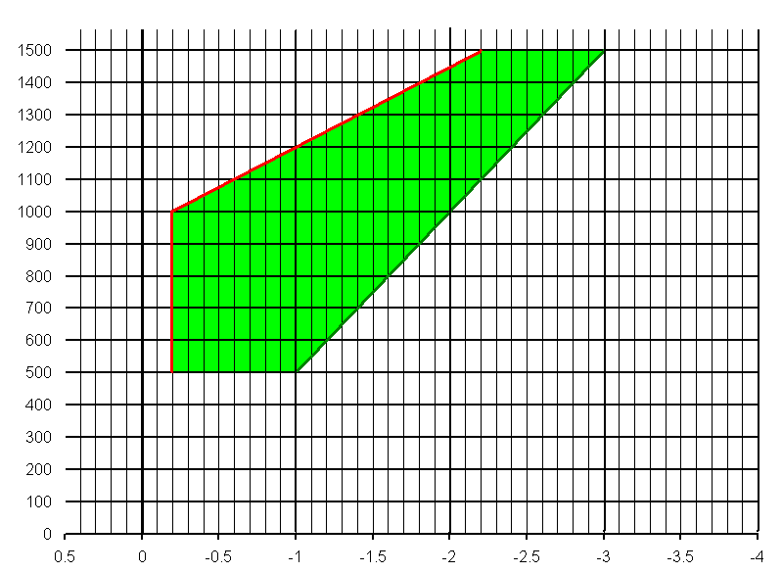
MINIMUM ROAD
ILLUMINATION DISTANCE
50m
POLISH PROPOSAL
Notes:
6

Slide 7
Thank you for attention

