Slide 1
GRBP 69th session
Document GRB-69-12
Agenda item 7.a
EMT
ETRTO answer to Contracting Party
question from GRB 68th session

Slide 2
From report GRB 68th session
28. The expert from ETRTO proposed amendments to UN Regulations Nos. 30 and 64 which introduce provisions related to extended mobility tyres (EMT) (ECE/TRANS/WP.29/GRVA/2018/6, ECE/TRANS/WP.29/GRVA/2018/7 and GRB-6814). He pointed out that EMT were already available on the market and needed to be regulated. The experts from Germany, Italy and Japan supported the proposals. The experts from France, Netherlands and Switzerland posed questions. The expert from UK requested data on the availability of EMT on the market. GRB was of the view that Contracting Parties needed more time to study the proposals and decided to defer this item to the next session.

Slide 3
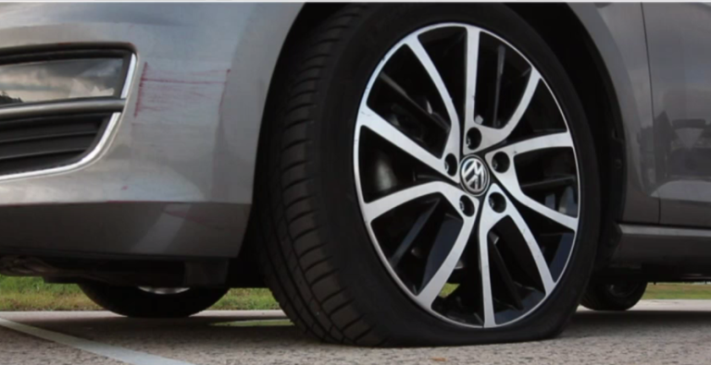
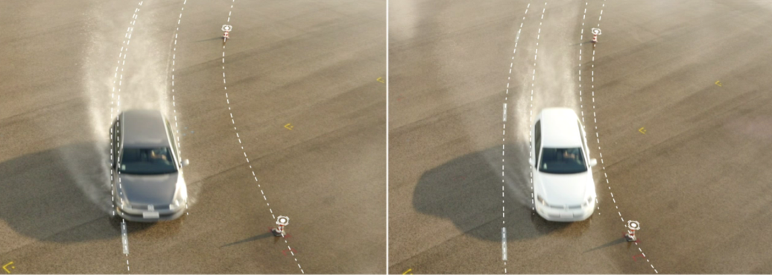
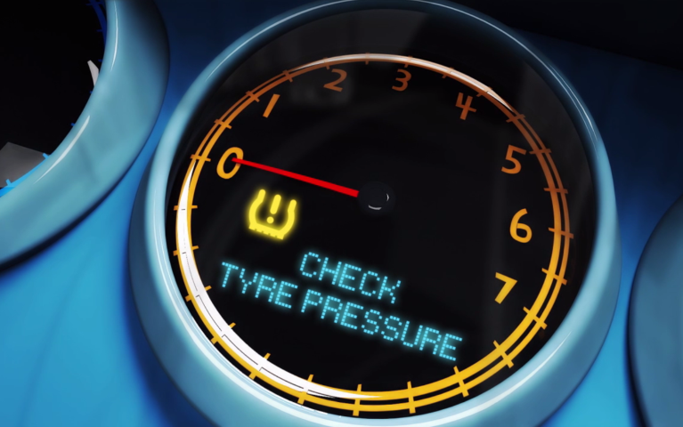
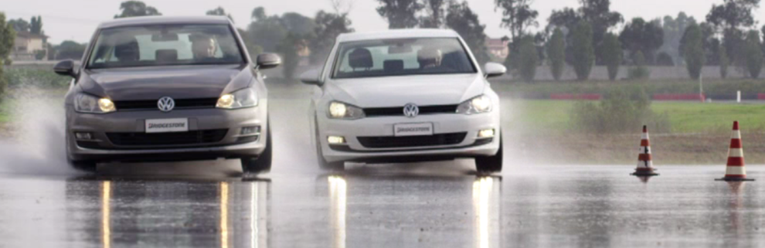
EMT: WHAT WE ARE TALKING ABOUT
RADIAL TYRES
YOU GOT A PUNCTURE
Without extended mobility capability
With extended mobility capability
To regulate
as EMT tyres

Slide 4
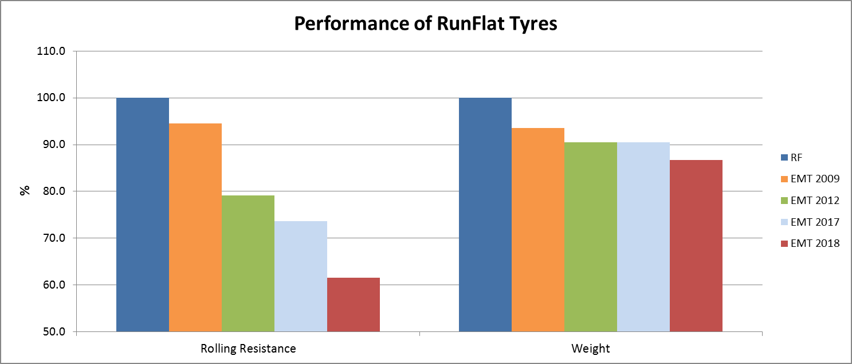
ACEA DATA ON RF vs. EMT
FROM GRRF-86-04
In addition to the performances set for conventional inflated tyres,
OEMs / Tyre Manufacturers needs
Rolling resistance improvement → Fuel consumption / CO₂ reduction.
Weight and stiffness improvement → better NVH (comfort, acoustics).
Chassis loads reduction → enabler for light-weight chassis components and consequent reduction of fuel consumption/CO₂ and safety increase due to reduced inertia.
Considerations
80 km on vehicle always kept
All the performance improvements were obtained without compromising vehicle dynamics in flat mode. Running EMT projects still show margin for improvement in weight and rolling resistance. EMT completely fulfils customer expectations as no complaint from the market was received.
ACEA Confidential data
At least 80 km on vehicle kept
-38%
-13%

Slide 5
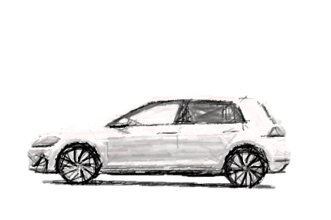
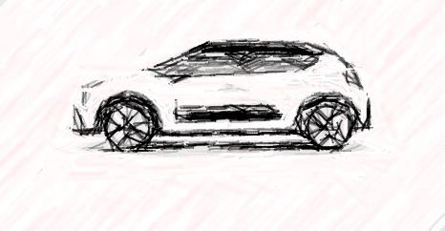
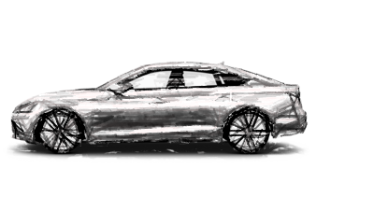
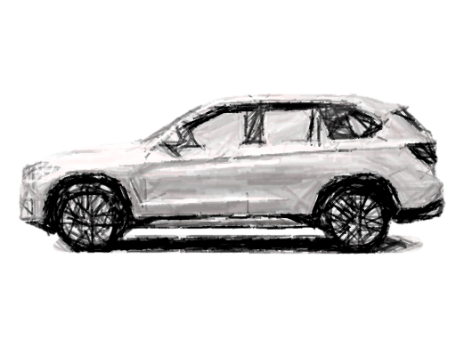
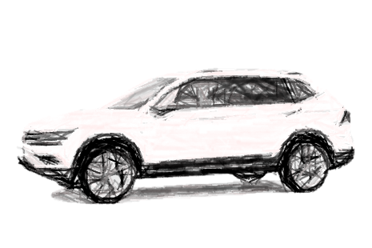
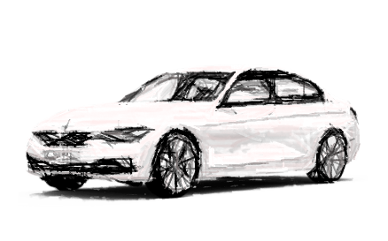
EMT PERFORMANCE EVIDENCE BIG PICTURE
FROM GRB-68-14
SW | AR | STRUCTURE | RIM CODE | LI | SS
225 | 45 | R | 17 | 91 | W
225 | 60 | R | 17 | 99 | V
255 | 40 | R | 18 | 95 | Y
195 | 55 | R | 16 | 87 | V
225 | 50 | R | 17 | 94 | W
245 | 50 | R | 18 | 100 | W
255 | 55 | R | 18 | 109 | V
255 | 50 | R | 19 | 103 | Y
315 | 35 | R | 20 | 110 | Y
285 | 40 | ZR | 19 | 103 | Y
225 | 50 | R | 18 | 95 | W
225 | 55 | R | 17 | 97 | W
255 | 40 | R | 18 | 95 | Y
205 | 60 | R | 16 | 96 | H
225 | 50 | R | 17 | 98 | H
265 | 50 | R | 19 | 110 | H
185 | 65 | R | 15 | 92 | V
205 | 55 | R | 16 | 94 | W
215 | 65 | R | 16 | 98 | V
225 | 45 | R | 17 | 94 | Y
245 | 45 | R | 18 | 100 | Y
255 | 35 | R | 19 | 96 | Y
ACTUAL EMT ON M1 SEGMENTS = 80 x 80 ON VEHICLE
C: medium cars
D: large cars
E: executive cars
F: luxury cars
J: sport utility cars
M: Multi purpose cars
S: Sports cars
GRB SEPT18: CPs requested additional data
LIST OF SIZES FROM ETRTO DoE & PRIVATE MANUFACTURERS DATA
PICTURES ARE EXAMPLES ONLY

Slide 6
EMT PERFORMANCE EVIDENCE – ADDITIONAL DATA
SW | AR | STRUCTURE | RIM CODE | LI | SS
225 | 45 | R | 17 | 91 | W
225 | 60 | R | 17 | 99 | V
255 | 40 | R | 18 | 95 | Y
195 | 55 | R | 16 | 87 | V
225 | 50 | R | 17 | 94 | W
245 | 50 | R | 18 | 100 | W
255 | 55 | R | 18 | 109 | V
255 | 50 | R | 19 | 103 | Y
315 | 35 | R | 20 | 110 | Y
285 | 40 | ZR | 19 | 103 | Y
225 | 50 | R | 18 | 95 | W
225 | 55 | R | 17 | 97 | W
255 | 40 | R | 18 | 95 | Y
205 | 60 | R | 16 | 96 | H
225 | 50 | R | 17 | 98 | H
265 | 50 | R | 19 | 110 | H
185 | 65 | R | 15 | 92 | V
205 | 55 | R | 16 | 94 | W
215 | 65 | R | 16 | 98 | V
225 | 45 | R | 17 | 94 | Y
245 | 45 | R | 18 | 100 | Y
255 | 35 | R | 19 | 96 | Y
AVAILABLE FOR | EMT TEST | VEHICLE PERFORMANCE
Mercedes A Class | OK | at least 80 x 80
BMW X3 | OK | at least 80 x 80
BMW 3 Series | OK | at least 80 x 80
Mini | OK | at least 80 x 80
BMW 3 Series | OK | at least 80 x 80
Mercedes S Class | OK | at least 80 x 80
BMW X5 | OK | at least 80 x 80
Rolls Royce Ghost | OK | at least 80 x 80
BMW X5 | OK | at least 80 x 80
BMW X5 | OK | at least 80 x 80
BMW X1 | OK | at least 80 x 80
Mercedes GLA | OK | at least 80 x 80
BMW 3 Series | OK | at least 80 x 80
Mercedes C Class | OK | at least 80 x 80
BMW 3 Series | OK | at least 80 x 80
BMW X5 | OK | at least 80 x 80
Citroen C3 | OK | at least 80 x 80
VW Golf | OK | at least 80 x 80
VW Tiguan | OK | at least 80 x 80
VW Golf | OK | at least 80 x 80
Audi A6 / BMW 5 Series | OK | at least 80 x 80
Audi A4 | OK | at least 80 x 80
CO-DEVELOPED WITH OEMS
REPLACEMENT
This list of tyres and vehicles is not exhaustive

Slide 7
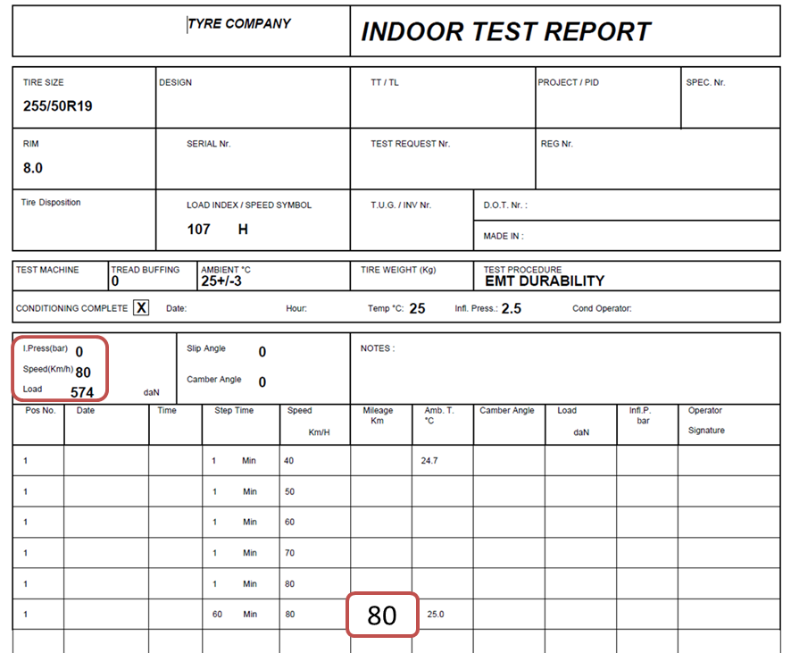
EMT PERFORMANCE EVIDENCE – EXAMPLE OF INDOOR TESTING
This tyre was tested according to EMT indoor procedure:
Zero inflation pressure,
80 km/h
60% Load Index
25°C
And achieved 80 km distance

Slide 8
EMT PERFORMANCE EVIDENCE – EMT ON VEHICLES
TYRE SIZES ¹⁾
245/40R19 98Y
245/45R17 99Y
245/45R18 100Y
255/40R19 100Y
255/40R20 101Y
255/45R20 101Y
255/55R18 109V
285/45R19 111W
Road test
TYRE | EMT test | ROAD test
A | 98 km | 80 km stop
B | 91 km | 80 km stop
C | 99 km | 80 km stop
D | 100 km | 80 km stop
E | 93 km | 80 km stop
F | 78 km | 80 km stop
G | 90 km | 80 km stop
H | 87 km | 80 km stop
Circuit length | > 20 km
Vehicle Load | +/- 80% max axle load
Speeds (acceleration, deceleration) | up to 80 km/h
Corners | yes
Lateral Acceleration | yes
0 kPa & valve out (drive axle) | yes
Running flat requirement | 80 km
1) May include tires still under development
Although there is no strong correlation between drum and vehicle tests, tyres that pass the drum test can provide safe performance on vehicle at least for the minimum requirement of 80 km at 80 km/h.

Slide 9
CONCLUSIONS
ETRTO considers that there is the evidence that a tyre meeting the drum test requirements will be able “to provide the vehicle with the basic tyre functions at a speed of 80km/h and a distance of 80 km when operating in flat tyre running mode.”
ETRTO recommends to provide the proper legal framework to Extended Mobility Tyres within UN R.30 while recognising EMT as an emergency mobility equipment in UN R.64, as per GRVA/2018/6 and GRVA/2018/7 Working Documents.

