Slide 1
Railway timetabling tools with automatic solutions
Jerzy Kleniewski
(in close collaboration with the Polish railways Infrastructure Manager –
the PKP Polish Railways – Polskie Linie Kolejowe S.A.)
Nov. 2018

Slide 2
About SKRJ…
Timetable construction process is realised with SKRJ application and its connected modules:
Internet application for path requests – complex www app for request handling;
SKRJ Octopus – web service interface – online connection for RU’s IT tools;
PDP – Passenger Portal – enables IM creating station timetables, internet searching tool for connections with train tracking in real time for passengers.

Slide 3
About SKRJ…
Programmed in DELPHI;
Invented and developed by PKP PLK IT department;
Development has started in 2007: first module for automatic catalogue path launched in 2009 and in 2010 module for „ad hoc” paths construction;
Full implementation from timetable 2014 (for annual and alternative TT).

Slide 4
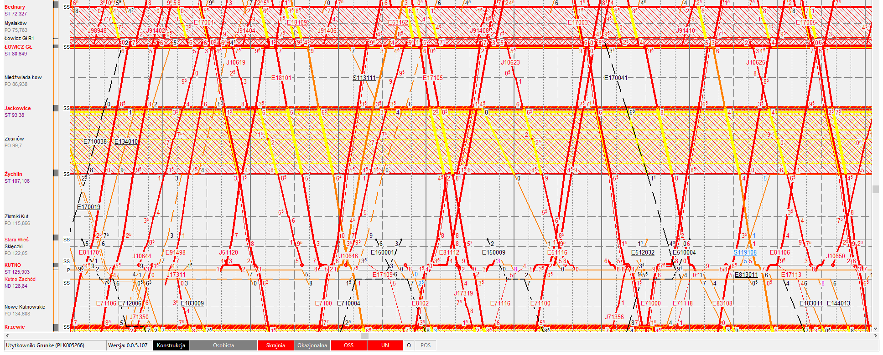
About SKRJ…
3 000 ad hoc requests daily;
Average waiting time for timetable is 60 minutes;
TT amended 5 Times per year to include 3500 – 4 000 temporary capacity restrictions each time;
171 constructor positions in TT department.

Slide 5
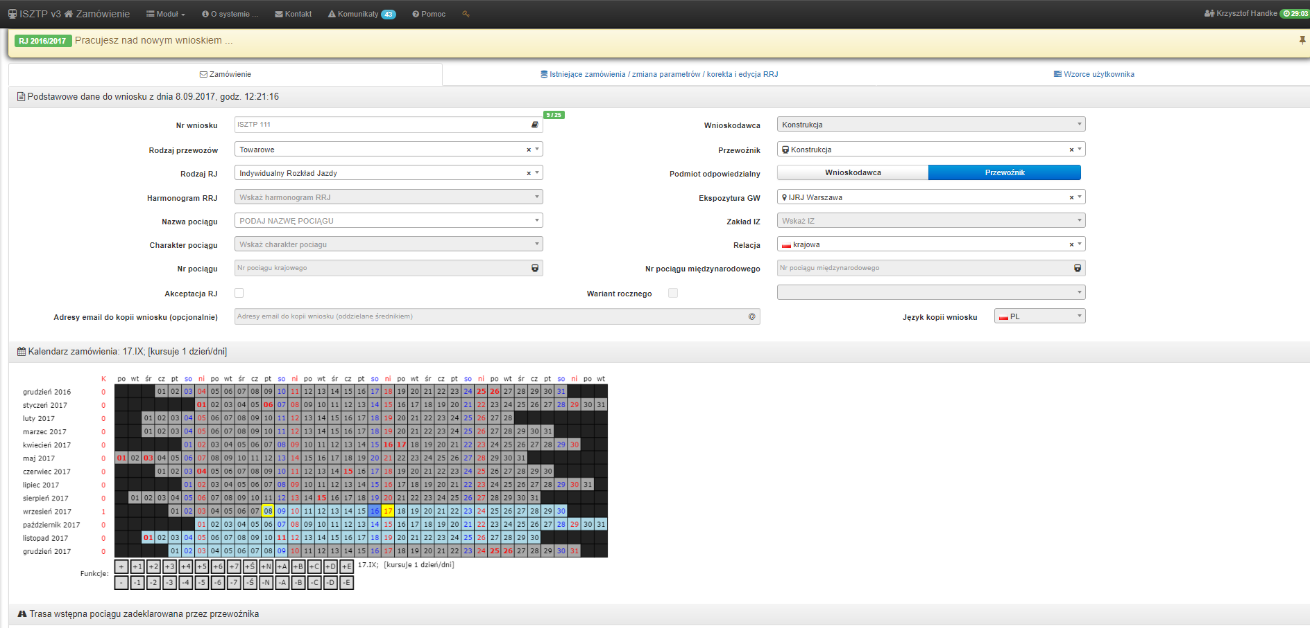
Path request
Path request are done 24/7 using dedicated internet application or web service;
Automatic correctness of path requests verifications are done at each stage (missing data, type of train, calendar etc.).

Slide 6
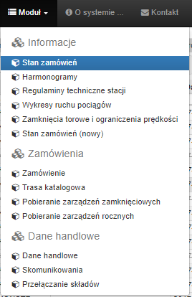
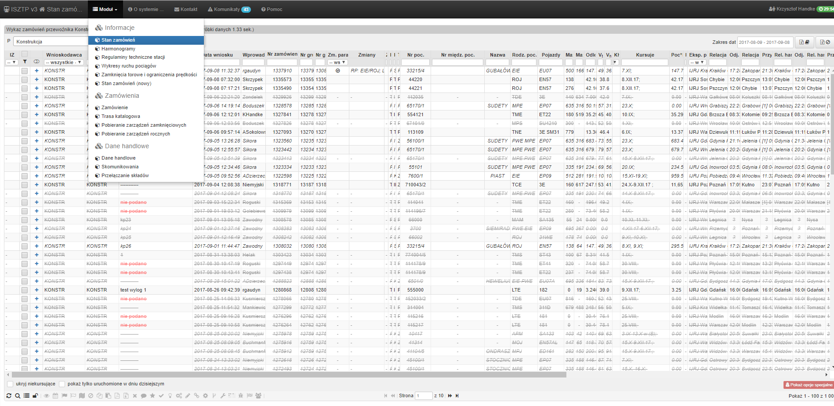
Path request
The carrier can keep track of the implementation status and has access to all orders

Slide 7
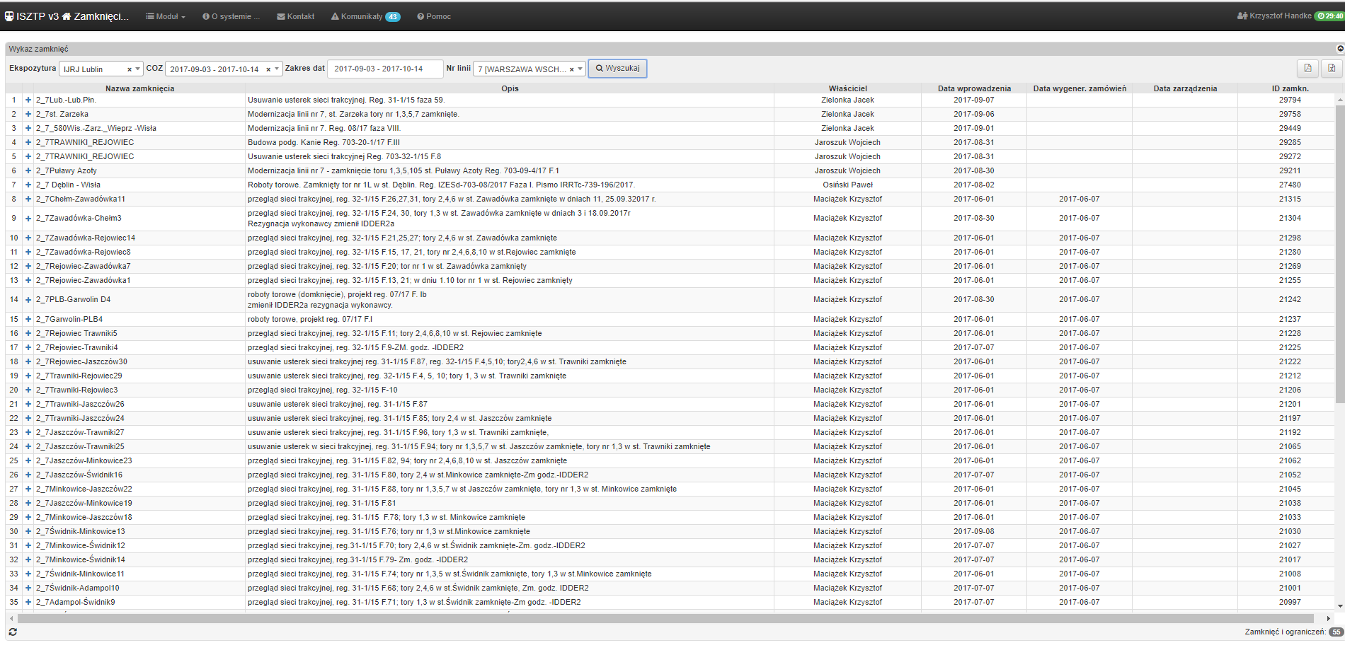
Path request
Application enables:
- Data input related to commercial data for passengers (facilities for handicapped infos, bike cars etc.) and train composition;
Handling of pax transfers between trains;
Timetable graphs display.

Slide 8
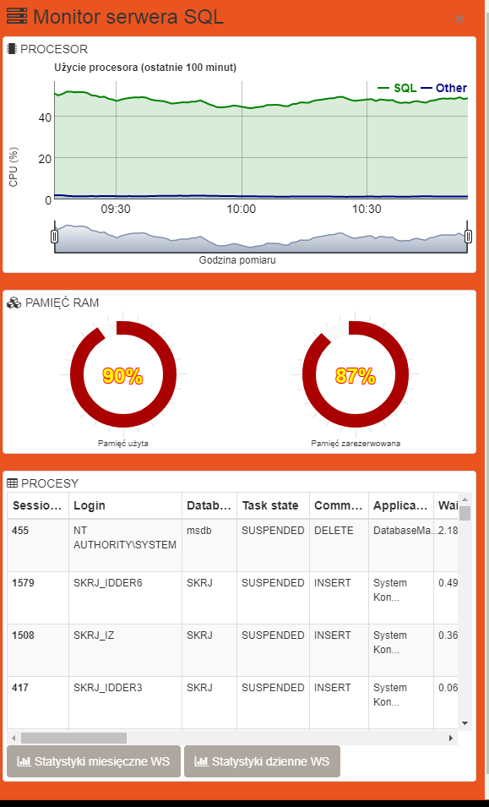
SKRJ WebService „Octopus”
Each RU may use webservice Octopus to connect its own tool with SKRJ;
Currently timetables are being delivered via the PLK webservice interface directly to locos, moreover Octopus feeds passenger trains screens with timetable information;
Webservice is monitored permanently with regard to its functioning and usage;
Due to high interest completely new interface has been created.
19 Rus (carriers)
Average 500 000 queries daily

Slide 9
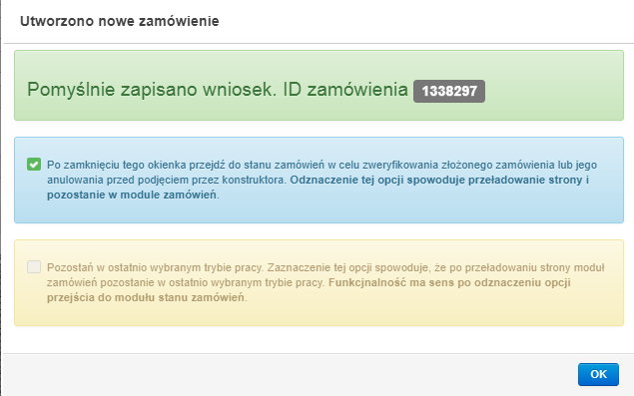
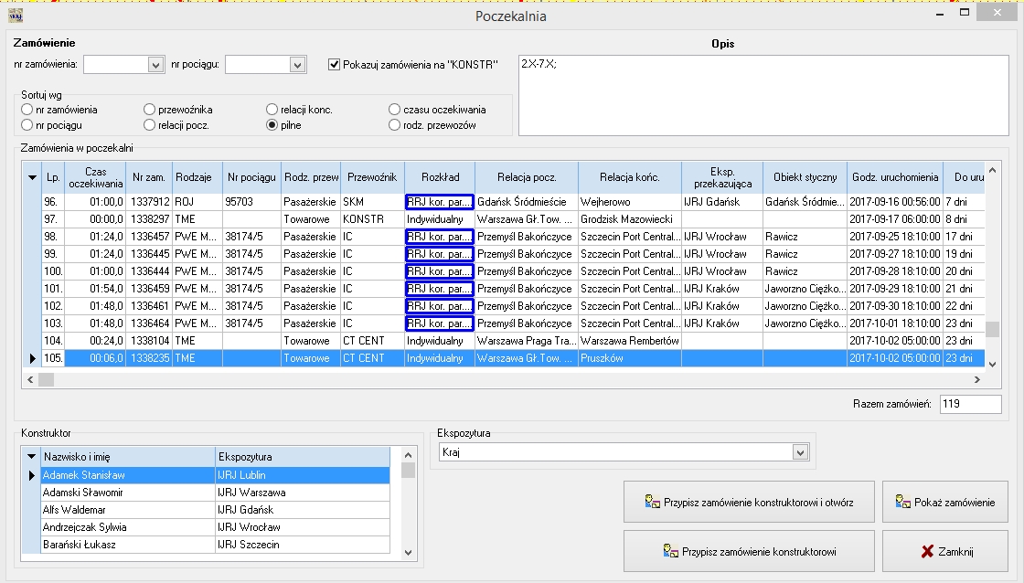
Path request realisation 1/4.
Each application, after submission by the carrier, goes to the development by the constructor
Queuing of requests according to the priority of the nearest start

Slide 10
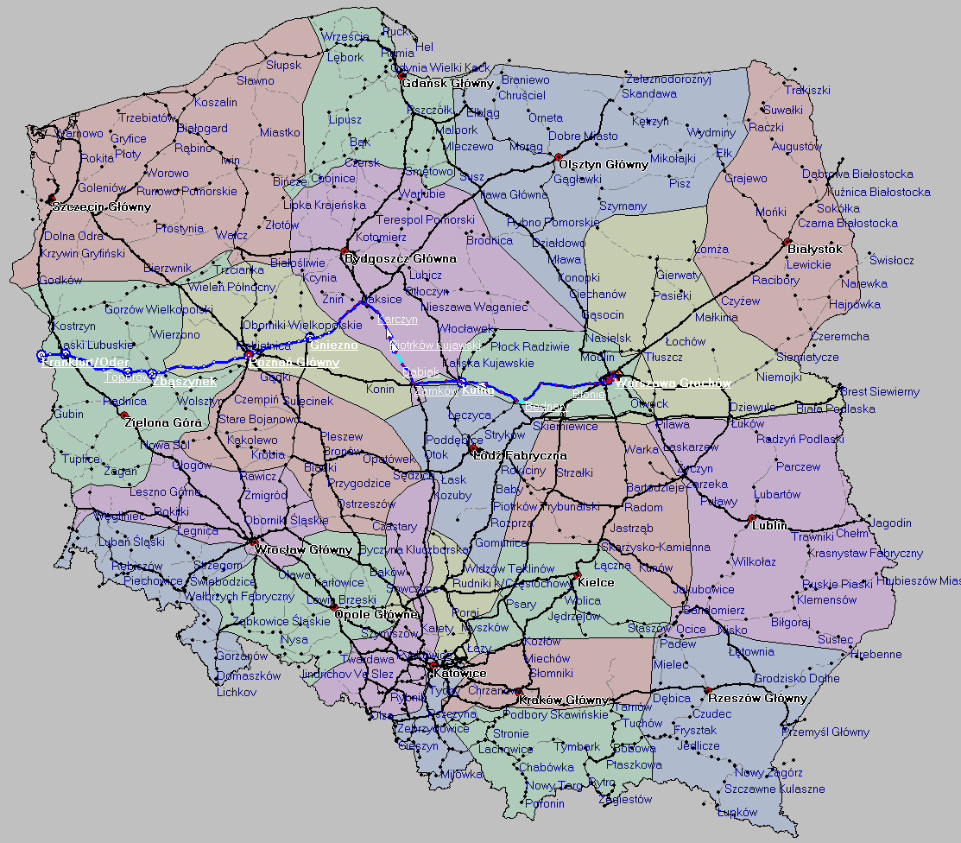
Path request realisation 2/4.
Path elaboration starts with route indication on the map which can be done manually by constructor or automatically using history of previously constructed paths.

Slide 11
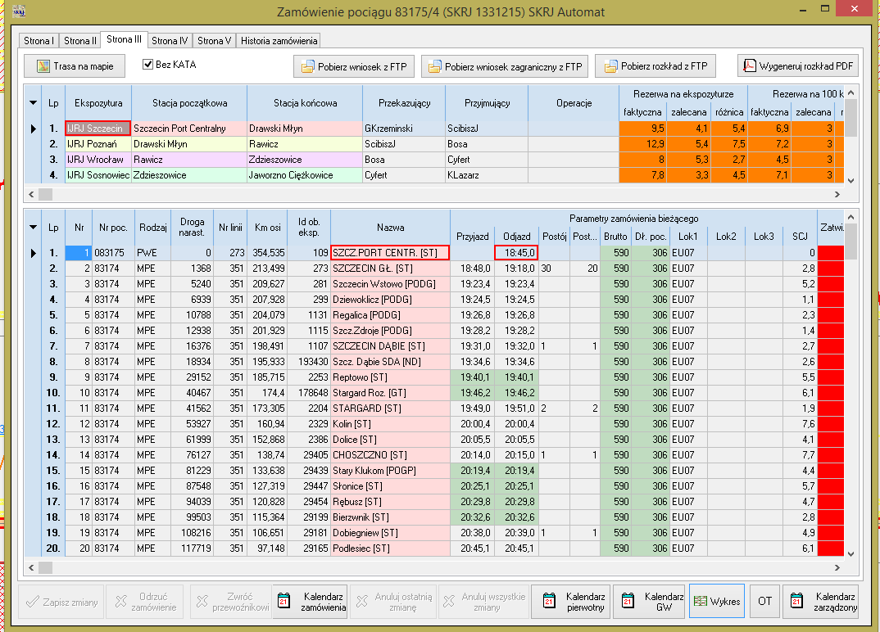
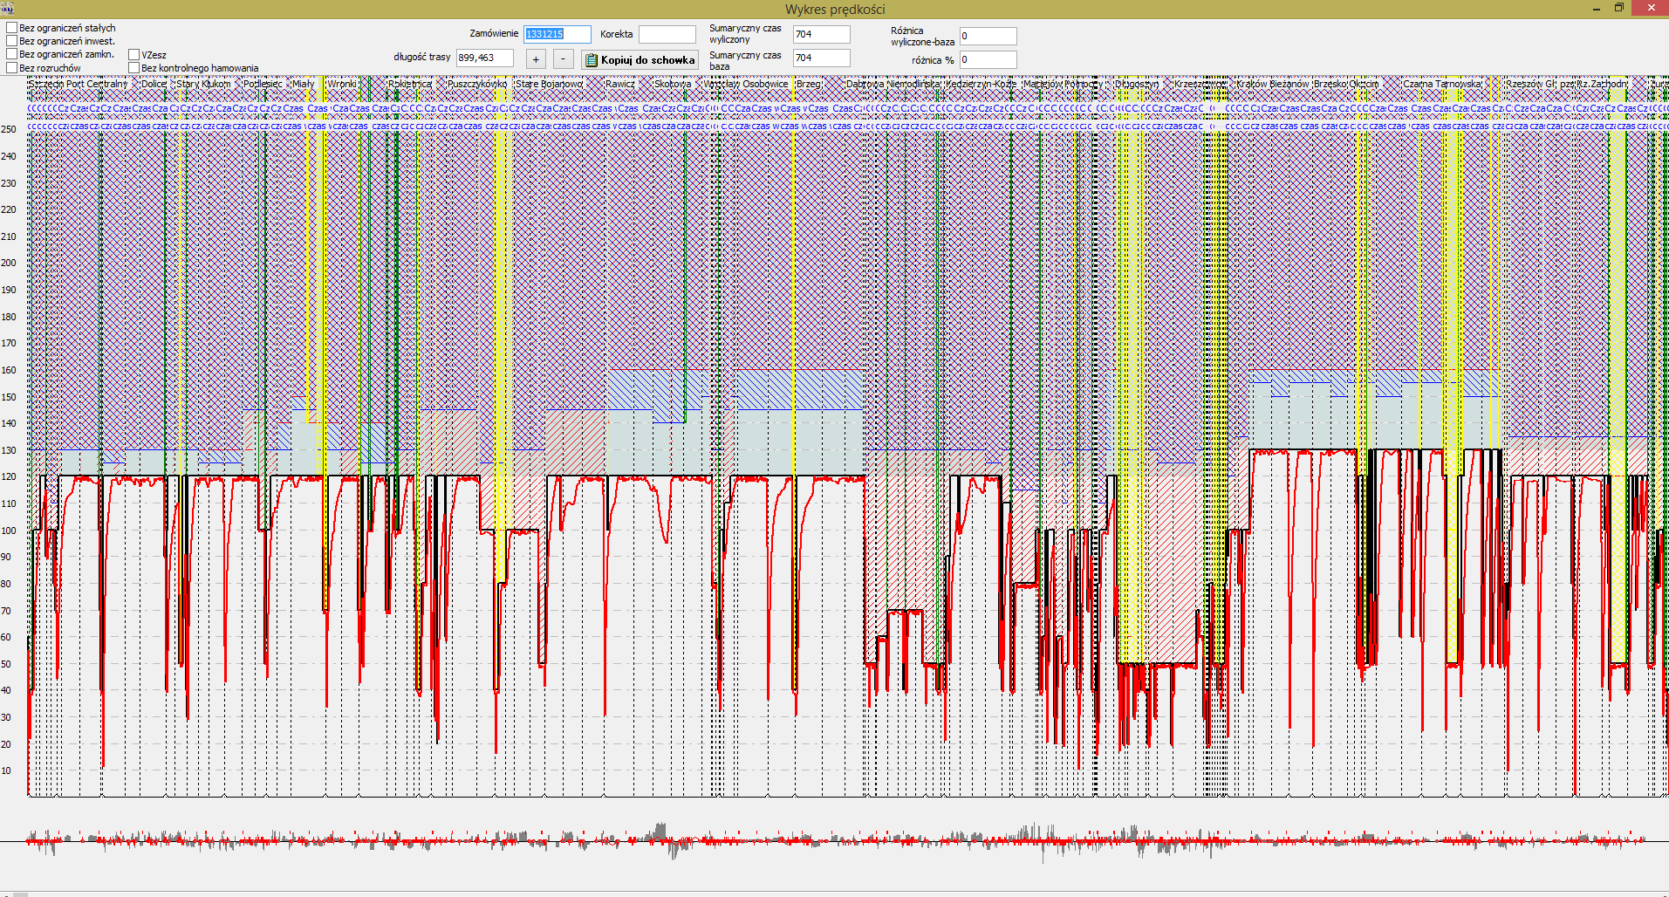
Path request realisation 3/4.
After marking the route, automatic calculation of travel times takes place, taking into account all infrastructure parameters

Slide 12
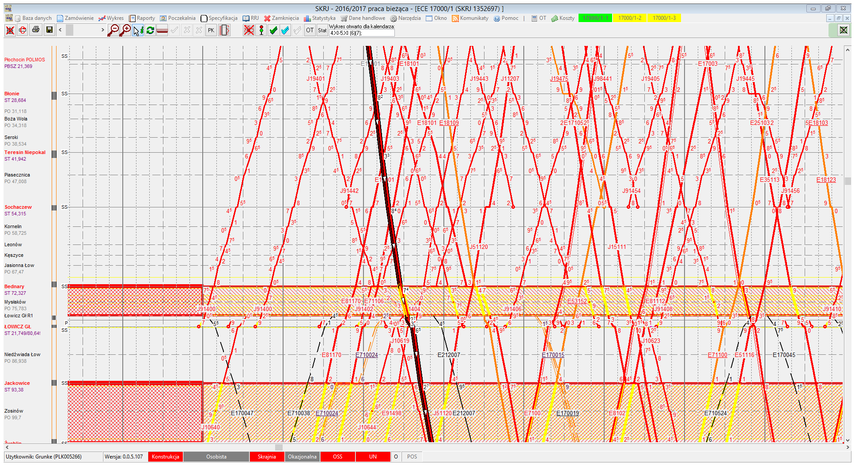
Path request realisation 4/4.
The final stage - working on the motion graph and determining the final running times.

Slide 13
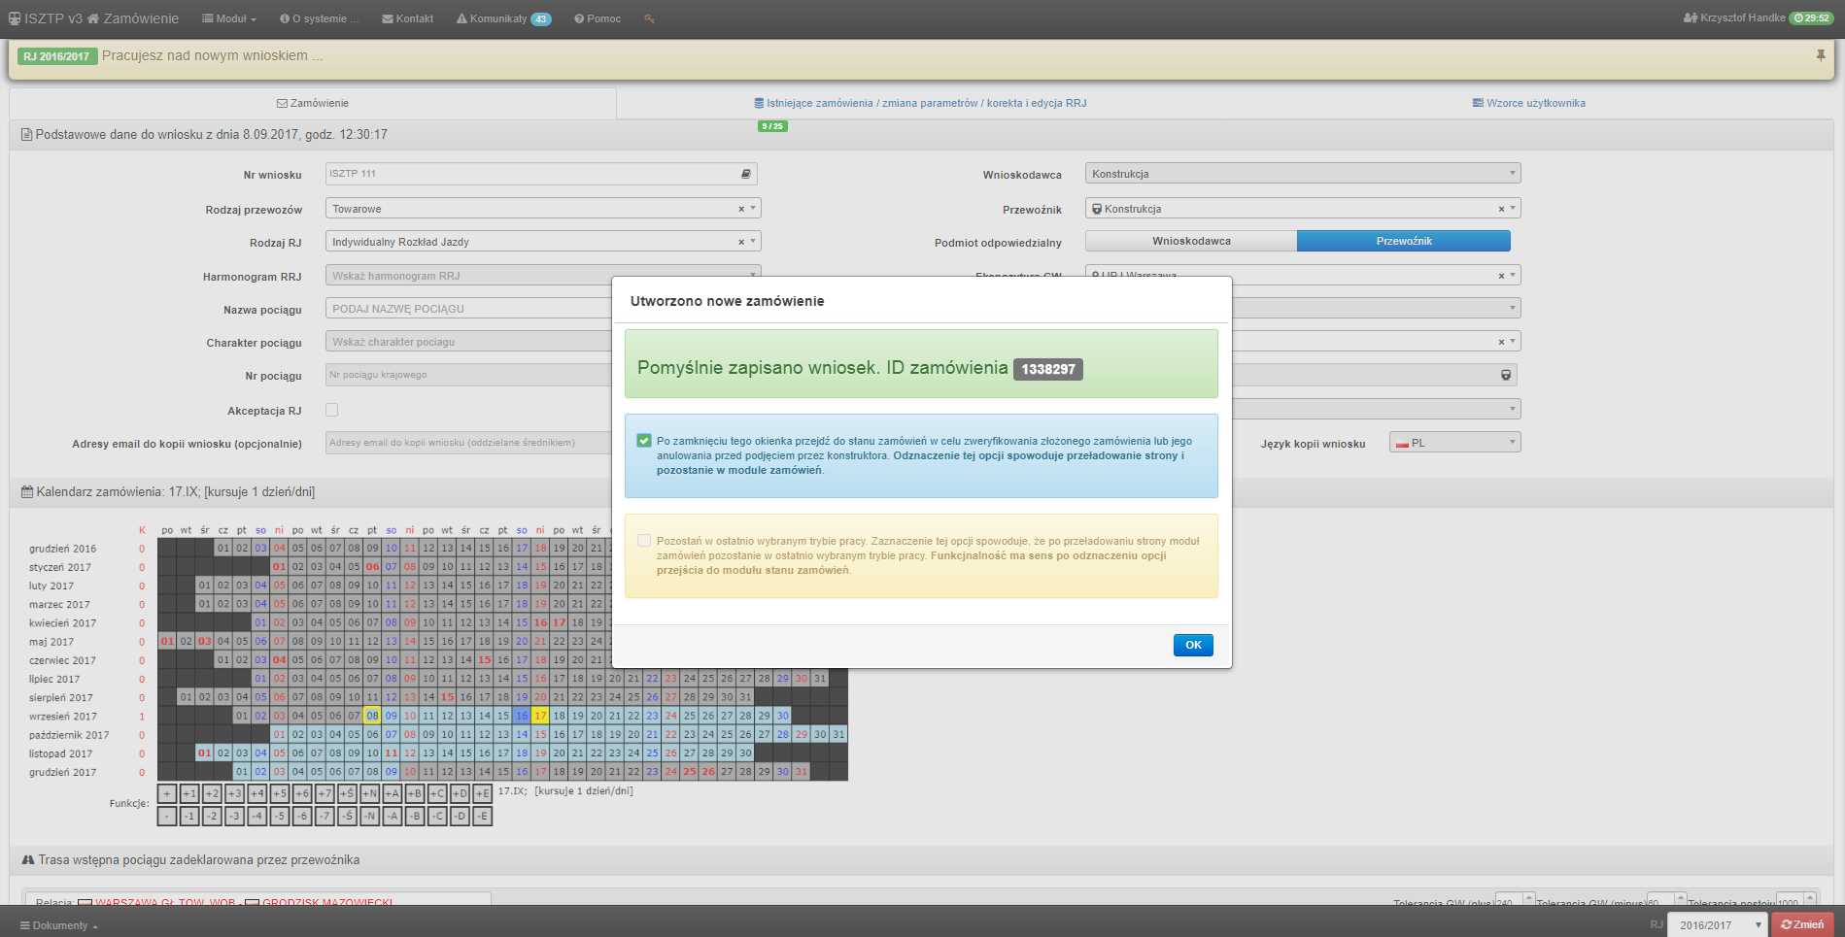
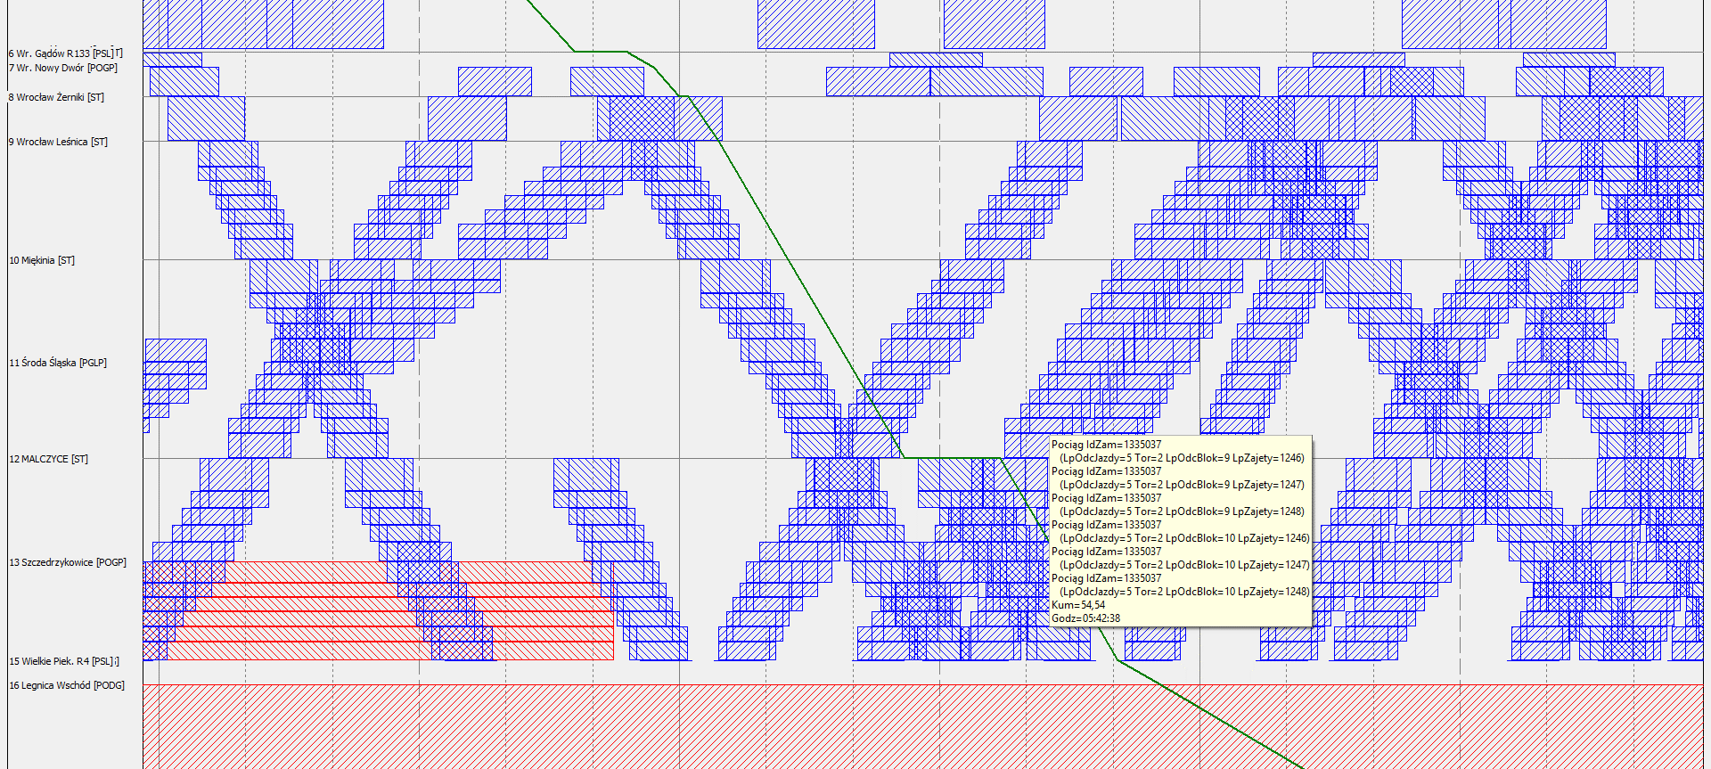
Automatic path request realisation
For selected types of trains, applications are carried out automatically without the participation of the constructor while maintaining the same quality and rules of running trains

Slide 14
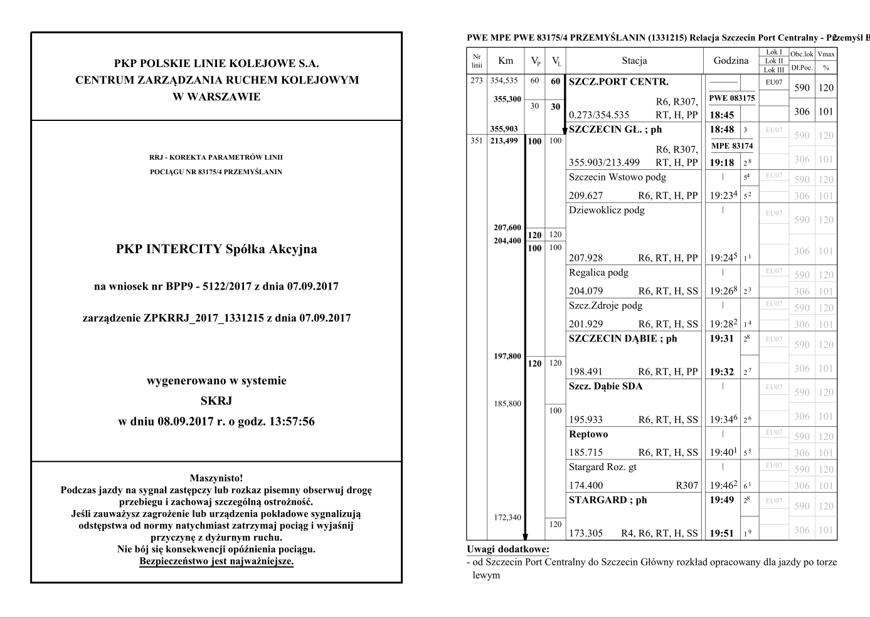
Final timetable
The final result is a prepared timetable in the service version for train service

Slide 15
Thank you for your attention

