Slide 1
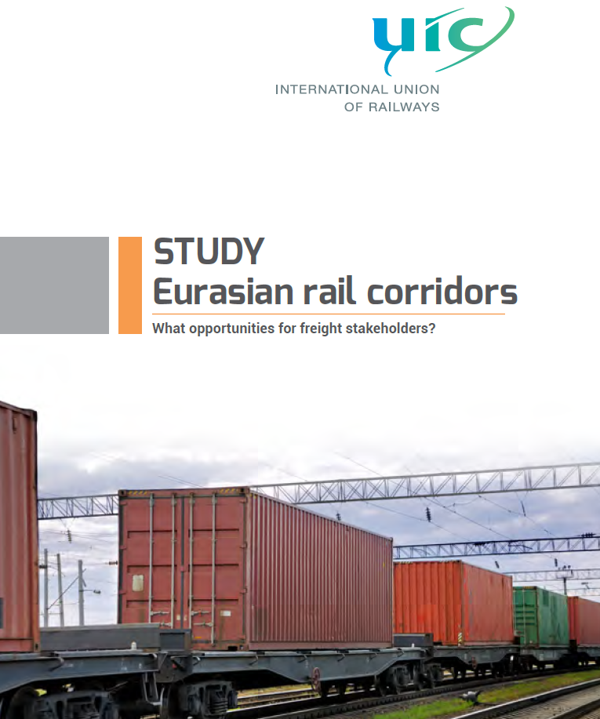
Geneva, 19 November 2018 UNECE

Slide 2
The study assesses the viability and the actions needed to promote existing and South-Eurasian routes and their connection to RFCs
A
Background and project objectives
  With the continuing economic development, cargo traffic flows between Asia and Europe are expected to increase
  Rail transport on the Asia-Europe route is increasing as well but its share stays small. Disadvantages regarding border crossings, reliability, infrastructure and other factors are still holding it back. Dropping sea freight rates aggravate the competition with sea freight
  Nevertheless, business initiatives to improve the competitiveness and quality of rail transport are growing on the Northern Eurasian rail routes and, more recent, on the Southern routes
  Especially China, Iran and Turkey are investing and promoting the Southern infrastructure links to Europe along the former Silk Road trading routes
  At the same time, Europe is investing in its cargo rail by creating common standards for the interoperability of networks in the nine Rail Freight Corridors and the Trans-European Transport Networks
Assessment of the viability of the Eurasian rail freight routes, with a focus on Southern routes and the interconnection with European Rail Freight Corridors
Overview on the traffic volumes, market players, infrastructure and performance of the rail routes – forecasting their development and potential until 2027
Define organizational strategy with its processes and functions required to implement the defined strategy
1
Assessment of key success factors, best practices and impeding factors for the initiatives
2
Recommendations for stakeholders on how to improve/reset their business activities and market the new alternatives as well as migration plan for UIC to support its members
3

Slide 3
Eurasian rail cargo transports have grown significantly, but still have a low intermodal market share
A
Development of rail freight between Asia and Europe
Transport between China and Europe via rail [Trains]
  Improvements driving volume development on Eurasian rail routes
    Reduction of transit time and increased punctuality
    Increase of destinations to 15 in Europe and 16+ in China
    Reduction of freight rates, subsidies from China's OBOR initiative
    Targeting of suitable customers and regions e.g. Western China
    Ease of border crossings through common consignment note, Eurasian Customs Union and local improvements
    Upgrading and extension of infrastructure e.g. in Kazakhstan
  However, market development and competition from other transport modes prevent rail transport from reaching higher market share
    Freight rates for container shipping have fallen significantly since 2011. Price level of rail transport is now 3 to 4+ times higher than shipping (Shanghai Shipping Exchange rate SCFI for Europe in March 2017 under USD 900 per TEU)
    Economic growth rates in China cooled down and the overall trade between Asia and Europe stagnated in 2015 and 2016
    Still room for efficiency and quality gains in waiting times and processes for border crossings and customs, reliability and client information etc.
CAGR +140.4%
1,777
2014
2015
2016¹⁾
Transport between China und Europe via rail [TEU]
~145,000
~65,000
~25,000
2014
2015
2016¹⁾
1) Roland Berger calculations based on interviews with several players, e.g. DB Cargo, TEL
Source: EATL, DB Cargo, CRIMT, press research, Roland Berger

Slide 4
In addition to the Europe-Asia routes in place in North Asia, new routes via Iran and Turkey are developed for rail cargo
A
Main Eurasian routes with track gauge (schematic)¹⁾
Chabarovsk
Amazar
4
Suifenhe
Vostochny
Helsinki
Zabaykalsk
Vladivostok
Irkutsk
2
Manzhouli
Malaszewicze
Moscow
Yekaterinburg
Novosibirsk
Ulan-Ude
Zamyn-Uud
Chop
Brest
Omsk
Naushki
Beijing
Dobra
Iletsk
3
Erenhot
Zahony
7
Astana
Shanghai
Kandagach
Dostyk
Alashankou
Swilengrad
Aktau
1
Urumqi
Istanbul
Poti
Khorgos
Kars
Baku
5
Almaty
Tabriz
Mary
Tashkent
6
Tehran
Mazar-e-Sharif
Sarakhs
Bandar Emam
Bafq
New Delhi
Bandar Abbas
Mirjaveh
Track gauge
Mumbai
1,520 mm
1,435 mm
1,676 mm
1) Conical projection to minimize visual distortion of distances; numbering based on route usage for Eurasian rail cargo transport
Source: UNESCAP, Roland Berger

Slide 5
Routes 1 and 2 are the fastest and most used routes with high reli-ability and good infrastructure – Alternatives need to be improved
A
Route assessment
Route
Length
Transit time¹⁾
Capacity and Comments
1
Via Alashankou/ Dostyk or Khorgos (Kazakhstan)
  10,000 km
  16-17 days
  High reliability, good infrastructure
  Sufficient capacities, new terminal in Khorgos
2
Via Manzhouli/ Zabaykalsk (Russia)
  11,000 km
  17-18 days
  High reliability, good infrastructure
  High volume but limited free capacity in Zabaykalsk
3
Via Erenhot/Zamyn-Uud (Mongolia)
  10,500 km
  18-19 days
  Alternative to route 2, additional border crossings
  Weak infrastructure in Mongolia, limited capacity
4
Via Suifenhe/ Vostochny (Russia)
  11,500 km
  18-19 days
  Suitable route for traffic from South Korea
  High reliability, good infrastructure
5
Via Dostyk or Khorgos/Baku
  12,000 km
  19-23 days
  Alternative for traffic to Southern Europe
  Two times RoRo shipping²⁾, limited capacity
6
Via Khorgos/Tash-kent/Tehran
  12,500 km
  Hardly used
  Weak infrastructure, route has to be developed
  Limited capacity
7
Via Tehran/Baku/ Moscow
  13,500 km
  Hardly used
  Suitable route for traffic from India to Europe
  Weak infrastructure, route has to be developed
1) Fast/Speed rail services can achieve a smaller transit time 2) Roll-on/roll-off shipping, rail cargo is driven on/off the vessel
Source: Company information, EATL, Roland Berger

Slide 6
Value chain of Eurasian rail cargo transport can be divided into setting up the trains and shipping the containers
A
Organization of Eurasian rail cargo transport
Set up of trains
Shippers
Shipping of containers
Chinese regional governments
Task forwarders with transportation of containers door to door
Own and finance local logistics platforms
Forwarders/Operators
Choose transport modes and get offered/find terminal to terminal trains by logistics platforms
Logistics platforms
Logistics platforms
Tender the organization of trains from Chinese border (west- and eastbound)
Use the trains previously set up
Operators
Operators
Use the trains previously organized
Organize trains through subcontracting
Carriers
Carriers
Transport the goods through respective countries
Forwarders/Operators
If required: Perform terminal to door transportation
Source: DB Cargo, expert interviews, Roland Berger

Slide 7
B
For 2027, a total rail potential of around 636,000 TEU is forecasted – Significant amount coming from shift from sea
Rail potential base case forecast ['000 TEU]
  Total rail potential includes
    Existing rail volumes increasing over time
    Shift from sea to rail, including growth of sea transport
  Shift from air as potential, but small (in terms of volumes) upside
  636 k TEU can roughly be translated into 21 trains per day in 2027 (assumption: 82 TEU per train²⁾)
  Due to separate analysis TEU volumes of South Asia, Turkey and Iran trade with EU 28 not included
  Extrapolated forecast until 2030 shows a total rail cargo volume of 810 k TEU
Market share rail
1.2%
2.5%
CAGR 14.7%
810
636
30
276
145
330
2016
2027
2030
Forecast: Rail
shifted from air¹⁾
Forecast:Rail
shifted from sea
Forecast: Rail
Rail Present
1) Rough estimate based on shift factors of 5% from overall Asia-Europe air traffic 2) Length of an European train
Source: Eurostat, Roland Berger

Slide 8
The logic of shifts to rail transport is associated primarily with transit time and price, suitable goods and rail acceptance
B
Logic and assumptions of rail shift scenario
Transit time and price
Shift logic
  Pure transport rates not decisive for high-value container, but time as decisive differentiation of rail to sea that can justify a price premium
  In a comprehensive view, fast transport times generate monetary savings from working capital and lead time benefits
  Reliability is key, especially for time-sensitive goods
  Due to high value of goods that impacts working capital and lead time benefits, product groups most relevant for shift are
    High-tech, computers, electronics
    Metal products, vehicles and automotive parts, spares
    Foodstuff and animal fodder
    Chemicals
  For time-sensitive containers, more reliability and a shorter transport time in comparison to sea freight can justify a shift
Suitable goods
  Specific commodities qualify more for rail transport, e.g. high-value goods
  Out of these, time sensitive goods justify shift to more expensive rail transport
Rail acceptance
  Acceptance of rail as alternative to sea shipping still not fully established
  Acceptance rate decisive to determine if full shift potential can be achieved
Source: Roland Berger

Slide 9
Timing and reliability stay key success factors – Operations have improved but market still sees further improvement potential
C
Prioritization and evaluation of success factors – Analysis of interviews
Parameter
Importance for rail link
Gap 2017¹⁾
Changes since 2011 and comments
Transport time
  Speed gains of approx. two days since 2011
  Gaps seen mostly inside Europe (slow transportation, delays)
Reliability
  Rail now more reliable than sea
  Especially shippers still see need for improvement and more information
Balanced quantities
  Continuously smaller eastwards transport volumes, changing only slowly
  Alternatives like stepwise returns make transport more complicated
Target goods
  Suitable goods are targeted and LCL offers were introduced
  Still potential, e.g. in chemicals, temperature controlled goods and air freight
Price
  No pure price competition but more competition through low sea freight rates
  Potential for more cost efficiency and less dependence on subsidies
Frequency, flexibility
  Frequency increased strongly in last years
  Many trains are still on request instead of regular trains
Target geogra-phical coverage
  Network has increased in past years
  Next step should be consolidation for more efficient geographical coverage
Availability
  Imbalance of traffic complicates return of platforms/containers
Customs
  Improvements in customs in the last years, partly seen as "solved problem"
  More potential at Chinese border and through electronic documentation
Legend: Higher filling of harvey balls shows higher importance; higher filling of gap shows higher gap, direction of arrow shows progress since 2011 (upwards = positive, downwards = neg.)
1) Gap depicts overall view of established routes (Northern routes), progress arrow can be flat/negative if expectations have risen at the same time as results
Source: Expert interviews, Roland Berger

Slide 10
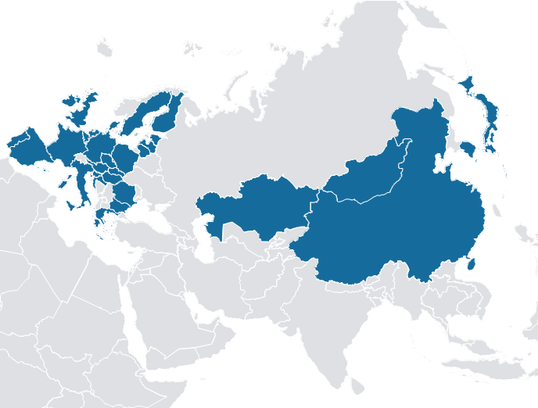
Southern routes' share of the traffic potential for 2027 is projected to reach 19,000 TEU corresponding to 3% of Eurasian rail traffic
D
Trade volume distribution 2027 ['000 TEU]
  Methodology
  Countries identified as preferred partners for Eurasian rail freight through Southern Routes: Bulgaria, Greece, Romania,
  Calculated share of 3% of forecasted EU 28 GDP for 2027
  Preconditions for upside expansion case
  Higher infrastructure capacity is needed to make Eurasian rail freight possible in bigger quantities and requires further investments on Southern routes
  Shorter transit times as well as lower rail prices for international transit is necessary to make Southern Routes competitive, especially in Turkey, and requires a clear political will
617
19
Origin and destination (O/D) countries
Source: Oxford Economics Global Economic Database, Roland Berger

Slide 11
The traffic on the Southern routes would reach 389,000 TEU, if other expected international traffic is accounted for as upside
D
Upside scenarios 2027 ['000 TEU]
  Forecast
  India, Pakistan and Bangladesh rail freight traffic was forecasted based on same method as O/Ds through Eurostat database
  Turkey and Iran traffic calculated in both directions to Europe and Asia¹⁾
  Preconditions for upside scenario
  Ensuring price competitiveness with sea transport as time advantage decreases with closer proximity
  Addressing issues of security and trans-border shipments, customs and bureaucracy
  Economic growth and political stability in Iran, Turkey, as well as between India and Pakistan
Upside for Southern routes
+2047%
64
389
226
80
19
Base case southern routes
EU-South Asia
EU-Turkey/Iran
Asia-Turkey/Iran
Total
1) Rough Turkey-Asia forecast based on data in USD provided by Turk Stat and applying average values identified through Eurostat
Source: Eurostat, Turkstat, Roland Berger

Slide 12
Gaps are larger for Southern routes and have to be overcome to establish a viable Southern alternative
D
Evaluation of success factors for Southern routes (Silk Road and TRACECA¹⁾)
Parameter
Importance for rail link²⁾
Gap 2017
Comments regarding Southern Routes
Transport time
  Speed slower than Northern routes (e.g. 17-20 days China-Turkey)
  Long distance, more border crossings/customs or mode changes
Reliability
  No established regular services yet
  Trial services TRACECA (DHL 2016) with delays of more than 4 days each
Balanced quantities
  Smaller eastward transport volumes are expected
  Need to examine possibilities for stepwise transports
Target goods
  Target goods in European O/Ds for Southern routes (East Europe) and in new O/Ds (Turkey, Iran) need to be specified and seasonality considered
  Even bigger competition from sea freight through shorter distance and good accessibility of Middle East and East European countries
  High network costs in Iran and Turkey
Price
Frequency, flexibility
  Routes not established as regular services yet
Target geogra-phical coverage
  Routes not established as regular services yet
Availability
  Routes not established as regular services yet
Customs
  Many transit countries are not part of a customs unit (Ukraine, Iran, Azerbaijan and Turkmenistan)
Legend: Higher filling of harvey balls shows higher importance; higher filling of gap shows higher gap
1) Transport Corridor Europe-Caucasus-Asia 2) Same importance as for general Eurasian transport
Source: Expert interviews, Roland Berger

Slide 13
Four European RFCs directly relevant as entryways for Eurasian rail cargo (RFC 6-9) – Only Malaszewicze/Brest with significant volume
E
Schematic map of RFCs¹⁾
Interconnection points of routes from Asia to European Rail Freight Corridors
Helsinki
Oslo
4
1
Malaszewicze – Brest (RFC 8)
Stockholm
2
Cierna – Chop (RFC 9) and Zahony – Chop (RFC 6)
Gdynia
Kaunaus
3
Swilengrad – Kapikule (RFC 7)
Bremerhaven
Swinoujscie
1
4
Via Stockholm (RFC 3)
Rotterdam
Amsterdam
Hannover
Hamburg
Poznan
Warsaw
Malaszewicze
London
Zeebrugge
Antwerpen
Berlin
Katowice
Krakow
European Rail Freight Corridors²⁾
Duisburg
2
Le Havre
Cologne
Prague
Zilina
Cierna
Paris
Metz
Luxembourg
Zahony
RFC 1: Rhine – Alpine
Strasbourg
Munich
Vienna
Bratislava
RFC 2: North Sea Mediterranean
Basel
Budapest
Arad
Amberieux
Verona
Ljubljana
Kelebia
Bucharest
Constanta
RFC 3: Scandinavian – Mediterranean
Bordeaux
Trieste
Koper
RFC 4: Atlantic
Bilbao
Lyon
Genoa
Ravenna
Sofia
Swilengrad
RFC 5: Baltic – Adriatic
3
RFC 6: Mediterranean
Lisbon
Madrid
Barcelona
RFC 7: Orient – East Mediterranean
Sines
RFC 8: North Sea – Baltic
Almeria
Athens/
Thriasio
RFC 9: Rhine – Danube or Czech – Slovak³⁾
Algeciras
Palermo
RFC 11: Amber⁴⁾
1) Schematic map does not include all potential RFC connections, sections in the focus of this study shown by bold lines 2) Initiatives regarding RFC 10 exist, but no official implementation decision 3) Only the part Cierna to Prague implemented, other routes to be implemented by 2020 3) To be launched in 2018
Source: Austrian Ministry for Transport, Innovation and Technology, RNE, press research, Roland Berger

Slide 14
The focus of operators and railways should be on operational efficiency and on customer-friendly product development
F
Recommendations for operators and railways
Streamline operations
Improve information/transparency
  Negotiate efficient border/terminal operations
  Tackle punctuality problems and minimize locomotive/driver changes in Europe
  Optimize cost structure for sustainability without subsidies
  Share information on arrival times
  Track reliability and use big data tools to optimize operations
Operators and railways
Broaden services
  Increase share of regular trains
  Develop sets of additional services
Participate in new opportunities
  Target and develop products for trends, e.g. e-commerce, temperature-controlled goods
Communicate infrastructure needs/ client expectations in Europe
  Communicate infrastructure needs/client expectations for international traffic
  Improve market orientation of RFCs
Use new regions as steps to Asia
  Market transports to/from Central Asia to China as options for stepwise increasing traffic
Evaluate and develop Silk Road markets
  Implement measures to improve service quality on Southern routes
  Research market potential of South Asian & Middle Eastern economies
Action fields:
Operations
Customer expectations
Regional actions

Slide 15

Thank you for your attention
Sandra Géhénot, Freight Director, gehenot@uic.org
UIC is the worldwide organisation for the promotion of rail transport at a global level and collaborative development of the railway system. It brings together some 200 members on all 5 continents, among them rail operators, infrastructure managers, railway service providers, etc. UIC maintains close cooperation links with all actors in the rail transport domain right around the world, including manufacturers, railway associations, public authorities and stakeholders in other domains and sectors whose experiences may be beneficial to rail development. The UIC's main tasks include understanding the business needs of the rail community, developing programmes of innovation to identify solutions to those needs and preparing and publishing a series of documents known as IRS that facilitate the implementation of the innovative solutions.

