Slide 1
Digital twin for infrastructure: Asset health and availability governed from predictive modelling and data processing. Johan Jonsson Genève 21 November 2018

Slide 2
Yesterday and today
Automatic Ticket Vending Machine, Topical Press 23 Feb 1942
The ‘utsonmobile’ application developed by the Centre for Railway Information System (CRIS)

Slide 3
Are we on the edge of change?
The integrated circuit, 1958
Jack Kilby of Texas Instruments

Slide 4
Tasks and Capabilities
Objective:
Mobility as a service
Logistics on demand
Our Capabilities:
Guaranteed asset health and availability
More value from data
Environmental & social sustainability
Digital information can help delivering Service timed to the second

Slide 5
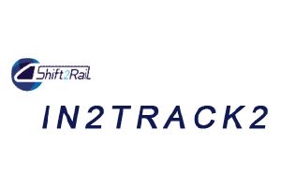
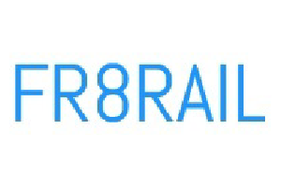
Our first steps to Interconnected ICT
Infra-structure
Rolling stock
Time table
Digital twin
Higher capacity timed to the second

Slide 6
Our first steps to Interconnected ICT
Maintenance
from equalised to predictive through condition based
Asset digitisation
location, diagnostics, condition data
Real time network mgmt
slot planning
Digital Twin through smart data
Big data analytics
Single system; moving & fixed objects together
Rolling stock; on board diagnostics
Signalling; traffic decision, position management
Infra; predictive maintenance
Freight; condition based strategies
Infra-structure
Rolling stock
Time table
Digital twin
Higher capacity timed to the second

Slide 7
Reliable railways through smart technology and collaboration

Slide 8
Test and implementation of maintenance related innovations for railway
The vision: A sustainable and connected railway by 2025
The challenge:
A deregulated system with many stakeholders each with different goals and objectives
Enable preventive maintenance by sharing data and information
To test and implement innovations in the railway system in an efficient way
“The technology is the easy part, the challenge lies within
implementation of new solutions”
The tool:
ePilot - an industry collaboration project initiated by Trafikverket
and operated by Luleå Railway Research Center at Luleå University of Technology

Slide 9
Difficult to see …

Slide 10
Scope for 2030
Digitisation of whole systems
Self-diagnostics
More data analytics
Real time monitoring
AI to predict functionality
Integration of digital systems from other transport modes
24/7 system availability
Increased and optimised network capacity

Slide 11
Thank you for listening!
Trafikverket: johan.jonsson@trafikverket.se
ePilot: jonas.larsson@trafikverket.se / Trafikverket veronica.jagare@ltu.se / Luleå University of Technology

