Slide 1

Rethink VIDEO security
ITF Annual Summit 2018, Leipzig
ITF/UIC/UNECE Railway Security Workshop
Emin SIMSEK
Bosch Security & Safety Systems

Slide 2




TODAY (PIXEL RACE)
TOMORROW
FUTURE
Delivering
excellence in video
security and data management
Rethink what video security can do?
Re-purpose
data to create
new uses for
your business
10%
100%
Irrefutable forensic evidence
Loss prevention / deter intruders
Highest quality of relevant images
Bitrate reduction
Minimizing the vulnerability to cybercrime
Utilize the hidden potential of captured data
Beyond security
E.g. monitoring presence, reduce utility bills, identify patterns in customer activity, improve sales
Percentages of video
data used
INCREASINGLY ‘ME-TOO’ PRODUCTS
VIDEO SECURITY SEEN AS LARGE INVESTMENT
%
2
Bosch Security & Safety Systems | 2018-05-23
© Robert Bosch GmbH 2018. All rights reserved, also regarding any disposal, exploitation, reproduction, editing, distribution, as well as in the event of applications for industrial property rights.

Slide 3

Video security Implications of today
Rethink Video Security
z
SCADA
Video management system
Situational Awareness Tools
Analytics
on the camera
Server based analytics
Specialized analytics
(e.g. face recognition)
Privacy protection tools
Alarm Management Platform
Fire alarm system
Access control system
Cameras
Intrusion detection system
Fixed
PTZ
Thermal
Body-worn
Onboard
…
Public address system
…..
3
Bosch Security & Safety Systems | 2018-05-23
© Robert Bosch GmbH 2018. All rights reserved, also regarding any disposal, exploitation, reproduction, editing, distribution, as well as in the event of applications for industrial property rights.

Slide 4



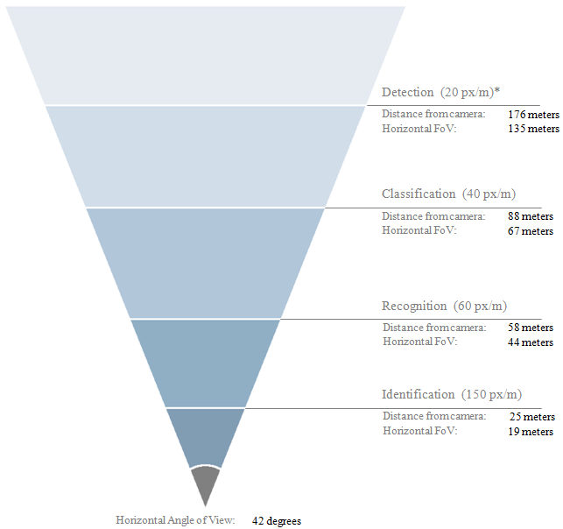

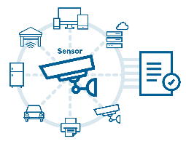
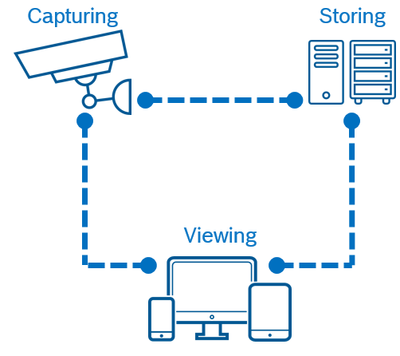


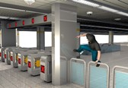





Improve the level of security
Rethink Video Security
Security
Implications
24/7 security
Alerts only when needed
Quickly retrieve data
Perimeter protection
Deter intruders
Integration with alarm management platforms
Right camera for right task
Highest image
quality
DORI
IEC 62676
Imaging features compliant with standards
starlight
During Operation
End-to-end
surveillance
Latest data
security measures
Bitrate
reduction ≤80%
Camera
as a sensor
In Alarm condition
Alerts only
when needed
Quickly retrieve
correct data
Video Analytics
extremely resistant
against shaking
Video content
analysis over
large distances
Reliable alerts,
even in extreme
weather conditions
4
Bosch Security & Safety Systems | 2018-05-23
© Robert Bosch GmbH 2018. All rights reserved, also regarding any disposal, exploitation, reproduction, editing, distribution, as well as in the event of applications for industrial property rights.

Slide 5
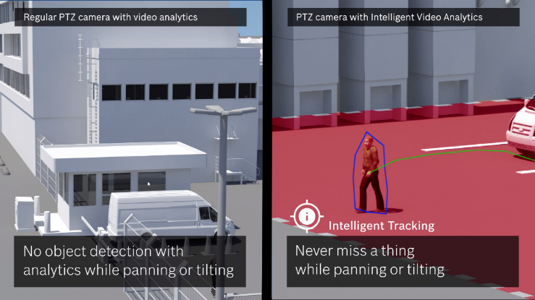
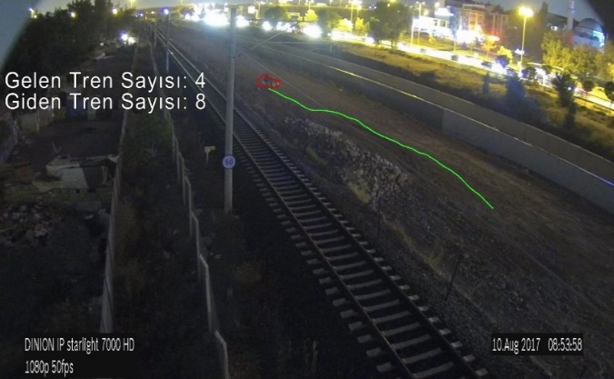
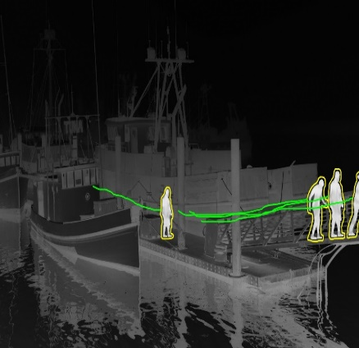
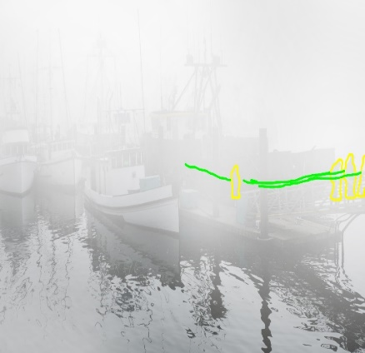
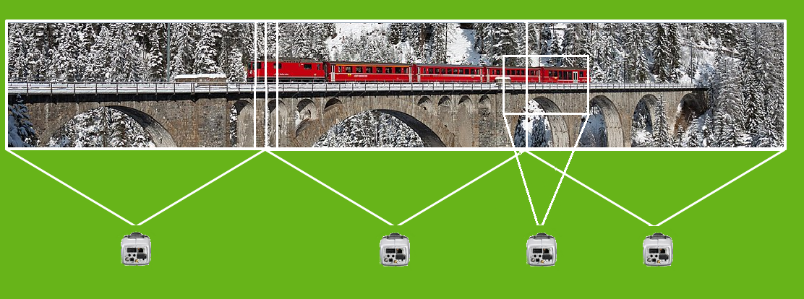
Provide uninterrupted 24/7 operations
Improve the level of security
Video anaytics while moving cameras
Virtual wayside fence
Full situational awareness is provided
by combining metadata
Covering long distances of wayside on single cameo
overlay
Picture-in-picture
5
Bosch Security & Safety Systems | 2018-05-23
© Robert Bosch GmbH 2018. All rights reserved, also regarding any disposal, exploitation, reproduction, editing, distribution, as well as in the event of applications for industrial property rights.

Slide 6

Irrefutable Forensic Evidence
Full flexibility when searching video for evidence
Live Alarm
Alarm Search
Record alarms
Search through recorded alarms
Full Forensic Search
Record metadata
Search with new criteria
by reevaluating metadata
!
Alarm!
Alarm!
Alarm!
Alarm!
Alarm!
Alarm!
Alarm!
6
Bosch Security & Safety Systems | 2018-05-23
© Robert Bosch GmbH 2018. All rights reserved, also regarding any disposal, exploitation, reproduction, editing, distribution, as well as in the event of applications for industrial property rights.

Slide 7





Smarter decisions with surveillance cameras
Beyond Security
Use video data for Operational Efficiency
Identify patterns in passenger activity
Manage queues
Improve service by improved staff schedules
Detect blocked emergency exits
Detect fire and smoke
Gather business statistics
Improve service
Improve safety
7
Bosch Security & Safety Systems | 2018-05-23
© Robert Bosch GmbH 2018. All rights reserved, also regarding any disposal, exploitation, reproduction, editing, distribution, as well as in the event of applications for industrial property rights.

Slide 8
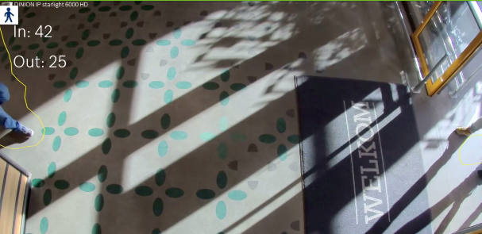
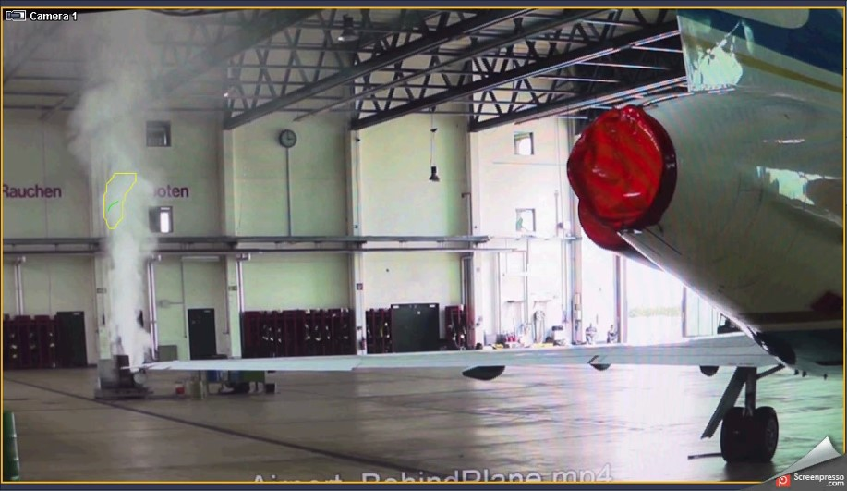
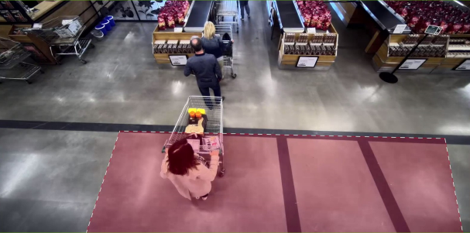
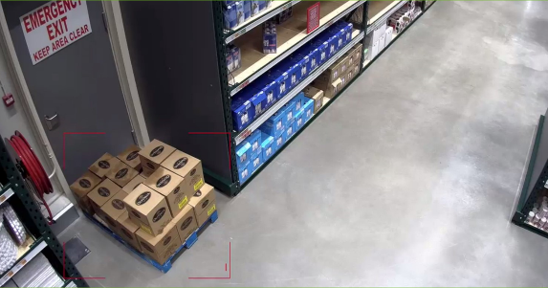
Smarter decisions with surveillance cameras
Beyond Security
Gather business statistics
Improve safety:
See fire before it spreads
Improve service
Improve safety:
Detect blocked exits
8
Bosch Security & Safety Systems | 2018-05-23
© Robert Bosch GmbH 2018. All rights reserved, also regarding any disposal, exploitation, reproduction, editing, distribution, as well as in the event of applications for industrial property rights.

Slide 9
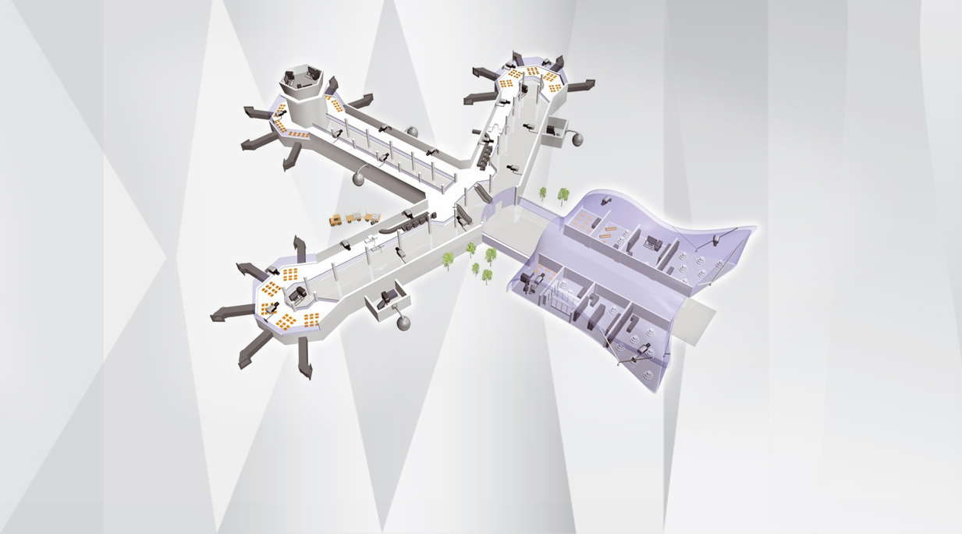
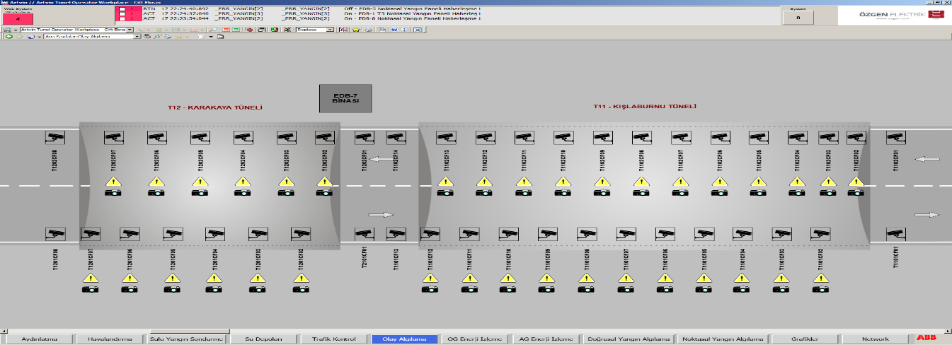
Beyond Security
Monitoring cameras via SCADA
Accessing incident moment directly from SCADA. Monitoring security alarms on GUI
Accessing incident moment directly from SCADA
Video management system directly receives IVA triggered alarms of Bosch cameras and allows recording as video, photo and metadata.
BVMS allows OPC connection which is also supported by many SCADA vendors .
9
Bosch Security & Safety Systems | 2018-05-23
© Robert Bosch GmbH 2018. All rights reserved, also regarding any disposal, exploitation, reproduction, editing, distribution, as well as in the event of applications for industrial property rights.

Slide 10
Today the real issues concern…
Market developments
Managing and make use of:
Minimizing:
The SKYROCKETING petabytes of captured video data
The VULNERABILLITY
to CYBERCRIME
10
Bosch Security & Safety Systems | 2018-05-23
© Robert Bosch GmbH 2018. All rights reserved, also regarding any disposal, exploitation, reproduction, editing, distribution, as well as in the event of applications for industrial property rights.

Slide 11

Confidentiality ensure that information is only read by the people who are allowed to read it integrity ensure that information can only be altered by people who are allowed to alter it availability ensure that information can be accessed
Confidentiality, Integrity, and Availability defined by the US National Institute Standards and Technology (NIST)

Slide 12
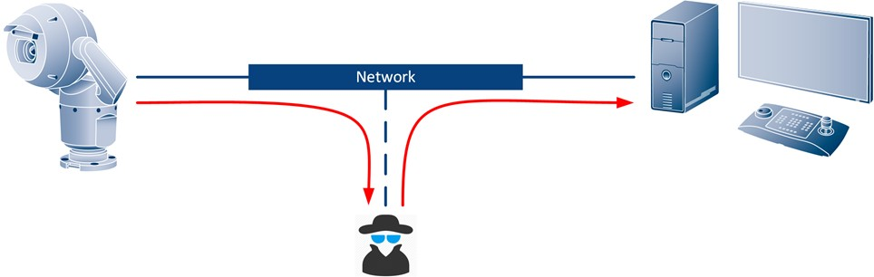
Confidentiality applied

Slide 13

Integrity applied

Slide 14
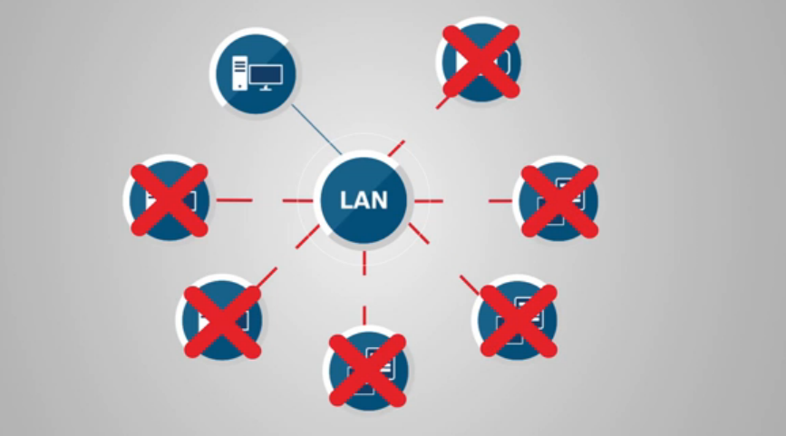
avaılabılıty applied

Slide 15

Thank you
Emin SIMSEK
Bosch Security & Safety Systems
International Business Development Manager, Railway/Public Transportation
emin.simsek@tr.bosch.com

