Slide 1
Rail Security and the passenger interface
Prof. Dr. Andrea Giuricin
CESISP – at University Milan Bicocca
Adj. Prof. UMN, MSUC, University Southern California, Purdue University
Visiting Professor at China Academy Railway Sciences, Beijing, China
CEO - TRA Consulting
Leipzig, 23rd of May 2018

Slide 2
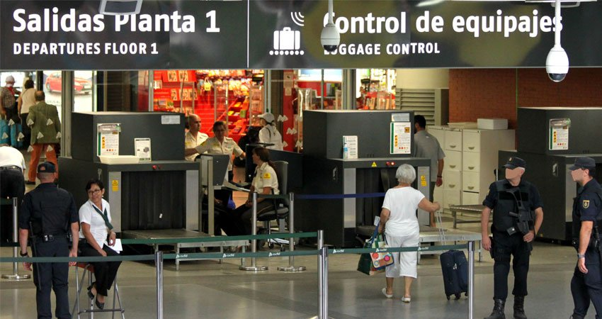
Rail Security

Slide 3
Rail Security
WHAT IS THE SECURITY?

Slide 4
Rail Security
SECURITY
PRIVACY
Ex-ante
During
Ex-post

Slide 5
Rail Security
Specialist subsystems …
Front
Office
Dynamic Information
Distribution
CRM
Service-Oriented Architecture (SOA)
Circulation
Fleet & Crew
Control Room
Maintenance
Revenue Accounting
Back
Office
.. totally integrated with SOA Architecture.

Slide 6
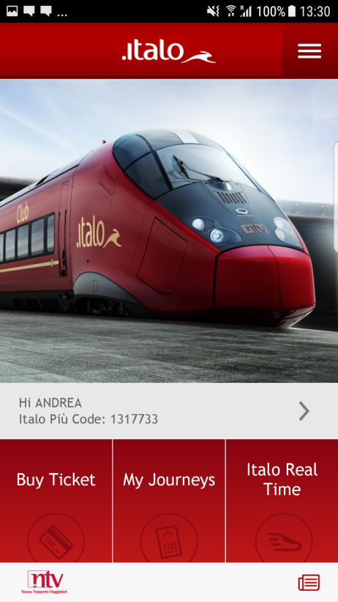
Rail Security
REAL TIME TARGETED INFORMATION (AUTOMATIC/SEMIAUTOMATIC FLOWS)
(Customer Operations Control System)
(CRM system)
(CMS system)
Monitor the customer experience and switch on alerts in case of disruptions
Select list of passenger number and types of registered Customers
Identify preferred contact
Select type of customized content
Deliver personalised info to customers and front line staff

Slide 7
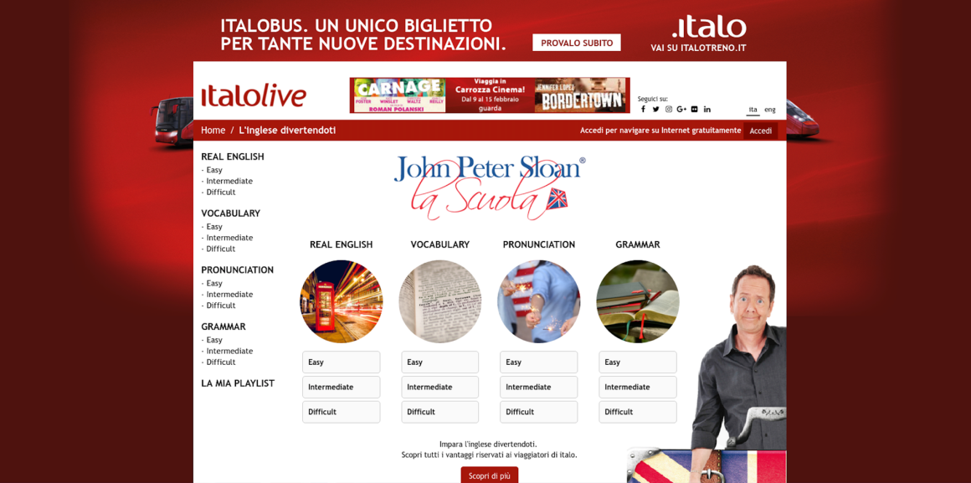
Rail Security
DATA OF CUSTOMERS
Utilization of DATA
WIFI and ON BOARD PORTAL
PROBLEM OF PRIVACY

Slide 8
Rail Security
Registration
“Ambassador”
High value – Sponsor &Voice
(Trip Frequency, Spending, Loyalty Tier, Age & Potential)
“Supporter”
Frequent Traveler - Connoisseur
Retention Rate
“Friend”
Recorded & profiled Traveler
Disruption metrics (delays, CXL, complaints, exc) lived by each traveler (recorded in a personal profile CRM)
“Customer”
(non recorded Traveler)

Slide 9
Rail Security
PARTNER FOR DISRUPTIONS
STATION AND ONBOARD CREW
NTV OPERATIONS COORDINATOR
CREW MANAGER
FIELD CUSTOMER OPERATIONS COORDINATOR
OPERATIONS CONTROL ROOM
CUSTOMER OPERATIONS AND INFORMATION COORDINATOR
OPERATIONS MANAGER PRONTO ITALO
SECURITY

Slide 10
THANK YOU FOR YOUR ATTENTION
Contact details:
Prof. Dr. Andrea Giuricin
Mob: +393386938369
Email: andrea.giuricin@unimib.it

