Slide 1
French considerations on R 22 - Helmets
Submitted by the expert from France | Informal document GRSP-62-19 (62nd GRSP, 12-15 December 2017 agenda item 10)
Pierre BAZZUCCHI
French MoT
General Directorate for energy and climate
GRSP 62nd session
December 2017

Slide 2
French considerations on R22
Motorcycle helmets have been evolving for several years thanks to new technologies
Research in biomechanical for head protection has made a lot of progress
Last series of amendments of R22 entered into force in 2000 (last supplement 2012)
Clarifications / new procedures or requirements needed to be added to take into account these new elements

Slide 3
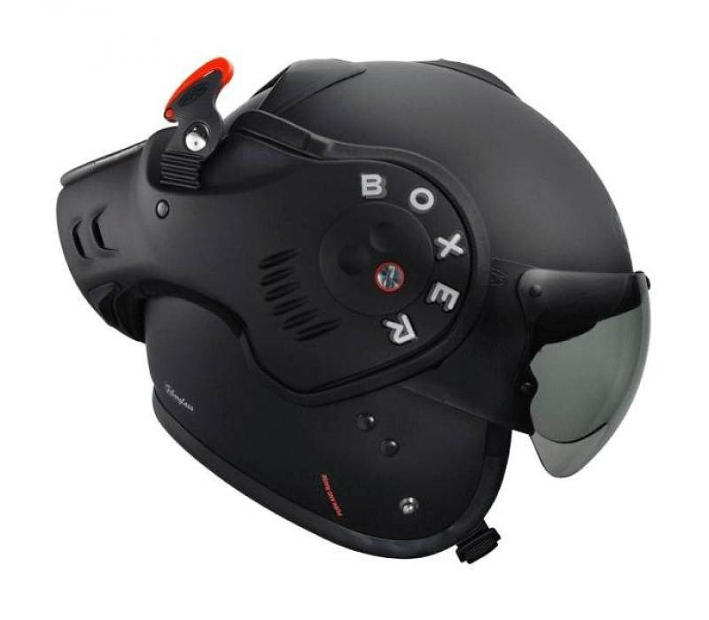
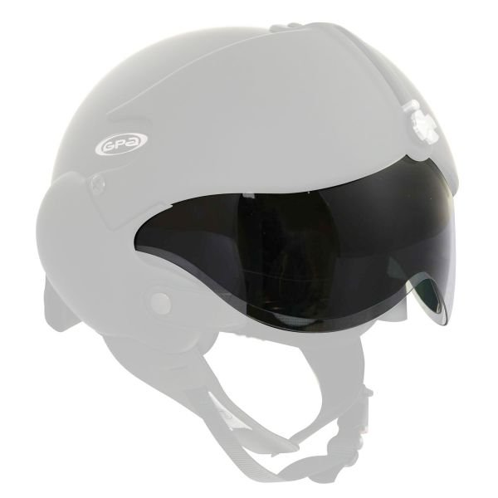
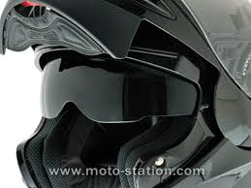
French considerations on R22
Movable protective lower face cover
J + P marking
Additional sun visor / double visor,
luminous transmittance (§ 2.12.),
sun visor definition (CE EN1938 marking,
mechanical characteristics (§ 7.8.2.))

Slide 4
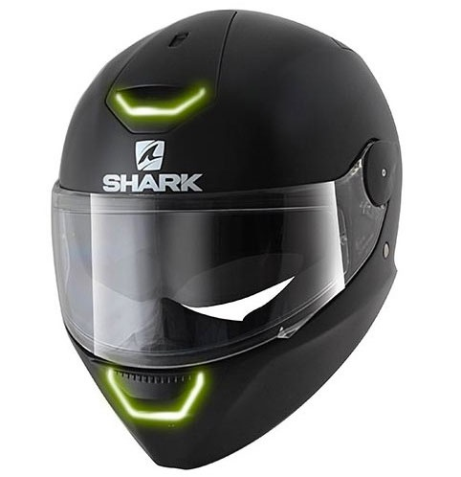
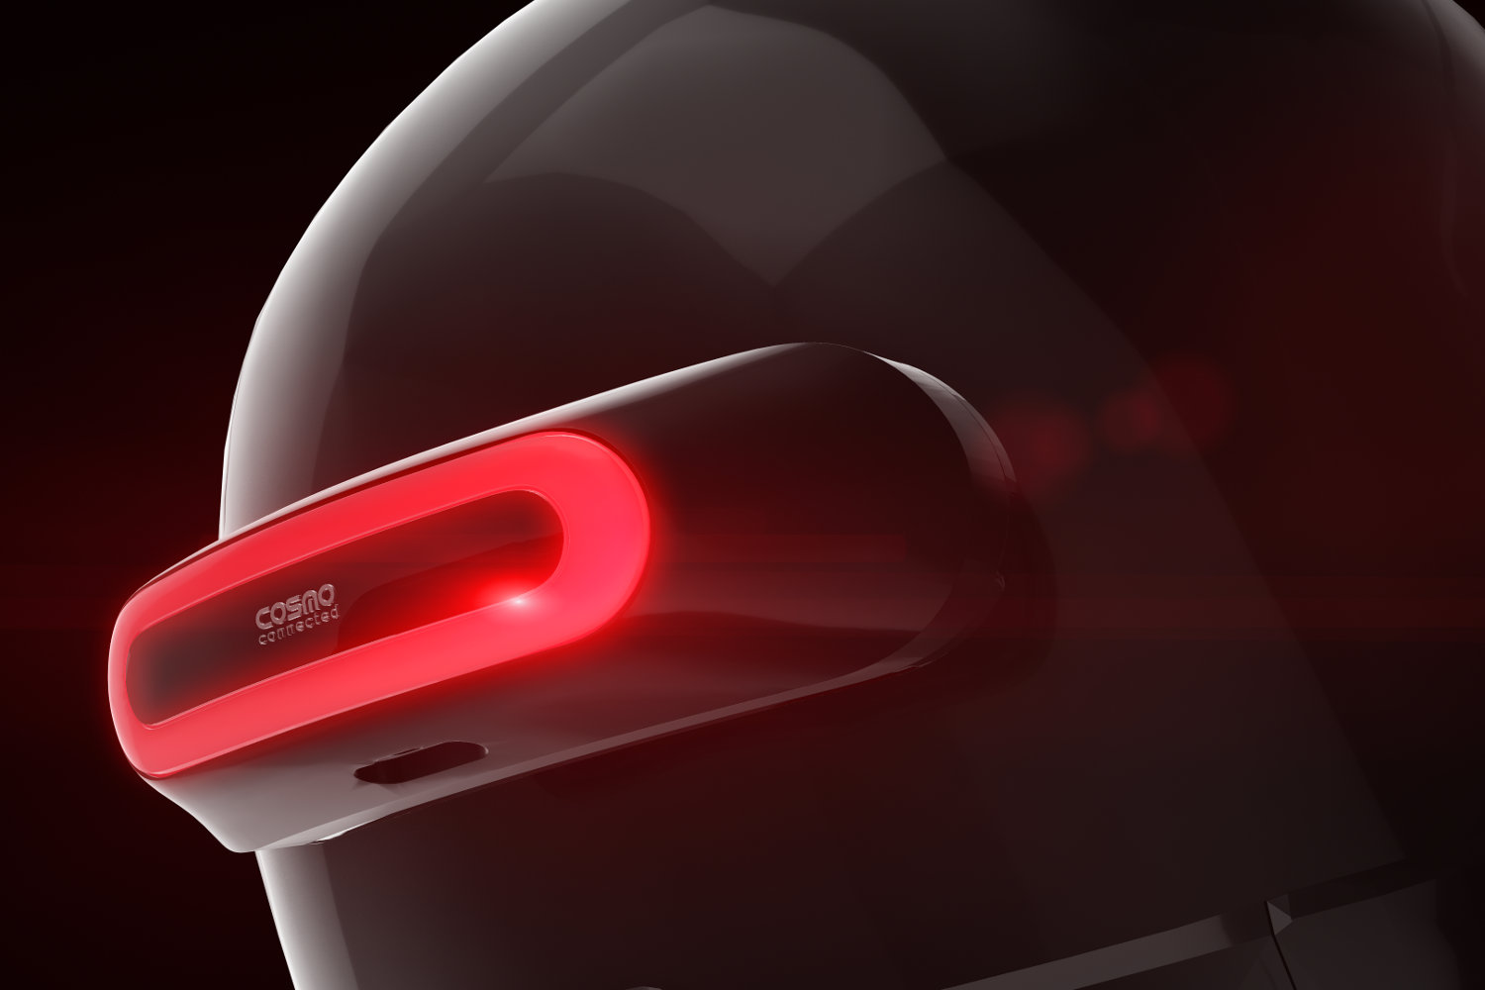
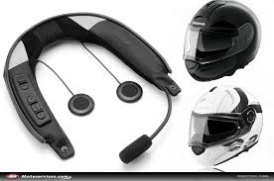
French considerations on R22
New add on to take into account:
Lightning equipment
Cameras
Audio – phone equipment
Design equipment

Slide 5
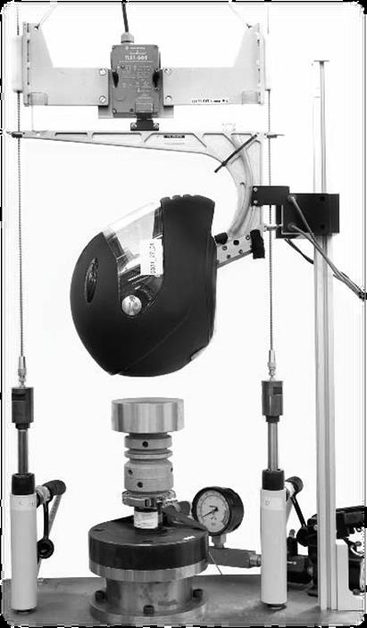
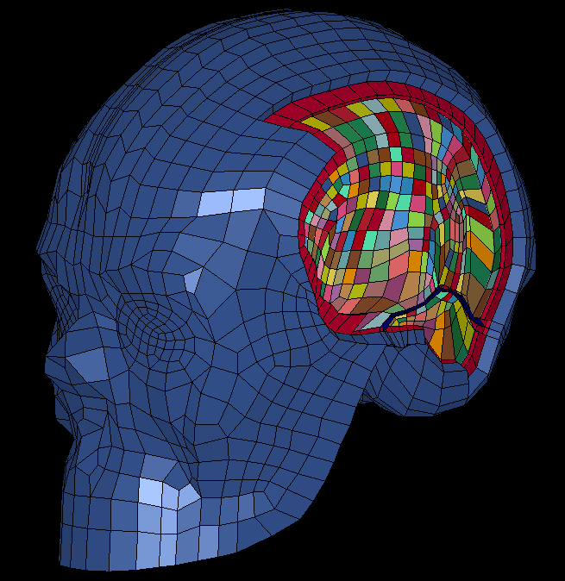
French considerations on R22
Progress in research for head protection improvment
New model (Finite element head model) with brain and skull
Studies from Strasbourg University (Pr Remy Willinger)
New tests (oblique impact) and additionnal criteria
(linear and rotational acceleration) ?
New head for testing ?

Slide 6
Thanks for your attention

