Slide 1
Informal document GRSP-62-01
(62nd GRSP, 12-15 December 2017
agenda item 24)
Draft New Regulation (UNR)
on Hydrogen-Fuelled Vehicles
of Categories L1, L2, L3, L4 and L5
The modifications to the informal document GRSP-61-03e and their justifications
JASIC Japan
＿＿＿＿＿＿
62nd GRSP Session
December 2017

Slide 2
Paragraphs 1.1. to 1.3, revised :
“1.1. Part I - Compressed hydrogen storage systems for hydrogen-fuelled vehicles of category L1, L2, L3, L4 and L5 ….
1.2. Part II - Specific components for compressed hydrogen storage systems for hydrogenfuelled hydrogen-fuelled vehicles of category L1, L2, L3, L4 and L5 ….
1.3. Part III - Hydrogenfuelled Hydrogen-fuelled vehicles of category L1, L2, L3, L4 and L5 ….”
* Suggested by European Commission
Justification:
“hydrogenfuelled” is to be corrected of its typological errors to “hydrogen-fuelled.”
This regulation consists of Part I, Part II and Part III. The modifications makes it clear that the same categories apply to Part I and Part II, as well as Part III.

Slide 3
Justification: “A container shall be metal liner reinforced with resin impregnated continuous filament (fully wrapped)” is not a definition but a requirement, therefore it is moved from paragraph 2. Definition to paragraph 5. Part I – Specifications of the compressed hydrogen storage system.
Paragraphs 2.4. and 5., revised :
“2.4. ”Container“ (for hydrogen storage) means the component within the hydrogen storage system that stores the primary volume of hydrogen fuel. A container shall be metal liner reinforced with resin impregnated continuous filament (fully wrapped).”
“5. Part I – Specifications of the compressed hydrogen storage system
A container shall be metal liner reinforced with resin impregnated continuous filament (fully wrapped) and a water capacity of 23 litres or less.
All new compressed hydrogen storage systems produced for on-road vehicle service shall have a NWP of 70 MPa or less, a service life of 15 years or less, a water capacity of 23 litres or less and be capable of satisfying the requirements of paragraph 5.”
* Suggested by European Commission

Slide 4
Paragraph 7.1.3.1., revised :
“7.1.3.1. (b) Storage system TPRDs. The hydrogen gas discharge from TPRD(s) of the storage system shall not be directed:
….
(ii) Into or towards any wheel housing of the vehicle and any brake operating section or any braking component that is subject to elevated temperatures during intended use;”
“7.1.3.1. (c) Other pressure relief devices …
….
(iii) Into or towards any wheel housing of the vehicle and any brake operating section or any braking component that is subject to elevated temperatures during intended use.”
* Suggested by European Commission
Justification:
“any brake operating section” includes brake-lever(s), brake-pedal(s) and so on, none of which relates to ignition of hydrogen gas. Therefore, it is modified to “or any braking component that is subject to elevated temperatures during intended use.”
“and” is to be corrected of its editorial error to “or .”

Slide 5
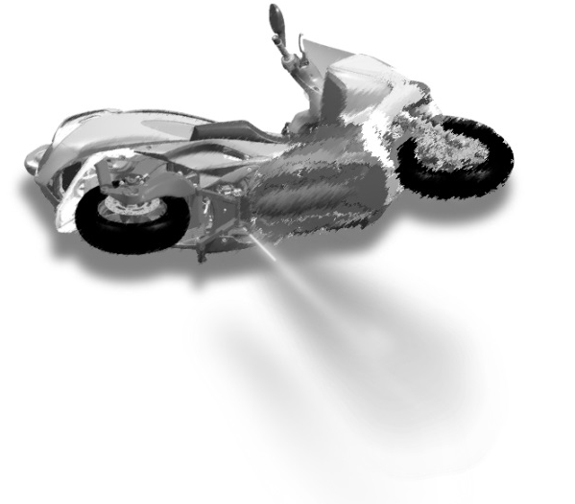
Paragraph 7.1.3.1., revised (necessary to choice) :
“7.1.3.1. (b) ….
(iv) [In any direction other than vertically downward perpendicularly outward from the bottom of the vehicle body.]”
Or
(iv)[In any direction other than vertically downward from the bottom of the vehicle body as considered in the normal design position.]”
* Suggested by Japan
* Suggested by European Commission
Justification:
“Vertically downward from the bottom of the vehicle body” does not clearly indicate the correct discharge-direction of the hydrogen gas in the case of a turned-over vehicle (“Perpendicularly outward” is more accurate in all vehicle’s positions. )

Slide 6
Paragraph 7.1.3.1 and 7.1.4.1., revised (necessary to choice):
“7.1.3.1. (c) Other pressure relief devices …
Into or towards the vehicle passenger or luggage compartments and to the passengers [or towards vehicle users];”
Or [or towards the driver or any passengers on the vehicle] ”
“7.1.4.1. Hydrogen leakage and/or permeation from the hydrogen storage system shall not directly vent into the passenger or luggage compartments and to the passengers [or towards vehicle users] , ….”
Or [or towards the driver or any passengers on the vehicle] ”
* Suggested by European Commission
* Suggested by Japan
Justification:
“the passengers” does not include the driver. The phrase is modified to include all persons on the vehicle.
“and” is to be corrected of its editorial error to “or. ”

Slide 7
Paragraph 7.1.6., revised:
“7.1.6. Tell-tale signal warning to driver
….
Visible to the driver while in the driver‘s designated seating position (with the driver’s seat belt fastened if such restraint system is installed);”
Justification:
“with the driver’s … installed” is put in parenthesis to refer to either case whether the seat belt is installed or not.
* Suggested by Japan
“if installed ” is modified to “if such restraint system is installed” to clarify what is installed.
* Suggested by European Commission

Slide 8
Paragraph 7.2.1., revised:
“7.2.1. Container Displacement
The storage container(s) shall remain attached to the vehicle at a minimum of one attachment point and shall stay within the installed location(s) after the accelerations test specified above.”
* Suggested by Japan
Justification:
This paragraph is a requirement for the acceleration test stipulated in paragraph 7.2. To make it clear, “after the accelerations test specified above” is added.
The original paragraph can be interpreted in such a way that the container is allowed to hang out of the vehicle body with one attachment point after the acceleration test. The requirement of “stay within the installed location(s)” is added for clarification because motorcycles generally do not have enough marginal space around the container compared with the automobiles.

Slide 9
Justification: The bold part “and the average burst pressure recorded of the last ten tests shall be at or above BPO-10 per cent” is added in order to reflect the amendment made to UNR 134 during the 61st session of GRSP .
Paragraph 9.3.2.1., revised:
“9.3.2.1. Rupture test in batch testing
The test shall be performed according to paragraph 2.1. (hydrostatic pressure rupture test) of Annex 3. The required rupture pressure shall be at least Bpmin and the average burst pressure recorded of the last ten tests shall be at or above BPO-10 per cent.”

Slide 10
Justification: “2 (±1) MPa” is added in order to reflect the amendment made to UNR 134 during the 61st session of GRSP instead of “≦3 Mpa.”
Annex 3, Paragraph 2.2., revised:
“2.2. Pressure cycling test (hydraulic)
….
The container is pressure cycled between 2 (±1) MPa ≤ 3 MPa and the target pressure at a rate not exceeding 10 cycles per minute for the specified number of cycles;“

Slide 11
List of corrigenda
Table 1 Overview of performance requirements
5.1. …. | Verification tests for baseline metrics ….
5.2. ….. 5.2.3. …. 5.2.7. 5.2.8. | Verification test for performance durability (Hydraulic sequential hydraulic tests) …. Surface damage test …. Residual proof pressure test Residual burst strength test Residual strength burst test
5.3. 5.3.1. 5.3.2. 5.3.3. 5.3.4. 5.3.5. | Verification test for expected on-road performance (Pneumatic sequential pneumatic tests) Proof pressure test Ambient and extreme temperature gas pressure cycling test (pneumatic) Extreme temperature static gas pressure leak/permeation test (pneumatic) Residual proof pressure test (hydraulic) Residual strength burst test (hydraulic)
5.4. | ….
5.5. | ….
5.2.7. Hydraulic residual pressure test Residual proof pressure test
5.2.8. Residual burst strength burst test
5.3.3. Extreme temperature static gas pressure leak/permeation test.

