Slide 1
Informal document GRSP-61-04
(61st GRSP, 8-12 May 2017, agenda item 25)
Submitted by the experts from Japan
UN Regulation (UNR) for Hydrogen-Fuelled Vehicles of Categories L1, L2, L3, L4 and L5
JASIC Japan
＿＿＿＿＿＿
61st GRSP Session
May 2017

Slide 2
Overview
Background
Outline of the UNR
Hydrogen container
Direction of hydrogen discharge upon TPRD activation
Protection of the container in the vehicle
Strength of the attachment of the container
Timeline

Slide 3
Background
Not possible to obtain mutually-recognized international type approvals for hydrogen-fuelled motorcycles due to the absence of international regulations
⇒ Japan to propose a new international regulation based on UNR134 and Japanese regulations
regulation |  | Four wheelers | Motorcycles
International | Hydrogen safety | GTR13 and UNR134 | Not yet
 | Electric safety | UNR100 ( and EVS GTR) | UNR136
Japanese | Hydrogen safety | Adopted GTR13 and UNR134 | ・Vehicle part: established in February, 2016
 |  |  | ・Hydrogen storage system part: Under construction
 | Electric safety | Adopted UNR100 | Adopted UNR136

Slide 4
Outline of the UNR
Scope
Two- and three-wheelers (L1, L2, L3, L4 & L5) with the compressed gaseous hydrogen system
Regulation number to differ from UNR134.
To be based on UNR134 and contain the following items including the requirements unique to motorcycles:
PART 1: Hydrogen storage system
・Type of container^{*1}
・Maximum water capacity^{*1}
・Performance requirements
PART 2: Specific components
・Performance requirements
PART 3: Vehicle fuel system
・Fuelling receptacle
・Over-pressure protection
・Hydrogen discharge systems (Direction^{*1})
・Purge
・Protection against flammable conditions
・Fuel system leakage
・Tell-tale signal warning
・Installation of the hydrogen container on-board a vehicle^{*1}
*¹ Newly added items with requirements unique to motorcycles

Slide 5
Outline of the UNR
Issues related to the requirements unique to motorcycles:
Small vehicle and small container(s)
Turnover
Sitting astride, etc.
Appropriate requirements below for motorcycles to be established in place of the post-crash safety requirements for four-wheelers.
Acceleration test for the strength of the attachment of the container
The requirements regarding abrasion-avoidance and vehicle body performance
Small
Turnover
Sitting astride

Slide 6
Hydrogen container
Maximum capacity: ≤ 23L (paragraph 5)
Specified, with the size of small garage for motorcycle taken into account, so that the internal hydrogen concentration will be ≤ 1%
(Small garage size: 2.2m×0.9m×1.8m = 3.56 m³)
Hydrogen container: Metal liner (Paragraph 2.4)
Fully-wrapped metallic liner container
Specified in view of the hydrogen fuelling technology so that the temperature inside the container can be kept at ≤ 85°C at the time of fuelling (this is not achievable with plastic liner containers).

Slide 7
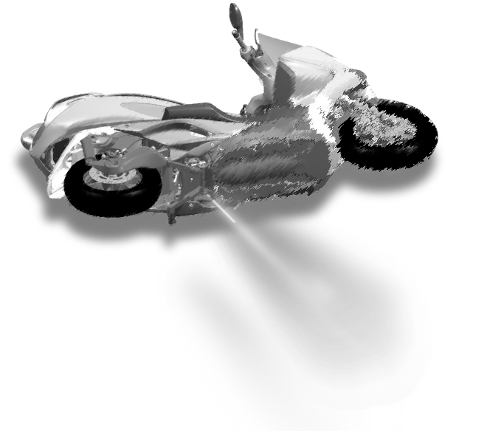
Direction of hydrogen discharge upon TPRD activation
Specified so that people around can identify the direction of hydrogen discharge upon activation of the thermally-activated pressure relief device (TPRD) even when the motorcycle is overturned.
The direction of hydrogen discharge upon activation of TPRD shall be “vertically downward from the bottom of the vehicle body”. (Paragraph 7.1.3.1.)
* Any other requirements for TPRD are the same as UNR134.

Slide 8
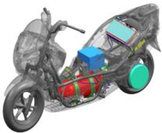
Protection of the container in the vehicle
To prevent local serious damage to the surface of the container in order to avoid its rupture:
(1) Abrasion-avoidance requirement
“The container, etc. shall not come in direct contact with the road surface in the event of turnover, etc.” (Paragraph 7.2.2.1.)
(2) Vehicle body performance requirement
“The container, etc. shall not come in direct contact with other parts, etc. (except protective part(s)) in the event of collision or vehicle crush, etc.” (Paragraph 7.2.2.2.)
Specific components
Container
Range of protection

Slide 9
Strength of the attachment of the container
Necessary to ensure the safety of the container by preventing it from detaching from the vehicle in the event of an accident.
The strength of the attachment of the container shall be verified by an acceleration test. (paragraph 7.2)
(1) Acceleration in the direction of travel: 43.5 G
(2) Acceleration horizontally perpendicular to the direction of travel: 63 G
The container shall remain attached to the vehicle at a minimum of one point after the test.
(1) Frontal collision
(2) Lateral collision
50 km/h
30 km/h
* Accelerations measured using the speeds determined based on accident data

Slide 10
Timeline
May 2017
Draft UNR as informal document to 61st GRSP. If necessary, a TF meeting shall be held.
December 2017
If there are no objections or substantive changes, Japan will send the Draft UNR as a “working document” to the 62nd GRSP and an agreement will be reached.
June 2018
If there are no objections or substantive changes, WP.29 will vote on the UNR.

Slide 11
Thank you for your attention.

