Slide 1
Draft Regulation on Driver Assist Systems to Avoid Blind Spot Accidents
Proposal for Regulation Text
Informal document GRSG-112-36
(112th GRSG, 24-28 April 2017,
agenda item 16.)
Patrick Seiniger
Federal Highway Research Institute
Germany
Notes:
Good morning / afternoon dear ladies and gentlemen.
My name is Patrick Seiniger from the Federal Highway Research Institute (BAST) in Germany. We are involved in the development of a regulation on Driver Assist Systems to Avoid Blind spot accidents, and please let me show you results of our first verification tests for a test procedure.

Slide 2
Structure
Summary of previous work
  Accidentology
  Relevant Parameters
  Derivation of Test Cases
  Test Tools & Conduction
Regulation
  Test Setup
  Test Cases
  Excerpt: relevant text
Notes:
Let me first start with only a few words on Accidentology. There has been a document summarizing our research report on accidentology and basic test cases as an informal document in the last GRSG session.
Based on accidentology, I will show you relevant parameters and test cases as well as assessment criteria. Main part of this presentation will be verification tests and test results and I will finish with a short conclusion.

Slide 3
summary

Slide 4
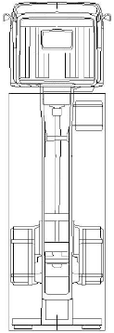
In depth accident analysis - results
Daytime about 90 %
90 % dry weather
Truck drivers sight O.K.;
obstruction in only 9 %
Only 22 % of the cases after previous
halt of the truck
In 90 % of the cases truck did not brake
In 90 % of the cases bicycle moved
Impact point at frontal part of the
truck (up to 6 m towards the rear)
90 % of fatalities with trucks above 7.5 t
6x more Bicycles than Pedestrians
Traffic lights do not play any role
60-80%
(UDB / DEKRA)
 | Cycl. | Ped.
accidents | 640 | 55
seriously injured | 118 | 16
fatalities | 23 | 4
Notes:
Results from this detailed accident study are shown on this slide. Accidents occur mostly during daytime and in dry weather. The truck driver’s sight is usually OK, and only a few cases have a recorded obstruction of sight like plants, parking cars. So accidents happen despite the variety of mirrors available on modern trucks.
In most cases, the truck did not brake and was not accelerating from a halt and the bicycle was moving. The impact position is mostly on the frontal part of the truck, marked with a red line in the figure – and in most cases, the vehicle was a heavy goods vehicle with a gross weight of more than 7.5 tons.

Slide 5
In depth accident analysis - results
Speeds:
Bicycle and truck did not change their speeds during the accident in about two thirds of all cases
Truck speeds are below 30 km/h in more than 90% of all cases
Bicycle speeds are below 20 km/h in more than 80% of all cases
Notes:
This slide shows the speed distributions as found in GIDAS: the left diagram shows absolute speeds, the right diagram speed differences. Main findings are:
Bicycle and truck did not change their speeds during the course of the accident in about two thirds of all cases,
Truck speeds are below 30 km/h in more than 90% of the cases, and bicycle speeds are below 20 km/h in more than 80% of the cases.

Slide 6
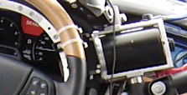
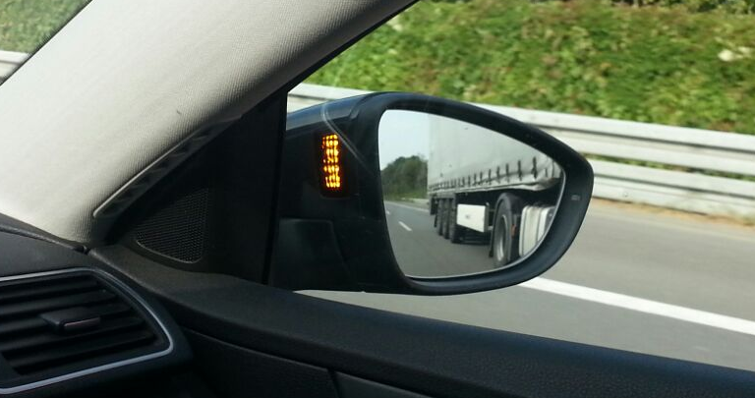
Difference between Warning and Information
Warning
  High intensity
  If issued right, good effects in steering driver‘s attention
  High annoyance if issued too often → risk of deactivation
Information
  Low intensity
  Low annoyance if issued too often → low risk of deactivation
  Lesser effect in steering driver‘s attention
Not Considered for Assistance System
Additional „warning“ shall be allowed
as long as initial „information“ signal is available
(= as it is in today‘s M₁ blind spot assist)
Considered for Assistance System
Notes:
Again, let me highlight the difference between warning and information. A driver warning usually has a high intensity. Think of the beep sound in your passenger car emergency brake system. If issued right (not too early, not too late, not too often), a warning has good effects in steering the driver’s attention towards a threat. But on the other hand, there is a high annoyance if this happens too often, which would then make the driver switch off the system.
An information system, on the other hand, has a low intensity, think for example of the lamp in a rearview mirror. This has a low annoyance, even if activated often, but of course has a lower effect in steering the driver’s attention. The key point here would be: the information is available when the driver needs it, but should not be in the focus at all other times.

Slide 7
Last Point of Information LPI
Stopping distance depends on driver reaction time and deceleration
Information should be given at a point when the vehicle driver can still comfortably come to a full stop BEFORE crossing the bicycle line of movement
This point is the „Last Point of Information“ (LPI)
Reaction time
Braking time
Reaction time
Braking time
Speed
Distance
Time
Time

Slide 8
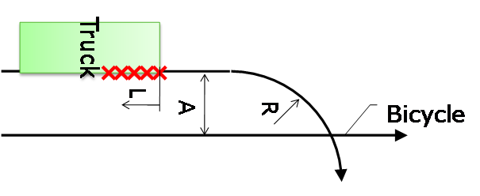
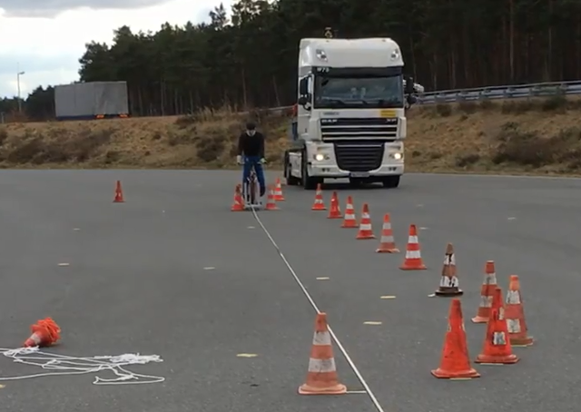
Test Setup
L – Impact location from front of truck
A – Initial lateral separation of HGV and Bicycle
R – Turning Radius of HGV
A
R

Slide 9
Original Test Cases
Bicycle 4s
before LPI
Information MUST be given at or before Last Point of Information (LPI)
Exact timing defined by manufacturer
Tests will simulate at least 8s before LPI
Region for
v_{HGV}>v_{Bicycle}
Bicycle
at LPI
ID | v_{Truck} [km/h] | v_{Cycle} km/h] | R [m] | Initial lateral separation [m] | Impact location with respect to front of truck [m]
1 | 10 | 20 | 5 | 1,5 | 6
2 | 10 | 20 | 10 | 4,5 | 6
3 | 10 | 20 | 10 | 4,5 | 3
4 | 10 | 20 | 10 | 1,5 | 0
5 | 10 | 10 | 5 | 4,5 | 0
6 | 20 | 10 | 25 | 4,5 | 0
7 | 20 | 20 | 25 | 1,5 | 6
to scale, 16x2.55m
Bicycle
before LPI
Bicycle
at LPI
Region for
v_{HGV}<v_{Bicycle}
Notes:
Here is a table showing the selected test cases, and color-coded the trajectories of the bicycle relative to the truck from 4 s before LPI until LPI. These test cases were already introduced in the document from last GRSG. The bicycle is at the LPI at the end of the trajectory line closest to the truck, and is 4 seconds away from the LPI at the other end of the trajectory line. Note that the upper region of the sensor field of view is the region where the truck is faster than the bicycle and the lower region is where the bicycle is faster than the truck.
For a successful assistance system, the information must be given at or before the Last Point of Information, but the exact timing before the LPI can of course be defined by the manufacturer. The test procedure guaranties a sufficient early stable phase of movement of both truck and bicycle, for instance 4 seconds.

Slide 10
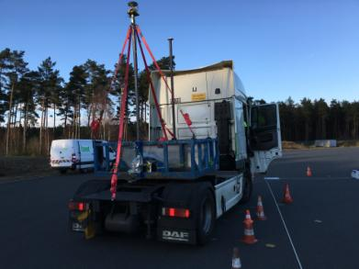
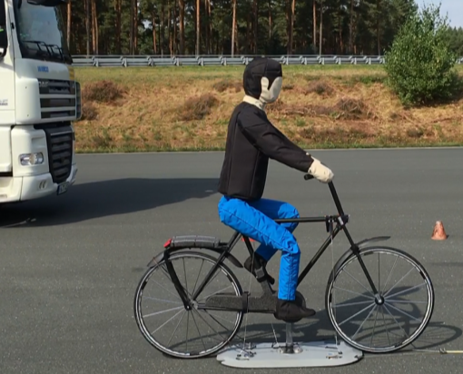
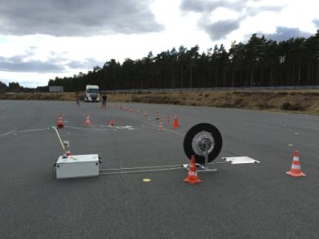
Possible Test Equipment
Vehicle
  Truck, manually driven, without trailer
  Position estimation: GeneSys DGPS
  Position transmitted to dummy propulsion system
Dummy
  Standard impactable bicycle dummy
  Draft dummy specs included in Regulation
Dummy Propulsion
  4a „Surfboard“ commercial Dummy Propulsion
  Synchronisation of triggering time
Notes:
Now for the verification or pretests of the defined test procedure. We did use a manually driven truck, tractor without trailer, where the position was measured by a GeneSys differential GPS system. The truck‘s position then was transmitted to the dummy propulsion system.
We did use a commercial pedestrian dummy by the company 4active systems in Austria, fixed to a regular bicycle. This combination does of course not allow impacts of truck to bicycle without damage.
The dummy was driven by a commercial dummy propulsion system from 4a as well. Synchronisation of the triggering time was calculated in the dummy propulsion system.

Slide 11
Speed Accuracy (manual driving)
20 km/h desired speed
10 km/h desired speed
±2 km/h seems
feasible
±2 km/h feasible

Slide 12
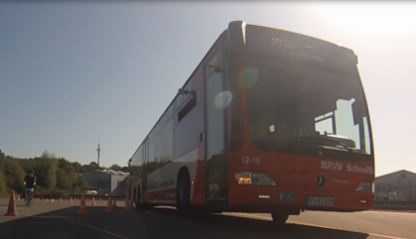
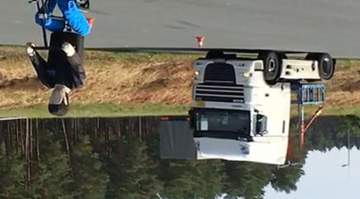
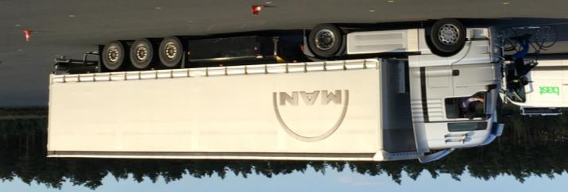
Influence of Vehicle Geometry (Example Case2)

Slide 13
Case 2: Overview
Single Tractor
Tractor + Trailer
Bus
Different vehicle types show different cornering styles
Corridors for test conduction need to be adjusted to take this into account

Slide 14
False Positive Tests
System must not react to trees, cones and other road clutter
Tests will always be carried out using cones
  Information should only be given when approaching the bicycle
Generic local road sign should be placed
  No information should be given when entering the corridor
  Additionally road sign positioned at entry of corridor

Slide 15
Summary
Accident data shows:
  Bicycles, daytime, no obstruction of sight
  Impact on right side of heavy trucks
  In majority of cases no starting or stopping
  Speed ranges below 20 km/h (bicycle), below 30 km/h (truck)
Concept for assistance system
  Information signal
  (comparable to M1 blind spot assist systems)
  7 draft test cases had been defined
  Test procedure can be conducted with current test tools
  Possible accuracies for speed and position (corridor) have been defined

Slide 16
regulation

Slide 17
Performance Requirements
5.3.1. Whenever the system is active, as specified in paragraph 5.3.1.4. below, the BSIS shall inform the driver about bicycles, travelling initially in parallel to the vehicle on the near side of the vehicle, that would be in conflict if the vehicle would start a turn towards the bicycle line of movement.
5.3.1.1. The information signal shall be given at a time when the vehicle driver would still be able to avoid a collision, taking into account an appropriate reaction time and an achievable brake deceleration.
5.3.1.2. The information signal shall meet the requirements as defined in paragraph 5.4. below.
5.3.1.3. The information signal shall be given independently from the activation of turn signals.
5.3.1.4. The BSIS shall be operative for all forward vehicle speeds between
1 km/h and 30 km/h.
5.3.1.5. The BSIS shall be able to give an information signal for all bicycles moving with a speed between 5 km/h and 20 km/h.
5.3.1.6. The BSIS shall not give an information signal for stationary objects that are not pedestrians or cyclists.
5.3.1.7. The information signal shall be provided in such a timely manner that the accident is avoided, i.e. the vehicle is stopped before crossing the bicycle trajectory, if there was a driver brake application, resulting in 5 m/s² brake deceleration, and initiated with a reaction time of 1.4 seconds after the information signal. This shall be tested as specified in paragraph 6.5.

Slide 18
Information must
be activated here
No information signal
at traffic sign or cone
15 ± 0.5 m
10 ± 0.5 m
α =arccos(r_{turn} –d_{lateral})/r_{turn}
Mark corridor using cones *,
spacing not more than 5 m
d_{corridor, outer}
sinα ∙ r_{turn}
Position cone to account
for initial swerving
if defined in Table 1.
Vehicle width + 1m
d_{c}
d_{corridor}
Line C
d_{lateral}
Line A**
Line B
r_{turn}
Collision Point
Bicycle line
of movement
Bicycle starting
position
*: Use locally common traffic cones,
height not less than 0.4 m
**: dashed or dash-dotted lines are for information only; they should not be marked on the ground within the corridor. They can be marked outside of the corridor.
If not specified, tolerances are ± 0.1 m
α
d_{b}
d_{a}
Synchronization:
a) dummy, b) vehicle
at the same time
d_{bicycle}
l_{corridor}

Slide 19
Test Cases
New Test Case | Orig. Test Case | r_{turn} | v_{vehicle} [km/h] | v_{Bicycle} [km/h] | d_{lateral} [m] | d_{a} [m] | d_{b} [m] | d_{c} [m] | d_{bicycle} [m] | l_{corridor} [m] | d_{corridor} [m] | d_{corridor,outer} [m] | Include cone to account for initial swerving?
1 | 1 | 5 | 10 | 20 | 1.5 | 44.4 | 15.8 | 4.3 | < 55 | > 70 | vehicle width + 1m | 5 | Yes
2 | 4 | 10 | 10 | 20 |  |  | 22 | 4.4 |  |  |  | 2 | Yes
3 | 7 | 25 | 20 | 20 |  |  | 38.3 | 10.7 |  |  |  | 1 | No
4 | 6 | 25 | 20 | 10 | 4.5 | 22.2 | 43.5 | 10 |  |  |  | 1 | No
5 | 5 | 5 | 10 | 10 |  |  | 19.8 | 2.4 |  |  |  | 6 | Yes
6 | 2 | 10 | 10 | 20 |  | 44.4 | 14.7 | 3.4 |  |  |  | 3 | Yes
7 | 3 |  |  |  |  |  | 17.7 |  |  |  |  | 2 | Yes
8 | 1* | 5 | 10 | 20 | 1.5 | 44.4 | 15.8 | 4.3 |  |  |  | 1 | No
9 | 4* | 10 | 10 | 20 |  |  | 22 | 4.4 |  |  |  |  | No
10 | 5* | 5 | 10 | 10 | 4.5 | 22.2 | 19.8 | 2.4 |  |  |  |  | No
11 | 2* | 10 | 10 | 20 |  | 44.4 | 14.7 | 3.4 |  |  |  |  | No
12 | 3* | 10 | 10 | 20 |  |  | 17.7 |  |  |  |  |  | No
Test cases where vehicle initially
swerves to the outside
Test cases where vehicle does
not swerve to the outside
Test Case No. corresponding
to presentations from GRSGs 2016

Slide 20
Test Procedure
6.5.1.Using cones and the bicycle dummy, form a corridor according to Figure 1, Appendix 1 of this document and the additional dimensions as specified in Table 1, Appendix 1 of this Regulation.
6.5.2.Position the bicycle target (as detailed in Annex 3 of this Regulation) at the appropriate starting position as shown in Figure 1, Appendix 1 of this Regulation.
6.5.3.Position a local traffic sign corresponding to sign C14 as defined in the Vienna convention on road signs and signals (speed limit 50 km/h) or the local sign closest to this sign in meaning on a pole at the entry of the corridor as shown in Figure 1, Appendix 1 of this Regulation.
6.5.4.Drive the vehicle at a speed as shown in Table 1, Appendix 1 of this document with a tolerance of +/- 2 km/h through the corridor.
6.5.5.Do not operate the turn lights when initiating the turn towards the bicycle trajectory.
6.5.6.Move the bicycle dummy on a straight line as shown in Figure 1, Appendix 1 of this document in way that the dummy position crosses line A (Figure 1, Appendix 1) with a
tolerance of +/- 0.5 m at the same time when the vehicle crosses line B (Figure 1, Appendix 1) with a tolerance of +/- 0.5 m (verify e.g. with video or picture).
Move the dummy in a way that the dummy moves in a steady state for at least 8 seconds, with the speed as shown in Table 1, Appendix 1 of this document with a tolerance of +/- 0.5 km/h, before reaching the collision point.
6.5.7.Verify that the Blind Spot Information signal has been activated before the vehicle crosses line C, Figure 1, Appendix 1 of this document.
6.5.8.Verify that the Blind Spot Information signal has not been activated when passing the traffic sign and any cones as long as the bicycle dummy is still stationary.

Slide 21
Future Improvements
To clarify: additional warnings can be given after LPI
Consider how to address approval of stand-alone / retrofit systems
Erase „original test case“ column from test case table

