Slide 1
Submitted by the Chair of the IWG on Tyre GTR
Informal document GRRF-84-05
84th GRRF, 19-22 September 2017
Agenda item 7(a)
IWG TYREGTR 16th Meeting*
Moscow, NAMI, 7-9 June 2017
Report of the Chair
* Meeting participants: China, India, Japan, Russian Federation, ETRTO, JATMA, USTMA

Slide 2
Current status of the UN GTR No. 16
Reference: UN GTR No. 16, Part 1, para. 23
The table describes the non-harmonized tests applicable to LT/C tyres
LT/C tyres | C type tyres | LT type tyres
Test name | Paragraphs related to Regulation No. 54 | Paragraphs related to FMVSS 139
Marking and tread wear indicators | 3.2., 3.3. and 3.4. | 3.2., 3.3. and 3.4.
Physical dimensions | 3.21. | 3.20.
High speed test | 3.16. | 3.19.
Endurance test | 3.16. | 3.17.
Low pressure test | None | 3.18.
Wet grip test | None | None
Run flat test | None | None
Strength test | None | 3.14.
Bead unseating test | None | 3.15.
Rolling sound emissions | 3.8. | None

Slide 3
Subject of Amendment No. 2 to UN GTR No. 16
Reference: Authorization ECE/TRANS/WP.29/AC.3/48
Amendment of the GTR text:
Addition of new definitions (Section 2)
Harmonization of the Load Range concept in relationship to Inflation Pressure (Section 2)
Alignment of the provisions with the most recent developments in UN Regulations Nos. 30 and 54 (Sections 3.3 and 3.5, Annexes 3 and 6 )
Harmonization of FMVSS 139 requirements relative to UNECE PSI index (Sections 3.14 and 3.15)
Addition of new harmonized provisions for physical dimensions of LT/C tyres (new Section 3.20; old Sections 3.20 & 3.21 to be deleted)
Addition of new harmonized provisions for high speed test for LT/C tyres (new Section 3.19, old Section 3.16 to be modified with endurance test only, old Section 3.19 to be deleted)
Other topics to be discussed:
Consideration of feasibility of harmonization of endurance test for LT/C tyres (Sections 3.16 and 3.17)
Consideration of feasibility of development of provisions for global tyre marking

Slide 4
Challenge 1: Incompatibilities identified when working on harmonization of Physical Dimensions Test
Reference: draft amendment No. 2 to UN GTR No. 16 “frozen” text TYREGTR-16-10
During discussions on the proposed amendments, the tyre industry identified incompatibilities in some cases regarding the UN Regulations and U.S. FMVSS standards, which have to be addressed in the harmonized GTR text.
Actions (to be) taken:
Create the list of tests depending on markings on tyres: Load Range, pressure index and Inflation pressure for maximum load (focused on LT/C tyres) (ETRTO)
Find out, where the information about the test pressure for each test used in this GTR does come from: either from tyre sidewall or from another source (ETRTO)
Clarify the relationship between the test pressure used in each GTR test and the test pressures stamped on the sidewall as per 3.3.5 and 2.56 (ETRTO)
Investigate whether the markings in paragraph 3 are mandatory according to the GTR text and will assess the need for rewording of paragraphs 3.2 and 3.3 (ETRTO)
Consider the need of change in GTR (and in R54?) of the definition of the measuring rim (ETRTO)
Consider the open topics in 3.20.5.5, 3.20.5.1, 3.2.X, and prepare a proposal by next IWG meeting (ETRTO)
Plus:
Prepare a justification related to item 2.77 to convince that the ASTM SRTT performance is constant in time (USTMA)

Slide 5
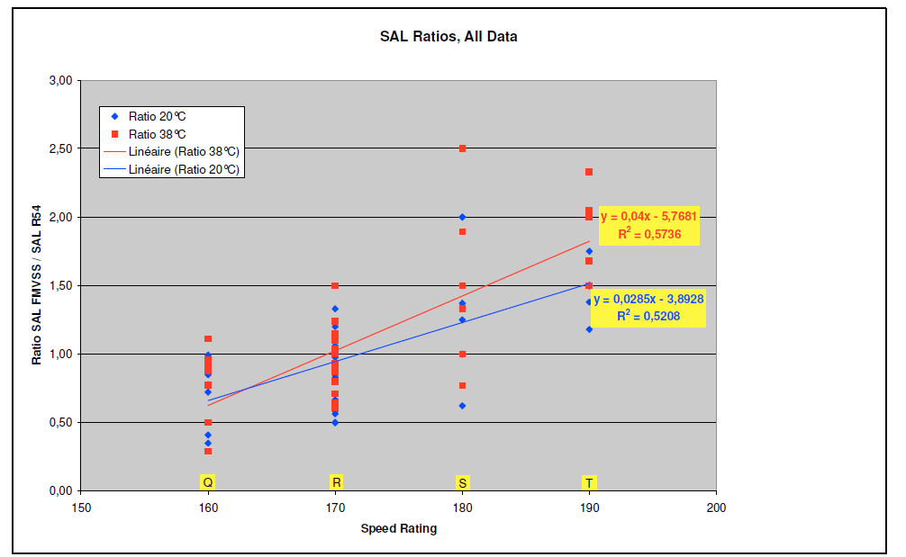
Challenge 2: Harmonization of provisions for High Speed Test for LT/C tyres
Reference: TYREGTR-16-07
Assessment of FMVSS139 High Speed test vs R54 Load/Speed test made by tyre industry:
FMVSS 139 more severe
?
R54 more severe
Since available results do not allow to decide between R54 and FMVSS139 High Speed tests for ‘R’ (and ‘S’) Speed Symbols, the proposal is to extend the mandate by 1 year in order to give tyre industry the possibility to confirm the initial results on the High Speed harmonised test method.
Actions (to be) taken:
Seek guidance from GRRF how to proceed (IWG Chair).

Slide 6
Other proposals
References: TYREGTR-15-06, TYREGTR-16-08, TYREGTR-16-05
Proposal by China (based on TYREGTR-15-06): IWG agreed that the relevant text containing alternative level of requirements may be included in GTR No. 16 as per Article 4.2 of the 1998 Agreement.
Actions (to be) taken:
Make a proposal and prepare a document based on the presentation TYREGTR-15-06 considering tyre industry response (TYREGTR-16-08) (China)
Consider whether it is possible to have the options in the GTR based on the Chinese proposal and the ways of possible harmonisation with the current GTR provisions (IWG).
Proposal by India (TYREGTR-16-05) to have an option for Contracting Parties to exclude from the scope tyres with Speed Symbol less than Q (para. 1.3): IWG experts were in agreement with the proposal with the exception of Japan, which requested study reservation.
Actions (to be) taken:
Add the Indian proposal in the draft GTR text between square brackets (IWG secretary).
Come with the statement on the Indian proposal by the next GRRF September 2017 session (Japan).

Slide 7
Other discussion topics
References: TYREGTR-16-06, TYREGTR-16-04
Consideration of feasibility of harmonization of endurance test for LT/C tyres (Sections 3.16 & 3.17): Presentation (TYREGTR 16-06) shown the high complexity in harmonizing the endurance test. The proposal is to keep the non-harmonized tests for the time being.
Action (to be) taken:
Report to GRRF that there is no feasibility to harmonize the provisions for the endurance test for LT/C tyres and wait for input from Contracting Parties how to proceed to further activities on this item (IWG Chair).
Consideration of feasibility of development of provisions for global tyre marking (proposal by the Russian Federation TYREGTR-16-04).
Action (to be) taken:
Assess the production volumes for C1 and C2 tyres that are currently approved for all markings (DOT, E (R30, R54, R117), CCC, ISI), which the global tyre marking is addressed to, and advise on the possibility on the further analysis of this global marking. The purpose is to measure the impact of a global marking compared to the actual situation (Tyre companies).

Slide 8
Request for guidance from GRRF
Whether to complete phase 2A (harmonization of Physical Dimensions Test) on time (as scheduled in Authorization ECE/TRANS/WP.29/AC.3/48)
or
Whether to wait to have the completion of the harmonised High Speed Test (phase 2B) to submit the complete package of Amendment No. 2 (phases 2A and 2B) with a 2-year extended mandate (till the end of 2019).
The IWG Chairman’s and the tyre industry preference would be to submit to GRRF the complete package of Amendment No. 2 (phases 2A and 2B) with 2-year delay.
Notes:
1. The work with harmonization of High Speed test may be completed earlier. In this case the draft Amendment No. 2 would be delivered earlier.
2. The part of the draft Amendment No. 2 related to harmonization of Physical Dimensions test and other updates as described above will be submitted for endorsement of GRRF by February 2018.

Slide 9
Next IWG 17th meeting
Reference: TYREGTR-17-01
Venue: European Tyre and Rim Technical Organization (ETRTO) (maximum 28 participants)
Address: Rue Defacqz 78-80, Brussels, Belgium
Schedule: November 2 & 3, 2017 (Thursday & Friday) from 09:30 to 17:30 (time tbc)
Objectives:
1. To resolve phase 2a (Physical dimensions) pending issues and finalize phase 2a proposal:
a. Current proposal;
b. Chinese proposal ;
2. To work on Harmonisation High speed test for LT/C tyres (phase 2b);
3. To work on planned topics:
a. Feasibility of provisions for global tyre marking;
b. Drafting the Proposal for the Technical Report and Statement of technical rationale and justification for Amendment 2 to UN GTR No. 16.
Please confirm your participation (name, organization) to this IWG meeting at latest by September 30th 2017 to the IWG secretary, Mr. Nicolas de Mahieu, e-mail: info@etrto.org
Please send the meeting documents to the IWG secretary.
The meeting documents may be found at: IWG 16th meeting: https://wiki.unece.org/display/trans/TYRE+GTR+SESSION+16 IWG 17th meeting: https://wiki.unece.org/display/trans/TYRE+GTR+SESSION+17

Slide 10
IWG TYREGTR Chairman: Mr. Andrei Bocharov (NAMI, Russian Federation), e-mail: ab@satrfond.ru, a.bocharov@nami.ru.

