Slide 1
UNECE IWG on EPPR for L-category vehicles
State of play
Informal document GRPE-75-24
75th GRPE, 6-9 June 2017,
Agenda item 9(b)
Adolfo Perujo
Chairman IWG EPPR (L-cat)

Slide 2
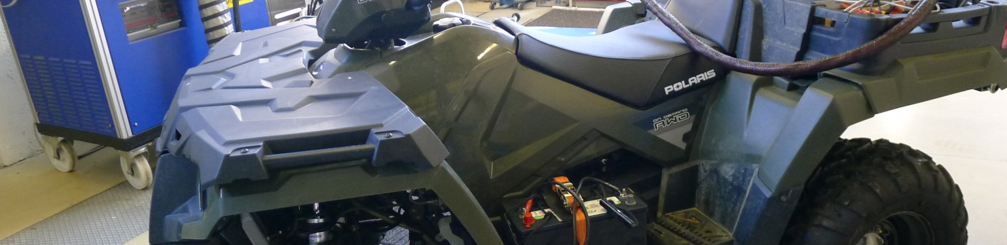
Outline
Background
State of play
      GTR on Evaporative and Crankcase emissions
      GTR on OBD-1
      GTR2
  Request for clarification
Next Steps /Roadmap
Past and next meetings

Slide 3
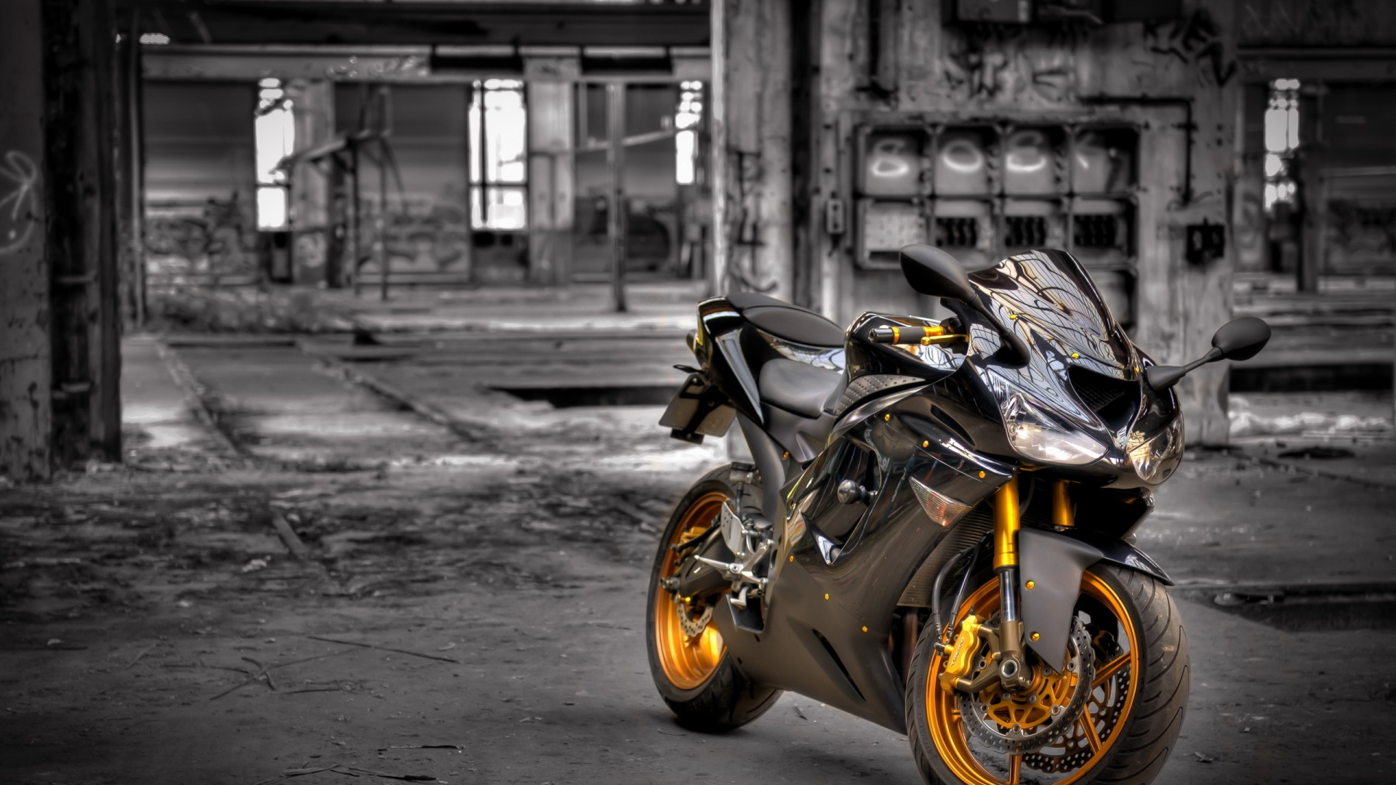
Background
ToR and mandate
Priority to work under 1998 Agreement but will also work under 1958 Agreement
Amend GTR No2 and develop new GTRs with respect to Environmental and Propulsion unit Performance Requirements
Create synergies with 58th Agreement and where possible develop common requirements in form of UN Reg(s)
Exchange information on current and future regulatory requirements for ‘light vehicles’
Adopted at WP29 Nov 2013
Extended at WP29 Jun 2015 (2016 to 2020) (ECE/TRANS/WP.29/AC.3/36/Rev.1)

Slide 4
Background
Topics to be covered by EPPR
Environmental performance:
    Type I: Tailpipe emissions test after cold start (revision);
    Type II: Tailpipe emissions test at (increased) idle / free acceleration;
    Type III: Emission test of crankcase gases;
    Type IV: Evaporative emissions test;
    Type V: Durability testing of pollution control devices;
    Type VII: Measurement of CO2 emissions, fuel consumption, electric energy consumption and electric range determination;
    Type VIII: On-board diagnostics environmental verification tests.
Propulsion unit performance:
    Unified rules and test procedures to measure power and torque for propulsion technologies fitted on L-category vehicles
    unified measurement of maximum design vehicle speed and/or power for restricted L-category vehicles should be developed and agreed upon.

Slide 5
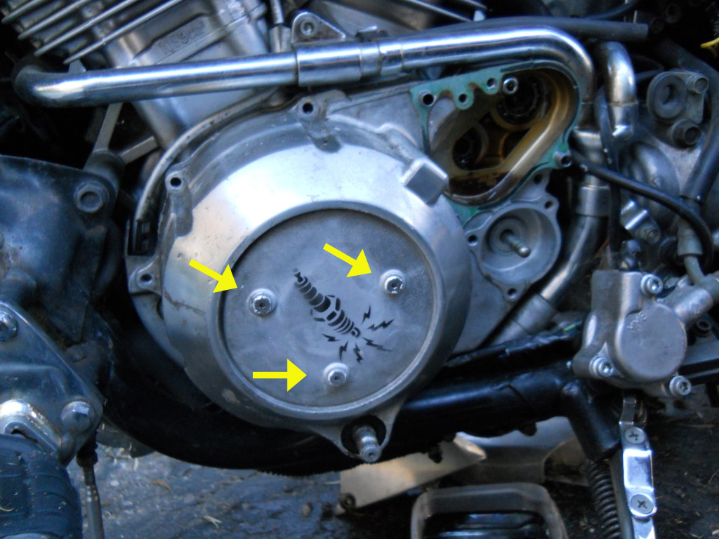
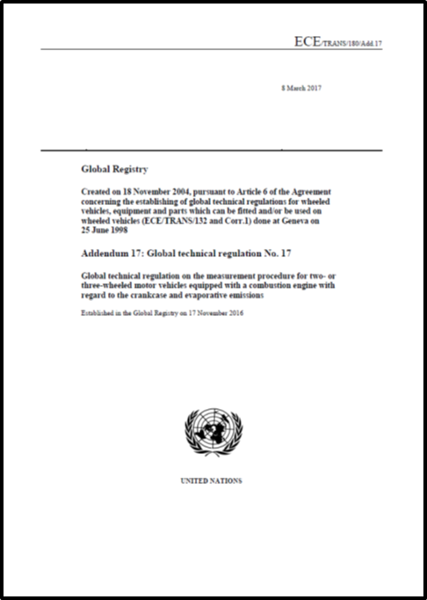
Evaporative and Crankcase emissions
Stay of Play
8 March 2017 (ECE/TRANS/180/Add.17)
Global Registry
Created on 18 November 2004, pursuant to Article 6 of the Agreement concerning the establishing of global technical regulations for wheeled vehicles, equipment and parts which can be fitted and/or be used on wheeled vehicles (ECE/TRANS/132 and Corr.1) done at Geneva on 25 June 1998
Addendum 17: Global technical regulation No. 17
Global technical regulation on the measurement procedure for two- or three-wheeled motor vehicles equipped with a combustion engine with regard to the crankcase and evaporative emissions
Established in the Global Registry on 17 November 2016
http://www.unece.org/fileadmin/DAM/trans/main/wp29/wp29wgs/wp29gen/wp29registry/ECE-TRANS-180a17e.pdf

Slide 6
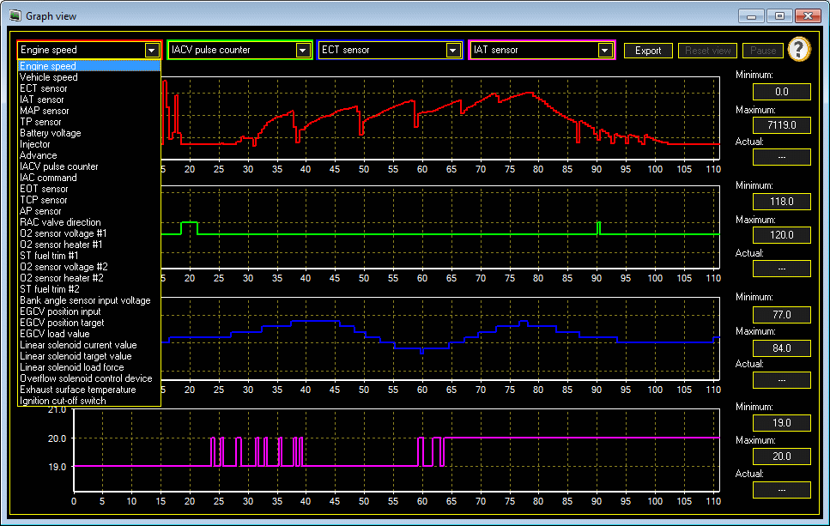
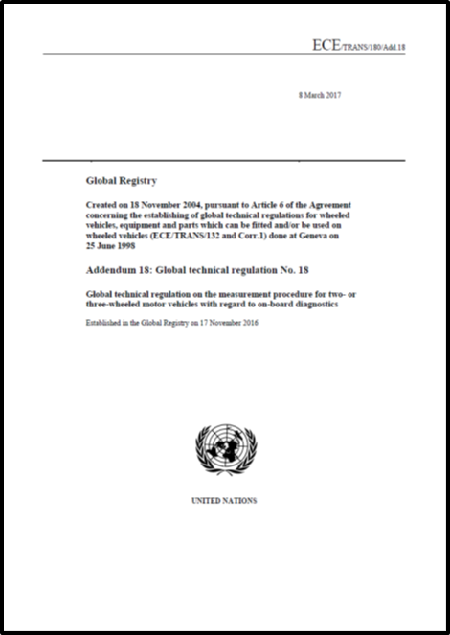
OBD-I
Stay of Play
        8 March 2017 (ECE/TRANS/180/Add.18)
Global Registry
Created on 18 November 2004, pursuant to Article 6 of the Agreement concerning the establishing of global technical regulations for wheeled vehicles, equipment and parts which can be fitted and/or be used on wheeled vehicles (ECE/TRANS/132 and Corr.1) done at Geneva on 25 June 1998
Addendum 18: Global technical regulation No. 18
Global technical regulation on the measurement procedure for two- or three-wheeled motor vehicles with regard to on-board diagnostics
Established in the Global Registry on 17 November 2016
http://www.unece.org/fileadmin/DAM/trans/main/wp29/wp29wgs/wp29gen/wp29registry/ECE-TRANS-180a18e.pdf

Slide 7

GTR2
Stay of Play
EPPR-11-15 Rev1 = proposal EC
IMMA has identified the differences between current GTR2 & EPPR-11-15 Rev1
Extensive document. Split the work, during 2016 and 2017
Intentions to present an informal documents to GRPE (January 2018)

Slide 8

Request for clarification
Temperature units
  Kelvin or ºC
  If Kelvin then 273.15 or 273.2 = 0ºC

Slide 9

Next steps
OBD 2
    Start full work on this item from beginning 2018 (agreed by all parties)
Durability (?)
GTRs to be transposed into UN Regulations (?)
….

Slide 10

EPPR Roadmap

Slide 11

Meetings

Slide 12


