Slide 1
UNECE IWG on EPPR for L-category vehicles
State of play
Informal document GRPE-74-12
74th GRPE, 9-13 January 2017,
Agenda item 9(b)
Adolfo Perujo
Chairman IWG EPPR (L-cat)

Slide 2
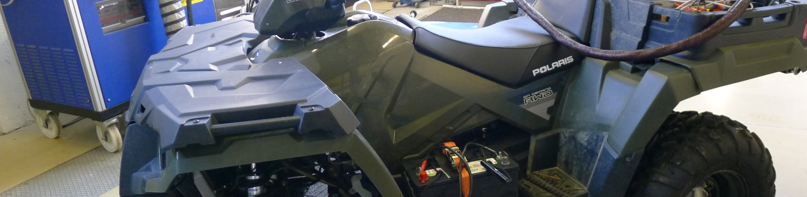
Outline
Background
Past and next meetings
State of play
      GTR on Evaporative and Crankcase emissions
      GTR on OBD-I
      GTR2
      OBD 2
Roadmap

Slide 3
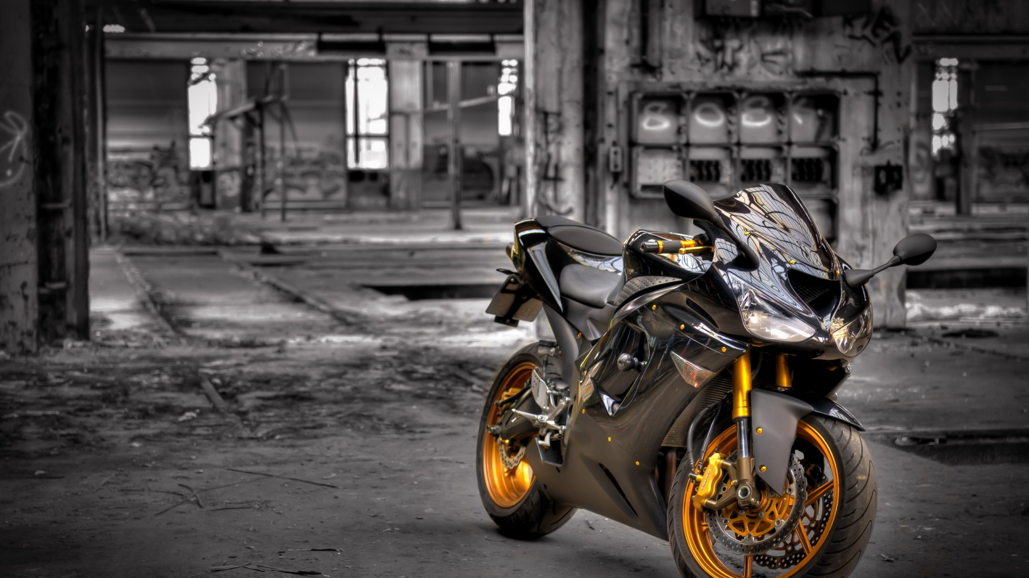
Background
ToR and mandate
Priority to work under 1998 Agreement but will also work under 1958 Agreement
Amend GTR No2 and develop new GTRs with respect to Environmental and Propulsion unit Performance Requirements
Create synergies with 58th Agreement and where possible develop common requirements in form of UN Reg(s)
Exchange information on current and future regulatory requirements for ‘light vehicles’
Adopted at WP29 Nov 2013
Extended at WP29 Jun 2015 (2016 to 2020) (ECE/TRANS/WP.29/AC.3/36/Rev.1)

Slide 4
Background
Topics to be covered by EPPR
Environmental performance:
    Type I: Tailpipe emissions test after cold start (revision);
    Type II: Tailpipe emissions test at (increased) idle / free acceleration;
    Type III: Emission test of crankcase gases;
    Type IV: Evaporative emissions test;
    Type V: Durability testing of pollution control devices;
    Type VII: Measurement of CO2 emissions, fuel consumption, electric energy consumption and electric range determination;
    Type VIII: On-board diagnostics environmental verification tests.
Propulsion unit performance:
    Unified rules and test procedures to measure power and torque for propulsion technologies fitted on L-category vehicles
    unified measurement of maximum design vehicle speed and/or power for restricted L-category vehicles should be developed and agreed upon.

Slide 5

Meetings

Slide 6
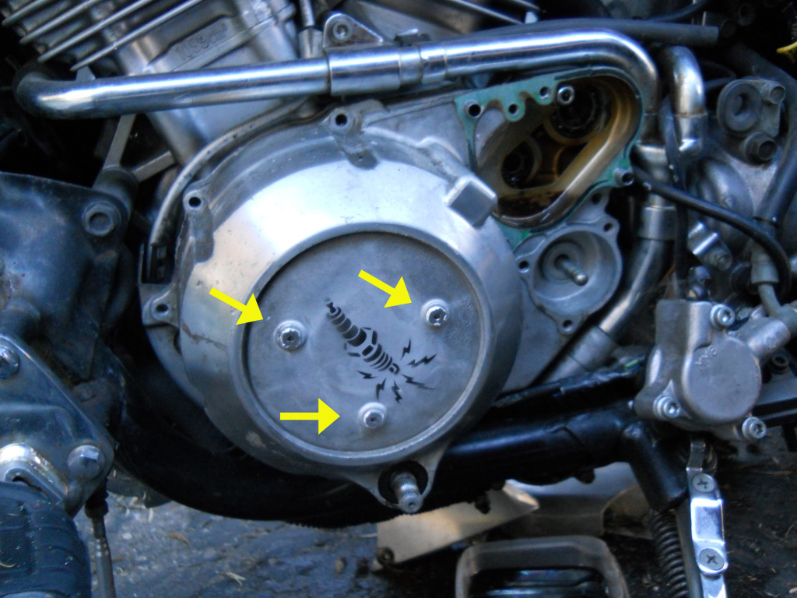
Evaporative and Crankcase emissions
Stay of Play
Adopted by the GRPE in its 72nd Session (Jan 2016)
The proposal for a new UN GTR on crankcase and evaporative emissions from two- or three-wheeled motor vehicles equipped with a combustion engine (ECE/TRANS/WP.29/2016/66, ECE/TRANS/WP.29/2016/67, ECE/TRANS/WP.29/AC.3/36/Rev.1) was established in the UN Global Registry on 17 November 2016 by consensus vote of the following Contracting Parties present and voting …

Slide 7
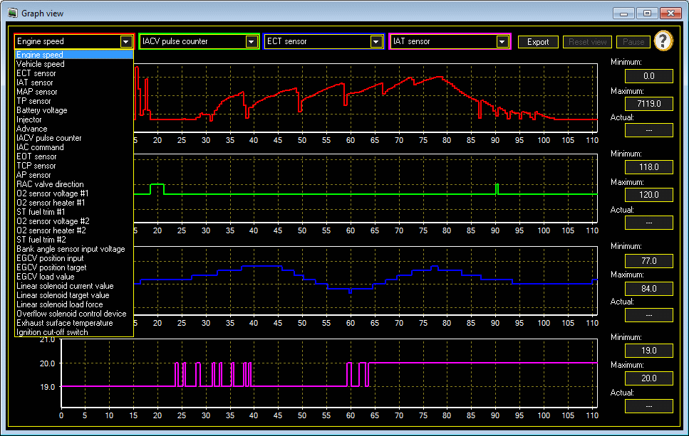
OBD-I
Stay of Play
Adopted by the GRPE in its 73rd Session of the GRPE (June 2016)
The proposal for a new UN GTR on the measurement procedure for two- or three-wheeled motor vehicles with regard to on-board diagnostics (ECE/TRANS/WP.29/2016/112, ECE/TRANS/WP.29/2016/113, ECE/TRANS/WP.29/AC.3/36/Rev.1) was established in the UN Global Registry on 17 November 2016 by consensus vote of the following Contracting Parties present and voting …

Slide 8

GTR2
Stay of Play
EPPR-11-15 Rev1 = proposal EC
IMMA has identified the differences between current GTR2 & EPPR-11-15 Rev1
Extensive document. Split the work, during 2016 and 2017
Japan has requested and the IWG has accepted to take the EURO 5 regulation as the basis for discussion and development of GTR 2 revision.
Intentions to present an informal documents to GRPE (June 2017)
Start full work on this item from beginning 2018 (agreed by all parties)
OBD2

Slide 9

EPPR Roadmap

Slide 10


