Slide 1
ASEP IWG Report to GRB 65th
Transmitted by the IWG ASEP
Informal document GRB-65-25
(65th GRB, 15-17 February 2017,
agenda item 4 (b))
Presentation of ECE/TRANS/WP.29/GRB/2017/2 - (IWG on ASEP) Proposal for Supplement 2 to the 03 series of amendments to Regulation
and GRB-65-26

Slide 2
Justifications
In order to propose a testing procedure, which is more consistent and clearly defined, the following technical modifications and extensions were introduced.
To facilitate reading and understanding, the text was re-structured.
In order to avoid misunderstanding and confusion which may induce different interpretations of application, the text was clarified.
Additional clarification were introduced in GRB-65 in order to avoid confusion or to give clearer specifications
(ex. transmission conditions, tests on different test tracks or under different environmental conditions, invalid gear

Slide 3
Justifications
Lot of inconsistency were highlight on symbols and acronyms for annex 7 and Annex 3.
IWG ASEP tries to correct them without interfere with Annex 3.
IWG recommends to GRB to fully review UN51.03 to make symbols and acronyms more consistent.

Slide 4
Technical modifications and extensions 1.1
1.1. New definitions for Annex 7, which are also applicable for Annex 3:
(a) Definitions for gear, gear ratio, gear_{i} and gear_{i+1} were added for clarity;
(b) The missing definition for mode was added and taken over from the first part of Global Technical Regulation No. 15;
(c) Definitions for "Stable" and "Unstable" accelerations were introduced to avoid ambiguity.

Slide 5
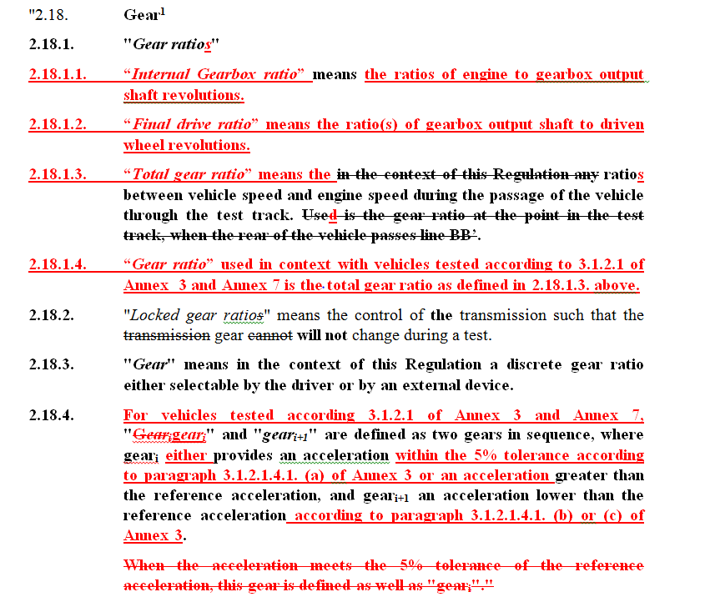
Technical modifications and extensions 1.1 + GRB-65-xx
1.1. New definitions for Annex 7, which are also applicable for Annex 3:
(a) Definitions for gear, gear ratio, gear_{i} and gear_{i+1} were added for clarity;
→ Text was modified to be more consistent with annex 1 and 3.

Slide 6
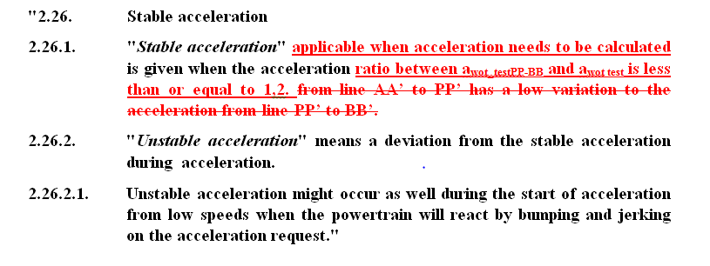
Technical modifications and extensions 1.1 + GRB-65-xx
1.1. New definitions for Annex 7, which are also applicable for Annex 3:
(c) Definitions for "Stable" and "Unstable" accelerations were introduced to avoid ambiguity.
→ Text was modified to propose a clear specification.
→ Modification Annex 7 §2.4

Slide 7
Technical modifications and extensions 1.2
1.2. The ambiguous principle of target speed 70 or 80 km/h was replaced by:
(a) 80 km/h target speed (depending on n_{BB_ASEP}) for locked transmission for the lowest valid gear and non-locked transmission, to make sure that, at the lowest gear, the vehicle is tested closest to the requested maximum engine speed;
(b) 70 km/h target speed was considered for all gears other than the lowest, as none of the higher gears can provide the maximum engine speeds higher than those achieved in the lowest gear.

Slide 8
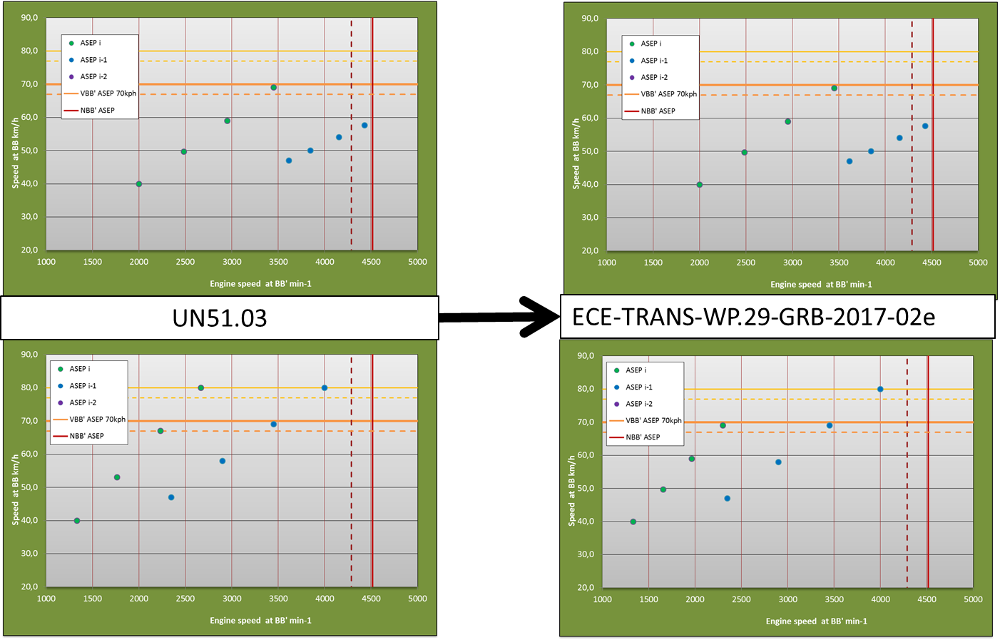
Technical modifications and extensions 1.2
Same Speed and engine speed range
Reduced speed range (until 10km/h)
Same engine range

Slide 9
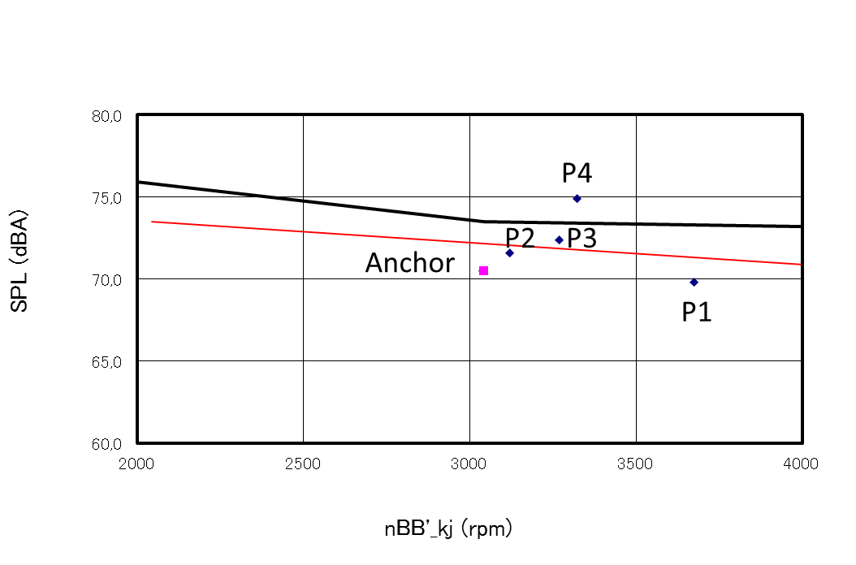
Technical modifications and extensions 1.4
1.4. For the slope assessment, the "slope_{κ} < 0 on non-locked automatic transmission, the selected transmission setup not valid" was enhanced by the provision that, in this case, the L_{urban} - assessment shall be used. Otherwise, it would not be clear what should happen in this situation.

Slide 10
Technical modifications and extensions 1.6
1.6. In order to uniform the limit concept extra margin (limit value - L_{urban} of Annex 3) for "silent vehicle" defined in the slope assessment method for vehicles with locked transmission, this concept was also applied to vehicles with non-locked transmission and for the L_{urban}- assessment.

Slide 11
Technical modifications and extensions 1.6
For locked modes :
Slope assessment method :
x = 2 dB(A) + limit value – Lurban
→ Bonus
L urban assesment method :
L_{urban_ASEP} (a asep, L urb, L crs, L asep) ≤3.0 dB(A)
→ No bonus

Slide 12
Technical modifications and extensions 1.6
For Slope assessment method :
For non-locked modes :
x = 3 dB(A)
→ No bonus
For locked modes :
x = 2 dB(A) + limit value – Lurban
→ Bonus

Slide 13
Technical modifications and extensions 1.7
1.7. In order to be technology neutral and to respect the rapid changes in technology towards high gear number transmissions, an additional condition to determine the gear to be tested was introduced for reference sound assessment for automatic transmission tested in locked position with 6 or more gears. An acceleration of 1.9 m/s² was defined from 50 km/h at AA to 61 km/h at BB + 5 m length vehicle to reflect the typical type approval condition under the 02 series of amendments to Regulation No. 51.

Slide 14
Technical modifications and extensions 1.8
1.8. The missing limits from the 02 series of amendments to Regulation No. 51 in the reference sound assessment were introduced:
(a) For N₁ vehicles, the limits of the 02 series of amendments to Regulation No. 51 were overtaken and +2 dB(A) added, using the same principle already defined in the reference sound assessment for vehicles of category M₁: for a category/sub-category, limit reference assessment equal to limit in the 02 series of amendments to Regulation No. 51 + 2 dB(A);
(b) The tolerances of the 02 series of amendments to Regulation No. 51 for direct injection diesel and off- road vehicles.

Slide 15
Technical modifications and extensions
1.9. The part on "L_{urban} - assessment" was moved before the reference sound assessment, to have the right order of assessment.
1.10. The conditions for direct measurement and simulation were separated and precised.
1.11. Speed normalization (0.15 * (V_{_BB_ASEP} - 50)) was moved from L_{urban_ASEP} to L_{urban_normalized} and L_{urban_ASEP} was renamed ΔL_{urban_ASEP.}
1.12. Flowcharts were introduced.

