Slide 1
Electronic exchange of information concerning Type Approval Authorities and Technical Services
Informal document WP.29-172-07 172nd WP.29, 20 - 23 June 2017, Agenda item 4.1
Note by the secretariat
WP29- Doc 343 web-based application

Slide 2
WP.29 Doc 343 application
The WP.29 Doc 343 application provides the plateform for exchange of information on the designation of Type Approval Authrities (TA) and/or Technical Services by Contracting Parties
Contracting Parties using this platform provide information discussed under WP.29 agenda item 4.1. (see ECE/TRANS/WP.29/343/Rev.X)

Slide 3
Decision in March 2017
The Heads of Delegations provide to the secretariat the contact data of the Single Point Of Contact (SPOC) of his/her Country in charge of providing the TA and TS designation information to the secretariat.
Credential will be provided to these SPOCs for access.
SPOCs may provide information through the platform any time they wish.
So far: only a few Countries shared contact data.

Slide 4
Access without log in
Any one accessing to the platform can find (under «home») information about:
Type Approval Authority(ies) and Technical Services (TS) in one Country
Thoses designated for approving and / or performing tests and applying provisions of a given Regulation for the purpose of Type Approval.
The platform uses the same codes as in ECE/TRANS/WP29/343/Rev.X, Annex 1
These codes can be decrypted online in the section: «Type Approval Authorities and Technical Services»

Slide 5
Descirption of the application HMI

Slide 6
Interface description (once logged in)
Log off button
Contact us here
Application to edit the contact data of TA and TS
Application to link TA and TS with Regulations
Short description of the platform
Home button
Browse the information available concerning a Regulation

Slide 7
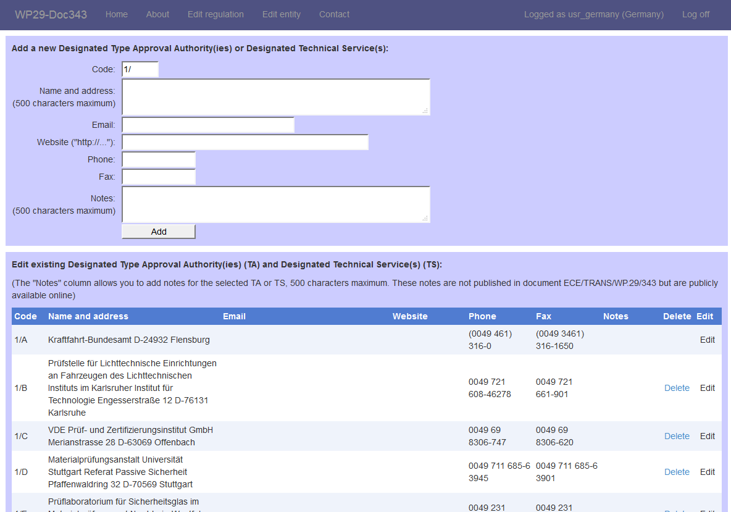
How to edit the name and contact data of a TA or a TS?
Create a new TA or TS:
Define the code
Provide contact data
Add a note if needed
OR
Edit existing TA or TS:
Delete one TA or TS
Or
Edit name, contact data, note;
Note:
Modifications will be displayed in Annex 1 and all tables in Part 1 of ECE/TRANS/WP29/343

Slide 8
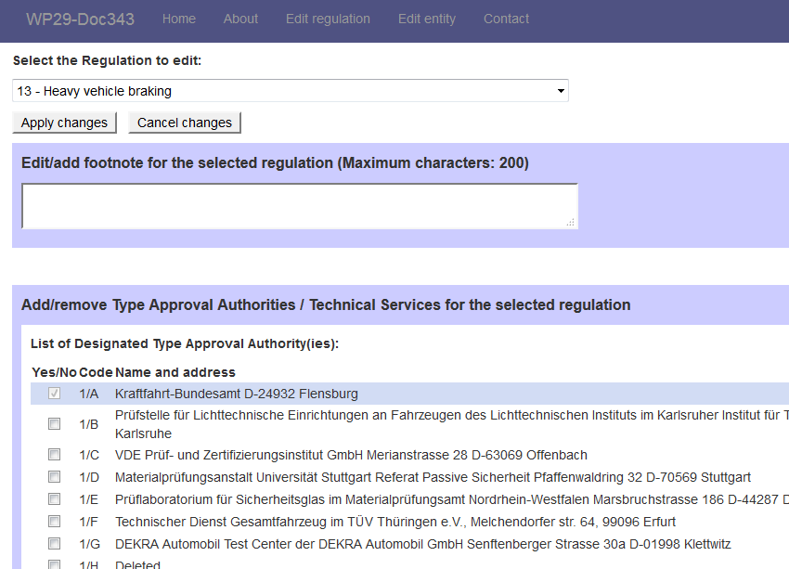
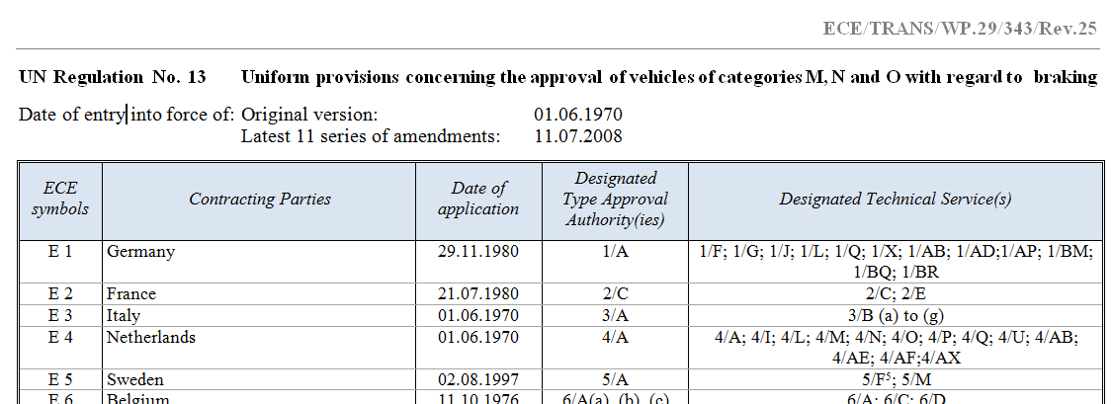
How to designate a TA or a TS for a given UN Regulation
Click on «edit regulation»
Select the Regulation
Select the TA and/or the TS that you want to add You may correct existing information by selecting or deselecting one or more TA or TS
You may want to add a footnote in order to add additional information in the field «edit footnote…»
Impact on the /343 document:

Slide 9
Proposed next steps
Bug fix
Head of Delegation of Contracting Parties will receive the credential for their Country.
Information on the Single Point Of Contact (SPOC) to be sent to the secretariat
As of 2018, notifications on Type Approval Authorities and Technical Services will exclusively provided through the application

