Slide 1
60th session of the Working Party on Intermodal Transport and Logistics of the Inland Transport Committee of the United Nations Economic Commission for Europe
(ITC UNECE) Geneva, November 22-24, 2017
TRANSITION TO DIGITAL DOCUMENT MANAGEMENT
DURING CARGO TRANSPORTATION
ON RAILWAY TRANSPORT
REPORT:
INESSA VLADIMIROVNA YAKOVLEVA
Deputy Head of the Informatization Department –
Head of the Department

Slide 2
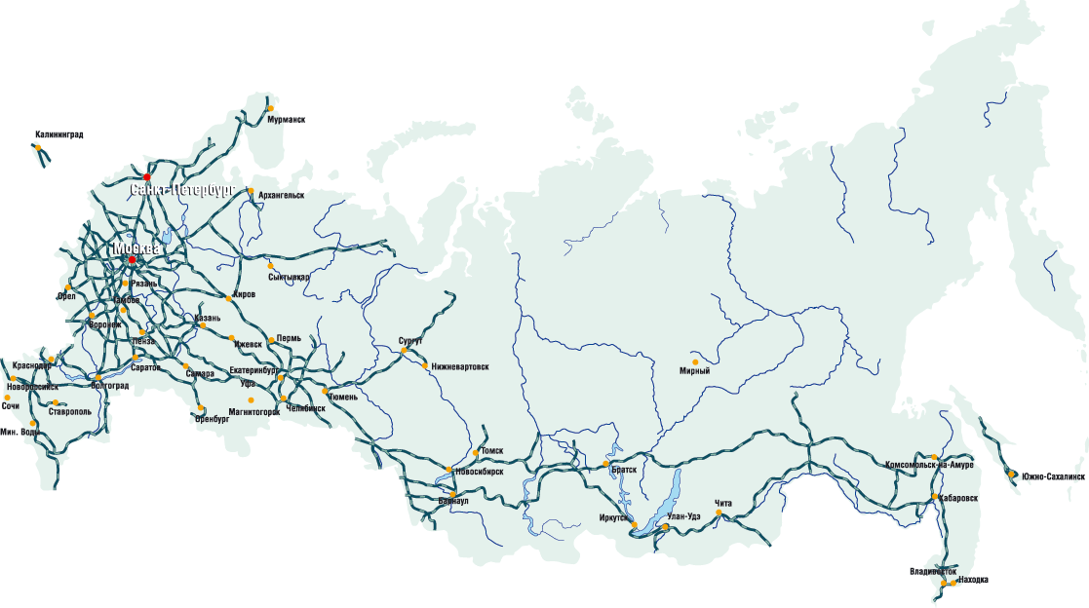
USE OF ELECTRONIC SIGNATURE IN JSC "RZD"
All the stations of JSC "RZD" open for cargo operations - over 3600 in total - are connected to the electronic signature infrastructure
More than 83,000 clients work in the electronic signature mode
Around 1,800,000 shipping and other documents are prepared monthly in the electronic signature mode

Slide 3
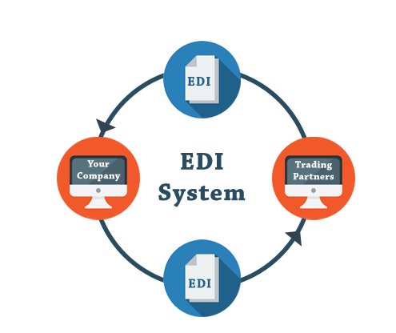
60_84
ELECTRONIC DATA INTERCHANGE DURING CARGO TRANSPORTATION IN INTERNATIONAL TRAFFIC
IMPLEMENTED EDI AGREEMENTS
PLANNED EDI AGREEMENTS
CHINA
MONGOLIA
DEMOCRATIC PEOPLE'S REPUBLIC OF KOREA
FINLAND
POLAND
BELARUS
UKRAINE
KAZAKHSTAN
AZERBAIJAN
LATVIA
LITHUANIA
ESTONIA
CUSTOMS AUTHORITIES
MARITIME TRANSPORT

Slide 4
STATISTICS OF DOCUMENT FLOW THROUGH THE TRAFFIC NETWORK OF JSC "RZD"
Notes:
По годам – By year

Slide 5
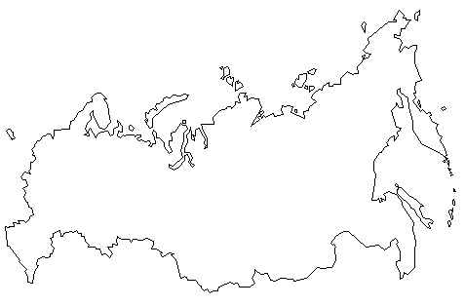
AIMS, OBJECTIVES, FUNCTIONAL CAPABILITIES
SYSTEMS OF ELECTRONIC INTERACTION WITH THE CUSTOMS
Increased competitiveness and sustainable growth of cargo rail transportation in international traffic
AIM:
OBJECTIVES:
Acceptance of cargo for transportation, 0% VAT confirmation
Departure registration
1. To increase the speed of trains passing through checkpoints
2. To streamline and speed up customs operations
3. To enhance effectiveness of interaction between the carrier, customs authorities and foreign trade actors
Execution of customs transit on railway checkpoints
Placement of cargo in temporary storage warehouses
RZD AUTOMATIC CONTROL SYSTEM
Temporary storage warehouses
Performance of cargo operations along the route
Transit
Release of cargo from temporary storage warehouses
Customs transit completion
Preliminary notification
Arrival registration

Slide 6
VAT REFUND
EXECUTION OF CUSTOMS DECLARATION
DEPARTURE ABROAD
VAT REFUND
Notes:
Порядок совершения таможенных операций при перемещении товаров в международном грузовом сообщении ж/д транспортом – Procedure of customs operations performance during cargo transportation in international traffic by rail
ФНС – Federal Tax Service
ТО убытия – Customs registration of departure
ОАО «РЖД» – JSC “RZD”
Отправитель – Consignor

Slide 7
60_84
EFFECTS
INTERACTION
EFFECTS OF IMPLEMENTATION:
through an automated integrated electronic interaction system
REDUCTION OF EXPENDITURES FOR PREPARING AND DELIVERING DOCUMENTS TO THE CUSTOMS
(million Rubles)
REDUCTION OF TIME FOR DOCUMENT PROCESSING (hours)
CLIENTS
Federal Customs Service of Russia, participants in foreign trade activities
RANGE OF IMPLEMENTATION
26 railway (overland) checkpoints at the state border, all stations of the Russian rail network open to cargo and commercial work
paper documents
Notes:
при временном хранении – during temporary storage
при завершении таможенной процедуры (транзит) – during completion of customs procedure (transit)
факт – fact
план – plan
при ввозе товара – in case of import of goods
при вывозе товара – in case of export of goods
ЭДО – Electronic document management
Бумага – Paper

Slide 8
ELECTRONIC INTERACTION DURING CARGO TRANSPORTATION
Notes:
Эксперимент по подтверждению ставки НДС 0% при экспорте в электронном виде – Experiment on confirmation of the 0% VAT rate during export in electronic form
Июль 2017 – July 2017
План мероприятий по поэтапному переходу совершения таможенных операций в электронном виде – Action plan for the phase-to-phase transition to the electronic form of customs operations performance
ИМПОРТ – IMPORT
Предварительное Информирование – Preliminary notification
Регистрация прибытия – Arrival registration
Помещение под таможенную процедуру ТТ – Placement under the customs transit procedure
Операции в пути следования – Operations along the route
Завершение ТТ – Customs transit completion
Станция назначения – Destination station
Помещение на хранение и выдача груза – Storage and release of cargo

Slide 9
DIRECTIONS OF DEVELOPMENT OF ELECTRONIC INTERACTION WITH THE FEDERAL AGENCIES OF EXECUTIVE POWER TILL 2020
1. Expansion of the range of electronic document management in the sphere of transit declaration execution and customs transit procedure completion in seaports with involvement of port services, shipping operators, stevedores
2. Electronic interaction with state control bodies and railway administrations of the Eurasian Economic Union member states when performing customs operations during cargo transportation under customs control throughout the entire territory of the EAEU
3. Implementation of electronic interchange with the Federal Customs Service and the Federal Tax Service for confirmation of the 0% VAT rate;

Slide 10
THANK YOU FOR YOUR ATTENTION
November 22-24, 2017

