Slide 1
Speaker:
Emelianov Andrey, Department of State policy in the field of railway transport,
Deputy director general
State policy in the field of development of the railway transport:
current status and perspective

Slide 2
Development of the West-East and North-South International Transport Corridors
Key projects:
International Transport Corridors
- Modernization of the Baikal-Amur and Trans-Siberian railway infrastructure
West-East Corridor
North-South Corridor
Lines under construction/design
Alternative sea routes
- Development of the ITC Primorye-1 and Primorye-2
- Reconstruction of the Makhalino-Khunchun border crossing
- The «Free Port of Vladivostok»

Slide 3
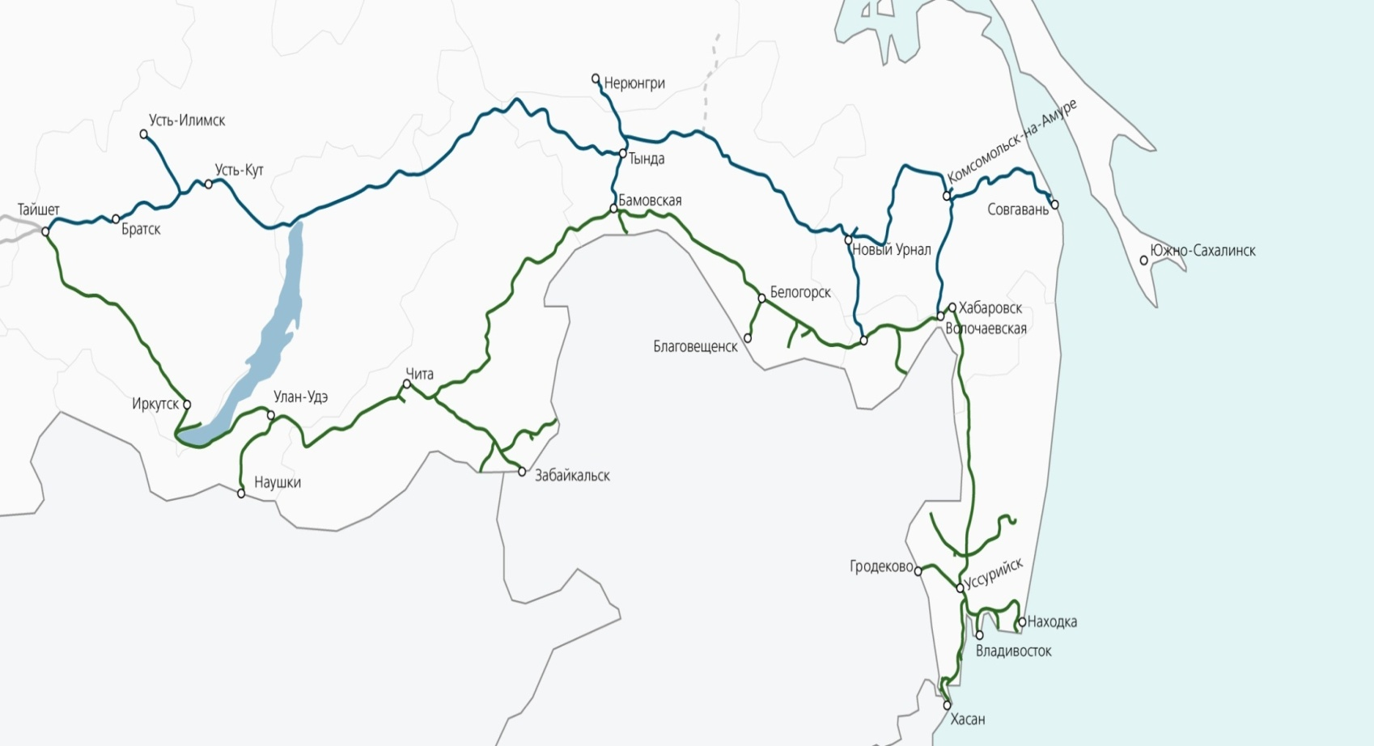
Railway Infrastructure’s Development of the East Russia
Goal – to develop and modernize the East Russia infrastructure in order
to handle extra cargo volumes by 66,8 million tonnes in 2022
Railway Infrastructure’s Development of the East Russia:
Construction of more than 547 km of extra main lines;
Construction and modernization of more than 91 rail station
and 42 passing loops;
Equipping 680 km of automatic block system
Modernization of 77 and construction of 7 substantions;
Modernization of more than 458 km of auto-lock system;
Construction and modernization of more than 350 buildings;
Construction of new 6,7 km single-track Baikal tunnel.
Result - work cargo capacity of Baikal Railway and Trans-Siberian Railway has increased by 10 % in 2016

Slide 4
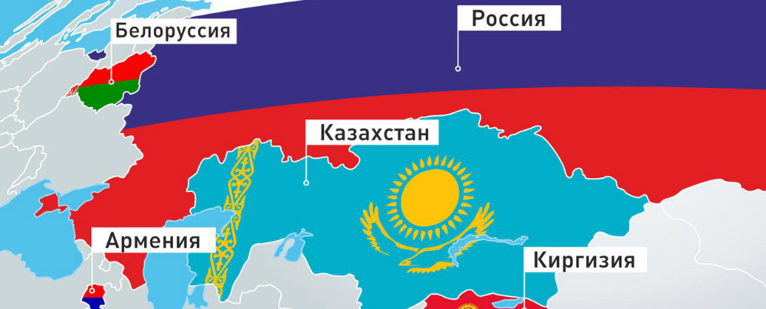
The Eurasian Economic Union
Belarus
Russia
Kazakhstan
Armenia
Kyrgyzstan
One-Stop Service Center
Improving Unified Customs Code
Connection between EAEU and Silk Road Economic Belt

Slide 5
Measures for the improvement of the Russian Federation legislation
preparation of the draft law
«About the direct intermodal transport»
preparation of the draft law
«About the shipping and forwarding operations»
Key points :
the contract terms of cargo and passengers transportation by different transport modes with one carriage document
the development of the direct intermodal communications
Key points :
the implementation of a transit transport corridors system
the optimization of a procedures and reducing of realization term of transit cargo state control
Key points :
terms of the contract of the transport expedition
informing customers about the expeditors and the list of services
enhancing the legal aspects
of the cargo transit
Expected results after the draft laws adoption:
increasing the attraction of the intermodal transportation
the combined usage of the advantages of each transport modes
reducing of the cargo carriage terms and improvement quality services
collection of additional cargo flows including realization of the transit potential
information accessibility for customers about the transport services

Slide 6
Unified Rail Transport Law
Joint Declaration
(26 February 2013, Geneva)
Draft legal provisions towards the Unified Railway Law
COTIF/CIM
SMGS
Unified Rail Transport Law

Slide 7
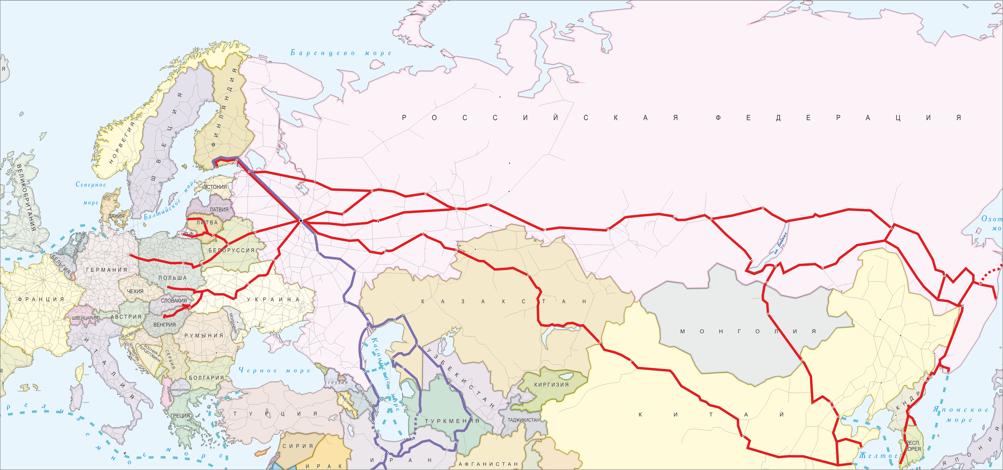
Priority directions of transportations development in the Russian Federation
Интеграция регионов России в мировую транспортную систему и подключения их транспортных коммуникаций к системе МТК
State support for Russian transit projects on the global stage
The integration of the Russian regions into the global transport system and connection their transport communications with the ITC system
Development of advanced terminal and logistics technologies and information systems
Strategic Course of the Russian Federation on the implementation of the ITC
transport and transit potential
Integration with the global multimodal operators
Enhancing of customs law and tariff policy
The implementation of complex infrastructure projects with the state participation

Slide 8
Thank you for attention!

